Slide 1
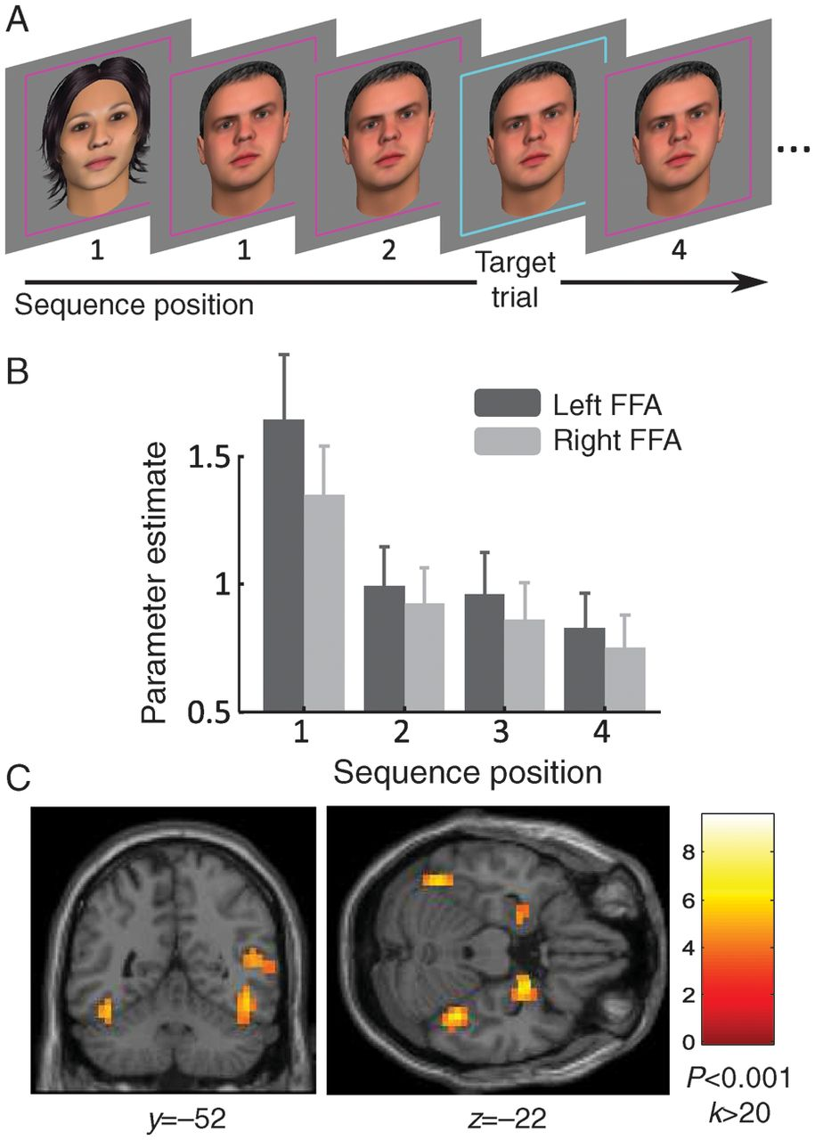
Figure 1. (A) The trial sequence. Each unique face exemplar occurred on 14 consecutive trials. All trials were ...
Notes:
Figure 1. (A) The trial sequence. Each unique face exemplar occurred on 14 consecutive trials. All trials were separated by a blank screen (2–6 s, jittered). (B) Sequence position effect. Univariate BOLD responses to faces occurring in sequence positions 1–4, in the left FFA (dark bars) and right FFA (light bars). Error bars represent standard error of the mean (SEM) across subjects. (C) Face localizer results. Group-level comparison (faces > houses) rendered on coronal (y = −52) and axial (z = −22) slices of a standard brain. Results are thresholded at P 20. The red-white scale indicates t-values.
Unless provided in the caption above, the following copyright applies to the content of this slide: © The Author 2012. Published by Oxford University Press.This is an Open Access article distributed under the terms of the Creative Commons Attribution Non-Commercial License (http://creativecommons.org/licenses/by-nc/3.0/), which permits unrestricted non-commercial use, distribution, and reproduction in any medium, provided the original work is properly cited.

Slide 2
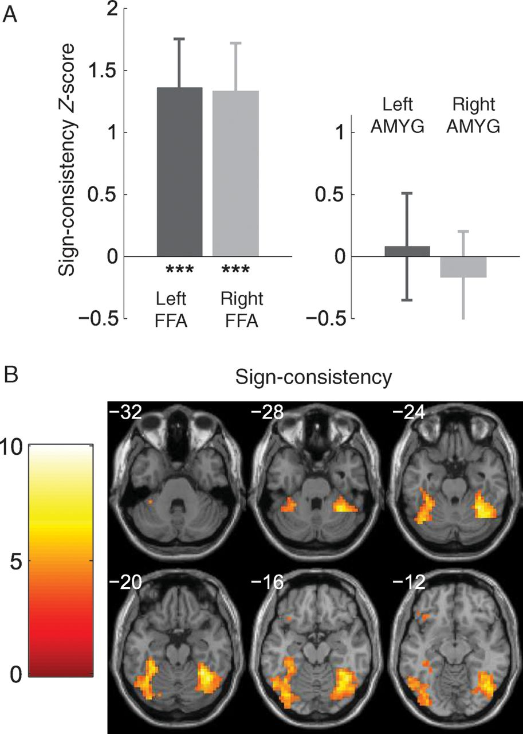
Figure 2. (A) Segregation of RS and enhancement voxels. Mean Fisher's Z-score in the FFA and amygdala (AMYG), for the ...
Notes:
Figure 2. (A) Segregation of RS and enhancement voxels. Mean Fisher's Z-score in the FFA and amygdala (AMYG), for the measure of sign consistency (see Materials and Methods). Error bars represent SEM across subjects; stars indicate significance against a null effect (***P < 0.001). (B) Searchlight analysis. Regions showing significant sign consistency (P 20) rendered on 6 transverse slices (z = −32 to z = −12) of a template brain. The color bar indicates the value of the T-statistic at the group level.
Unless provided in the caption above, the following copyright applies to the content of this slide: © The Author 2012. Published by Oxford University Press.This is an Open Access article distributed under the terms of the Creative Commons Attribution Non-Commercial License (http://creativecommons.org/licenses/by-nc/3.0/), which permits unrestricted non-commercial use, distribution, and reproduction in any medium, provided the original work is properly cited.

Slide 3
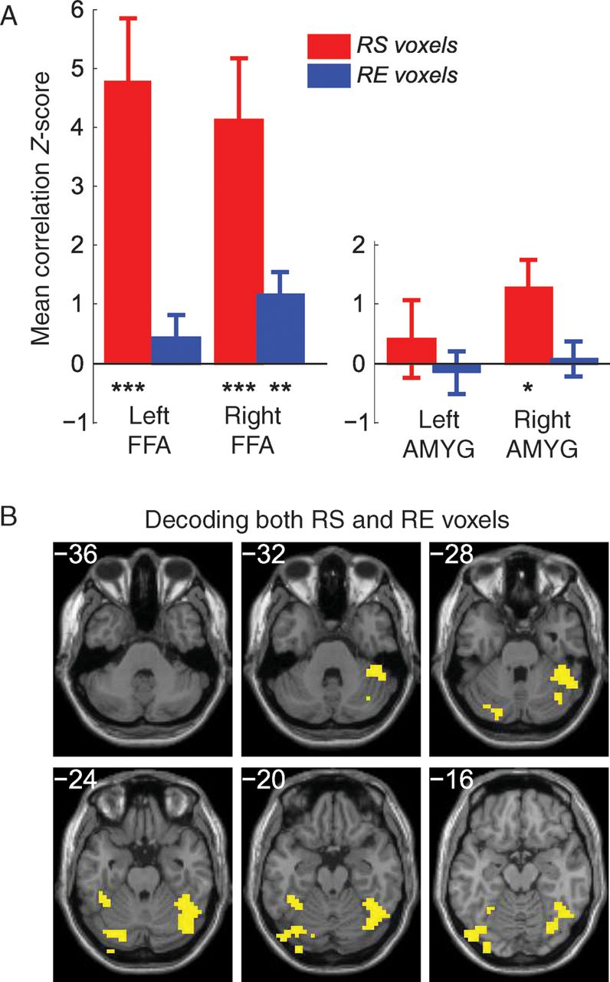
Figure 3. (A) Multivariate pattern consistency for RS and enhancement voxels. Mean Fisher's Z-score for the voxel-wise ...
Notes:
Figure 3. (A) Multivariate pattern consistency for RS and enhancement voxels. Mean Fisher's Z-score for the voxel-wise correlation (see Materials and Methods) assessing pattern consistency in the FFA and amygdala (AMYG), separately for RS voxels (in red) and RE voxels (in blue). Error bars represent SEM across subjects; stars indicate significance against a null correlation (*P < 0.05, **P < 0.01, ***P < 0.001). (B) Conjunctive searchlight analysis. Regions showing significant pattern consistency of both RS voxels (P 20) and RE voxels (P 20), rendered on 6 transverse slices (z = −36 to z = −16) of a template brain.
Unless provided in the caption above, the following copyright applies to the content of this slide: © The Author 2012. Published by Oxford University Press.This is an Open Access article distributed under the terms of the Creative Commons Attribution Non-Commercial License (http://creativecommons.org/licenses/by-nc/3.0/), which permits unrestricted non-commercial use, distribution, and reproduction in any medium, provided the original work is properly cited.

Slide 4
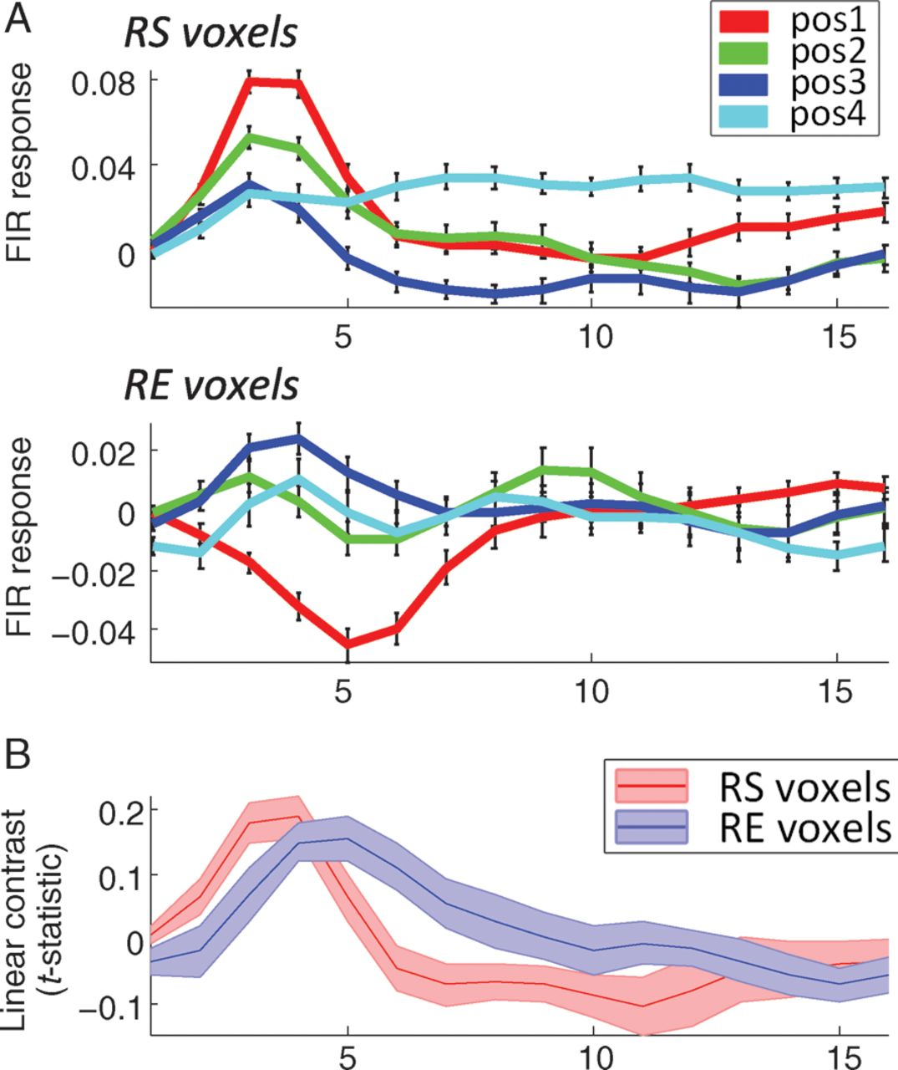
Figure 4. (A) Temporal response of RS and RE voxels. Average BOLD response of RS and RE voxels in the right FFA to the ...
Notes:
Figure 4. (A) Temporal response of RS and RE voxels. Average BOLD response of RS and RE voxels in the right FFA to the different stimulus position (positions 1–4), assessed at different time points (scans of 2 s) after stimulus onset using a FIR model. The timecourses were baselined and smoothed in time (see methods). (B) Timing of the repetition effect. Time course of the t-statistic of the linear effect across stimulus position.
Unless provided in the caption above, the following copyright applies to the content of this slide: © The Author 2012. Published by Oxford University Press.This is an Open Access article distributed under the terms of the Creative Commons Attribution Non-Commercial License (http://creativecommons.org/licenses/by-nc/3.0/), which permits unrestricted non-commercial use, distribution, and reproduction in any medium, provided the original work is properly cited.

Slide 5
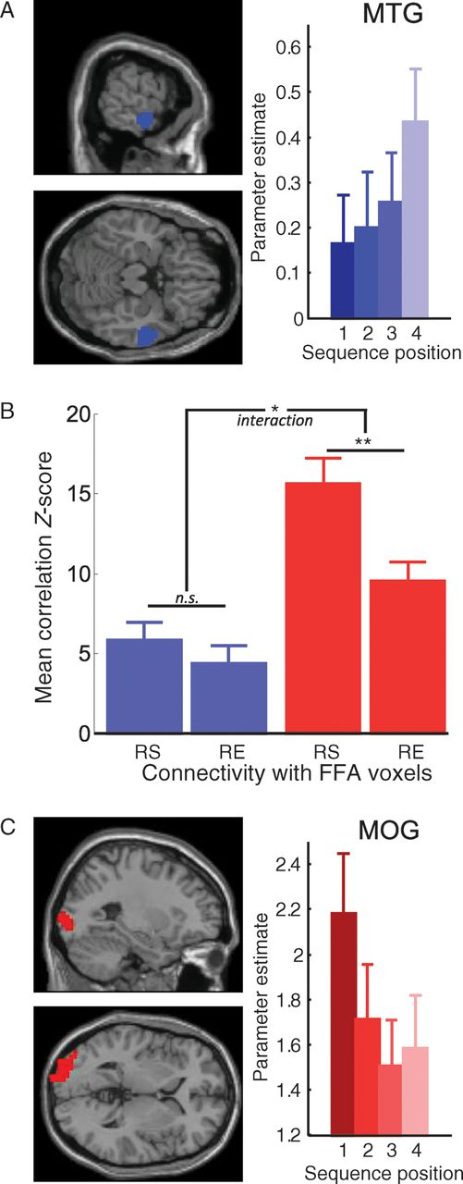
Figure 5. Connectivity analyses between FFA voxels and MTG and MOG. (A–C) Rendering of the MTG (A, in blue) and MOG (C, ...
Notes:
Figure 5. Connectivity analyses between FFA voxels and MTG and MOG. (A–C) Rendering of the MTG (A, in blue) and MOG (C, in red) ROI on a template brain, with their respective univariate BOLD responses to faces occurring in sequence positions 1–4. (B) Mean correlation Z-scores between the residual activities (from a FIR model) in the MTG (blue bars) and MOG (red bars) and the residual activities in the RS and RE populations of the FFA.
Unless provided in the caption above, the following copyright applies to the content of this slide: © The Author 2012. Published by Oxford University Press.This is an Open Access article distributed under the terms of the Creative Commons Attribution Non-Commercial License (http://creativecommons.org/licenses/by-nc/3.0/), which permits unrestricted non-commercial use, distribution, and reproduction in any medium, provided the original work is properly cited.

Slide 6
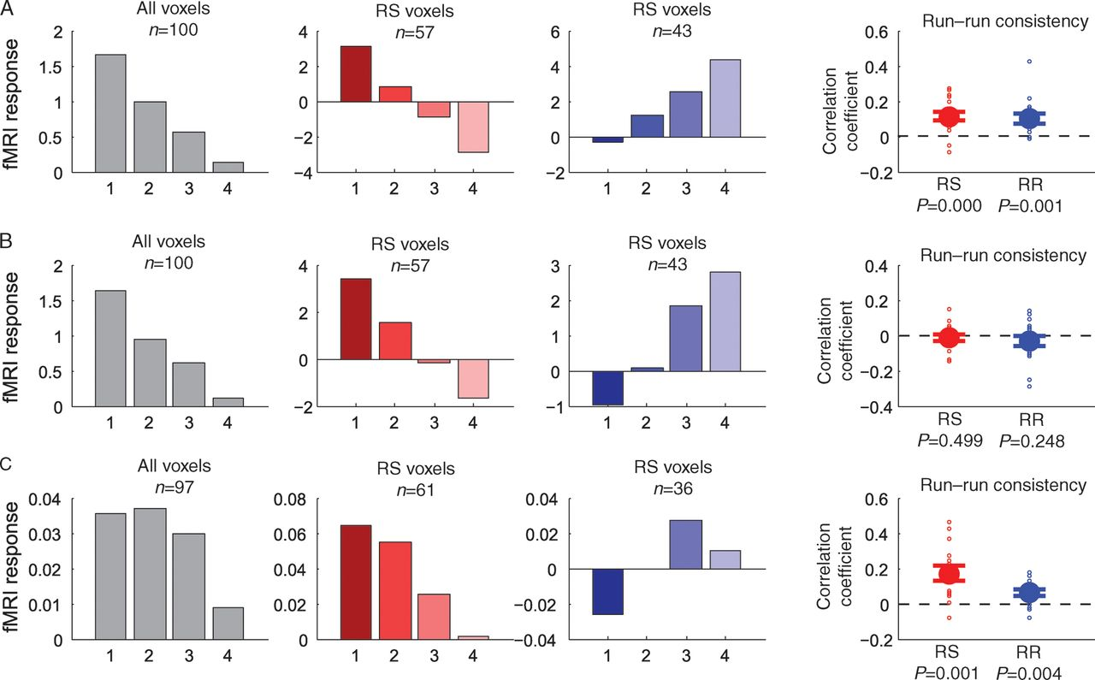
Figure 6. Univariate and multivariate analyses applied to simulated and real data. (A) Simulated data for the ...
Notes:
Figure 6. Univariate and multivariate analyses applied to simulated and real data. (A) Simulated data for the repetition sensitivity model, (B) simulated data for the face selectivity, and (C) real data. The 3 bar graphs show univariate responses (y-axis: Arbitrary units) as a function of sequence positions (1–4), separately for all voxels (gray), RS voxels (red), and RE voxels (blue). The rightmost graph shows the correlation coefficient r for each virtual subject, along with the group average and standard error, separately for RS voxels (red) and RE voxels (blue); P-values refer to the t-test against zero correlation across subjects. The data in C are calculated from the FIR responses in Figure 3 multiplied with a canonical HRF profile.
Unless provided in the caption above, the following copyright applies to the content of this slide: © The Author 2012. Published by Oxford University Press.This is an Open Access article distributed under the terms of the Creative Commons Attribution Non-Commercial License (http://creativecommons.org/licenses/by-nc/3.0/), which permits unrestricted non-commercial use, distribution, and reproduction in any medium, provided the original work is properly cited.

