Slide 1
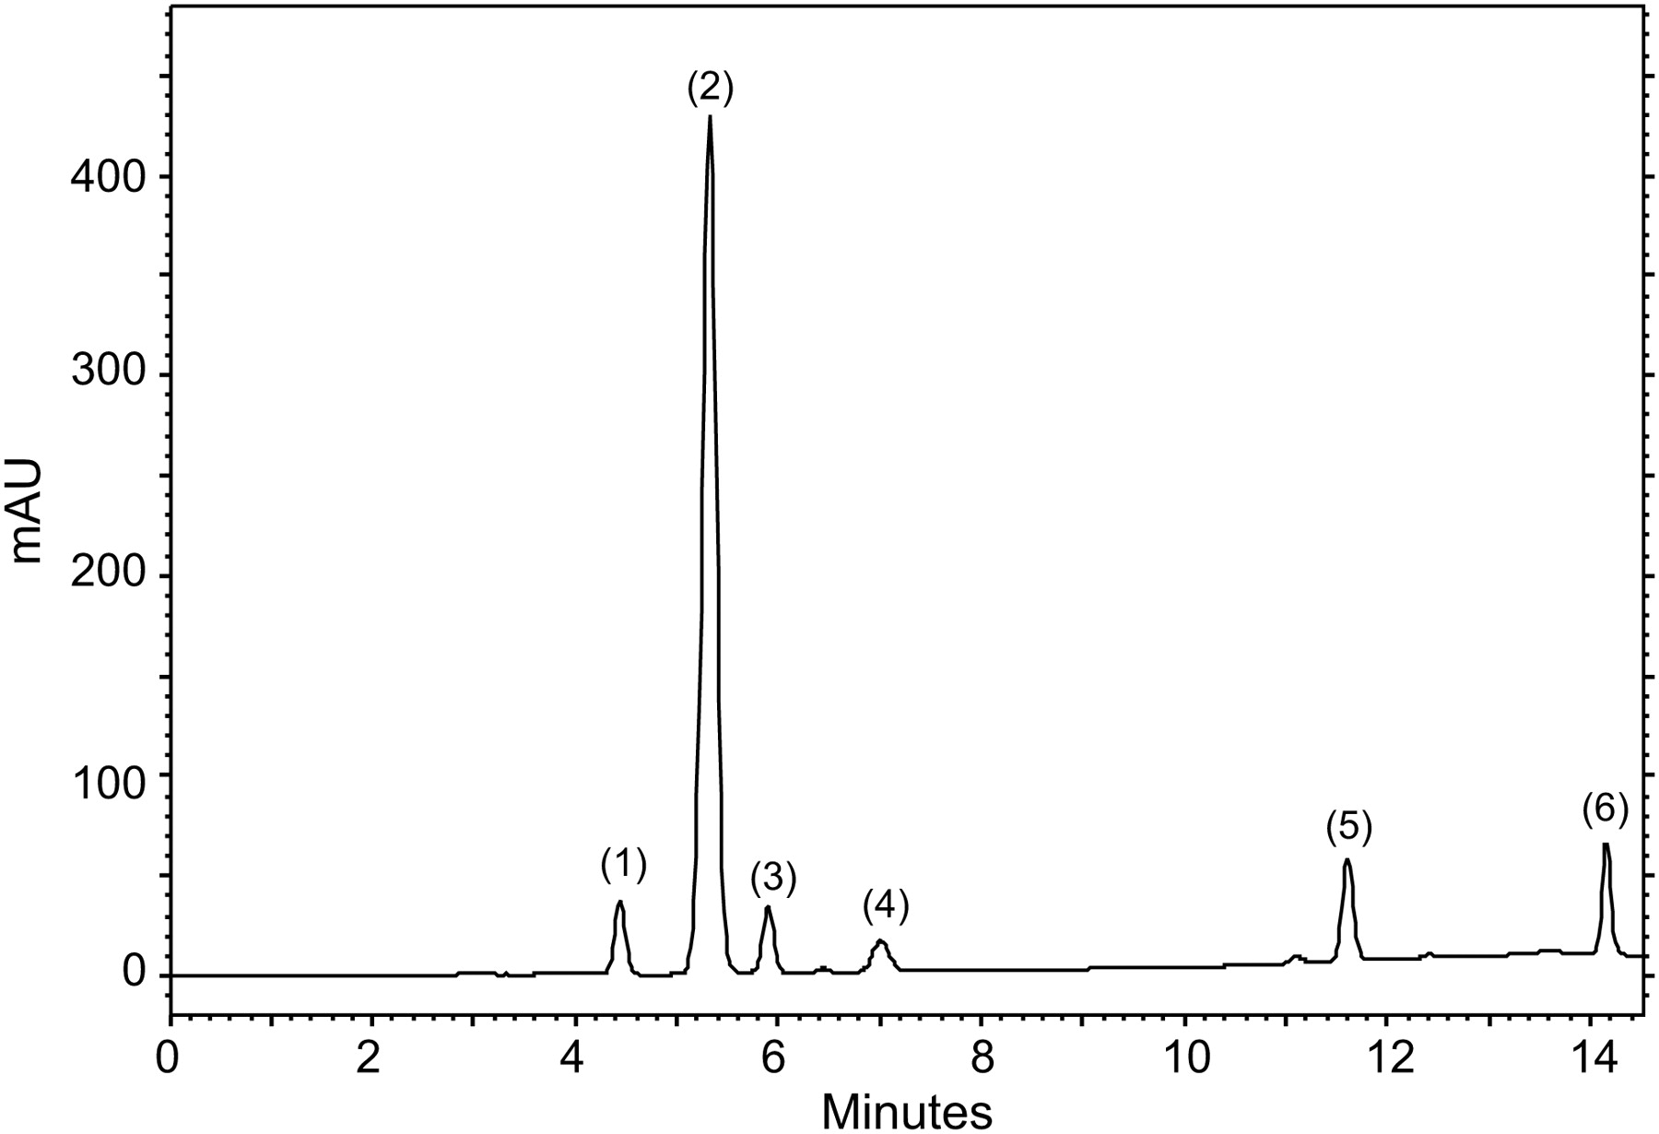
Figure 1. Sample chromatogram of a reference solution containing the six analytes using a mobile phase of phosphate ...
Notes:
Figure 1. Sample chromatogram of a reference solution containing the six analytes using a mobile phase of phosphate buffer–methanol 80:20 (v/v) and gradient elution. Peak 1, hydroquinone; Peak 2, acetaminophen; Peak 3, p-benzoquinone; Peak 4, 4-aminophenol; 5, 4-nitrophenol; 6, 4'-chloroacetanilide.
Unless provided in the caption above, the following copyright applies to the content of this slide: © The Author [2012]. Published by Oxford University Press. All rights reserved. For Permissions, please email: journals.permissions@oup.com

Slide 2
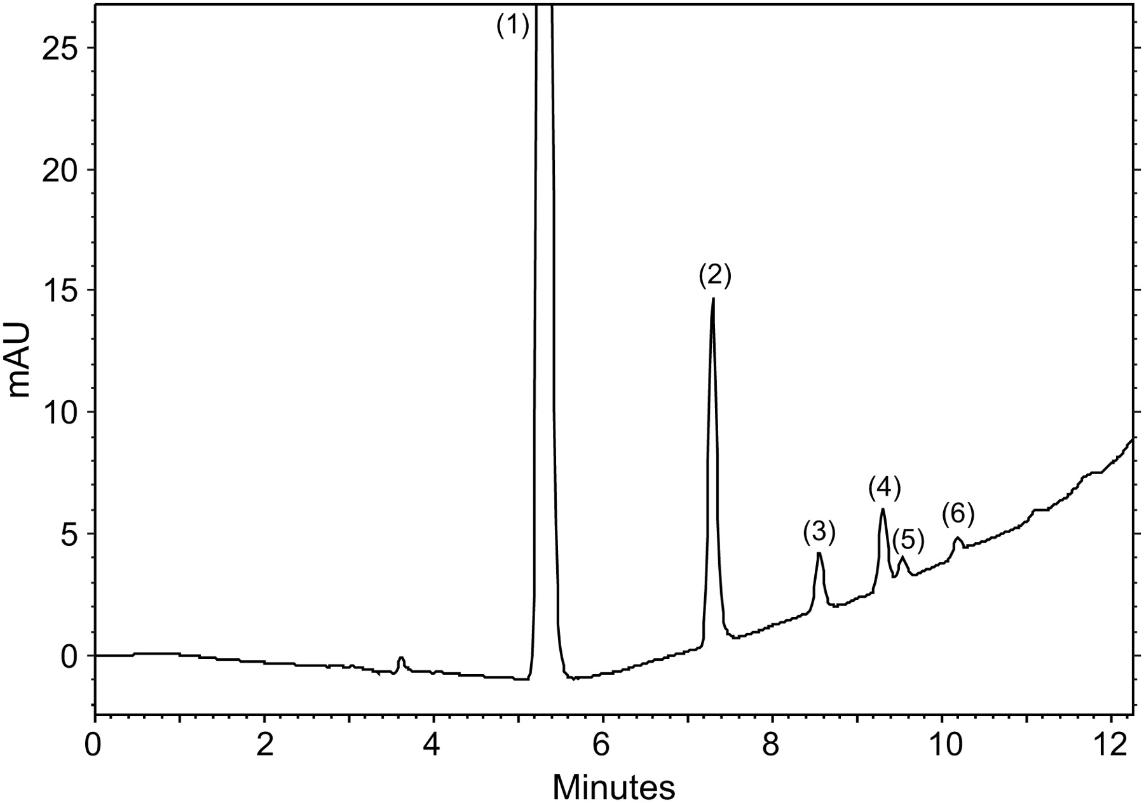
Figure 3. Sample chromatogram of a methanolic solution of acetaminophen prepared as described in section Forced ...
Notes:
Figure 3. Sample chromatogram of a methanolic solution of acetaminophen prepared as described in section Forced degradation studies (iii) kept at 25°C for 60 days: Peak 1, acetaminophen; Peak 2, p-aminophenol; Peaks 3, 4, 5, and 6 unknown compounds.
Unless provided in the caption above, the following copyright applies to the content of this slide: © The Author [2012]. Published by Oxford University Press. All rights reserved. For Permissions, please email: journals.permissions@oup.com

Slide 3
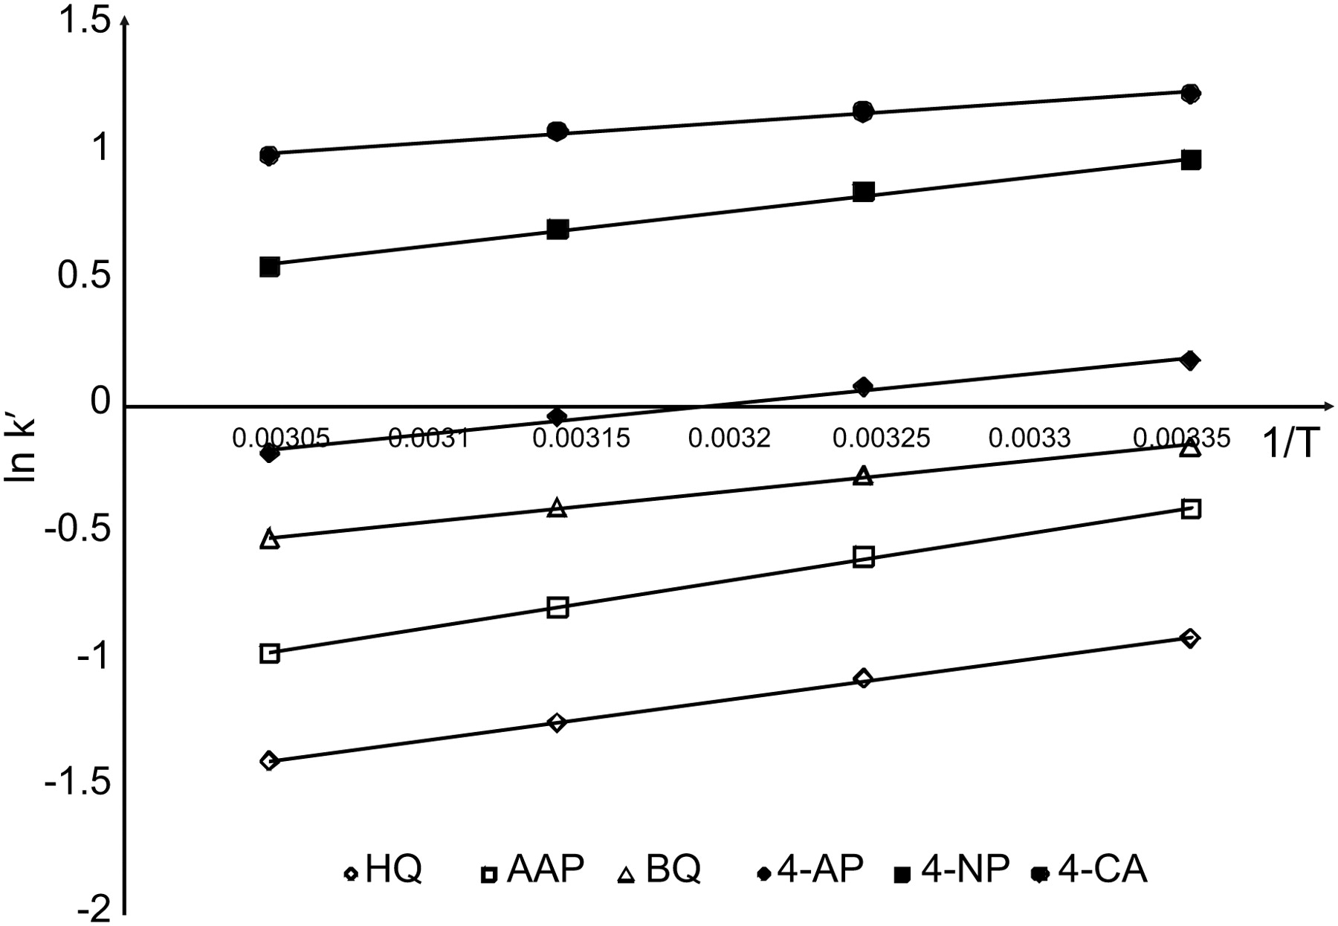
Figure 2. Variations of ln k' = f(1/T) for all the studied compounds.
Notes:
Figure 2. Variations of ln k' = f(1/T) for all the studied compounds.
Unless provided in the caption above, the following copyright applies to the content of this slide: © The Author [2012]. Published by Oxford University Press. All rights reserved. For Permissions, please email: journals.permissions@oup.com

