Slide 1
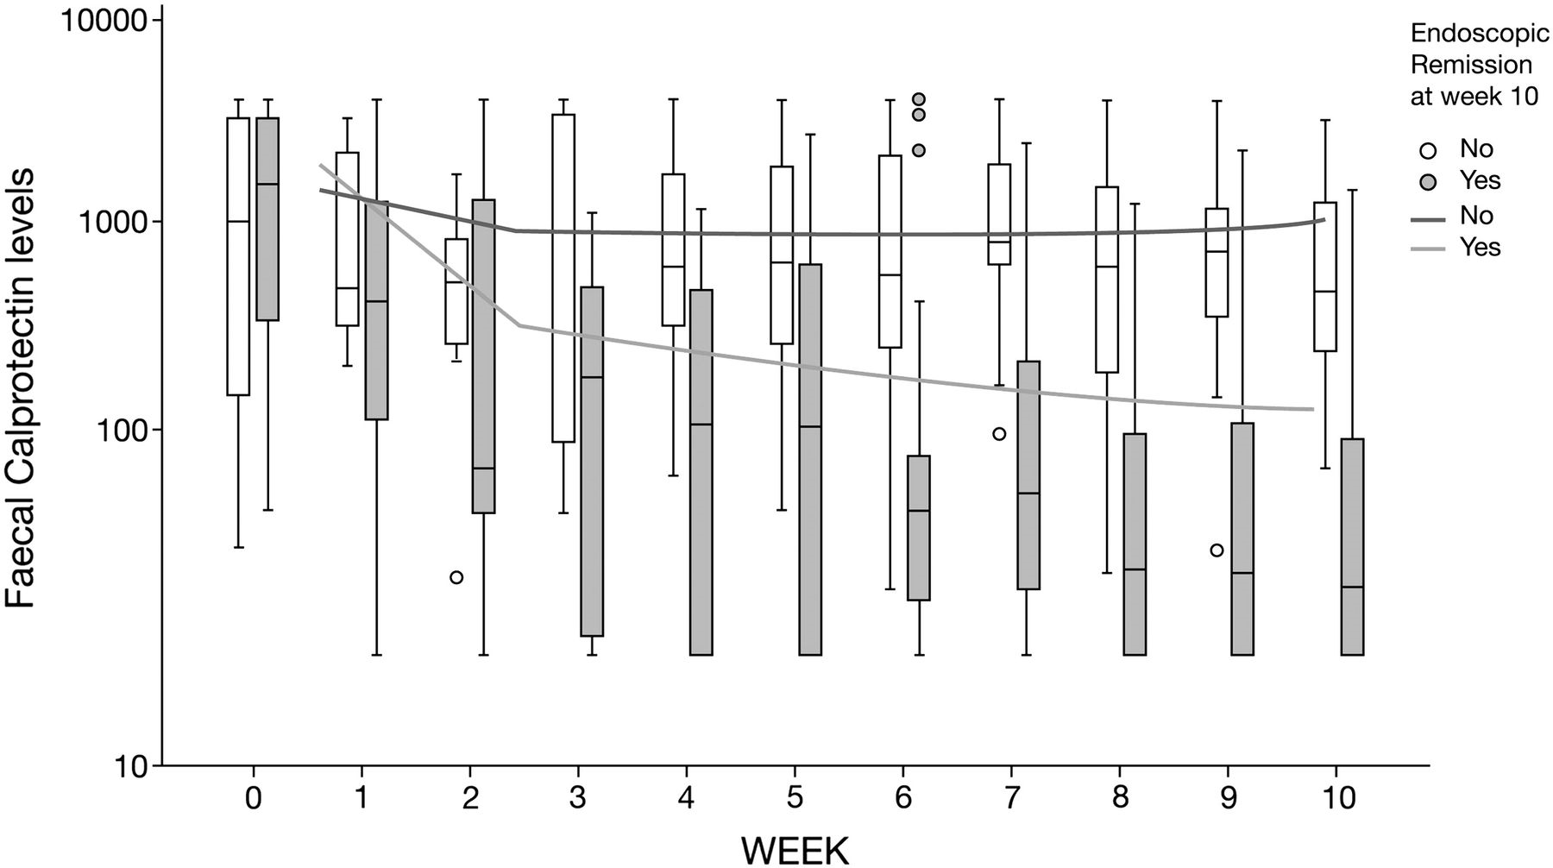
Figure 1 Evolution of calprotectin levels under infliximab therapy in function of the induction of endoscopic ...
Notes:
Figure 1 Evolution of calprotectin levels under infliximab therapy in function of the induction of endoscopic remission at week 10. Legend: Boxplots describe medians and interquartile ranges of the completers Lines show the result of the mixed models analysis (ITT analysis).
Unless provided in the caption above, the following copyright applies to the content of this slide: © 2011 European Crohn's and Colitis Organisation

Slide 2
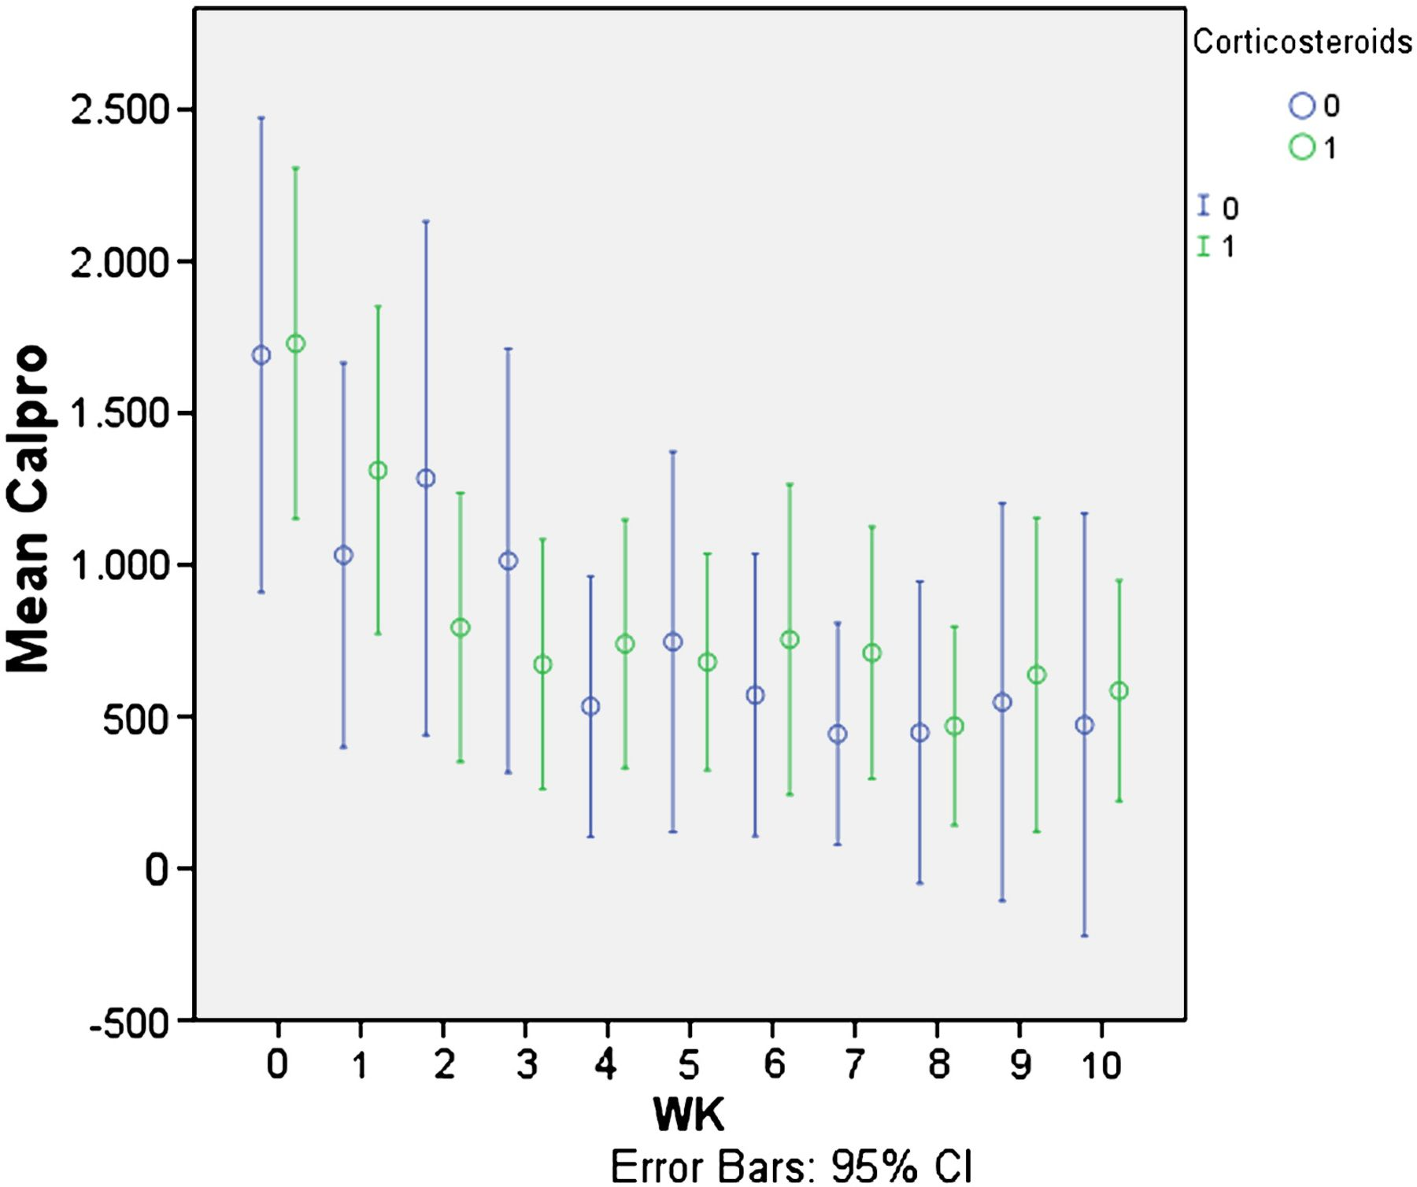
Figure 2 Evolution of calprotectin levels under infliximab therapy in function of the induction of endoscopic ...
Notes:
Figure 2 Evolution of calprotectin levels under infliximab therapy in function of the induction of endoscopic remission at week 10 and concomitant use of corticosteroids. Legend: Boxplots describe medians and interquartile ranges of the completers. Lines show the result of the mixed models analysis (ITT analysis).
Unless provided in the caption above, the following copyright applies to the content of this slide: © 2011 European Crohn's and Colitis Organisation

