Slide 1
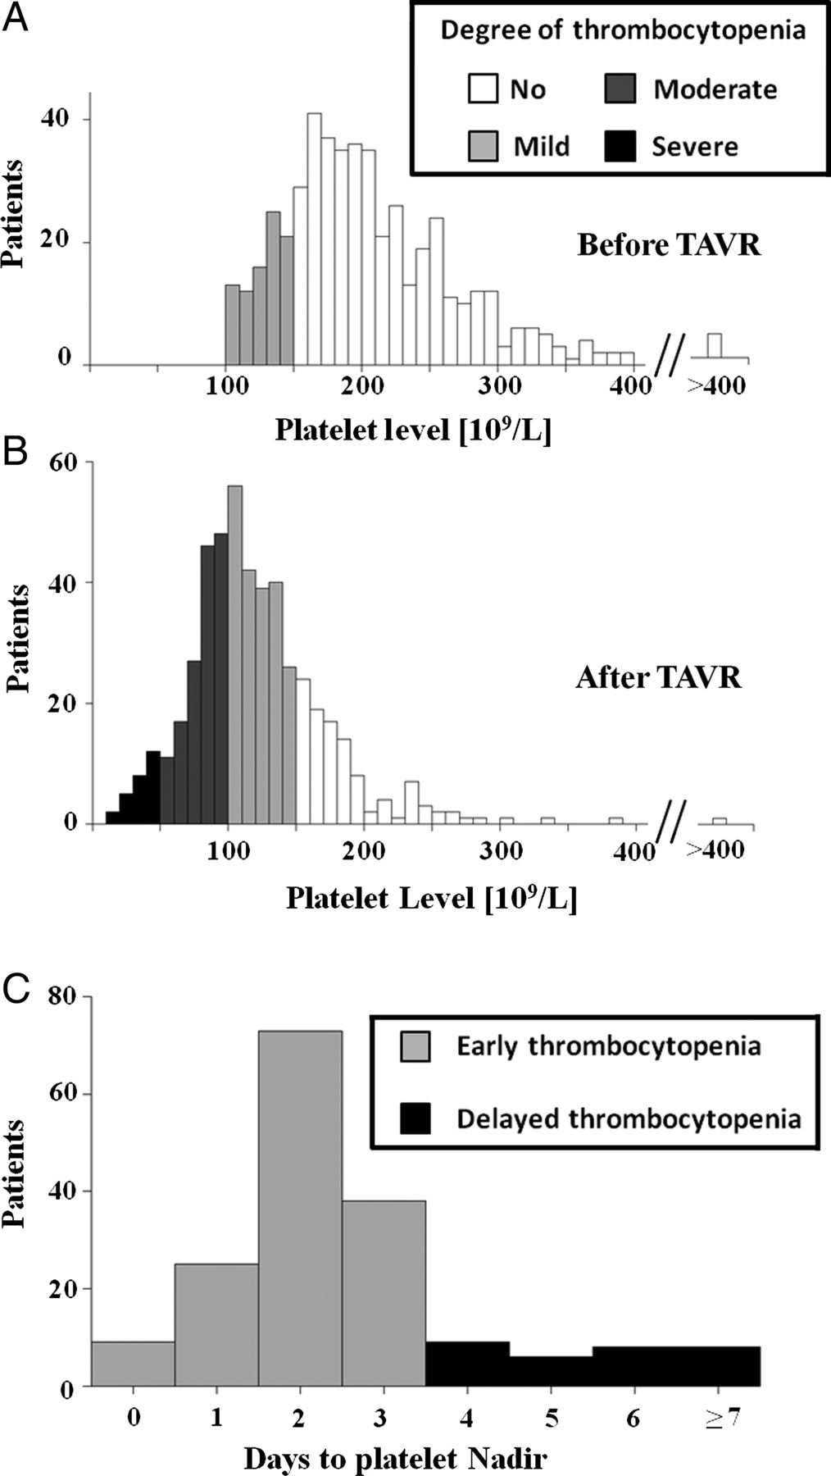
Figure 1 (A) Distribution of cases according to the baseline platelet counts. Sixteen cases with baseline moderate ...
Notes:
Figure 1 (A) Distribution of cases according to the baseline platelet counts. Sixteen cases with baseline moderate thrombocytopenia were excluded from the analysis for acquired thrombocytopenia. (B) Distribution of cases according to the nadir platelet counts (lowest platelet count during post-procedural hospitalization). (C) Distribution of the time to nadir level in patients with moderate or severe acquired thrombocytopenia divided into early acquired thrombocytopenia (time to nadir ≤3 days, white boxes) and delayed (≥4 days, black). TAVR, transcatheter aortic valve replacement.
Unless provided in the caption above, the following copyright applies to the content of this slide: Published on behalf of the European Society of Cardiology. All rights reserved. © The Author 2014. For permissions please email: journals.permissions@oup.com

Slide 2
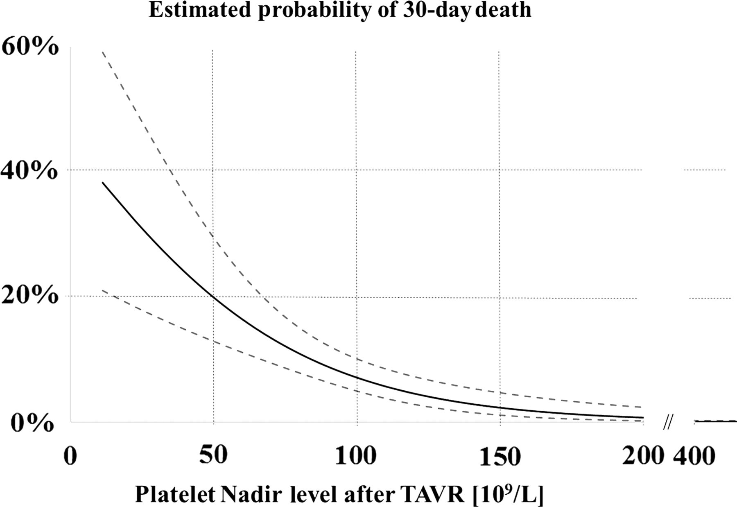
Figure 2 Estimated probability of 30-day death according to the nadir platelet level. An inflection for having ...
Notes:
Figure 2 Estimated probability of 30-day death according to the nadir platelet level. An inflection for having increased 30-day mortality is observed at nadir platelet count of 50–70 × 109/L. A decrease in platelet nadir count from 100 × 109 to 50 × 109/L was associated with a 2.8× higher death rate: 19.9% (CI 12.9–29.3%) vs. 7.1% (CI 4.9–10.0%).
Unless provided in the caption above, the following copyright applies to the content of this slide: Published on behalf of the European Society of Cardiology. All rights reserved. © The Author 2014. For permissions please email: journals.permissions@oup.com

Slide 3
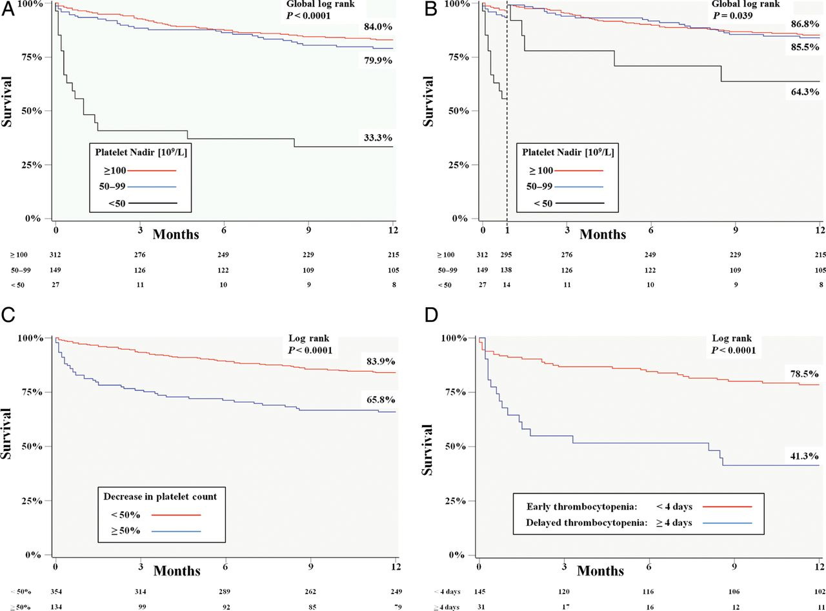
Figure 3 Kaplan–Meier 1-year survival curves. (A) Survival according to the severity of acquired thrombocytopenia ...
Notes:
Figure 3 Kaplan–Meier 1-year survival curves. (A) Survival according to the severity of acquired thrombocytopenia after TAVR. There was no significant difference between patients with mild/no acquired thrombocytopenia and those with moderate thrombocytopenia (84.0 vs. 79.9%, P = 0.38). Patients with severe thrombocytopenia had the worst survival (33.3%, P< 0.001). (B) One-year survival with 1-month landmark analysis: comparison of 1-year survival of only patients who survived 1-month after the procedure. The survival of patients with severe thrombocytopenia remained worse than others (P = 0.039). (C) Stratification according to the level of decrease in platelet count (DPC) during hospitalization. DPC = (baseline count−nadir count)/baseline count. Patients with high DPC (≥50%) had worse survival than those with low DPC (<50, 83.9 vs. 65.8%, P < 0.001). (D) Stratification of patients with moderate/severe thrombocytopenia according to the time to nadir count. Patients with delayed nadir (time to nadir ≥4 days, black boxes) had worse 1-year survival than those with early nadir (<4 days, 78.5 vs. 41.3%, P < 0.001).
Unless provided in the caption above, the following copyright applies to the content of this slide: Published on behalf of the European Society of Cardiology. All rights reserved. © The Author 2014. For permissions please email: journals.permissions@oup.com

