Slide 1
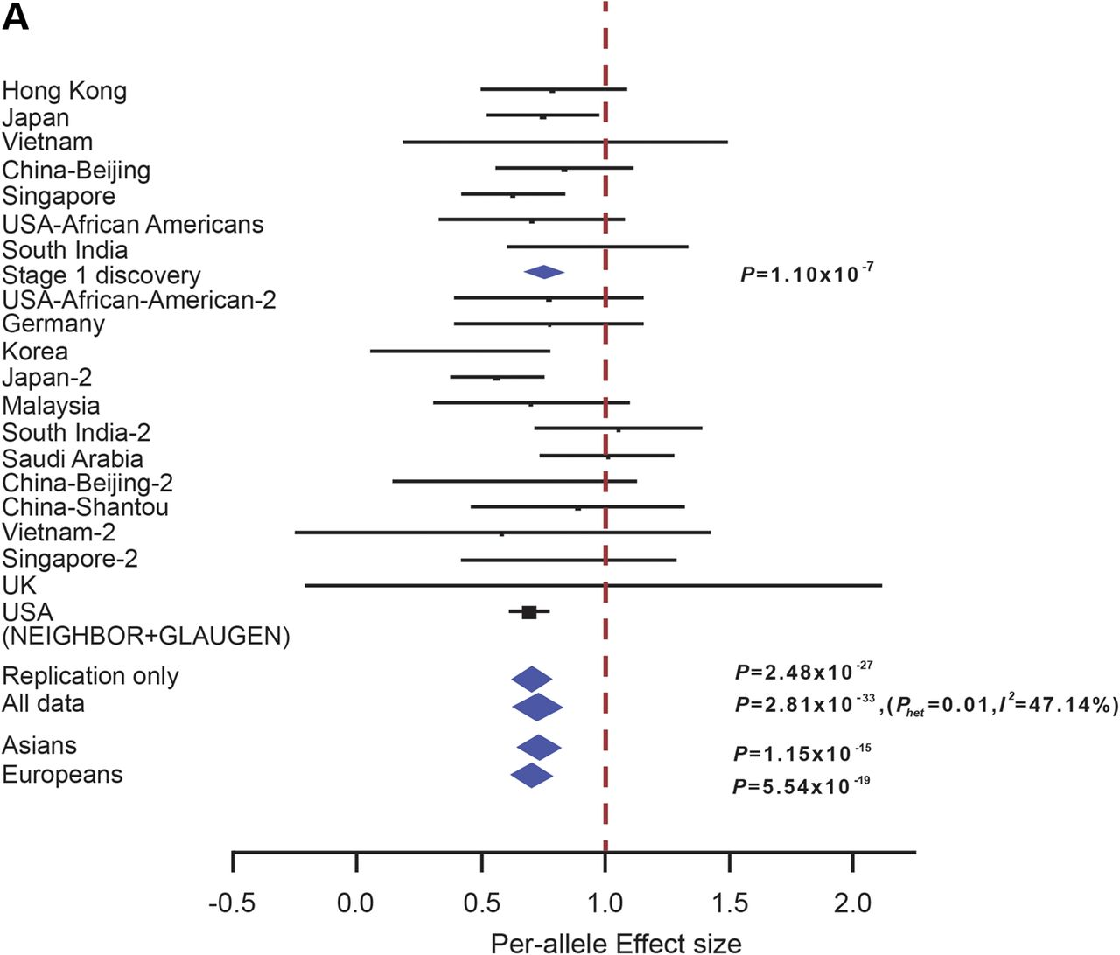
Figure 1. Forest plots showing evidence of association between SNPs: (A) CDKN2B-AS1 rs2157719, (B) CDC7/TGFBR3 ...
Notes:
Figure 1. Forest plots showing evidence of association between SNPs: (A) CDKN2B-AS1 rs2157719, (B) CDC7/TGFBR3 rs1192415 and (C) FNDC3B rs4894796. The vertical line represents a per-allele odds ratio of 1.00. The oblongs represent point estimates (referring to the per-allele odds ratio), with the height of the oblongs inversely proportional to the standard error of the point estimates. Horizontal lines indicate the 95% confidence interval for each point estimate. Meta-analysis of Stages 1 and 2, OR, Pmeta and I2 was labeled on the right-hand side for corresponding analysis. For rs4894796 genotyping, see Supplementary Material, Information for sample collections.
Unless provided in the caption above, the following copyright applies to the content of this slide: © The Author 2015. Published by Oxford University PressThis is an Open Access article distributed under the terms of the Creative Commons Attribution Non-Commercial License (http://creativecommons.org/licenses/by-nc/4.0/), which permits non-commercial re-use, distribution, and reproduction in any medium, provided the original work is properly cited. For commercial re-use, please contact journals.permissions@oup.com

Slide 2
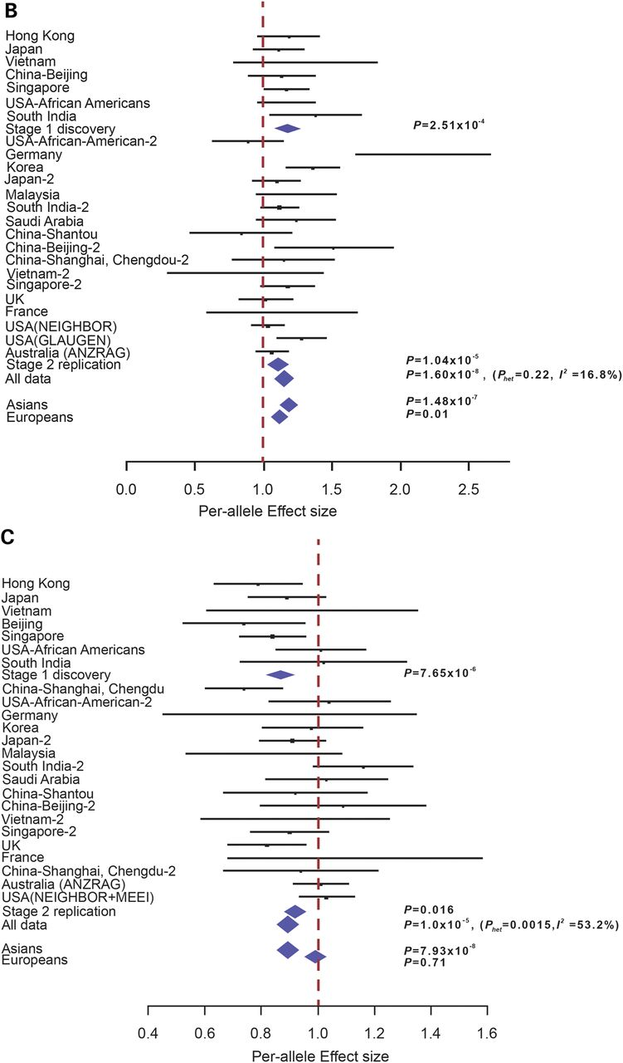
Figure 1 Continued
Notes:
Figure 1 Continued
Unless provided in the caption above, the following copyright applies to the content of this slide: © The Author 2015. Published by Oxford University PressThis is an Open Access article distributed under the terms of the Creative Commons Attribution Non-Commercial License (http://creativecommons.org/licenses/by-nc/4.0/), which permits non-commercial re-use, distribution, and reproduction in any medium, provided the original work is properly cited. For commercial re-use, please contact journals.permissions@oup.com

Slide 3
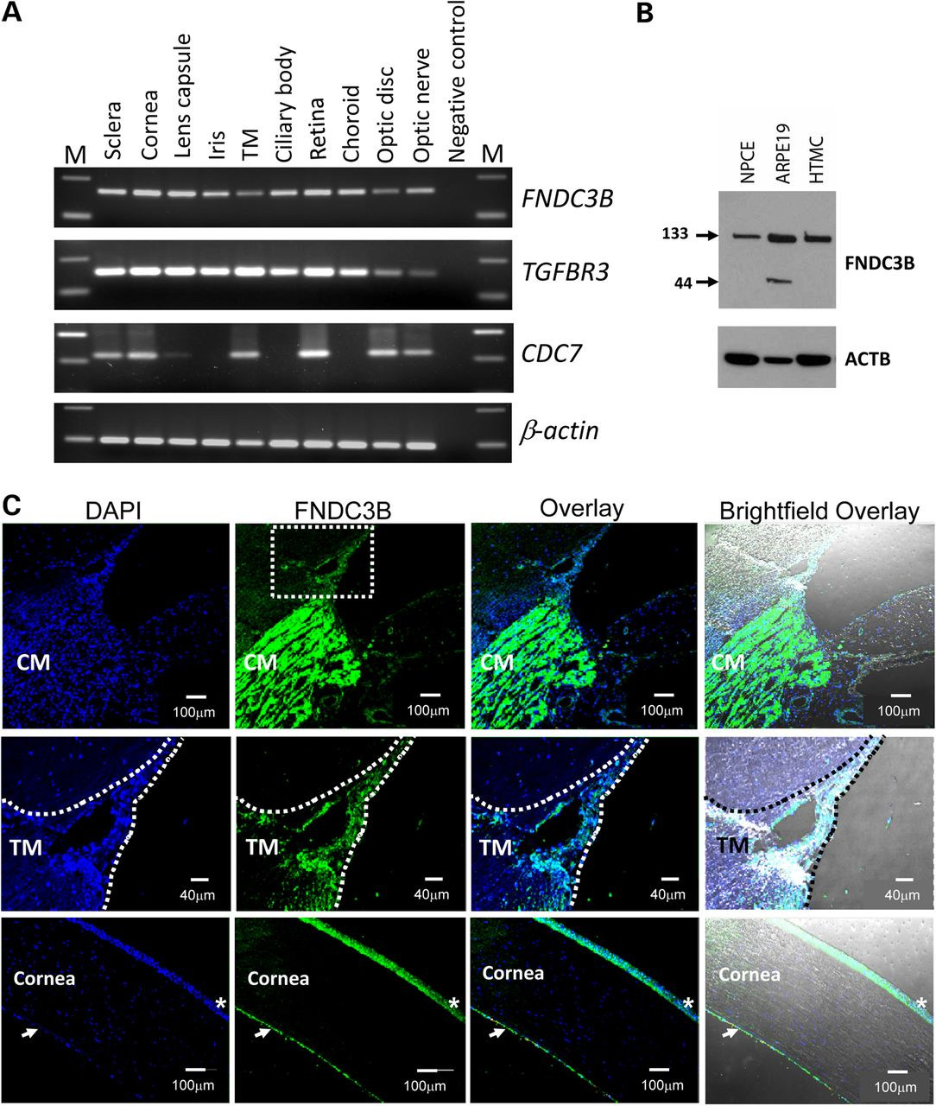
Figure 2. Analysis of FNDC3B, TGFBR3 and CDC7 expression in ocular tissues. (A) The FNDC3B-specific 162 bp and ...
Notes:
Figure 2. Analysis of FNDC3B, TGFBR3 and CDC7 expression in ocular tissues. (A) The FNDC3B-specific 162 bp and TGFBR3-specific 152 bp amplification product was observed in all analyzed ocular tissues. CDC7-specific 242 bp product was observed in sclera, cornea, trabecular meshwork, retina, optic disc and optic nerve. The ubiquitously expressed gene, ACTB was used as the normalizing control. A no template sample acted as the negative control (NC) to ensure non-contamination of the RT–PCR reaction mix. The variable M denotes molecular-weight marker. (B) Immunoblot of whole cell lysates from NPCE, retinal pigment epithelial (ARPE19) and HTM cells, probed for FNDC3B and β-actin, as a loading control. Positions of the ∼133 and ∼44 kDa forms of FNDC3B are indicated. All ocular cells analyzed expressed the ∼133 kDa protein, while ARPE19 cells expressed a smaller ∼44 kDa isoform of FNDC3B. (C) Immunolocalization of FNDC3B in human eye tissues. Strong immunofluorescence labeling of FNDC3B (green) was seen in the ciliary muscle (CM) (top row). Scale bar: 100 µm. In the trabecular meshwork (TM, middle row), FNDC3B (green) labeling was relatively weaker. Scale bar: 40 µm. FNDC3B positive immunoreactivity was also observed in cornea epithelial (*) and cornea endothelial cells (white arrows) (bottom row). Nuclei were stained with DAPI (blue). Scale bar: 100 µm.
Unless provided in the caption above, the following copyright applies to the content of this slide: © The Author 2015. Published by Oxford University PressThis is an Open Access article distributed under the terms of the Creative Commons Attribution Non-Commercial License (http://creativecommons.org/licenses/by-nc/4.0/), which permits non-commercial re-use, distribution, and reproduction in any medium, provided the original work is properly cited. For commercial re-use, please contact journals.permissions@oup.com

