Slide 1
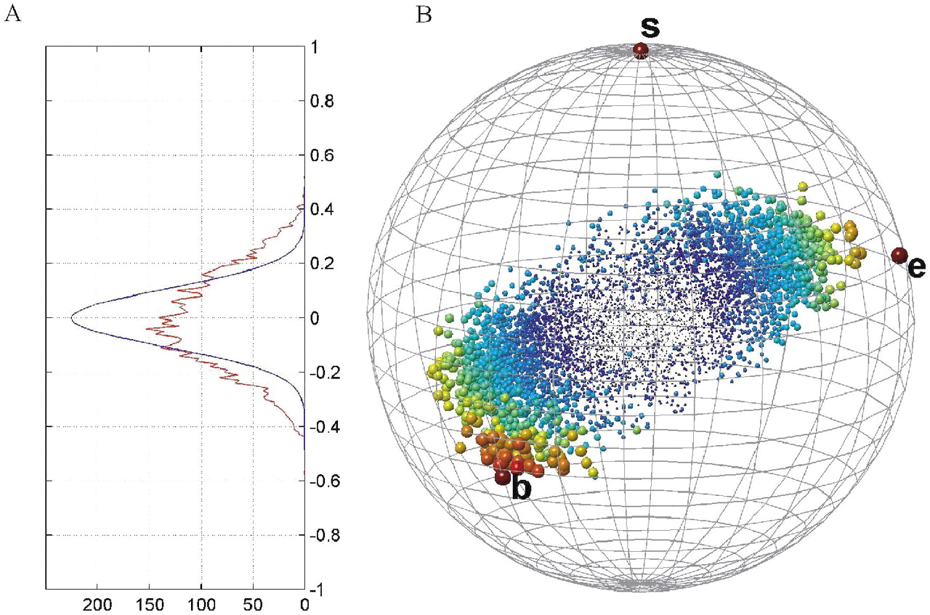
Fig. 1 (A) The histogram of the genes' correlation with the real survival vector (projection onto the vertical s ...
Notes:
Fig. 1 (A) The histogram of the genes' correlation with the real survival vector (projection onto the vertical s axis—red curve), and with a random permutation of the survival vector (blue curve). (B) Globe of genes in the ‘world’ spanned by the normalized survival (s), BUB1 (b) and ESR1 (e). The survival is located at the north pole, while BUB1 (chosen from a large cluster of genes characterized by negative correlation with survival) and ESR1 (chosen from a large cluster of genes characterized by positive correlation with survival) are on the sphere's surface and their relative locations are determined by their angles with survival and with each other. All other (normalized) genes are represented by spots whose size and color illustrate how close the gene is to the surface (large red spots are close and small blue are far). The genes create an elongated structure at an angle <π/2 with s, implying that a large number of genes exhibit non-vanishing correlations with survival.
Unless provided in the caption above, the following copyright applies to the content of this slide: Bioinformatics vol. 21 issue 2 © Oxford University Press 2005; all rights reserved.

Slide 2
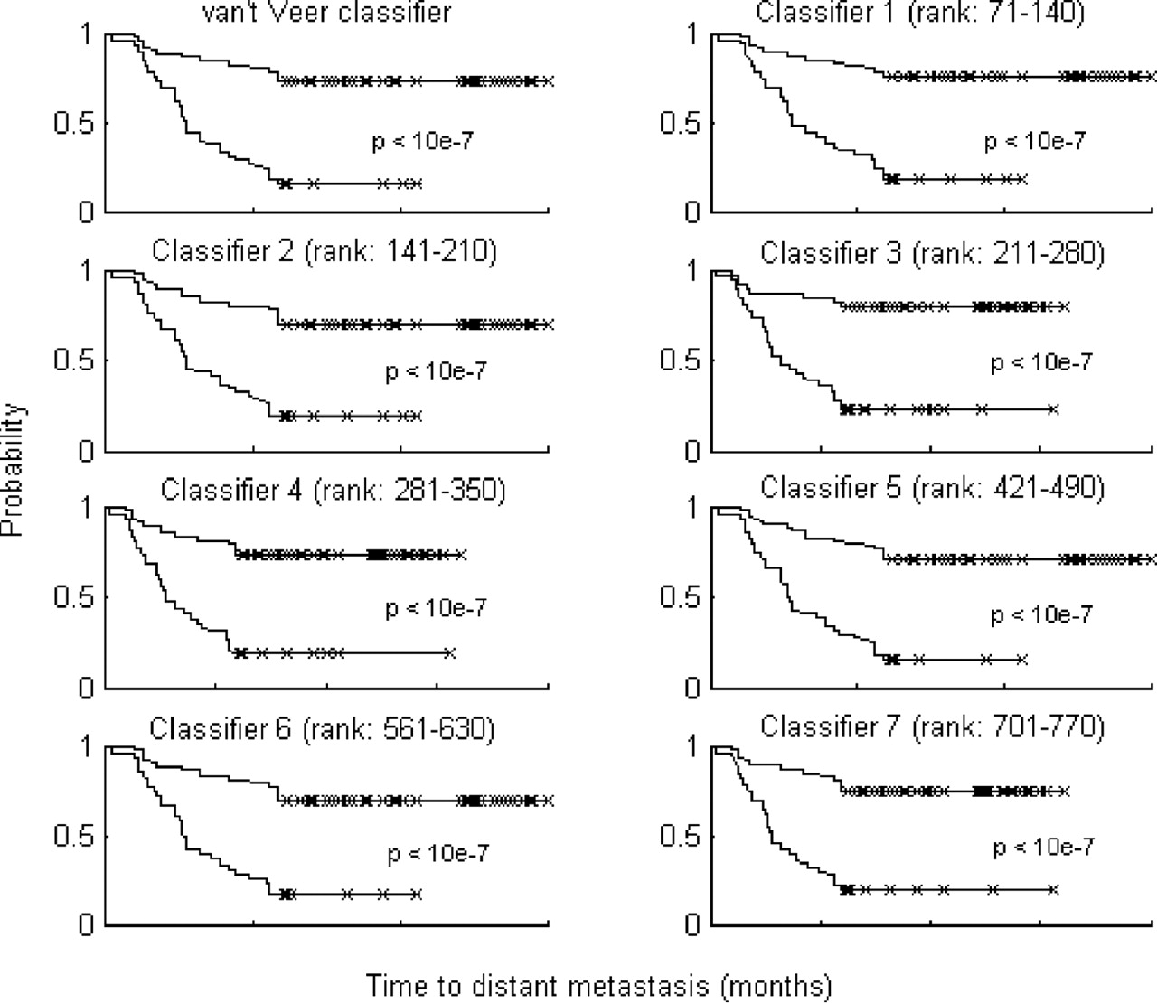
Fig. 2 Kaplan–Meier analysis of van't Veer et al.'s classifier and of the seven alternative classifiers as obtained ...
Notes:
Fig. 2 Kaplan–Meier analysis of van't Veer et al.'s classifier and of the seven alternative classifiers as obtained from classifying all 96 samples. Upper curves describe the probability of remaining free of metastasis in the group of samples classified as having a good prognosis signature, while the lower curves describe the poor prognosis group.
Unless provided in the caption above, the following copyright applies to the content of this slide: Bioinformatics vol. 21 issue 2 © Oxford University Press 2005; all rights reserved.

Slide 3
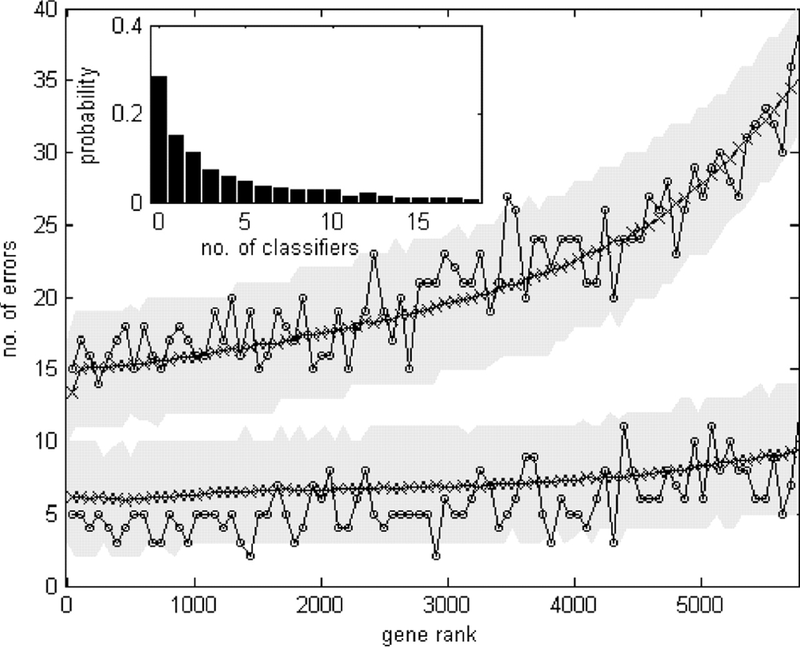
Fig. 3 The average performance of a series of classifiers generated by consecutive sets of 70 genes. The fluctuating ...
Notes:
Fig. 3 The average performance of a series of classifiers generated by consecutive sets of 70 genes. The fluctuating curves present the number of errors produced by the classifiers resulting from one particular selection of training and test sets (upper, training errors out of 77 samples; lower, test errors out of 19). The x-axis represents the rank of the genes in the classifiers. The average over 1000 partitions is plotted as black x's; the two gray areas are the 95% confidence intervals of the training and test errors. Inset: histogram of the number of classifiers whose training and test errors are at least as low as those of the first classifier (based on the 70 genes with highest correlation to survival). Of the 1000 partitions, for ∼28% no such classifier was found, whereas for ∼6% five were found. Note that >70% of the training sets produce at least one classifier with the same performance as the top 70 genes; the expected number of such classifiers is around 4.
Unless provided in the caption above, the following copyright applies to the content of this slide: Bioinformatics vol. 21 issue 2 © Oxford University Press 2005; all rights reserved.

Slide 4
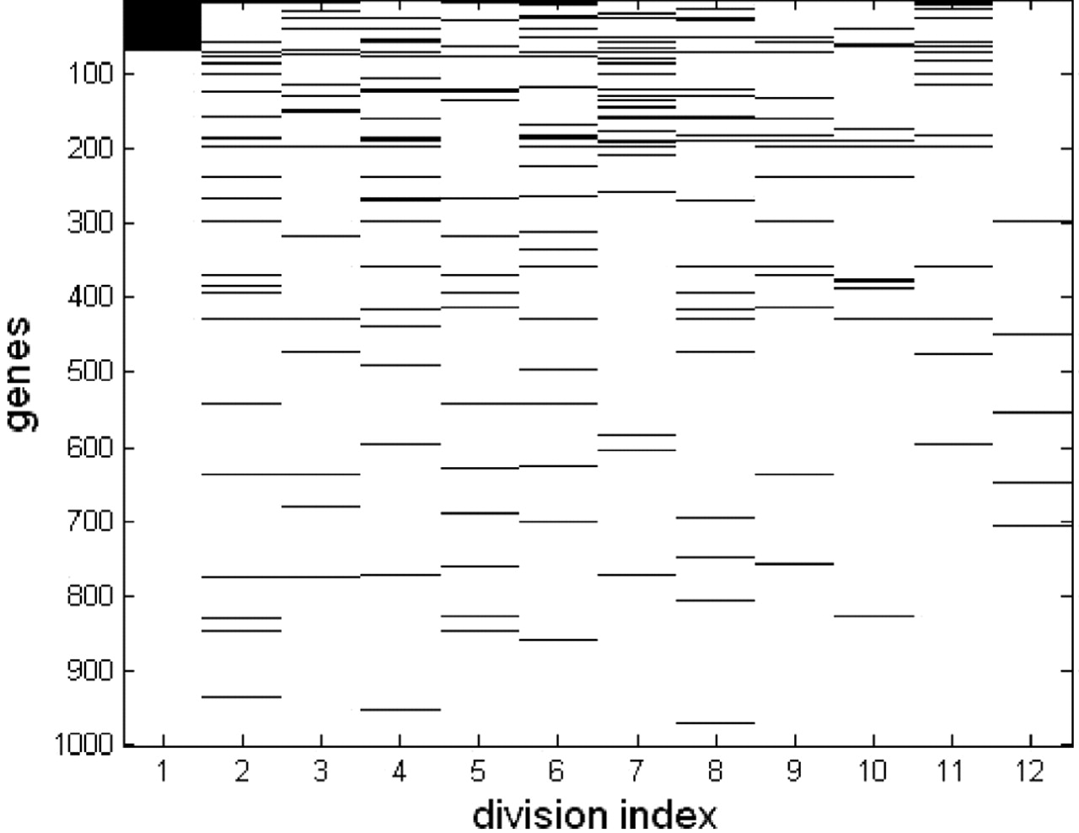
Fig. 4 Ten sets of top 70 genes, identified in 10 randomly chosen training sets of N = 77 patients (using ...
Notes:
Fig. 4 Ten sets of top 70 genes, identified in 10 randomly chosen training sets of N = 77 patients (using bootstrapping—see Materials and Methods). Each row represents a gene and each column a training set. The genes were ordered according to their correlation rank in the first training set (leftmost column). For each training set, the 70 top-ranked genes are colored black. The genes that were top ranked in one training set can have a much lower rank when another training set is used. The two rightmost columns (columns 11 and 12) mark those of the 70 genes published by van't Veer et al. (2002) and the 128 genes appearing in (Ramaswamy et al., 2003) that are among the top 1000 of our first training set.
Unless provided in the caption above, the following copyright applies to the content of this slide: Bioinformatics vol. 21 issue 2 © Oxford University Press 2005; all rights reserved.

Slide 5
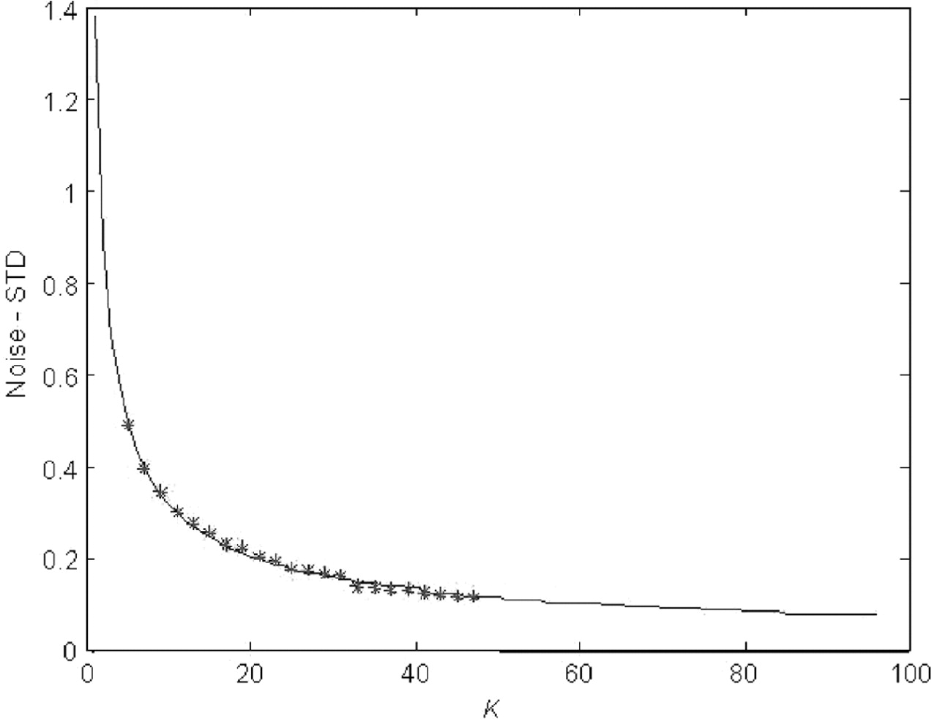
Fig. 5 Standard deviation (STD) of a gene's correlation with disease outcome, averaged over 5852 genes (y-axis) as a ...
Notes:
Fig. 5 Standard deviation (STD) of a gene's correlation with disease outcome, averaged over 5852 genes (y-axis) as a function of sample size K (x-axis). The curve is the polynomial fit to the results obtained for K between 2 to 48. This curve was used to extrapolate the STD to larger values of K. (The values extrapolated to K = 77 were used to calculate the error-bars presented in Fig. 6.)
Unless provided in the caption above, the following copyright applies to the content of this slide: Bioinformatics vol. 21 issue 2 © Oxford University Press 2005; all rights reserved.

Slide 6
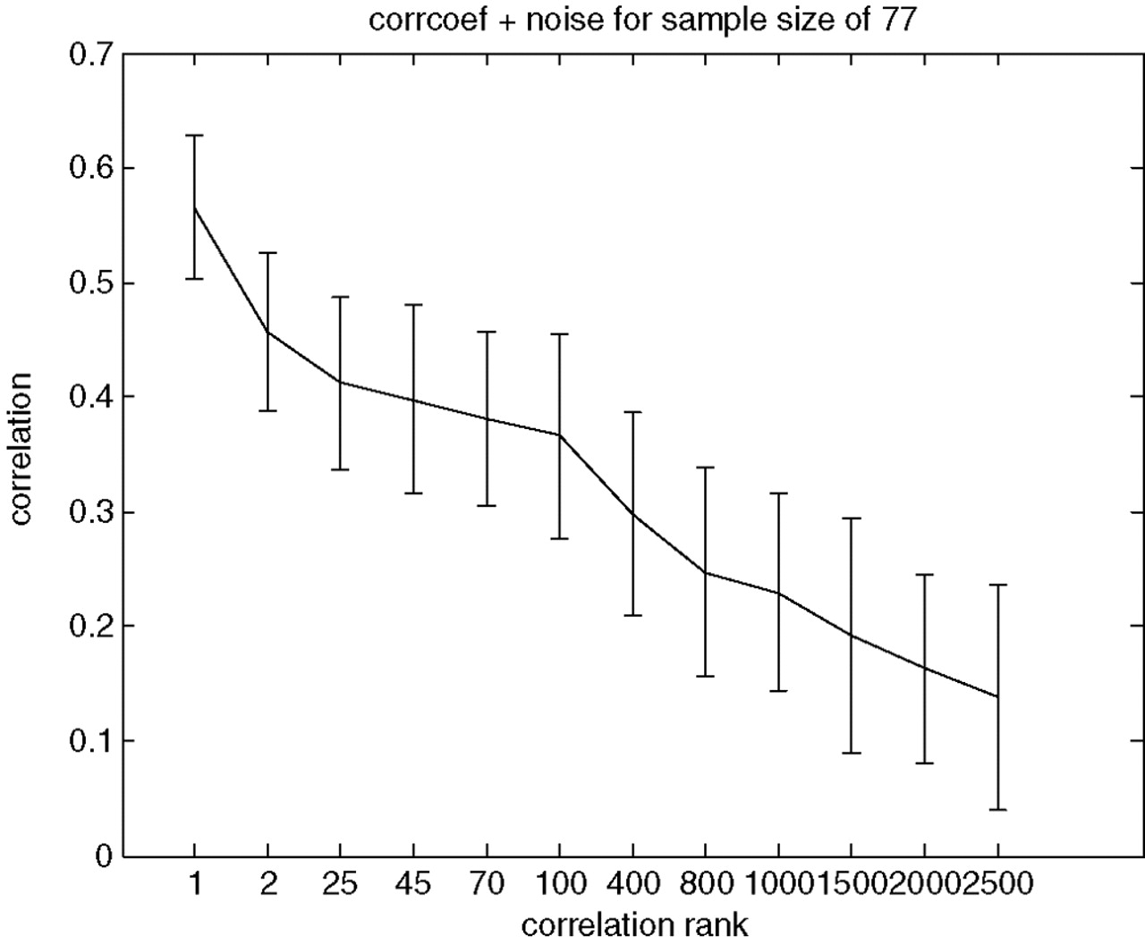
Fig. 6 Correlation of genes with survival versus their ranks. The correlation of each gene (y-axis) was measured ...
Notes:
Fig. 6 Correlation of genes with survival versus their ranks. The correlation of each gene (y-axis) was measured based on the 96 samples, and the genes were ordered according to their correlation magnitude (x-axis). The error bars represent the noise (STD) of a gene based on sample size 77 (see Materials and Methods).
Unless provided in the caption above, the following copyright applies to the content of this slide: Bioinformatics vol. 21 issue 2 © Oxford University Press 2005; all rights reserved.

Slide 7
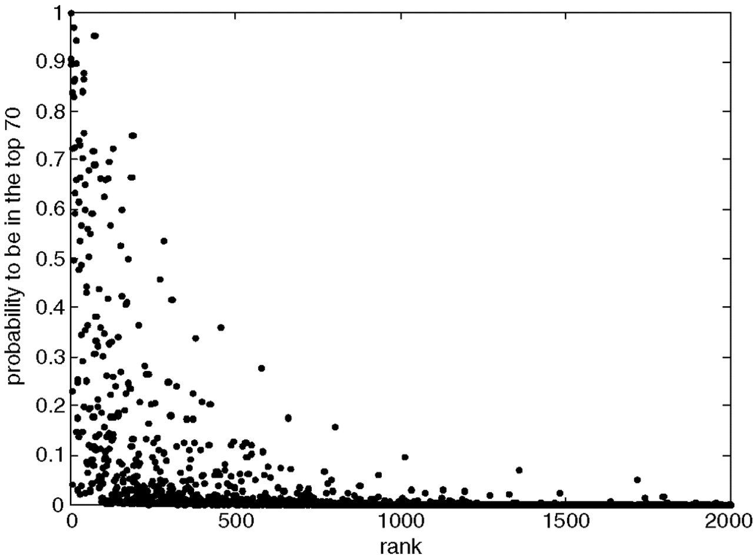
Fig. 7 The probability of genes to be included in a list of top 70. The genes were ranked on the basis of their ...
Notes:
Fig. 7 The probability of genes to be included in a list of top 70. The genes were ranked on the basis of their correlation with outcome, as measured over the 77 samples of one particular (randomly chosen) training set.
Unless provided in the caption above, the following copyright applies to the content of this slide: Bioinformatics vol. 21 issue 2 © Oxford University Press 2005; all rights reserved.

Slide 8
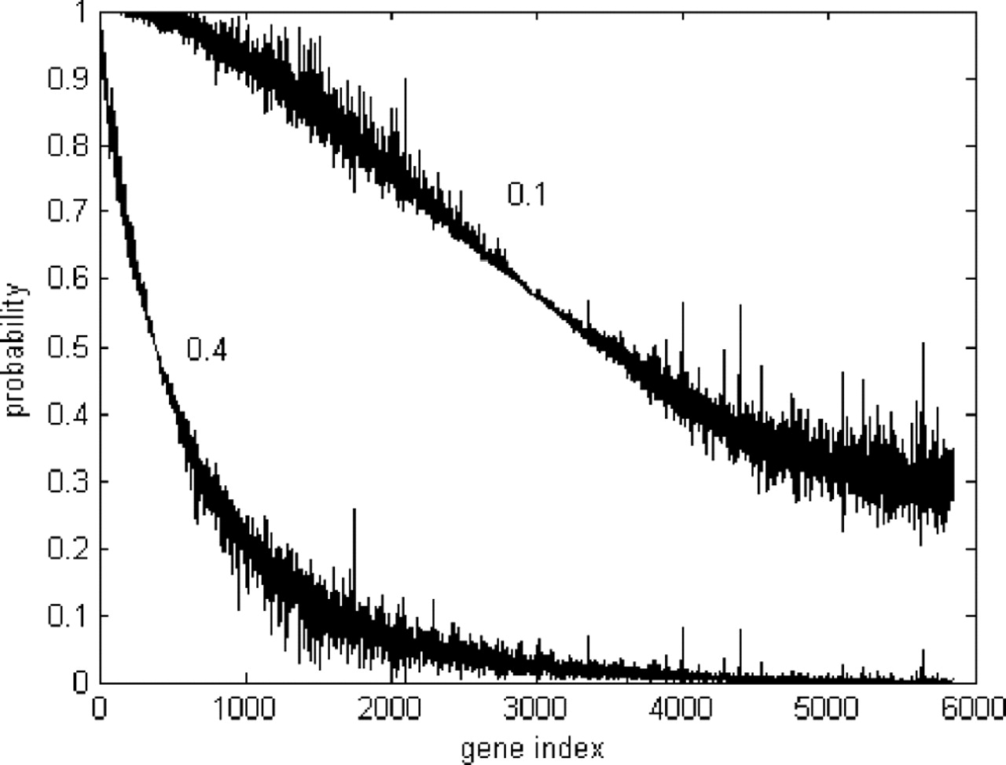
Fig. 8 The probability (y-axis) that genes have a correlation higher than a given threshold, calculated on the basis ...
Notes:
Fig. 8 The probability (y-axis) that genes have a correlation higher than a given threshold, calculated on the basis of noise derived for a training set of 77 samples. The x-axis represents the gene ranks according to their correlation with all 96 samples. The left curve corresponds to threshold of 0.4 and the right curve to threshold 0.1.
Unless provided in the caption above, the following copyright applies to the content of this slide: Bioinformatics vol. 21 issue 2 © Oxford University Press 2005; all rights reserved.

