Slide 1
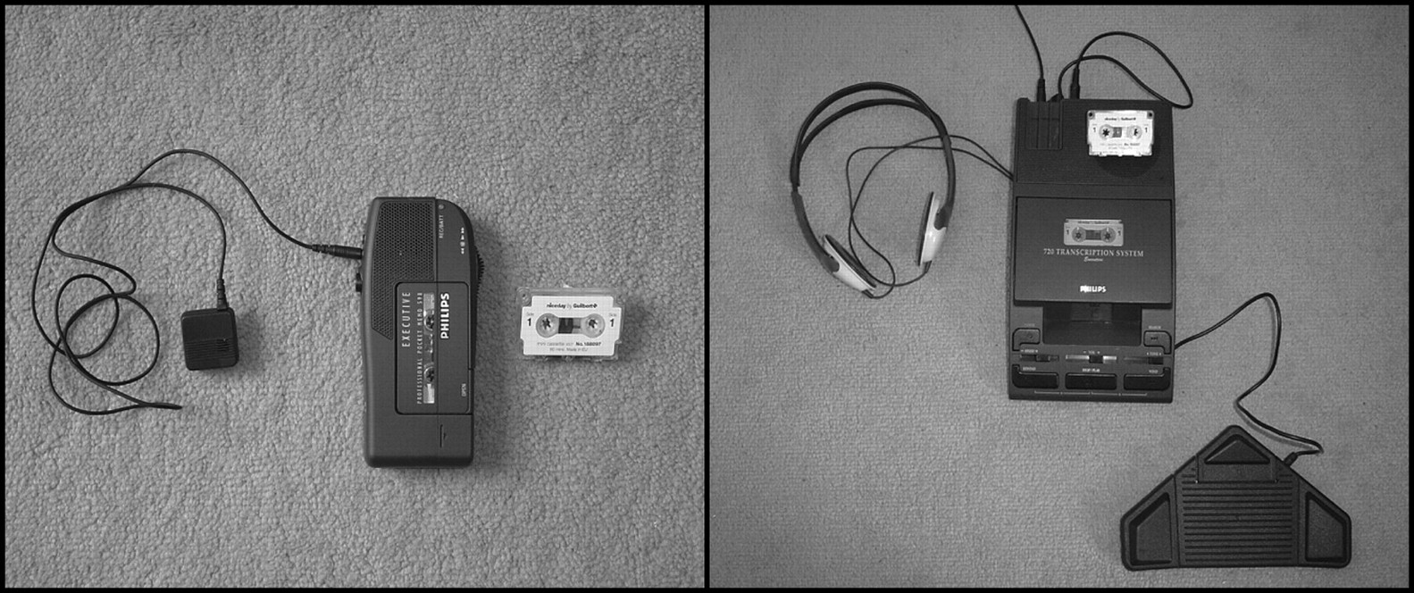
FIGURE 1 Analogue audio recording equipment: dictaphone with microphone and mini-cassette tape and foot-pedal ...
Notes:
FIGURE 1 Analogue audio recording equipment: dictaphone with microphone and mini-cassette tape and foot-pedal controlled transcription machine with headphones
Unless provided in the caption above, the following copyright applies to the content of this slide: © 2008 The AuthorsThis is an Open Access article distributed under the terms of the Creative Commons Attribution Non-Commercial License (http://creativecommons.org/licenses/by-nc/2.0/uk/) which permits unrestricted non-commercial use, distribution, and reproduction in any medium, provided the original work is properly cited.

Slide 2
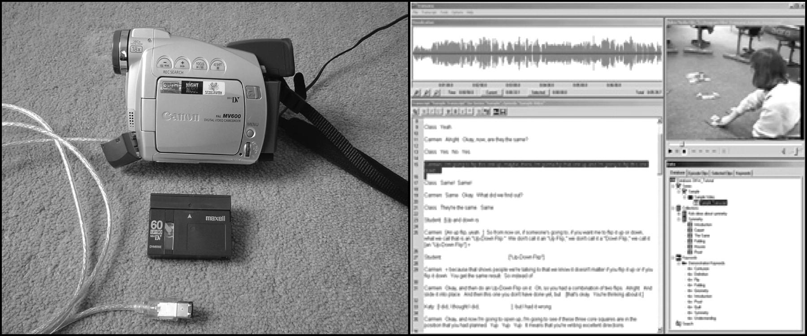
FIGURE 2 Digital video recording equipment: video camera with firewire computer lead, mini DV cassette and Transana ...
Notes:
FIGURE 2 Digital video recording equipment: video camera with firewire computer lead, mini DV cassette and Transana transcribing software
Unless provided in the caption above, the following copyright applies to the content of this slide: © 2008 The AuthorsThis is an Open Access article distributed under the terms of the Creative Commons Attribution Non-Commercial License (http://creativecommons.org/licenses/by-nc/2.0/uk/) which permits unrestricted non-commercial use, distribution, and reproduction in any medium, provided the original work is properly cited.

