Slide 1
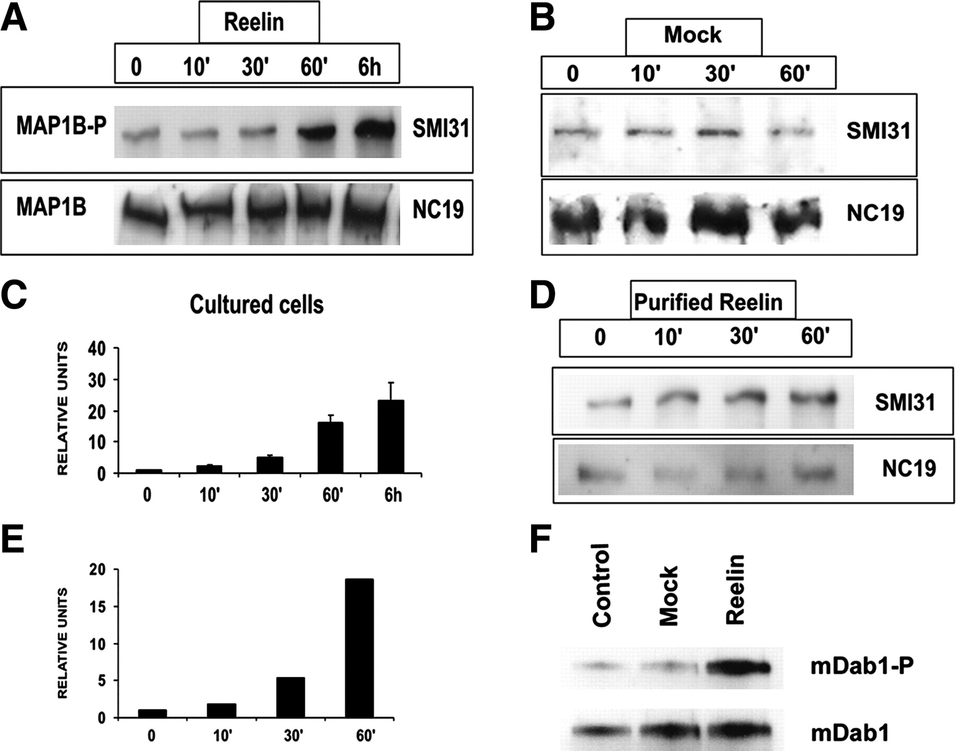
Figure 1. Reelin increases the levels of mode I MAP1B phosphorylation. (A) Western Blots illustrating induction of ...
Notes:
Figure 1. Reelin increases the levels of mode I MAP1B phosphorylation. (A) Western Blots illustrating induction of MAP1B phosphorylation by Reelin-conditioned media. Cortical neurons were cultured for 48 h and then treated with Reelin-conditioned medium for different times (0, 10, 30, 60 min and 6 h). Western blots of soluble cell extracts were incubated with antibodies against the mode I MAP1B phosphoepitope (SMI31), or total MAP1B (NC 19). α-Tubulin antibodies were used as loading controls. Reelin incubation results in a marked increase in mode I phosphorylation levels of MAP1B (SMI31). The phosphorylation levels of MAP1B protein in the SMI31 epitope were determined by densitometry and normalized respect to the total levels of MAP1B (NC19) in cultured cells (C). (B) MAP1B phosphorylation levels after treatment with mock-culture medium. Cortical neurons were cultured for 48 h and treated with conditioned medium from mock-transfected 293T cells for different times (10, 30, 60 min). The phosphorylation levels of MAP1B protein in the SMI31 epitope were determined by densitometry and normalized respect to the total levels of MAP1B (NC19) (data not shown). (D) MAP1B phosphorylation levels after treatment with partially purified Reelin. Western blots of soluble cell extracts from Reelin-treated or untreated neurons (0), were incubated with antibodies against MAP1B (SMI31 and NC19). The phosphorylation degree of MAP1B protein in the SMI31 epitope was determined by densitometry, normalized respect to the levels of total MAP1B (NC19), and graphically represented (E). (F) Reelin treatment induced mDab1 tyrosine phosphorylation. MDab1 protein was immunoprecipitated after exposure to Reelin or mock supernatant and further incubated with an anti-phosphotyrosine antibody. While mock-transfected cells did not induce a noticeable increase in mDab1 phosphorylation, Reelin-transfected cells increased phospho-tyrosine mDab1 levels.
Unless provided in the caption above, the following copyright applies to the content of this slide: © Oxford University Press 2004; all rights reserved

Slide 2
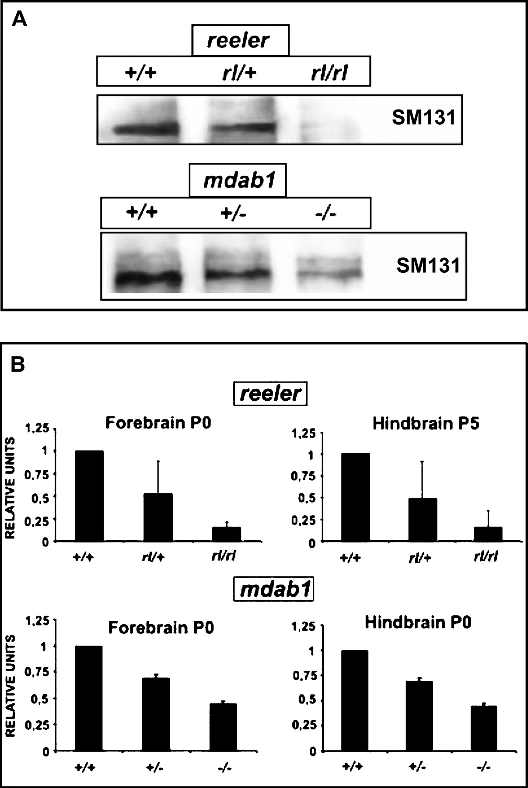
Figure 2. Reduced mode I MAP1B phosphorylation in Reeler and Dab1 −/− mutants. (A) Western blots illustrating mode I ...
Notes:
Figure 2. Reduced mode I MAP1B phosphorylation in Reeler and Dab1 −/− mutants. (A) Western blots illustrating mode I MAP1B phosphorylation levels in brain extracts from the forebrain (P0) of reeler, rl/+ and wild-type mice (upper panel), and from mdab1 (−/−), mdab1 (+/−) and wild-type littermates (lower panel). Western blots were incubated with the SMI31 antibody. (B) Histograms showing densitometric analysis of mode I MAP1B phosphorylation in the forebrains and hindbrains of reeler and mdab1 mutant brains (mean ± SD; three cases each). The phosphorylation levels of MAP1B protein in the SMI31 epitope were determined as described above. The data was normalized respect to total MAP1B values (NC19), and graphically represented. The data from wild-type brains were referred as 1 relative unit. Note markedly decreased phosphorylation levels in homozygous and heterozygous mutant brains, compared to their wild-type littermates.
Unless provided in the caption above, the following copyright applies to the content of this slide: © Oxford University Press 2004; all rights reserved

Slide 3
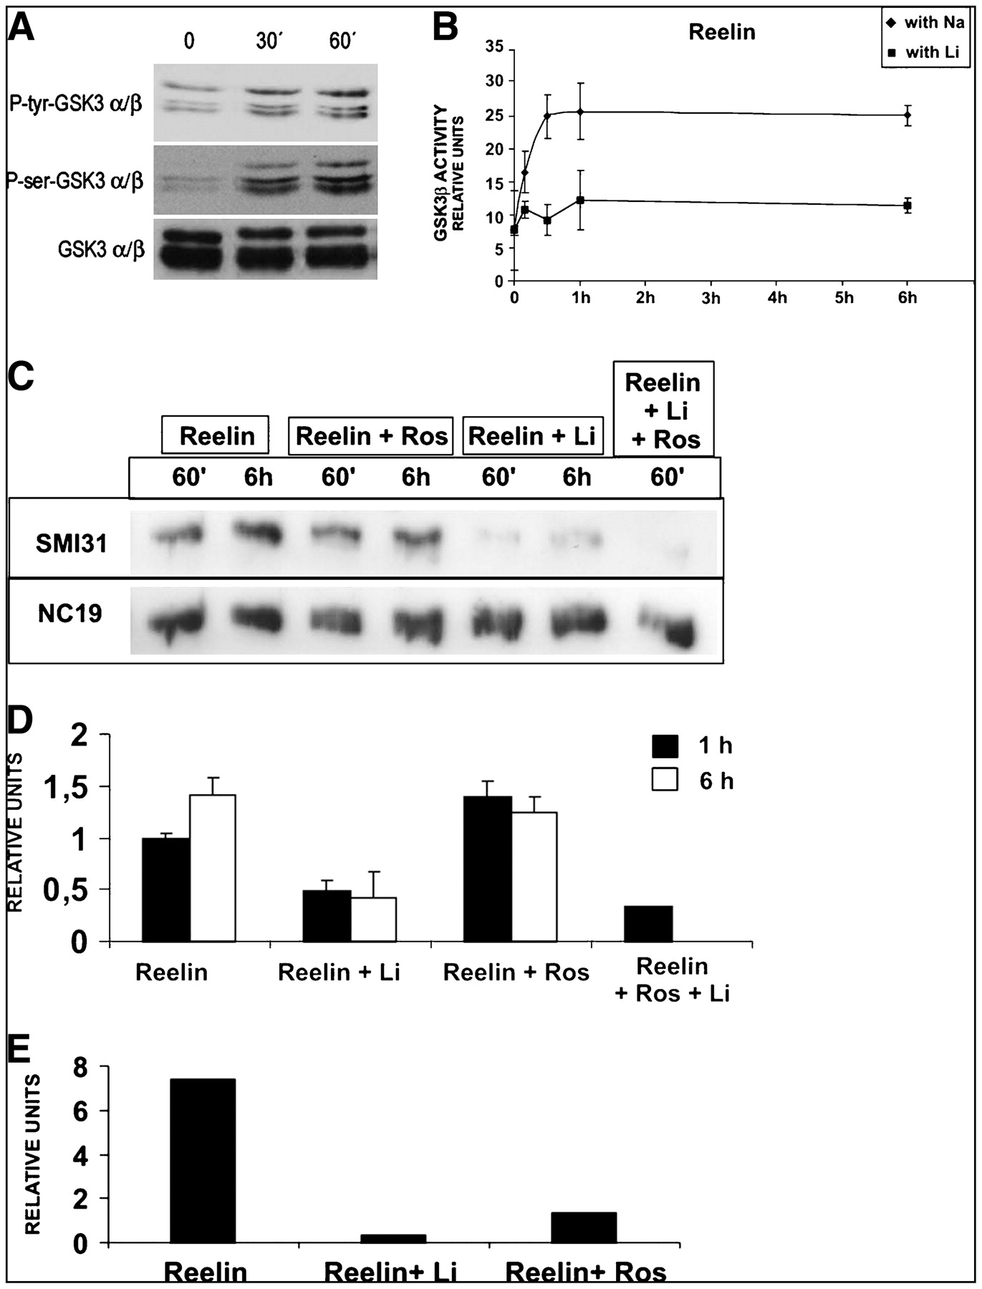
Figure 3. Contribution of GSK3 and CDK5 in the type I MAP1B phosphorylation induced by Reelin. (A) Western blots ...
Notes:
Figure 3. Contribution of GSK3 and CDK5 in the type I MAP1B phosphorylation induced by Reelin. (A) Western blots showing P-Tyr-GSK3 (upper panel), P-Ser-GSK3 (middle panel) and GSK3 total levels (lower panel) in cortical cultures treated with Reelin-conditioned media for 0–60 min, showing an increase of both GSK3 tyrosine and serine phosphorylation. (B) Plots illustrating the phosphorylation levels (mean ± SD) of a GSK3-specific peptide substrate in neuronal cultures after exposure to Reelin containing media for 0–6 h, in the presence or absence of LiCl, a GSK3 inhibitor. GSK3 kinase activity is considered to be the difference between the kinase activities in the presence (filled squares) or absence of LiCl (filled diamonds). Note that GSK3 activity increases shortly after Reelin exposition, consistent with an increase in tyrosine phosphorylation of the kinase; and the increased activity lasts for 6 h. (C) Western blot of soluble cell extracts from cortical neurons exposed to Reelin alone for 1 or 6 h, with Reelin and lithium chloride (Li), roscovitine (Ros), or both Li and Ros. Membranes were immunoreacted with the SMI31 MAb to visualize mode I MAP1B phosphorylation, or with the NC19 antibody. (D) Densitometric analysis of the Western blot shown in (C). The data were normalized with respect to the values corresponding to total MAP1B levels (NC19). (E) Densitometric analysis of mode I MAP1B phosphorylation levels as detected with the SMI31 MAb, normalized to total MAP1B levels. Embryonic cortical neurons were cultured on laminin-coated plates for 48 h, and then exposed for 1 h to Reelin alone, or to Reelin plus lithium (Li) or to Reelin plus roscovitine (Ros). Inhibition of either CDK5 (Ros) or GSK3 (Li) activities greatly reduces Reelin-induced MAP1B phosphorylation levels.
Unless provided in the caption above, the following copyright applies to the content of this slide: © Oxford University Press 2004; all rights reserved

Slide 4
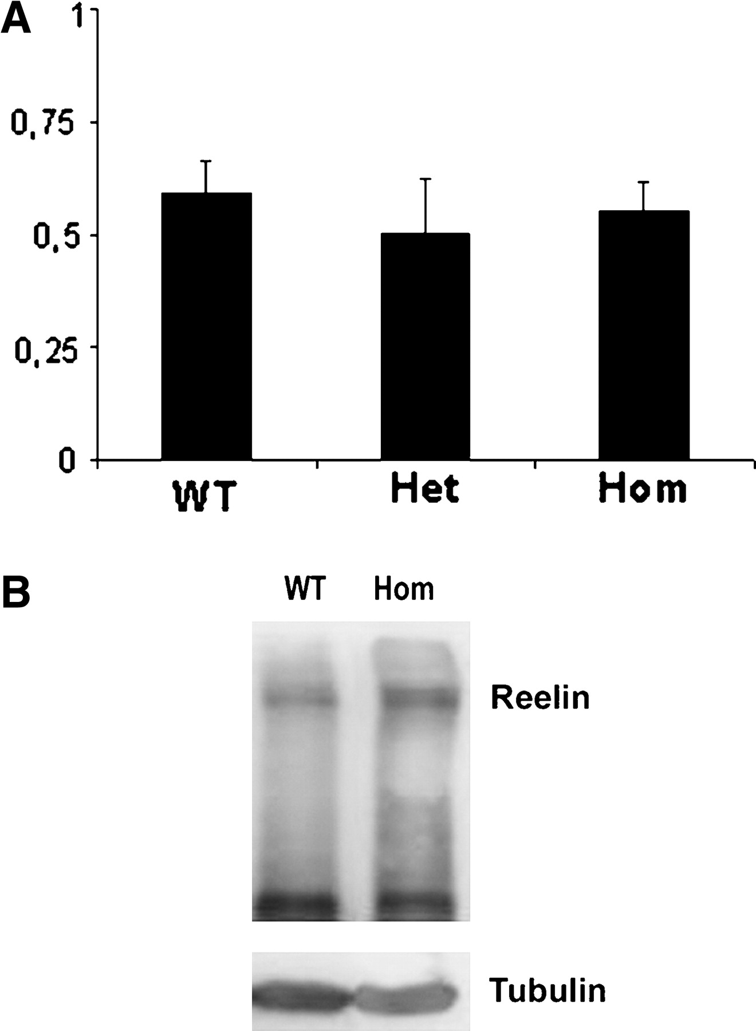
Figure 4. Reelin levels are unaltered in map1b mutants. (A) RT-PCR for reelin mRNA showing no significant variations ...
Notes:
Figure 4. Reelin levels are unaltered in map1b mutants. (A) RT-PCR for reelin mRNA showing no significant variations amongst wild-type, heterozygous and homozygous animals. Samples were normalized against actin mRNA internal control. (B) Western blot of brain extracts derived from wild-type and homozygous animals showing no signicant variations in the levels of Reelin protein. Samples were normalized against tubulin as an internal control.
Unless provided in the caption above, the following copyright applies to the content of this slide: © Oxford University Press 2004; all rights reserved

Slide 5
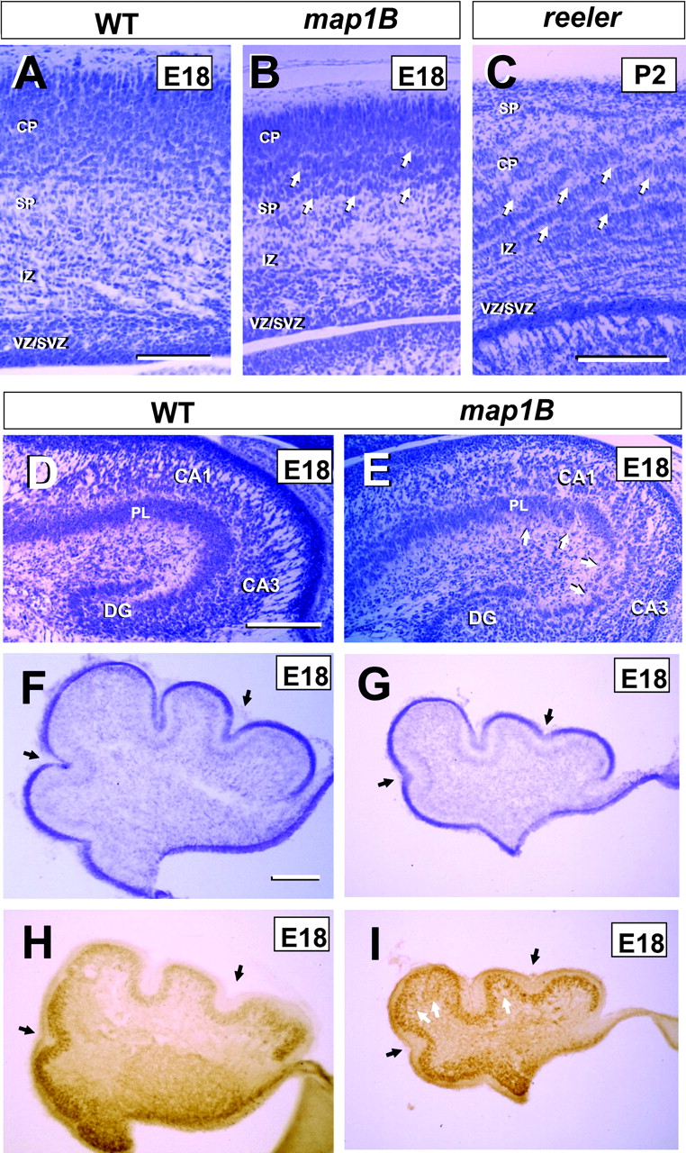
Figure 5. Migration abnormalities in map1B-deficient mice. (A–C) Laminar organization of the developing neocortex in ...
Notes:
Figure 5. Migration abnormalities in map1B-deficient mice. (A–C) Laminar organization of the developing neocortex in wild-type embryos (A), map1B mutants (B) and in reeler mice (C). Nissl-staining. In map1B mutants (B), the subplate and the lower cortical plate show a disorganized, wavy distribution of neurons (white arrows), which resembles that in reeler mice (C). Scale bar, 200 μm. (D, E) Cytoarchitectonics of the embryonic hippocampus in wild-type (C) and map1B-deficient (D) embryos. Note the disorganized pyramidal layer (PL) (arrows in E) in the mutant hippocampus. Scale bar, 200 μm. (F–I) Cytoarchitectonics of the embryonic cerebellum in wild-type (F, H) and map1B mutant embryos (G, I). (F, G) are Nissl-stained sections. (H, I) are sections immunostained with calbindin antibodies. The mutant cerebellum displays smaller size and foliation defects (black arrows), compared to the wild-type cerebellum. Calbindin immunostaing shows that mutant Purkinje cells (I) appear to be more widespread distributed (white arrows) than wild-type Purkinje cells (H). Scale bar, 200 μm. Abbreviations: CP, cortical plate; SP, subplate; IZ, intermediate zone; VZ, ventricular zone; SVZ, subventricular zone; CA1-CA3, hippocampal regions; DG, dentate gyrus.
Unless provided in the caption above, the following copyright applies to the content of this slide: © Oxford University Press 2004; all rights reserved

Slide 6
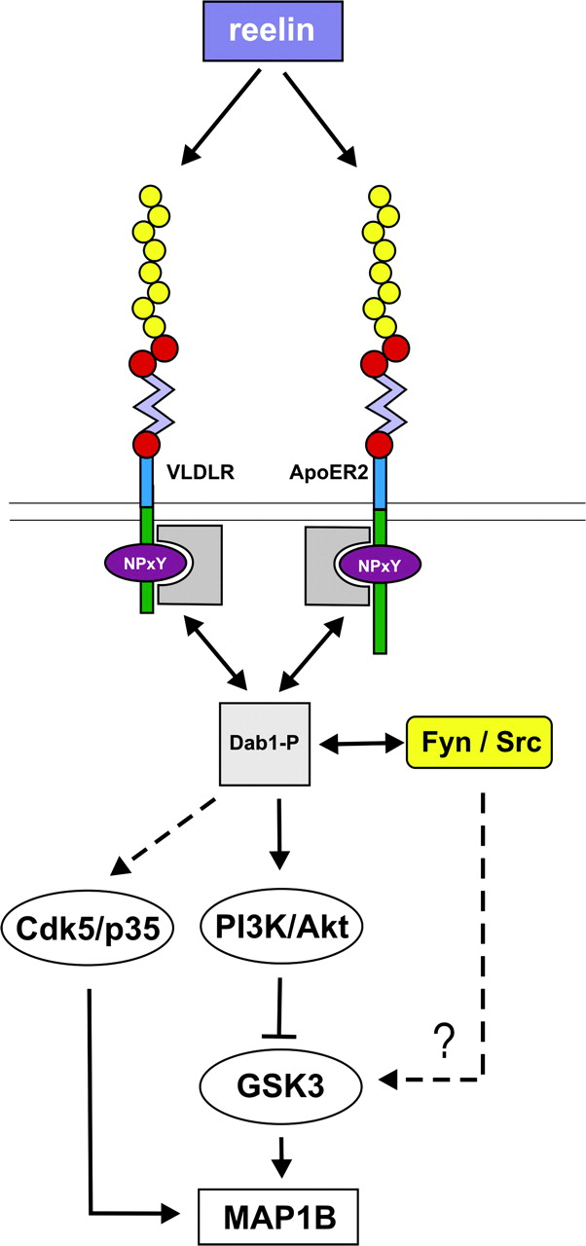
Figure 8. Schematic diagram showing the Reelin signaling pathway. The extracellular protein Reelin binds to the VLDLR ...
Notes:
Figure 8. Schematic diagram showing the Reelin signaling pathway. The extracellular protein Reelin binds to the VLDLR and ApoER2 receptors. The adaptor protein Dab1 associates with the NPxY motifs in the cytoplasmic domains of these receptors. Reelin binding to their receptors activates Src/Fyn tyrosine kinases, resulting in phosphorylation of Dab1. Furthermore, the Reelin signaling pathway activates a complex array of intracellular cascades including PI3K/Akt, Cdk5 and probably other unknown kinases. These intracellular kinases control GSK3 activity, which, together with CDK5, phosphorylate MAP1B. Mutations in the reelin and dab-1 genes elicit a similar decrease in mode I-MAP1B phosphorylation.
Unless provided in the caption above, the following copyright applies to the content of this slide: © Oxford University Press 2004; all rights reserved

Slide 7
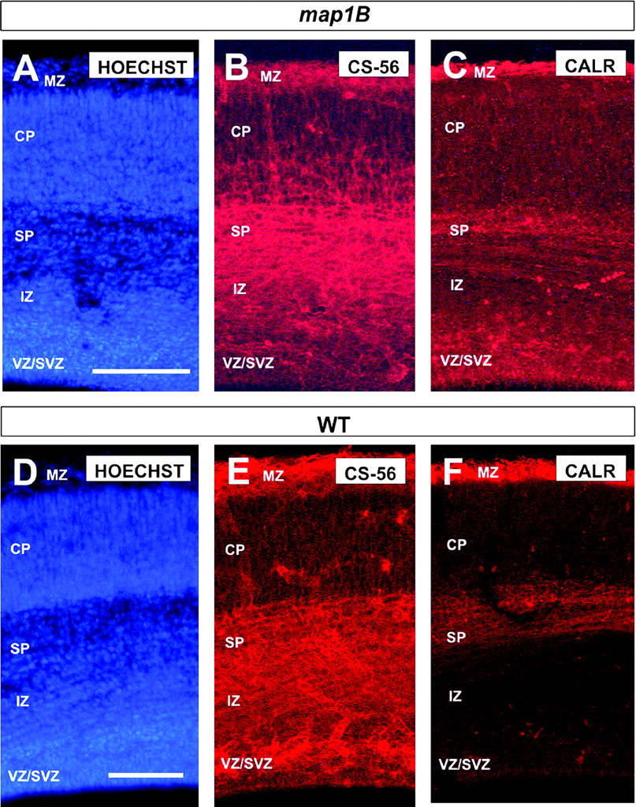
Figure 7. Distribution of subplate cells and Cajal–Retzius cells in the map1B mutant neocortex. (A–F) Comparison of the ...
Notes:
Figure 7. Distribution of subplate cells and Cajal–Retzius cells in the map1B mutant neocortex. (A–F) Comparison of the distribution of subplate cells (B, E: CS-56-immunoreactivity) and Cajal–Retzius cells (C, F: calretinin-immunoreactivity) in the map1B mutant and wild-type parietal neocortex at E18. No major differences were detected. (A) and (D) are sections counterstained with bisbenzimide, to illustrate the pattern of lamination. Abbreviations as in Figure 5.
Unless provided in the caption above, the following copyright applies to the content of this slide: © Oxford University Press 2004; all rights reserved

Slide 8
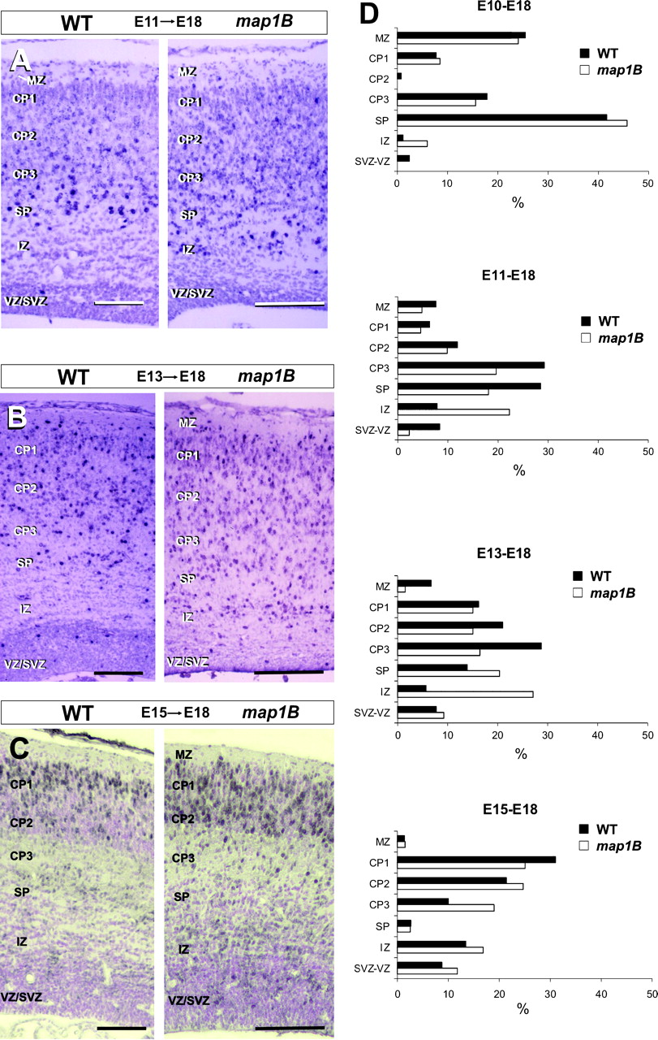
Figure 6. Distribution of BrdU-labeled neurons in the parietal neocortex. (A–C) Examples illustrating the distribution ...
Notes:
Figure 6. Distribution of BrdU-labeled neurons in the parietal neocortex. (A–C) Examples illustrating the distribution of neurons labeled by BrdU at E11 (A), E13 (B) or E15 (C), and analyzed at E18 in wild-type (left) and map1B mutant (right) embryos. Scale bars, 200 μm. (D) Radial distribution of BrdU-labeled neurons (in percentages) in the parietal neocortex of wild-type (black bars) and map1B mutant (white bars) embryos. Postmitotic neurons were labeled at E10, E11, E13 or E15, and were analyzed at E18. Cortical layers comprised the subventricular/ventricular zones (SVZ/VZ), intermediate zone (IZ), subplate (SP), marginal zone (MZ), and the lower, middle and upper tiers of the cortical plate (CP3, CP2, CP1).
Unless provided in the caption above, the following copyright applies to the content of this slide: © Oxford University Press 2004; all rights reserved

