Slide 1
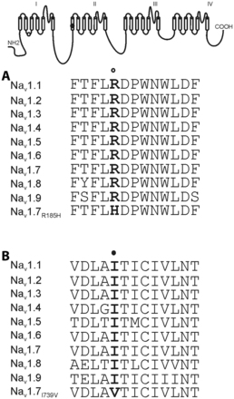
Figure 1 Schematic of a voltage-gated sodium channel showing the locations of the R185H (open circle) and I739V (solid ...
Notes:
Figure 1 Schematic of a voltage-gated sodium channel showing the locations of the R185H (open circle) and I739V (solid circle) substitutions and the aligned sequences for the linker between Nav1 DIS2 and DIS3 (A) and for the relevant part of Nav1 DIIS1 (B). R185 (bold) and I739 (bold) are both conserved in all known human voltage-gated sodium channels.
Unless provided in the caption above, the following copyright applies to the content of this slide: © The Author (2012). Published by Oxford University Press on behalf of the Guarantors of Brain. All rights reserved. For Permissions, please email: journals.permissions@oup.com

Slide 2
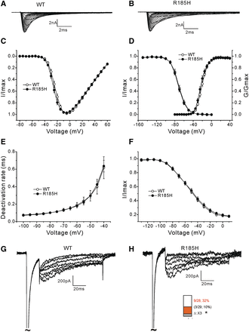
Figure 2 Voltage-clamp analysis of wild-type (WT) and R185H channels in DRG neurons. Representative current traces ...
Notes:
Figure 2 Voltage-clamp analysis of wild-type (WT) and R185H channels in DRG neurons. Representative current traces recorded from DRG neurons from Nav1.8-null mice expressing wild-type (A) or R185H (B), evoked by voltage steps (100 ms) from −80 to 60 mV in 5-mV increments, from a holding potential of −100 mV. (C) Normalized peak current–voltage relationship curves for wild-type and R185H channels. (D) Comparison of voltage-dependent activation and steady-state fast-inactivation for wild-type and R185H channels. R185H does not alter activation or fast-inactivation. (E) Comparison of time constants for deactivation. R185H displays similar deactivation rates as wild-type channels. (F) Comparison of steady-state slow-inactivation curves between wild-type and R185H variant channels. R185H does not alter steady-state slow-inactivation. (G and H) Representative resurgent current traces recorded from DRG neurons expressing wild-type (G) or R185H (H) channels. Inset bar graph showing a higher percentage of DRG neurons expressing R185H (9 of 28 cells, 32%) (red) compared to cells expressing wild-type channels (3 of 29 cells, 10%) (grey) produce resurgent currents. *P < 0.05.
Unless provided in the caption above, the following copyright applies to the content of this slide: © The Author (2012). Published by Oxford University Press on behalf of the Guarantors of Brain. All rights reserved. For Permissions, please email: journals.permissions@oup.com

Slide 3
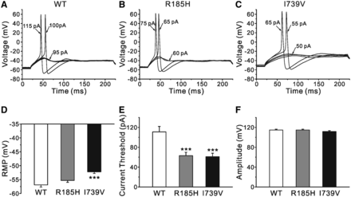
Figure 3 R185H and I739V both render DRG neurons hyperexcitable. (A) Representative traces from a DRG neuron (0 - to ...
Notes:
Figure 3 R185H and I739V both render DRG neurons hyperexcitable. (A) Representative traces from a DRG neuron (0 - to 5-day-old rat) expressing wild-type (WT) channels, showing sub-threshold response to 95 pA current injection and subsequent action potentials evoked by injections of 100 pA (current threshold for this neuron) and 115 pA. (B) Representative traces from a DRG neuron expressing R185H variant channels, showing a lower current threshold (65 pA for this neuron) for action potential generation. (C) Representative traces from a DRG neuron expressing I739V variant channels, showing a lower current threshold (55 pA for this neuron) for action potential generation. (D) R185H does not alter resting membrane potential (RMP) of DRG neurons, but I739V significantly depolarizes RMP by 4.7 mV. ***P < 0.001 versus wild-type. (E) Comparison of current threshold among DRG neurons expressing wild-type, R185H or I739V channels. Current thresholds of DRG neurons are significantly reduced after expression R185H or I739V variant channels. ***P < 0.001 versus wild-type. (F) Comparison of action potential amplitude among DRG neurons expressing wild-type, R185H and I739V channels. R185H and I739V do not have an effect on action potential amplitude of DRG neurons.
Unless provided in the caption above, the following copyright applies to the content of this slide: © The Author (2012). Published by Oxford University Press on behalf of the Guarantors of Brain. All rights reserved. For Permissions, please email: journals.permissions@oup.com

Slide 4
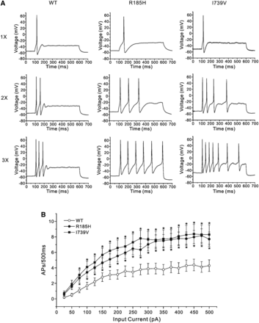
Figure 4 R185H and I739V both increase repetitive firing in DRG neurons. (A) Representative responses of DRG neurons ...
Notes:
Figure 4 R185H and I739V both increase repetitive firing in DRG neurons. (A) Representative responses of DRG neurons (0 - to 5-day-old rat) expressing wild-type (WT), R185H and I739V channels, respectively, to 500 ms depolarizing current steps that are one, two and three times (top, middle and bottom traces, respectively) the current threshold for action potential generation. (B) Comparison of mean action potential (AP) spike numbers among DRG neurons expressing wild-type, R185H and I739V channels across a range of 500 ms step current injections from 25 to 500 pA. *P < 0.05 versus wild-type. R185H and I739V variant channels both increase spike numbers compared to wild-type.
Unless provided in the caption above, the following copyright applies to the content of this slide: © The Author (2012). Published by Oxford University Press on behalf of the Guarantors of Brain. All rights reserved. For Permissions, please email: journals.permissions@oup.com

Slide 5
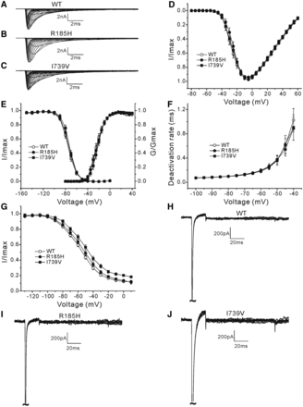
Figure 5 Voltage-clamp analysis of wild-type (WT), R185H and I739V channels in SCG neurons. Representative current ...
Notes:
Figure 5 Voltage-clamp analysis of wild-type (WT), R185H and I739V channels in SCG neurons. Representative current traces recorded from SCG neurons (0 - to 5-day-old rat) expressing wild-type (A), R185H (B) or I739V channels (C), evoked by voltage steps (100 ms) from −80 mV to 60 mV in 5-mV increments, from a holding potential of −100 mV. (D) Normalized peak current–voltage relationship curves for wild-type, R185H and I739V channels. (E) Comparison of voltage-dependent activation and steady-state fast-inactivation for wild-type, R185H and I739V channels. R185H and I739V do not alter activation or fast-inactivation. (F) Comparison of time constants for deactivation. R185H and I739V both display similar deactivation rates as wild-type channels. (G) Comparison of steady-state slow-inactivation curves among wild-type, R185H and I739V variant channels. R185H does not alter steady-state slow-inactivation. I739V shifts the steady-state slow-inactivation to the right by 6.1 mV and increases the non-inactivated current at 10 mV. (H–J) SCG neurons expressing wild-type (H), R185H (I) or I739V (J) channels do not produce resurgent currents.
Unless provided in the caption above, the following copyright applies to the content of this slide: © The Author (2012). Published by Oxford University Press on behalf of the Guarantors of Brain. All rights reserved. For Permissions, please email: journals.permissions@oup.com

Slide 6
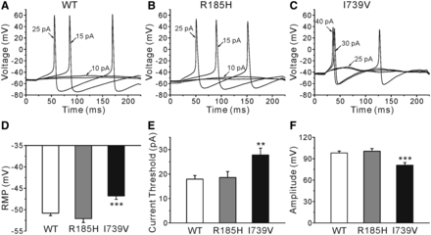
Figure 6 R185H does not alter SCG neurons excitability, but I739V renders SCG neurons (0 - to 5-day-old rat) ...
Notes:
Figure 6 R185H does not alter SCG neurons excitability, but I739V renders SCG neurons (0 - to 5-day-old rat) hypoexcitable. (A) Representative traces from a SCG neuron expressing wild-type (WT) channels show sub-threshold responses to 10 pA current injection and subsequent all-or-none action potentials elicited by current inputs of 15 pA and 25 pA. (B) Representative traces from a SCG neuron expressing R185H channels, showing similar current threshold for action potential generation as SCG neuron expressing wild-type channels. (C) Representative traces from a SCG neuron expressing I739V channels, showing that a higher current injection of 30 pA is required to generate the first all-or-none action potential. (D) R185H does not alter the RMP of SCG neurons, but I739V causes a significantly depolarizating shift in RMP by 4.0 mV. ***P < 0.001 versus wild-type. (E) Average current threshold of SCG neurons expressing R185H channels is not significantly different from SCG neurons expressing wild-type channels, whereas it is significantly increased after expression of I739V variant channels. **P < 0.01 versus wild-type. (F) SCG neurons expressing R185H channels display similar action potential amplitude as neurons expressing wild-type channels, whereas the amplitude is significantly smaller after expression I739V channels. ***P < 0.001 versus wild-type.
Unless provided in the caption above, the following copyright applies to the content of this slide: © The Author (2012). Published by Oxford University Press on behalf of the Guarantors of Brain. All rights reserved. For Permissions, please email: journals.permissions@oup.com

Slide 7
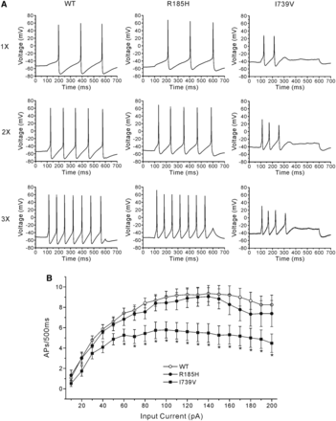
Figure 7 I739V attenuates repetitive firing in SCG neurons, while R185H does not affect repetitive firing. (A) ...
Notes:
Figure 7 I739V attenuates repetitive firing in SCG neurons, while R185H does not affect repetitive firing. (A) Representative responses of SCG neurons (0 - to 5-day-old rat) expressing wild-type (WT), R185H and I739V channels, respectively, to 500 ms depolarizing current steps that are one, two and three times (top, middle and bottom traces, respectively) the current threshold for action potential (AP) generation. (B) Comparison of mean action potential spike numbers between SCG neurons expressing wild-type, R185H and I739V channels across a range of 500 ms step current injections from 10 to 200 pA. Compared to wild-type, I739V attenuates spike numbers, while R185H does not. *P < 0.05 versus wild-type.
Unless provided in the caption above, the following copyright applies to the content of this slide: © The Author (2012). Published by Oxford University Press on behalf of the Guarantors of Brain. All rights reserved. For Permissions, please email: journals.permissions@oup.com

