Slide 1
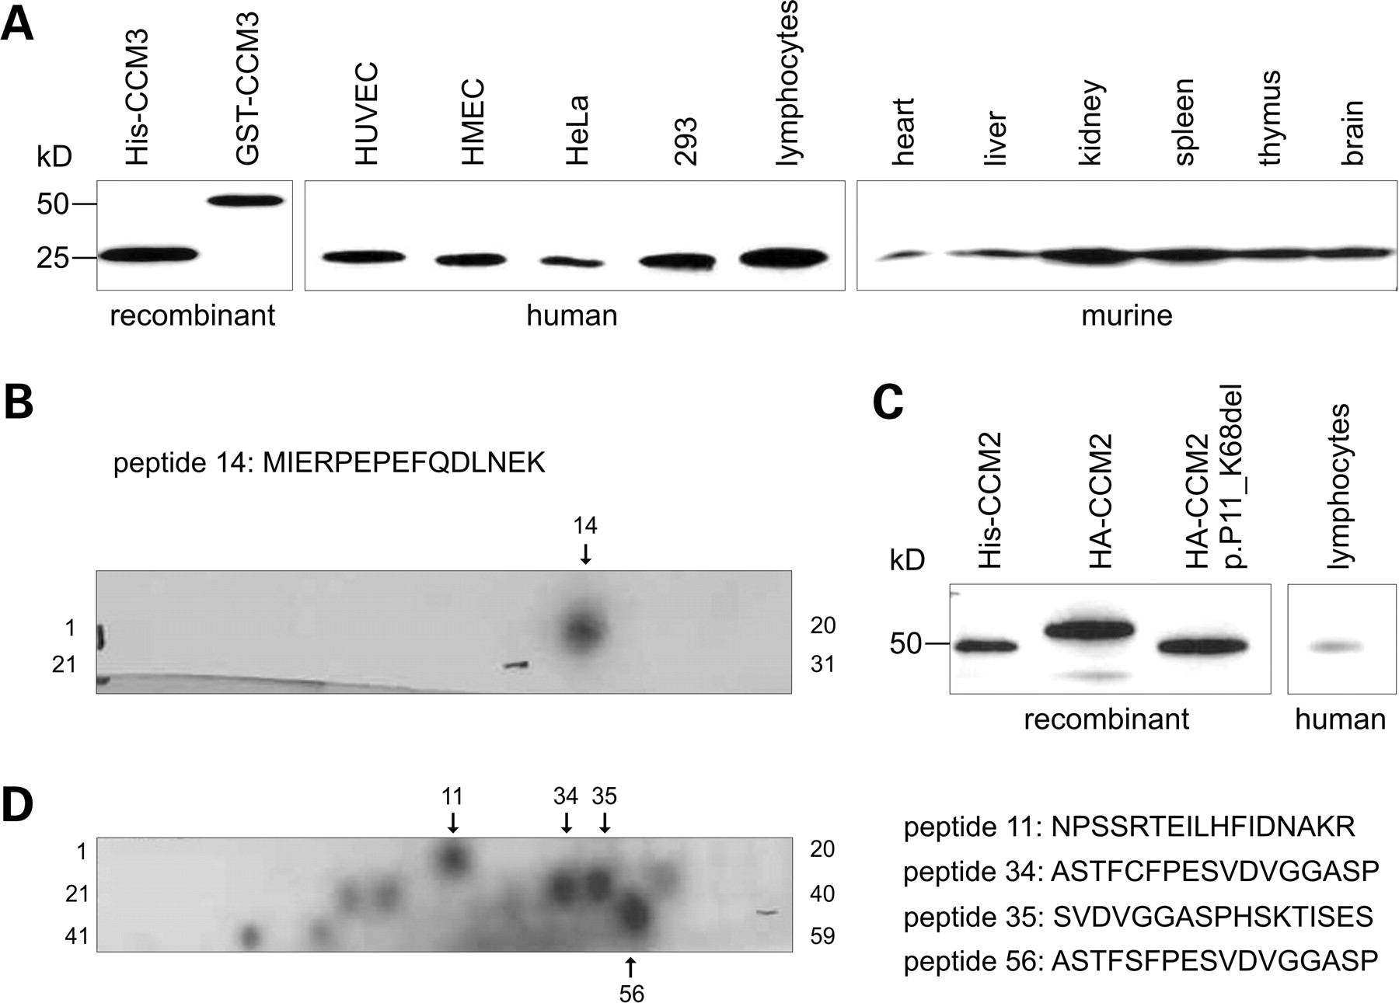
Figure 1. (A) Polyclonal anti-human CCM3 antibody specifically reacts with a protein of the size of recombinant human ...
Notes:
Figure 1. (A) Polyclonal anti-human CCM3 antibody specifically reacts with a protein of the size of recombinant human CCM3 purified from E. coli (lane 1) in the indicated human cell and murine tissue lysates (HUVEC, human umbilical vein endothelial cells; HMEC, human microvascular endothelial cells; HeLa, human epitheloid cervix carcinoma cells; 293, human embryonal kidney cell line). Ten micrograms of lysates was separated on 10–20% polyacrylamide–SDS gradient gels and analyzed by western blotting. (B) CCM3 epitope mapping using PepSpotsTM technology. (C) Polyclonal anti-human CCM2 antibody recognizes recombinant human CCM2 purified from E. coli, HA-tagged CCM2 as well as HA-tagged CCM2:p.P11_K68del (18) overexpressed in 293 cells and a protein of the size of CCM2 in lymphocyte lysates. (D) CCM2 epitope mapping using PepSpotsTM technology. Peptide 11 resides within the PTB domain making cross-reactivity likely. Peptide 56 was artificially modified and corresponds to peptide 34.
Unless provided in the caption above, the following copyright applies to the content of this slide: © 2008 The Author(s).This is an Open Access article distributed under the terms of the Creative Commons Attribution Non-Commercial License (http://creativecommons.org/licenses/by-nc/2.0/uk/) which permits unrestricted non-commercial use, distribution, and reproduction in any medium, provided the original work is properly cited.

Slide 2
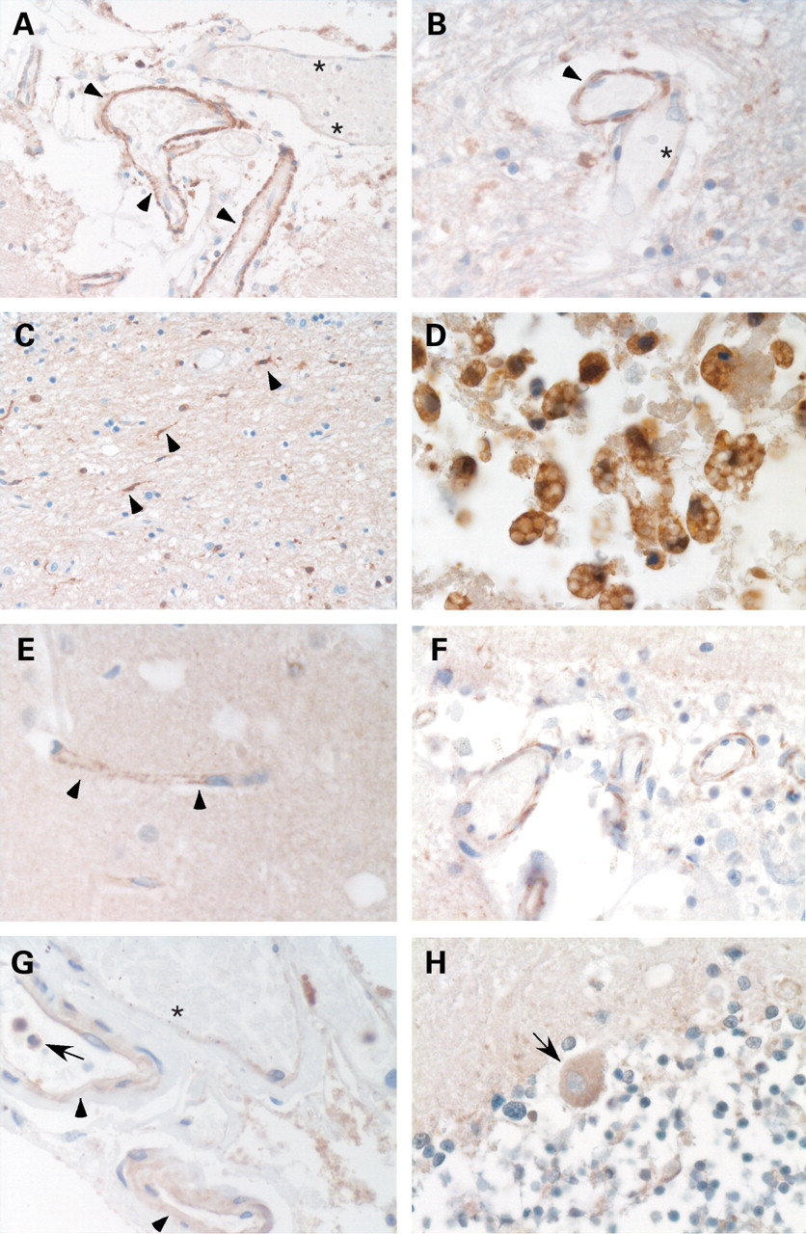
Figure 2. Expression of CCM proteins in human brain tissues. (A) Polyclonal anti-human CCM1 antibody stains vascular ...
Notes:
Figure 2. Expression of CCM proteins in human brain tissues. (A) Polyclonal anti-human CCM1 antibody stains vascular endothelia (arrowheads) in normal meningeal tissues. The asterisks indicate an adjacent blood vessel with immunonegative endothelial cells. (B) Stronger (arrowhead) and weaker (asterisk) staining intensities with the anti-CCM1 antibody in parenchymal vessels. The CCM1 antibody also stains (C) microglia and (D) foamy macrophages in the vicinity of a cavernous lesion. (E) Granular staining of capillary vessels in the brain parenchyma (E) and the meninges (F) incubated with the polyclonal anti-human CCM2 antibody. (G and H) Positive immunoreactivity of vessel endothelia with the polyclonal anti-human CCM3 antibody which also detected (G) polymorphonuclear blood cells (arrow) and (H) Purkinje cells (arrow) in the cerebellum. (G) Similar to anti-CCM1, anti-CCM3 shows different staining intensities for endothelia of vessels with broadened walls (arrow head) when compared with adjacent thin-walled vessels (asterisk).
Unless provided in the caption above, the following copyright applies to the content of this slide: © 2008 The Author(s).This is an Open Access article distributed under the terms of the Creative Commons Attribution Non-Commercial License (http://creativecommons.org/licenses/by-nc/2.0/uk/) which permits unrestricted non-commercial use, distribution, and reproduction in any medium, provided the original work is properly cited.

Slide 3
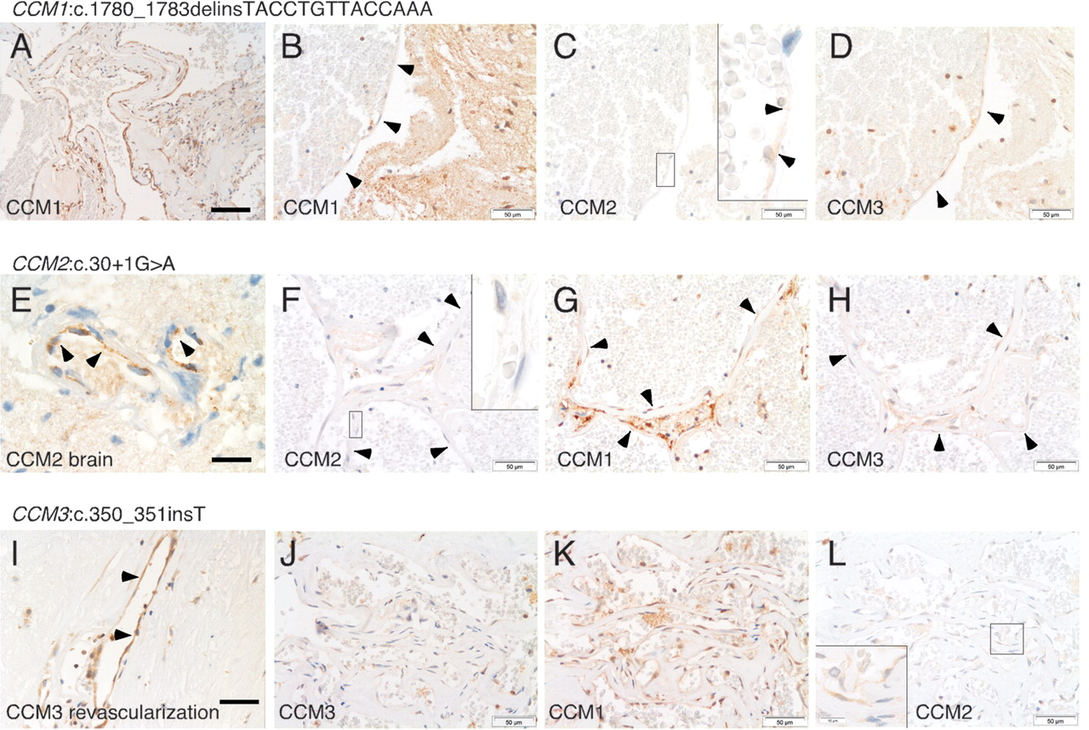
Figure 3. Serial sections from carriers of a known germline mutation in one of the three CCM genes immunostained for ...
Notes:
Figure 3. Serial sections from carriers of a known germline mutation in one of the three CCM genes immunostained for CCM1, CCM2 and CCM3, respectively. Immunohistochemistry with the anti-human CCM1 antibody revealed (A) CCM1-positive and (B) CCM1-negative endothelia (arrowheads) within the same cavernous malformation tissue section of a CCM1:c.1780_1783delinsTACCTGTTACCAAA germline mutation carrier (Table 1, No. 2), whereas (C) CCM2- and (D) CCM3-immunoreactivity was observed. (E) Normal brain arterial endothelium of a CCM2:c.30+1G>A germline mutation carrier (Table 1, No. 4) reacts with the anti-human CCM2 antibody while (F) cavernous endothelium in the same tissue section does not. (G and H) Immunostaining for CCM1 and CCM3 is positive in caverns from this individual. (I) Vessels in revascularized thrombosed caverns of a CCM3:c.350_351insT germline mutation carrier (Table 1, No. 7) show CCM3-immunoreactivity, whereas (J) pristine caverns do not. (K and L) Positive immunostaining for CCM1 and CCM2 in the same cavernous lesion. Scale bar in (A): 100 µm, in (E): 20 µm, all others: 50 µm. Insets in (C) and (L) demonstrate faint granular immunoreactivity for CCM2, whereas the inset in (F) shows negativity for CCM2 at five times higher magnification (original magnification 100×).
Unless provided in the caption above, the following copyright applies to the content of this slide: © 2008 The Author(s).This is an Open Access article distributed under the terms of the Creative Commons Attribution Non-Commercial License (http://creativecommons.org/licenses/by-nc/2.0/uk/) which permits unrestricted non-commercial use, distribution, and reproduction in any medium, provided the original work is properly cited.

