Slide 1
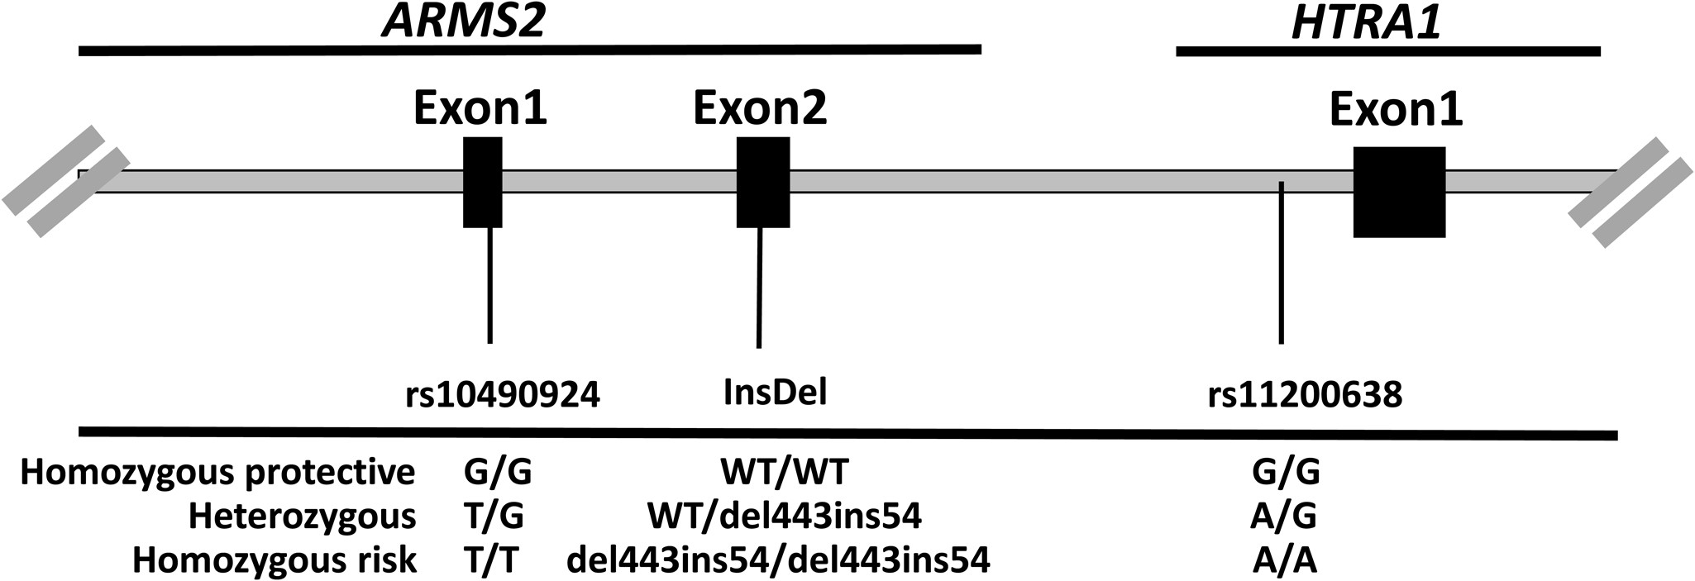
Figure 1. Variants at the chromosome 10q26 locus. For simplification and without loss of generality, the variants will ...
Notes:
Figure 1. Variants at the chromosome 10q26 locus. For simplification and without loss of generality, the variants will be designated by the ARMS2 SNP (rs10490924) genotype for the rest of the figures.
Unless provided in the caption above, the following copyright applies to the content of this slide: © The Author 2014. Published by Oxford University Press. All rights reserved. For Permissions, please email: journals.permissions@oup.com

Slide 2
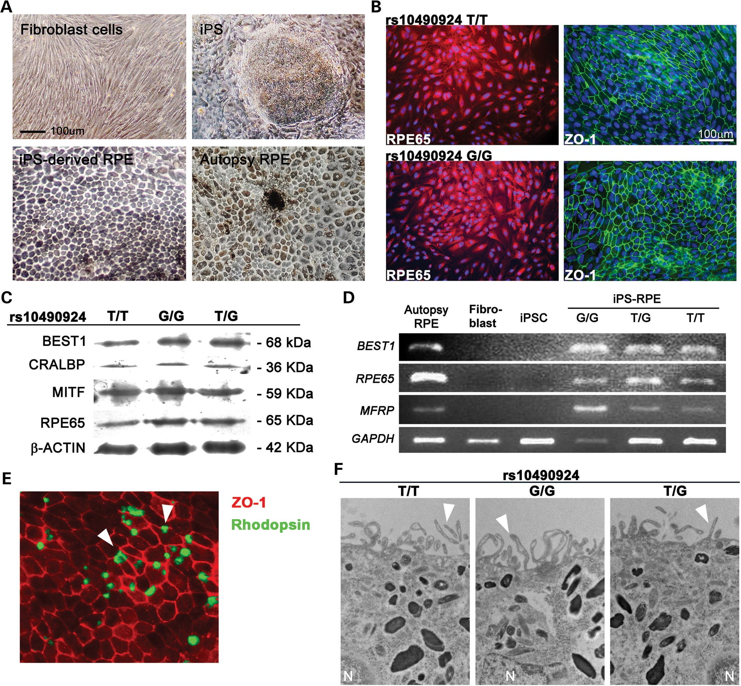
Figure 2. Induction of RPE cells from patient-specific iPS cells. (A) Various stages of iPSC-derived RPE cell ...
Notes:
Figure 2. Induction of RPE cells from patient-specific iPS cells. (A) Various stages of iPSC-derived RPE cell generation from donor tissue. Comparison of primary human autopsy-RPE cells with iPSC-derived RPE cells. Hexagonal shaped cells and dark perinuclear melanin granules, which are typical features of RPE, can be observed on iPSC-derived RPE cells. Scale bars: 100 μm. (B) Immunocytochemistry. Visualization of RPE65, an RPE marker; ZO-1 showed correct morphology and tight junction formation in homozygous high-risk T/T and protective G/G iPSC-derived RPE cells. Scale bars: 100 μm. (C and D) Western blot and RT–PCR expression profiling revealed the RPE characteristic proteins and RPE genes, respectively. Loading control, β-actin and GAPDH. (E) Immunofluorescent images of internalized rod outer segments (ROS) in wild-type iPSC-RPE cells to verify the function of iPSC-derived RPE cells. (×20). (F) Transmission electron microscopic images of iPSC-RPE showed the presence of apical microvilli (arrow), intracellular pigment (×12 000). N, nucleus.
Unless provided in the caption above, the following copyright applies to the content of this slide: © The Author 2014. Published by Oxford University Press. All rights reserved. For Permissions, please email: journals.permissions@oup.com

Slide 3
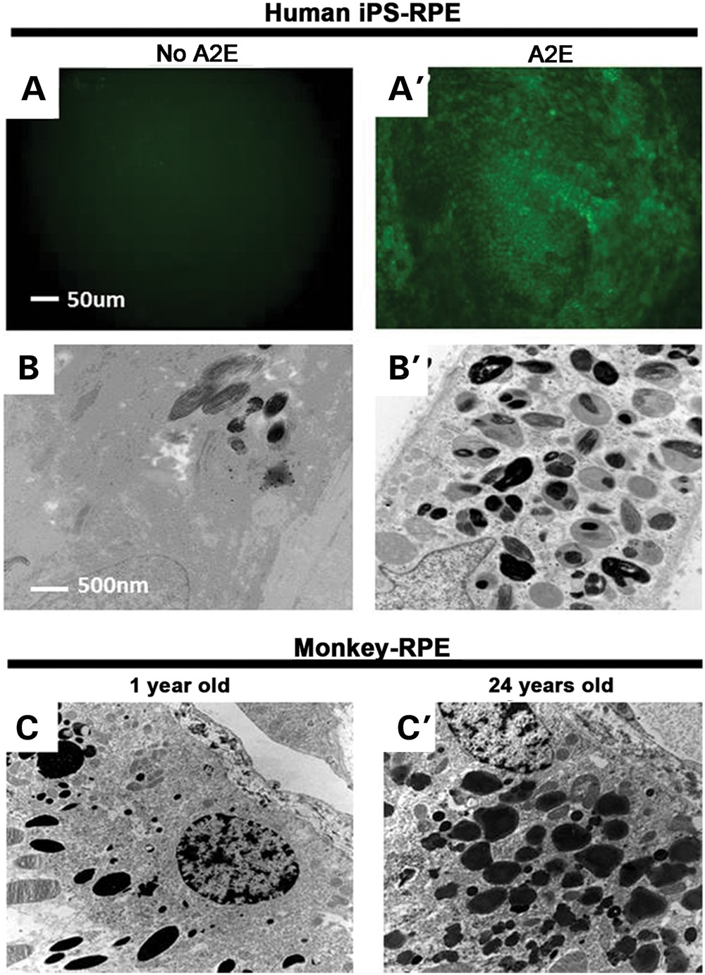
Figure 3. Model of aging in cultured RPE mimics aged monkey RPE within an intact eyeball. (A and A′) iPSC-derived RPE ...
Notes:
Figure 3. Model of aging in cultured RPE mimics aged monkey RPE within an intact eyeball. (A and A′) iPSC-derived RPE from AMD patients cultured on transwell for 10 days; autofluorescence can be seen under fluorescence microscope in A′. (B and B′) Transmission electron microscopy; in the presence of 10 μM A2E over 10 days (A2E), more structures composed of lipofuscin and melanin appeared in B′ than before A2E treatment in B. Lipofuscin and melanin deposits are gray and black, respectively. (C and C′) Electron microscopy of RPE in fixed sections of eyes from 1- and 24-year-old rhesus monkeys.
Unless provided in the caption above, the following copyright applies to the content of this slide: © The Author 2014. Published by Oxford University Press. All rights reserved. For Permissions, please email: journals.permissions@oup.com

Slide 4
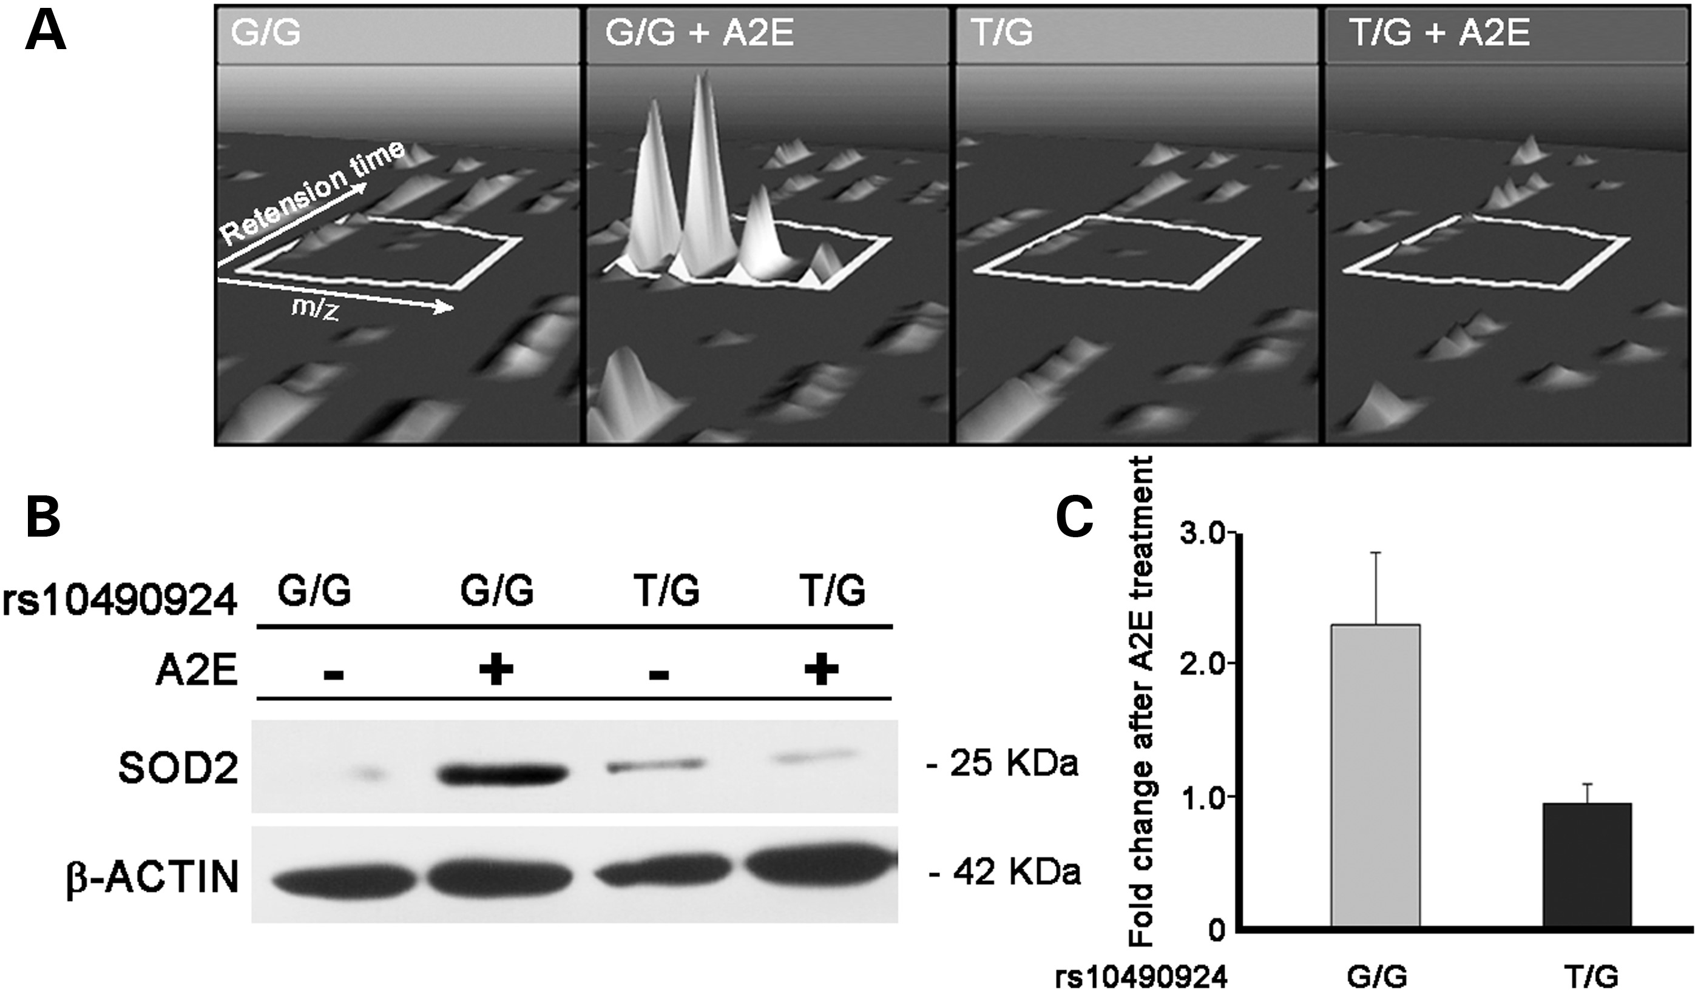
Figure 4. Shotgun proteomic mass spectrometry-based measurement of differential expression of SOD2. (A) ...
Notes:
Figure 4. Shotgun proteomic mass spectrometry-based measurement of differential expression of SOD2. (A) Three-dimensional visualization of isotopic clusters of a single SOD2 peptide example as rendered by TransOmics software. The peptide was highly expressed in RPE cells with the wild-type protective G/G genotype after A2E treatment, but that over-expression is not seen in the risk T/G genotype after A2E treatment. Volume under peak (peak height) indicates peptide abundance (z-dimension), which is then rolled up to protein abundance as calculated by the TransOmics software. Axes represent retention time and m/z (mass-to-charge ratio). (B) SOD2 immunoblot results are the same as mass spectrometry protein level; loading control, β-actin. (C) Densitometry of SOD2 signal from Figure 3B, normalized to β-actin. Fold change measurement after treatment is shown based on protein level before treatment.
Unless provided in the caption above, the following copyright applies to the content of this slide: © The Author 2014. Published by Oxford University Press. All rights reserved. For Permissions, please email: journals.permissions@oup.com

Slide 5
Figure 5. Impaired SOD2 stress response in cultured human RPE accompanies the presence of the high-risk allele. Cell ...
Notes:
Figure 5. Impaired SOD2 stress response in cultured human RPE accompanies the presence of the high-risk allele. Cell cultures were either iPSC-derived RPE or primary RPE from autopsy tissue. The genotype of each cell's origin is indicated (G/G for homozygous for protective haplotype, T/G for heterozygous and T/T for homozygous for risk haplotype). (A) SOD2 activity was measured in triplicate cultures for each of the six cell types. The triplicate measures were averaged and then normalized (A2E-aged cells normalized to non-aged cells). SOD2 activity in RPE from protective wild-type cell lines was dramatically increased in response to the aging treatment. In contrast, SOD2 activity in RPE from high-risk AMD patients (T/G and T/T) was decreased. (# of patients the cell lines came from: iPSC-RPE cells – nG/G = 2, nT/G = 1, nT/T = 1; autopsy-RPE – nG/G = 2, nG/T = 2, nT/T = 1. All samples were tested in triplicate.) Error bars show SEM for different cell lines and significance was calculated using unpaired and two-tailed t-test analyses between wild-type and T/G, T/T high-risk alleles, respectively. *P < 0.05; **P < 0.01. (B) Antioxidant capacity of human RPE after A2E treatment differs depending on genotype. The decay was slowed by SOD2, which neutralizes peroxyl radicals; antioxidant capacity is promoted in wild-type cell lines, while antioxidant capacity was lowered in T/G and T/T cell lines. Fluorescence intensity was measured every 5 min, and decay curves were generated which indicated changes in antioxidant capacity over time. The differences in net area under the curve before and after A2E treatment were calculated (+2.49, −0.47 and −0.85, for G/G, T/G and T/T, respectively).
Unless provided in the caption above, the following copyright applies to the content of this slide: © The Author 2014. Published by Oxford University Press. All rights reserved. For Permissions, please email: journals.permissions@oup.com

Slide 6
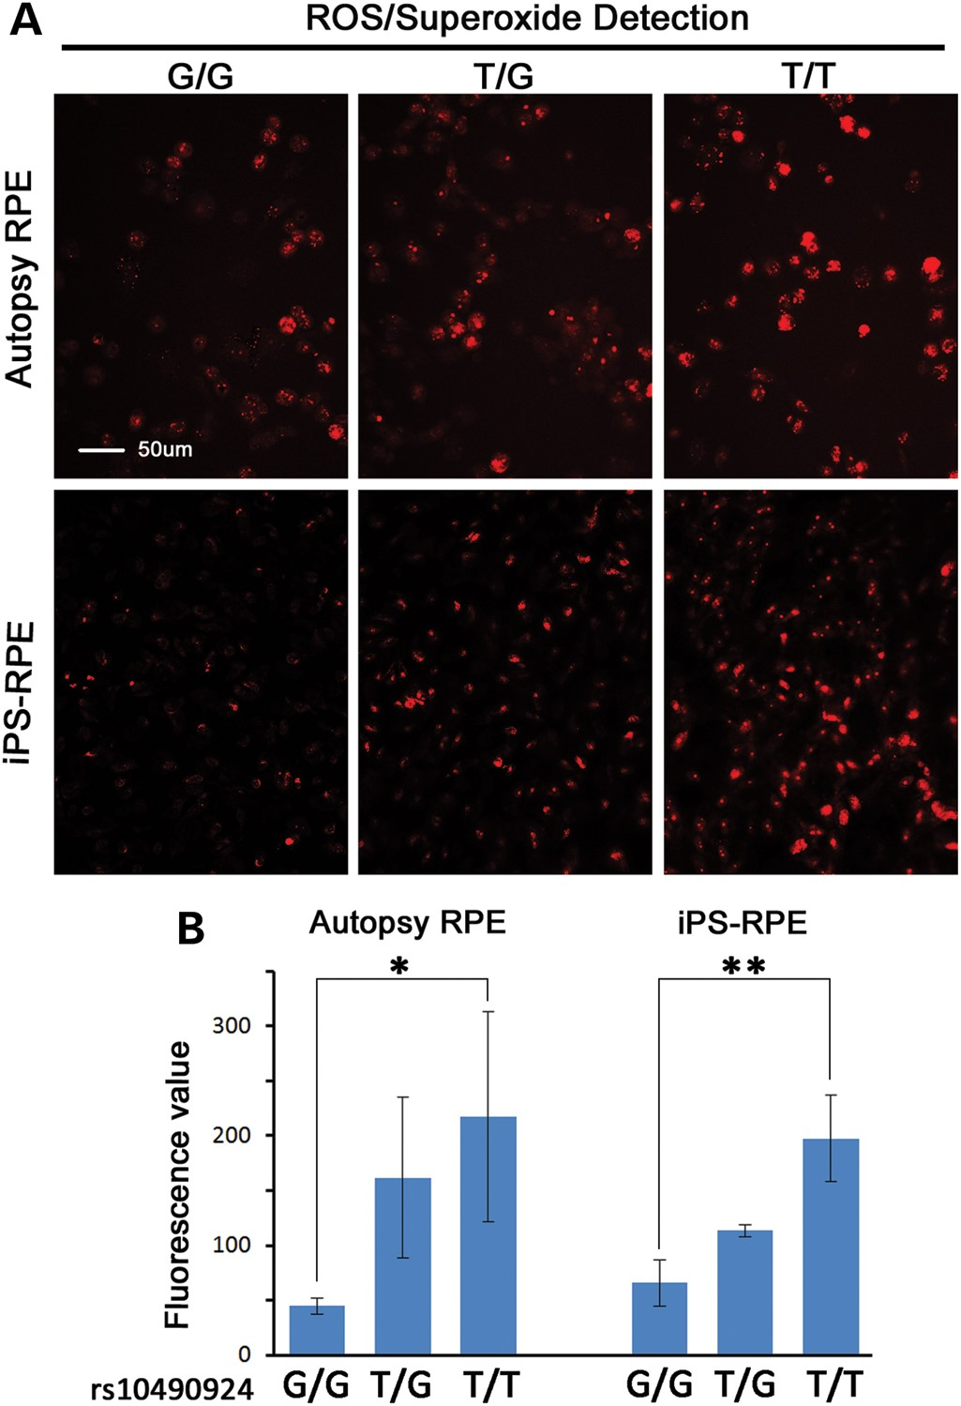
Figure 6. ROS/superoxide levels in cultured human RPE treated with ROS inducer (Pyocyanin) are increased in the ...
Notes:
Figure 6. ROS/superoxide levels in cultured human RPE treated with ROS inducer (Pyocyanin) are increased in the presence of the high-risk allele. (A) Fluorescence microscopy; intensity of red signals proportional to superoxide levels. (B) Quantified fluorescence values in relationship to risk factor genotype. Repeat fluorescence counts for at least three other distinct microscopic fields were obtained and averaged. There was a statistically significant difference in fluorescence values between wild-type (G/G) and homozygote high-risk (T/T) alleles (*P < 0.05; **P < 0.01). This trend is observed in both autopsy and iPSC-derived RPE.
Unless provided in the caption above, the following copyright applies to the content of this slide: © The Author 2014. Published by Oxford University Press. All rights reserved. For Permissions, please email: journals.permissions@oup.com

Slide 7
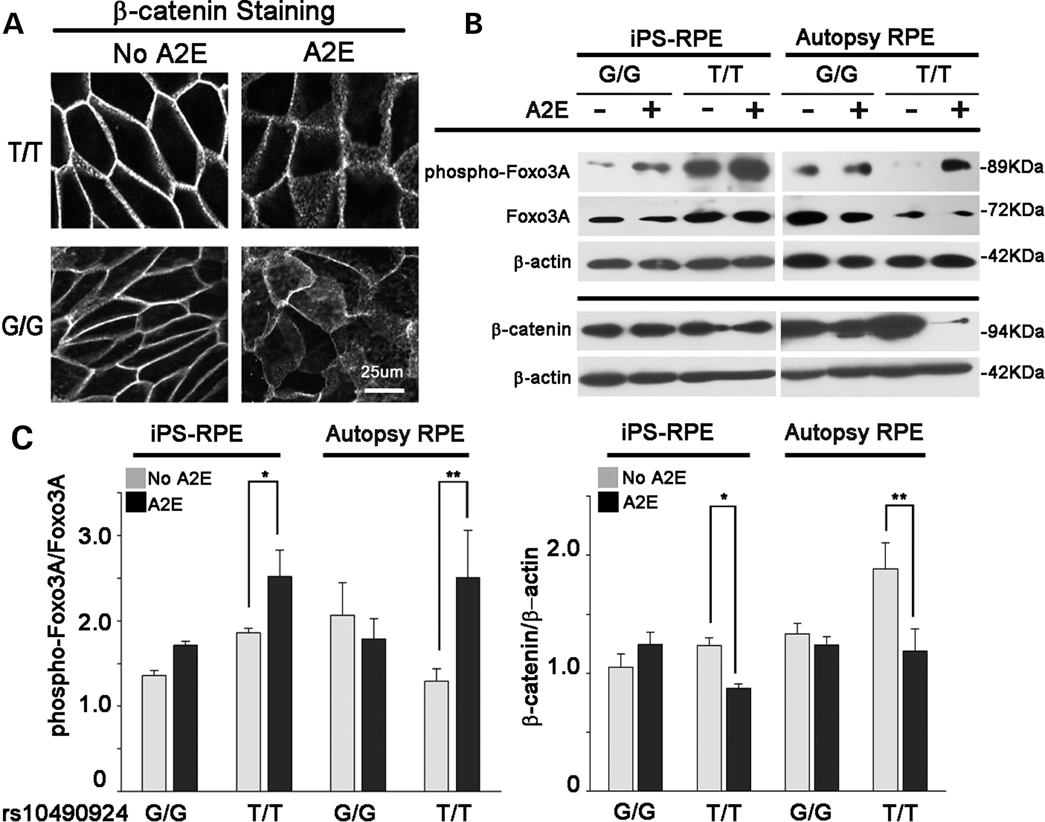
Figure 7. Increased ratios of phospho-FOXO3A to total FOXO3A are accompanied by decreased β-catenin levels in high-risk ...
Notes:
Figure 7. Increased ratios of phospho-FOXO3A to total FOXO3A are accompanied by decreased β-catenin levels in high-risk cell lines. A2E-treated RPE were transferred to RPE media for 20 days before β-catenin morphological and immunofluorescence studies were performed. (A) Confocal images showed translocation of β-catenin from the periphery to the cytoplasm of RPE cells. (B and C) A discernible decrease in β-catenin in both rs10490924 T/T cell lines from iPSC and autopsy can be seen, while phospho-FOXO3A/total FOXO3A protein levels were increased correspondingly. Error bars show SEM for different cell lines and significance was calculated using unpaired and two-tailed t-test analyses (*P < 0.05; **P < 0.01).
Unless provided in the caption above, the following copyright applies to the content of this slide: © The Author 2014. Published by Oxford University Press. All rights reserved. For Permissions, please email: journals.permissions@oup.com

Slide 8
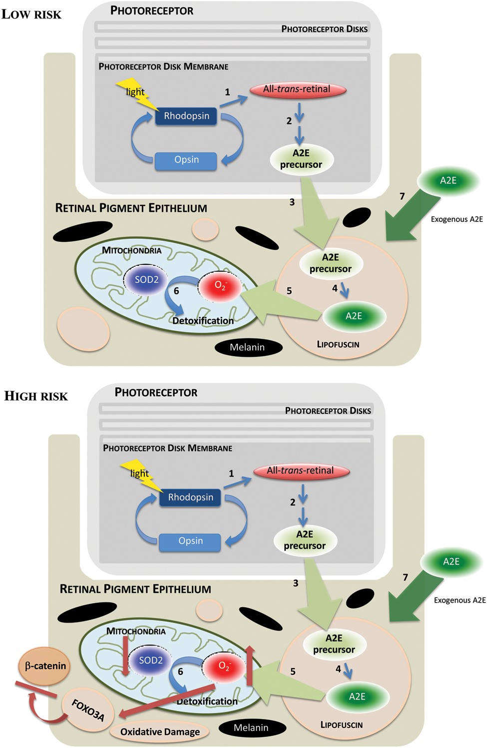
Figure 8. High-risk AMD alleles are associated with diminished SOD2 activity. ATR is generated from the photobleaching ...
Notes:
Figure 8. High-risk AMD alleles are associated with diminished SOD2 activity. ATR is generated from the photobleaching of rhodopsin in the photoreceptor disk membrane (1). A fraction of this ATR undergoes several reactions (2) before releasing an A2E precursor. This A2E precursor is phagocytosed into the RPE cell (3). Cleavage of the A2E precursor in RPE lysosomes releases A2E, which accumulates as a component of lipofuscin (4). A2E photosensitizes the formation of singlet oxygen and superoxide anion (5), and the latter is detoxified in the RPE mitochondria by superoxide dismutase 2 (SOD2) (6). The present study involves accumulation of A2E in RPE cells (7). As the presence of high-risk AMD alleles causes a decrease in SOD2 activity, a rise in ROS will increase oxidative damage. At the same time, ROS-activated FOXO3A can down regulate β-catenin.
Unless provided in the caption above, the following copyright applies to the content of this slide: © The Author 2014. Published by Oxford University Press. All rights reserved. For Permissions, please email: journals.permissions@oup.com

