Slide 1
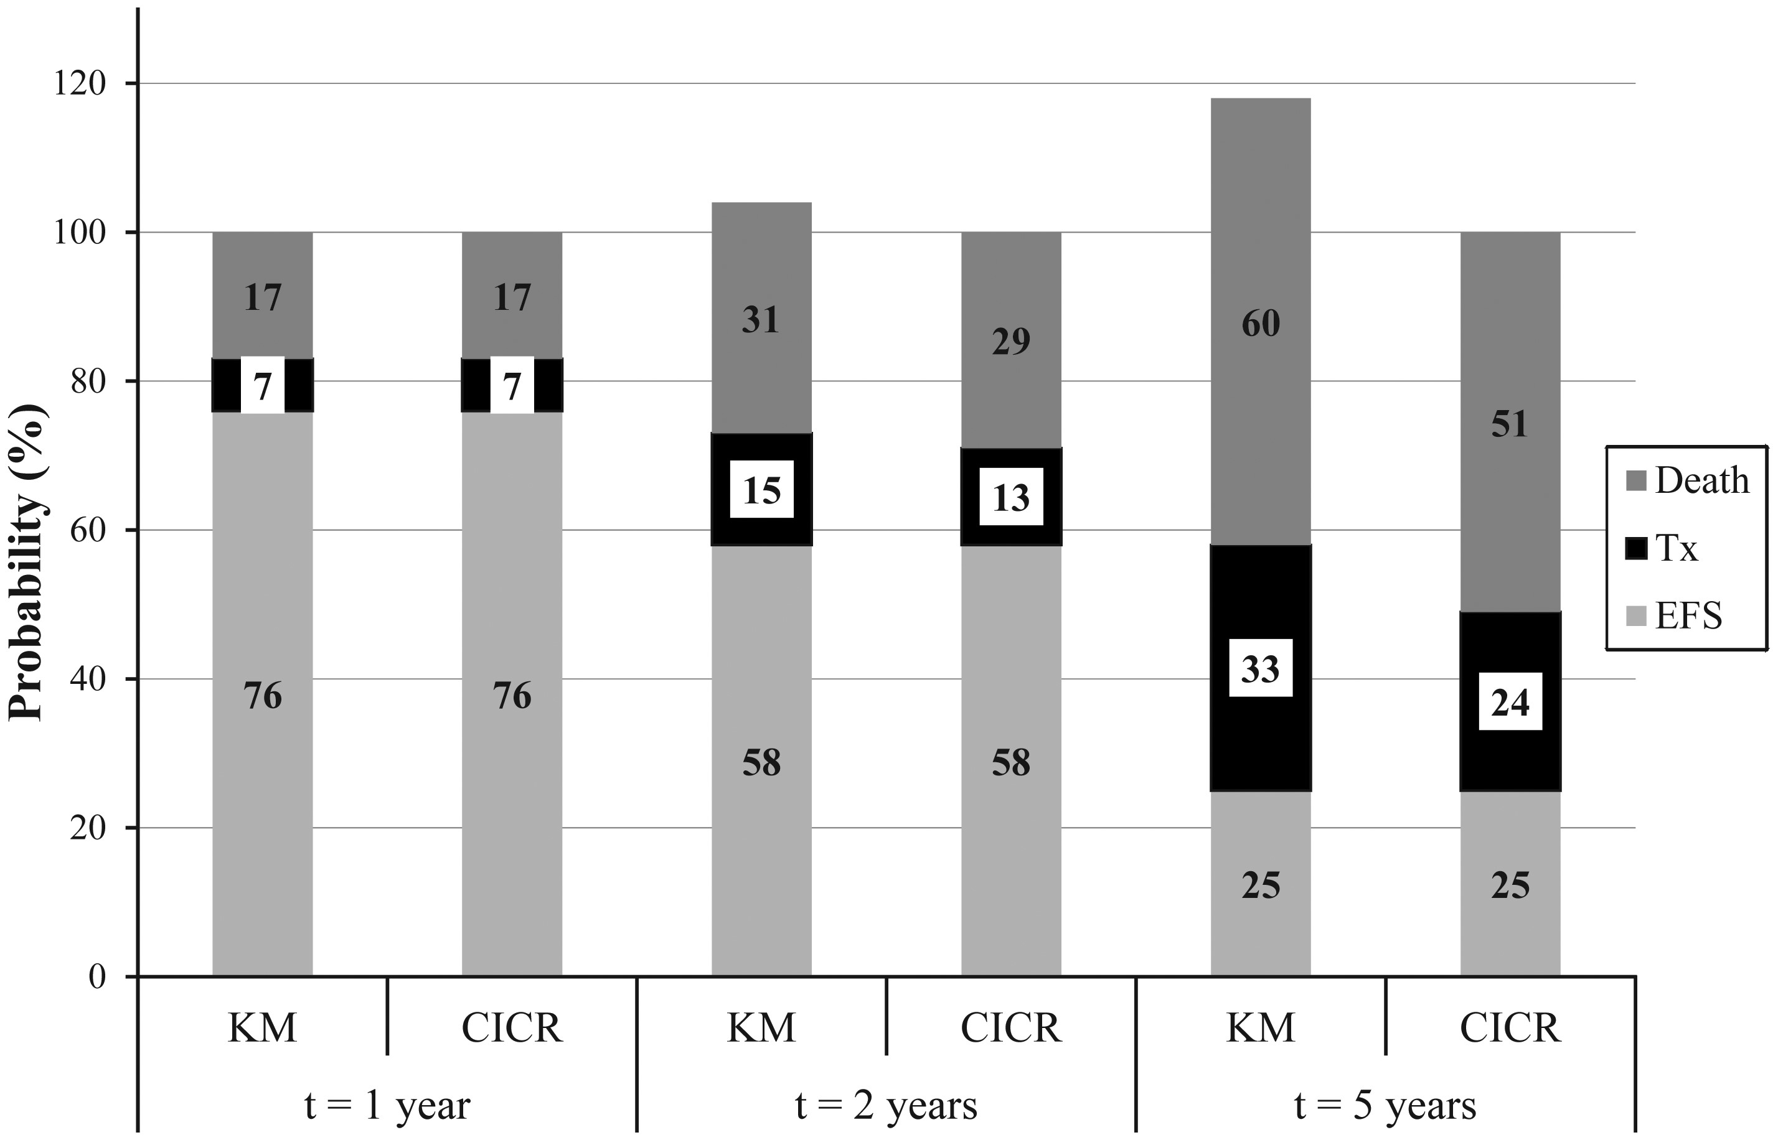
FIGURE 1: Probabilities (in %) of dying (before receiving a transplant) before time t, receiving a transplant (Tx) ...
Notes:
FIGURE 1: Probabilities (in %) of dying (before receiving a transplant) before time t, receiving a transplant (Tx) before time t and being alive and not having received a transplant until time t at t= 1, 2 and 5 years from Day 91 after the start of dialysis using the Kaplan–Meier (KM) and CICR method.
Unless provided in the caption above, the following copyright applies to the content of this slide: © The Author 2013. Published by Oxford University Press on behalf of ERA-EDTA. All rights reserved.

Slide 2
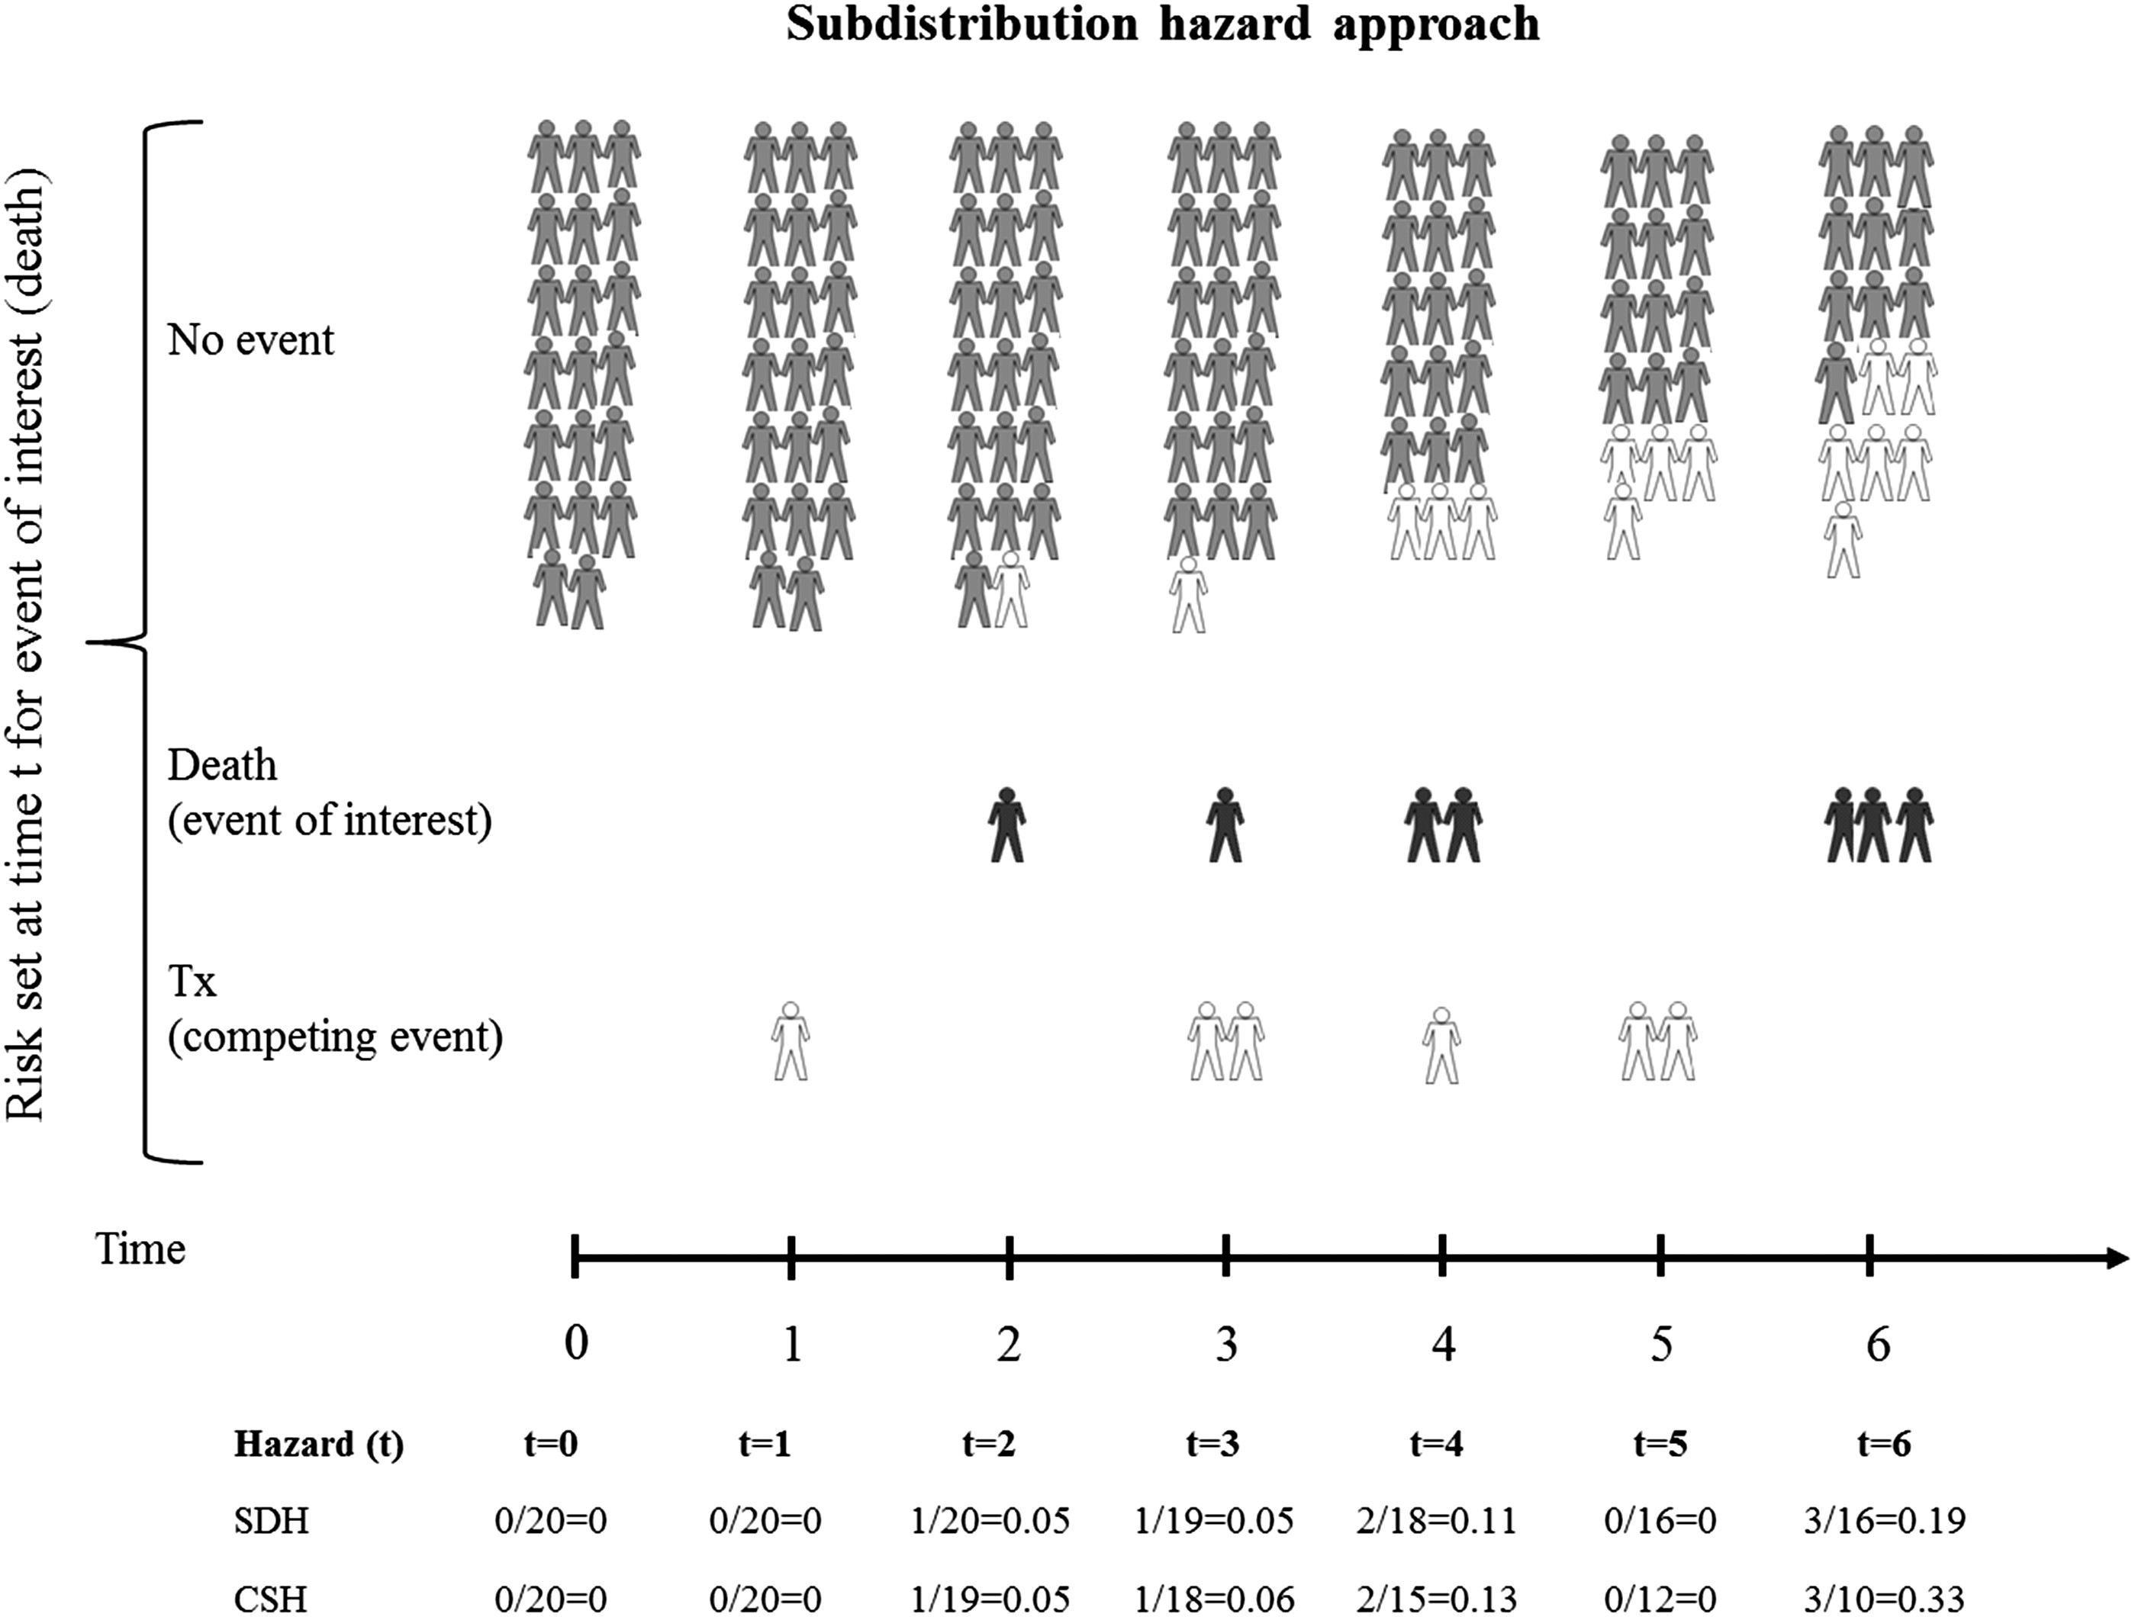
FIGURE 2: Overview of the calculation of the subdistribution hazard: The risk set starts with 20 individuals (grey). ...
Notes:
FIGURE 2: Overview of the calculation of the subdistribution hazard: The risk set starts with 20 individuals (grey). Over time, individuals may experience the event of interest (death, black) or the competing event (transplantation, white) and those having a competing event are maintained in the risk set. Consequently, over time, a greater proportion of the risk set becomes full of individuals who have had the competing event prior to that time. The subdistribution hazard (SDH) for death is given at the bottom of the figure along with the cause-specific hazard (CSH) for death for comparison. Note that, because individuals are maintained in the risk set, the SDH of the event of interest tends to be lower than the CSH (adapted from Lau et al. [6]).
Unless provided in the caption above, the following copyright applies to the content of this slide: © The Author 2013. Published by Oxford University Press on behalf of ERA-EDTA. All rights reserved.

Slide 3
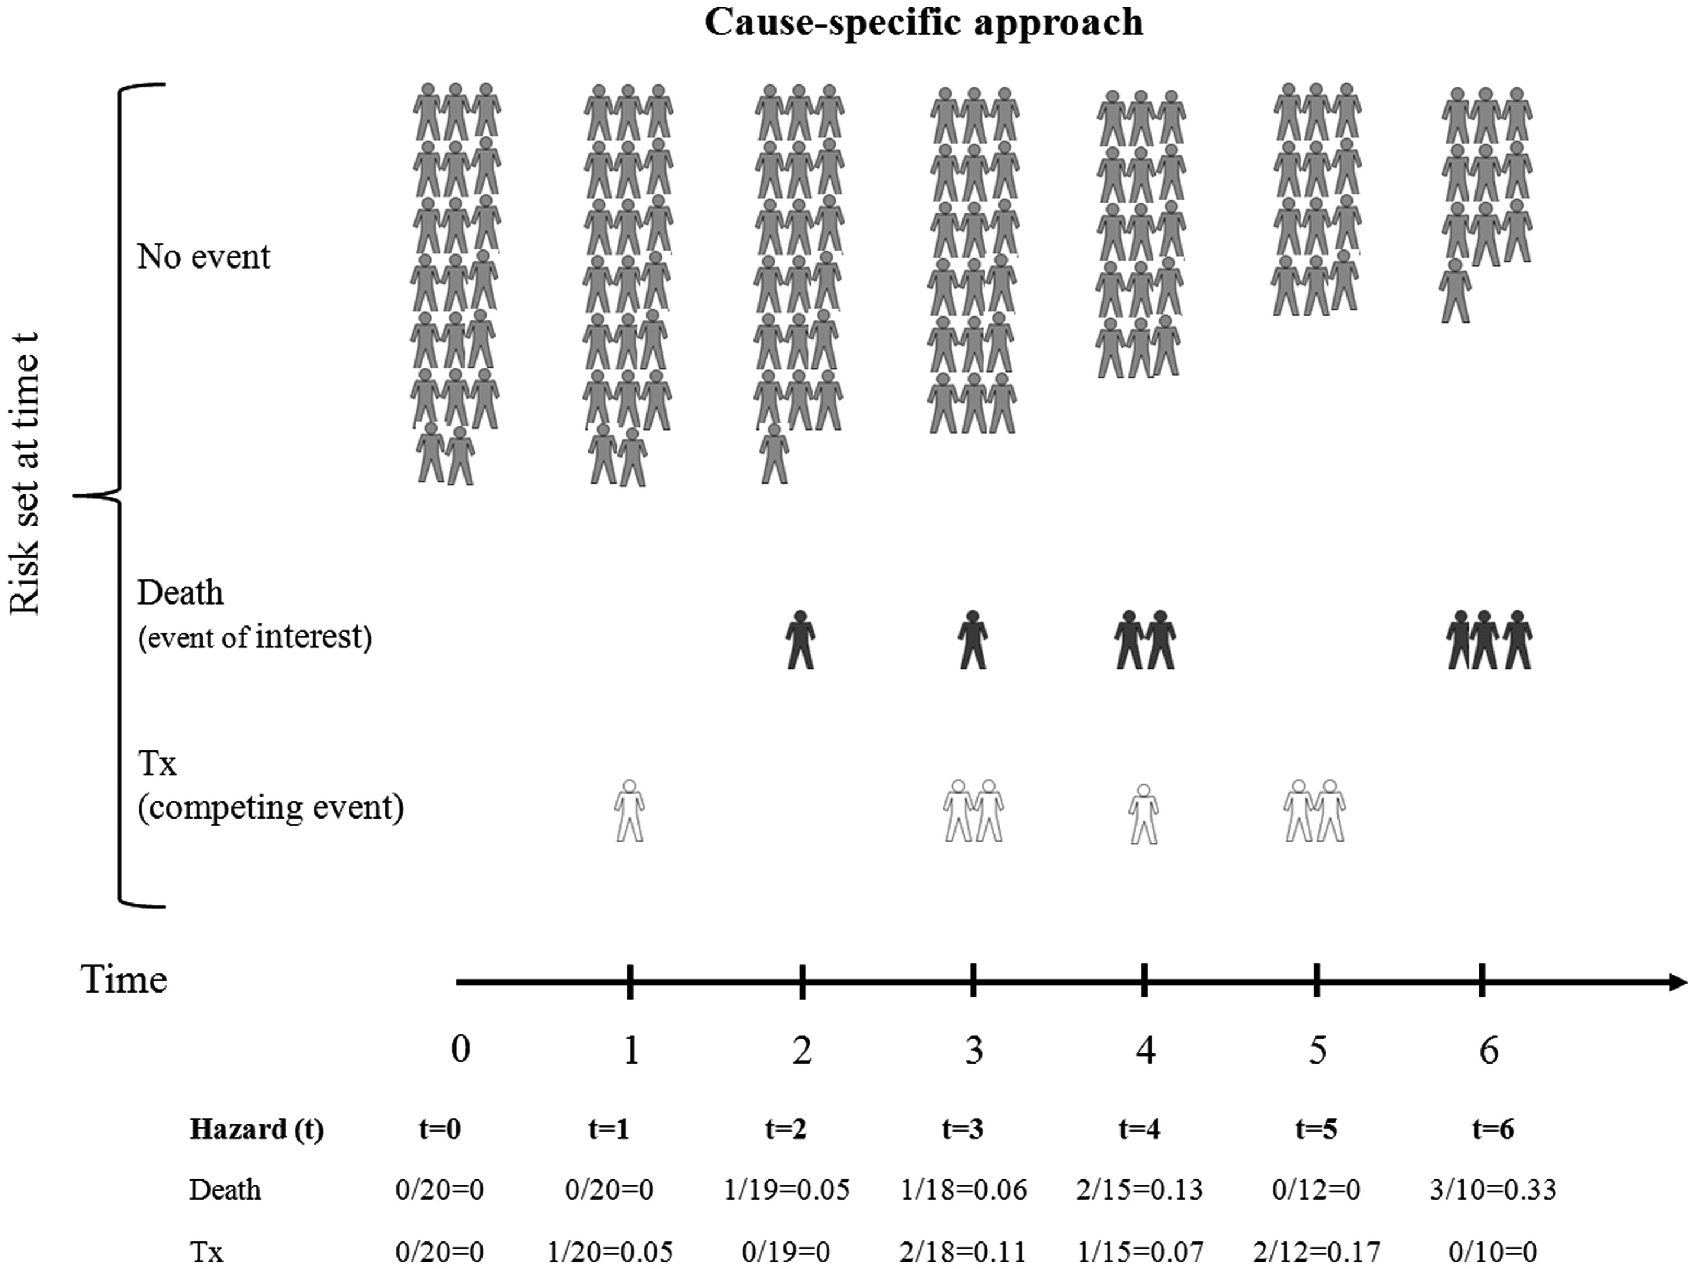
FIGURE 3: Overview of the calculation of the cause-specific hazard: The risk set starts with 20 individuals (grey). ...
Notes:
FIGURE 3: Overview of the calculation of the cause-specific hazard: The risk set starts with 20 individuals (grey). Over time, individuals have either the event of interest (death, black) or the competing event (transplantation, white). As individuals have either event, they are removed from the remaining risk sets. The calculation for the cause-specific hazard for both events is given at the bottom of the figure (adapted from Lau et al. [6]).
Unless provided in the caption above, the following copyright applies to the content of this slide: © The Author 2013. Published by Oxford University Press on behalf of ERA-EDTA. All rights reserved.

