Slide 1
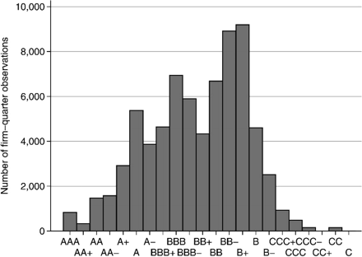
Figure 1 Distribution of Issuer Credit Ratings This figure shows the distribution of S&P domestic long-term issuer ...
Notes:
Figure 1 Distribution of Issuer Credit Ratings This figure shows the distribution of S&P domestic long-term issuer credit rating for firms in the quarterly CRSP/Compustat merged data set, excluding financials and utilities. The sample period is 1986 Q1-2010 Q4.
Unless provided in the caption above, the following copyright applies to the content of this slide: © The Author 2011. Published by Oxford University Press on behalf of The Society for Financial Studies. All rights reserved. For Permissions, please e-mail: journals.permissions@oup.com.

Slide 2
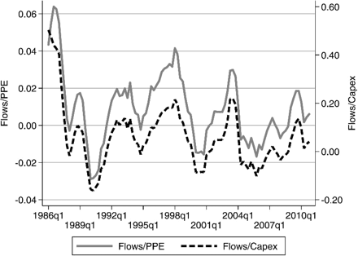
Figure 2 High-Yield Mutual Fund Flows relative to PPE and Capex of BBB and BB Firms This figure shows the time series ...
Notes:
Figure 2 High-Yield Mutual Fund Flows relative to PPE and Capex of BBB and BB Firms This figure shows the time series of flows into high-yield mutual funds. Monthly aggregate flows into high-yield mutual funds are from the Investment Company Institute. Cumulative high-yield fund flows calculated over four quarters are scaled by either total PPE or cumulative capital expenditures over four quarters of CRSP/Compustat firms rated BBB+ through BB−, excluding financials and utilities. The sample period is 1986 Q1-2010 Q4.
Unless provided in the caption above, the following copyright applies to the content of this slide: © The Author 2011. Published by Oxford University Press on behalf of The Society for Financial Studies. All rights reserved. For Permissions, please e-mail: journals.permissions@oup.com.

