Slide 1
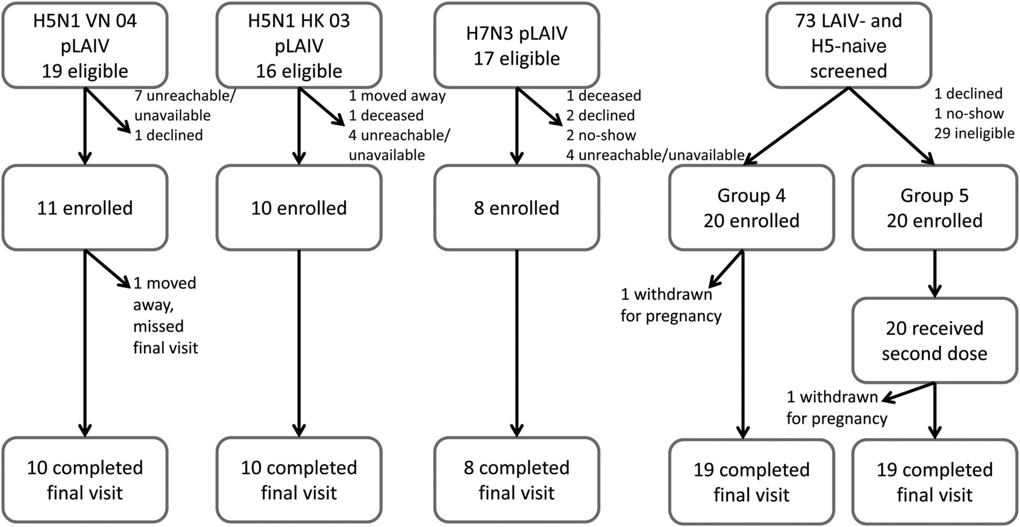
Figure 1. Study design. Abbreviations: H5, influenza A(H5N1); H5N1, influenza A(H5N1); H7N3, influenza A(H7N3); LAIV, ...
Notes:
Figure 1. Study design. Abbreviations: H5, influenza A(H5N1); H5N1, influenza A(H5N1); H7N3, influenza A(H7N3); LAIV, live attenuated influenza vaccine.
Unless provided in the caption above, the following copyright applies to the content of this slide: Published by Oxford University Press on behalf of the Infectious Diseases Society of America 2014. This work is written by (a) US Government employee(s) and is in the public domain in the US.

Slide 2
Figure 2. A, Kinetics of the hemagglutination inhibition (HAI) antibody response following vaccination with influenza ...
Notes:
Figure 2. A, Kinetics of the hemagglutination inhibition (HAI) antibody response following vaccination with influenza A(H5N1) inactivated subvirion influenza vaccine (ISIV) in individuals primed with influenza A(H5N1) pandemic live attenuated influenza vaccine (pLAIV), in those primed with influenza A(H7N3) pLAIV, or in LAIV-naive individuals. HAI assay–based reciprocal geometric mean titers (GMTs) to wild-type A/VietNam/1203/2004(H5N1), using horse red blood cells. Dotted line indicates a HAI assay–based GMT of 1:40. Groups are represented by the following symbols: filled circle, group 1 (influenza A[H5N1] VN 04 pLAIV); square, group 2 (influenza A[H5N1] HK 03 pLAIV); triangle, group 3 (influenza A[H7N3] pLAIV); open circle, group 4 (single dose of influenza A[H5N1] ISIV); and X, group 5 (2 doses of influenza A[H5N1] ISIV). B, Influenza A(H5N1) pLAIV primes for a rapid antibody response to influenza A(H5N1) ISIV. Reverse cumulative frequency distribution of HAI titers for subjects in group 1 (primed with influenza A[H5N1] VN 2004 pLAIV) on day 7 after receipt of ISIV. C, Reverse cumulative frequency distribution of HAI titers from subjects in groups 1, 2, 4, and 5 on day 28 after receipt of the last dose of ISIV. Groups are represented by the following symbols: filled circle, group 1 (influenza A[H5N1] VN 04 pLAIV); square, group 2 (influenza A[H5N1] HK 03 pLAIV); open circle, group 4 (1 dose of ISIV); and X, group 5 (2 doses of influenza A[H5N1] ISIV).
Unless provided in the caption above, the following copyright applies to the content of this slide: Published by Oxford University Press on behalf of the Infectious Diseases Society of America 2014. This work is written by (a) US Government employee(s) and is in the public domain in the US.

Slide 3
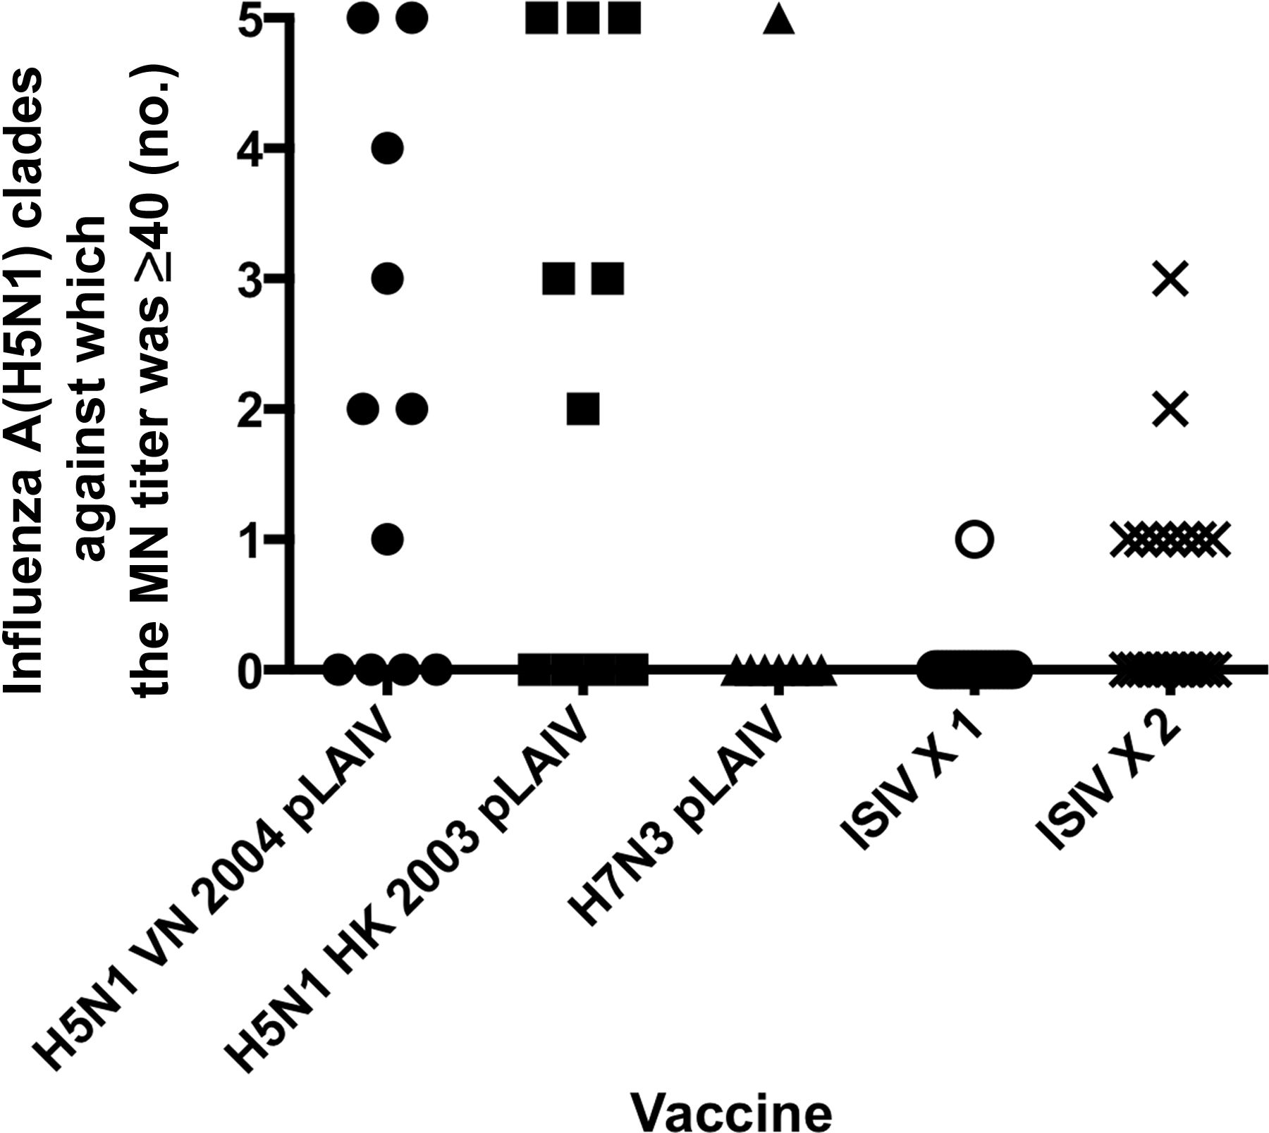
Figure 3. Influenza A(H5N1) pandemic live attenuated influenza vaccine (pLAIV) priming elicits neutralizing antibodies ...
Notes:
Figure 3. Influenza A(H5N1) pandemic live attenuated influenza vaccine (pLAIV) priming elicits neutralizing antibodies that show broad cross-reactivity against influenza A(H5N1) from antigenically distinct clades. The proportion of subjects from each group with a reciprocal microneutralization (MN) titer of ≥40 against any one of 5 influenza A(H5N1) viruses from 4 antigenically distinct clades of the Gs/gd lineage. MN assay was performed using reverse genetics–derived PR8 reassortant viruses bearing the hemagglutinin from the following viruses: A/VietNam/1203/2004 (clade 1), A/Indonesia/5/2005 (clade 2.1.3), A/Anhui/1/05 (clade 2.3.4), A/turkey/Turkey/1/05 (clade 2.2.1), and A/Egypt/3072/2101 (clade 2.2.1). Groups are represented by the following symbols: filled circle, group 1 (influenza A[H5N1] VN 04 pLAIV); square, group 2 (influenza A[H5N1] HK 03 pLAIV); triangle, group 3 (influenza A[H7N3] pLAIV); open circle, group 4 (single dose of influenza A[H5N1] inactivated subvirion influenza vaccine [ISIV]); and X, group 5 (2 doses of influenza A[H5N1] ISIV).
Unless provided in the caption above, the following copyright applies to the content of this slide: Published by Oxford University Press on behalf of the Infectious Diseases Society of America 2014. This work is written by (a) US Government employee(s) and is in the public domain in the US.

Slide 4
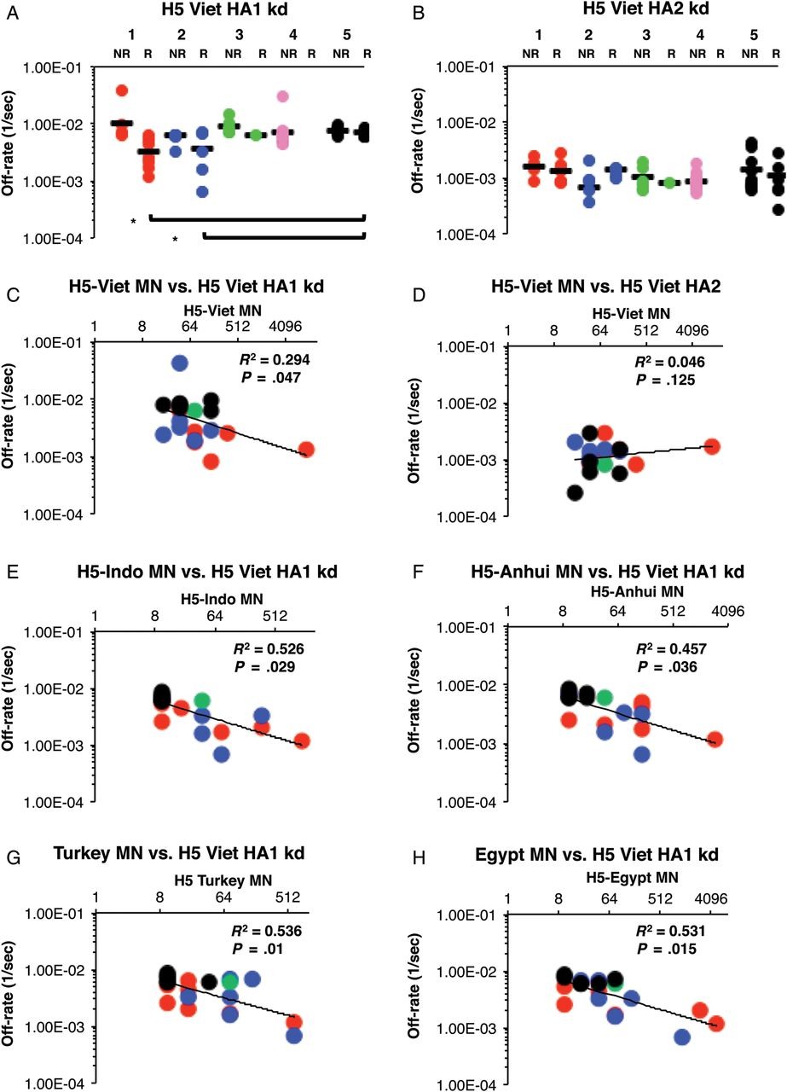
Figure 4. A and B, Live attenuated influenza vaccine (LAIV) priming enhances antibody affinity (slower off-rates) to ...
Notes:
Figure 4. A and B, Live attenuated influenza vaccine (LAIV) priming enhances antibody affinity (slower off-rates) to influenza A(H5N1) hemagglutinin polypeptide 1 (HA1; but not HA2). Surface plasmon resonance (SPR) analysis of postvaccination sera from all responders (R; MN ≥1:40) and nonresponders (NR; MN <1:40) from all 5 study groups was performed with properly folded functional oligomeric influenza A(H5N1) rHA1 (A) and rHA2 (B) domains from influenza A/VN/1203/2004. Antibody off-rate constants that describe the fraction of antibody-antigen complexes decaying per second were determined directly from the serum sample interaction with rHA1 (1–330) protein and rHA2 (331–480), using surface plasmon resonance in the dissociation phase. Serum antibody off-rate constants (each symbol represents 1 individual) were determined as described in Materials and Methods. Differences in mean off-rate constants were statistically significant between different vaccine groups, with a P value of < .05 (by the t test). The off-rate constants were determined from 2 independent SPR runs. Groups are represented by the colored circles as follows: group 1, red (influenza A[H5N1] VN 04 pLAIV); group 2, blue (influenza A[H5N1] HK 03 pLAIV); group 3, green (influenza A[H7N3] pLAIV); group 4, pink (single dose of influenza A[H5N1] inactivated subvirion influenza vaccine [ISIV]); and group 5, black (2 doses of influenza A[H5N1] ISIV). C–H, Serum antibody off-rate to VN04 rHA1 (but not rHA2) in influenza A(H5N1) pLAIV–primed individuals correlates with the in vitro neutralizing capacity against the homologous and heterologous influenza A(H5N1) from different clades. Neutralizing titer is expressed as the standardized end-point neutralizing antibody titer of sera obtained after vaccination. Serum antibody off-rate constants (each symbol represents 1 individual) of responders against rHA1 (C); but not rHA2 (D) of VN04 correlated with the in vitro homologous neutralizing influenza A(H5N1) capacity as determined by MN titers. E–H, Antibody affinity of responders against VN04 rHA1 correlated strongly with heterologous cross-neutralizing titers against A/Indonesia/5/2005 (clade 2.1.3; E), A/Anhui/1/05 (clade 2.3.4; F), A/turkey/Turkey/1/05 (clade 2.2.1; G), and A/Egypt/3072/2101 (clade 2.2.1; H). Responders in each group are represented by the colored circles as follows: group 1, red (influenza A[H5N1] VN 04 pLAIV); group 2, blue (influenza A[H5N1] HK 03 pLAIV); group 3, green (influenza A[H7N3] pLAIV); group 4, pink (single dose of influenza A[H5N1] ISIV); group 5, black (2 doses of influenza A[H5N1] ISIV).
Unless provided in the caption above, the following copyright applies to the content of this slide: Published by Oxford University Press on behalf of the Infectious Diseases Society of America 2014. This work is written by (a) US Government employee(s) and is in the public domain in the US.

