Slide 1
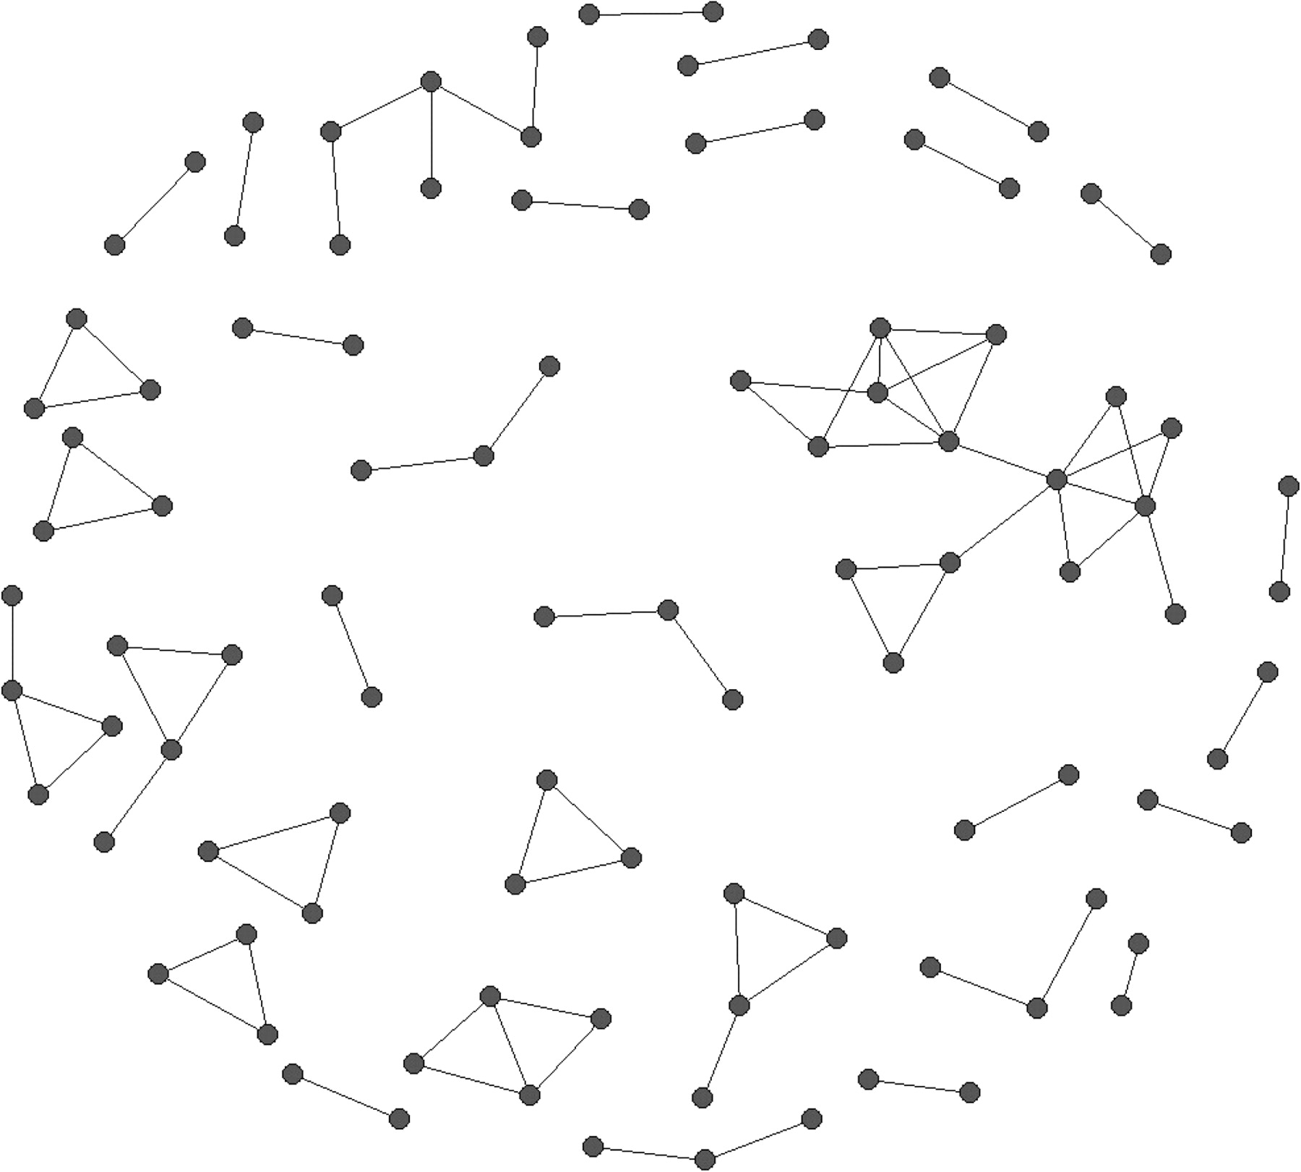
Fig. 1. Network configuration of black men who have sex with men (n = 100, 86 dyads).
Notes:
Fig. 1. Network configuration of black men who have sex with men (n = 100, 86 dyads).
Unless provided in the caption above, the following copyright applies to the content of this slide: © The Author 2008. Published by Oxford University Press. All rights reserved. For permissions, please email: journals.permissions@oxfordjournals.org

