Slide 1
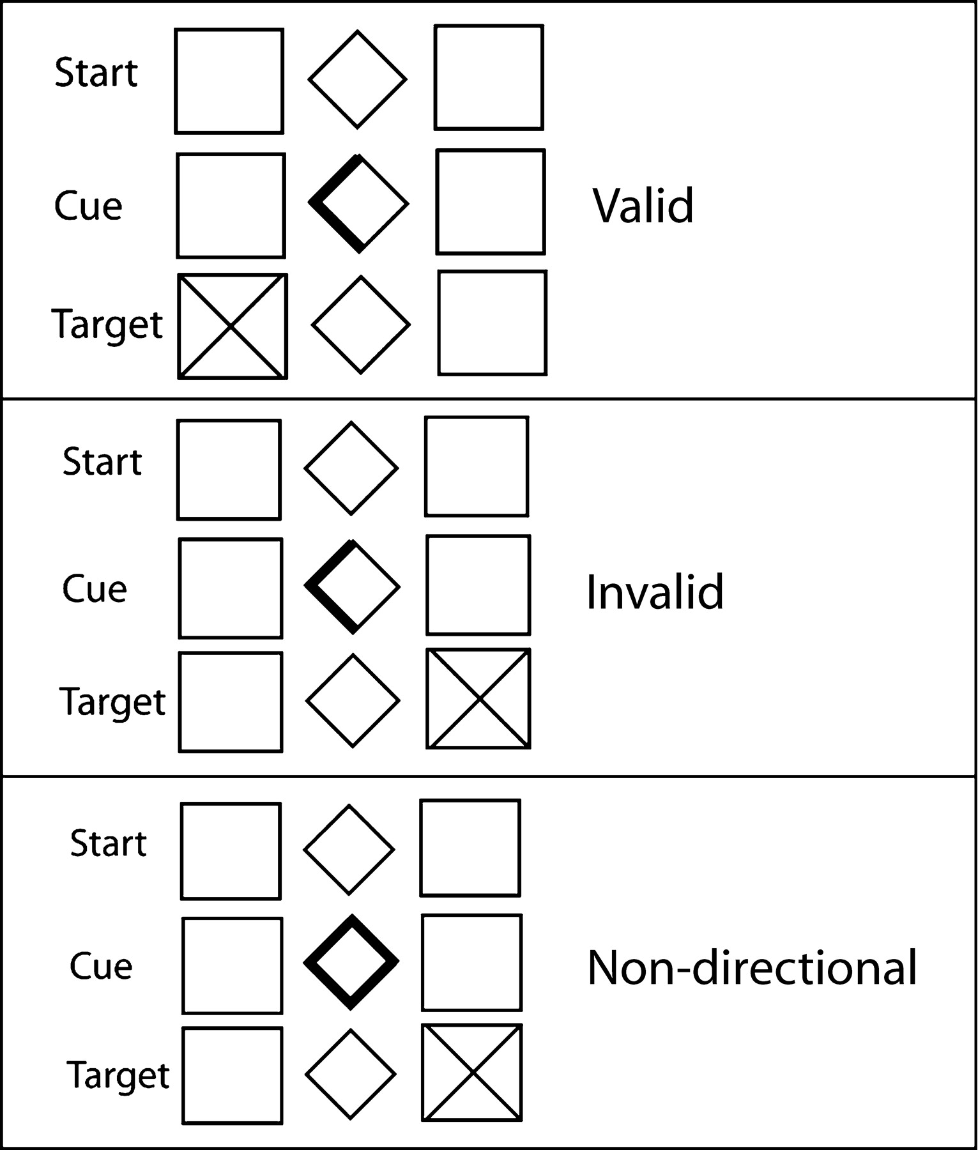
Figure 1. Paradigm.
Notes:
Figure 1. Paradigm.
Unless provided in the caption above, the following copyright applies to the content of this slide: © The Author 2005. Published by Oxford University Press. All rights reserved. For permissions, please e-mail: journals.permissions@oupjournals.org

Slide 2
Figure 2. (A) Mean reaction time (RT) for each trial in each condition. ND = non-directional trials. (B) Mean ...
Notes:
Figure 2. (A) Mean reaction time (RT) for each trial in each condition. ND = non-directional trials. (B) Mean difference in RT to non-directional cues in the NEUTRAL condition compared to the averaged RT to valid and invalid cues in NEUTRAL, WIN and LOSE. Error bars represent the standard error of the mean.
Unless provided in the caption above, the following copyright applies to the content of this slide: © The Author 2005. Published by Oxford University Press. All rights reserved. For permissions, please e-mail: journals.permissions@oupjournals.org

Slide 3
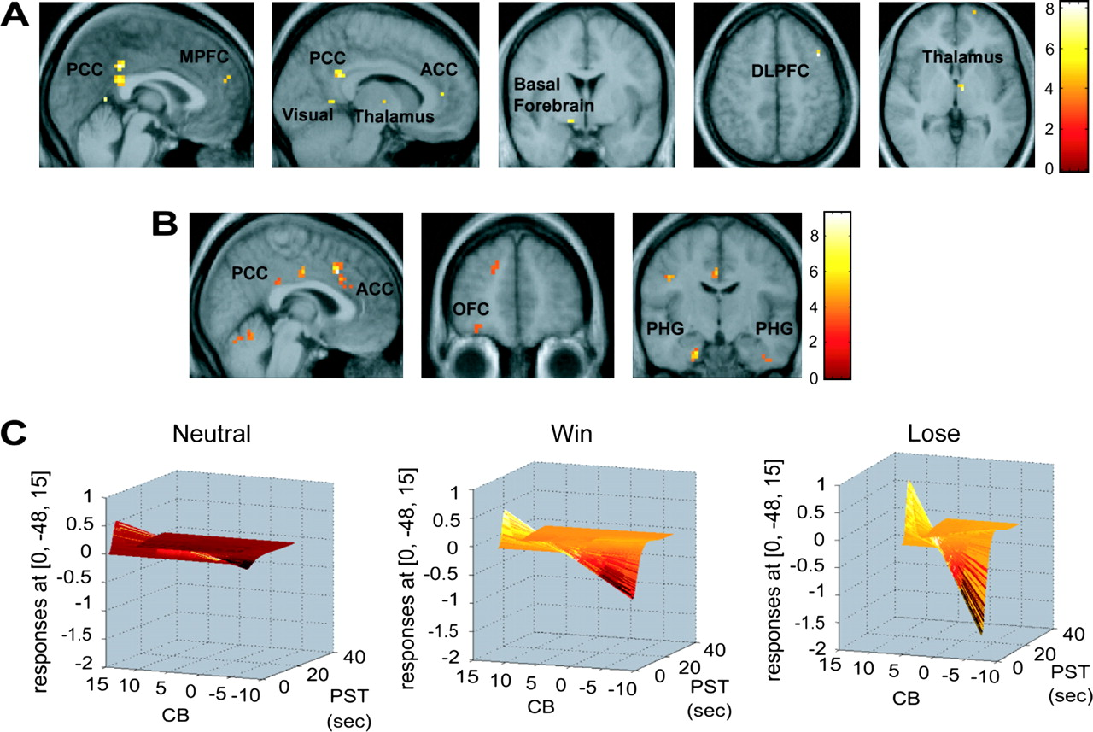
Figure 3. Visual spatial expectancy. (A) Images from the group random effects analysis of the regression of cue benefit ...
Notes:
Figure 3. Visual spatial expectancy. (A) Images from the group random effects analysis of the regression of cue benefit score across the whole brain in all three conditions (WIN, LOSE and NEUTRAL). Peaks labeled are reported in Table 2. The images are thresholded at P < 0.001 uncorrected. Top sagittal sections showing activity in the anterior and posterior cingulate cortex (ACC and PCC), medial prefrontal cortex (MPFC), visual cortex (Vis) and thalamus (Thal); coronal section below displays basal forebrain (BF) activity and axial sections show dorsolateral prefrontal cortex activity (DLPFC); and thalamic peak. Color bars represent t-values. (B) Images from the group random effects analysis showing regions with a greater relationship to the cue benefit score in the WIN and LOSE conditions compared to the neutral condition. The images are thresholded at P < 0.005. From left to right: saggital section showing enhanced activation in the cingulate cortex, coronal section showing orbitofrontal cortex (OFC) activity and coronal section displaying bilateral parahippocampal gyrus (PHG) peaks. The color bar represents t-values. (C) Graphs of the cue benefit score (CB) (z-axis; scale ranging from −10 to 10), plotted against fMRI signal in the same region of the posterior cingulate cortex (y axis; scale ranging from 1 to −2) as a function of peristimulus time (PST) (x-axis; scale ranging from 0 to 40 s) in the three conditions (WIN, LOSE and NEUTRAL) in a representative subject. The color-coding is added only to facilitate viewing depth.
Unless provided in the caption above, the following copyright applies to the content of this slide: © The Author 2005. Published by Oxford University Press. All rights reserved. For permissions, please e-mail: journals.permissions@oupjournals.org

Slide 4
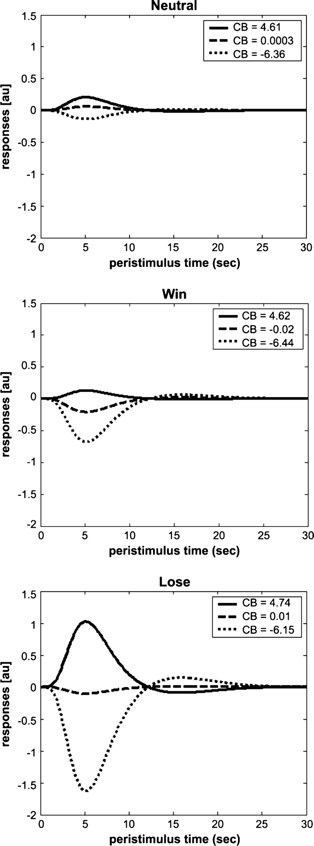
Figure 4. Fitted response in the posterior cingulate cortex at three levels of cue benefit. Graphs show the response in ...
Notes:
Figure 4. Fitted response in the posterior cingulate cortex at three levels of cue benefit. Graphs show the response in the posterior cingulate cortex (PCC) at three levels of cue benefit (CB) score for the NEUTRAL (top), WIN (middle) and LOSE (bottom) conditions in a representative subject. y-axis = response in arbitrary units (au). x-axis = peristimulus time in s. The degree to which the response varies as a function of CB score depends upon the incentive condition.
Unless provided in the caption above, the following copyright applies to the content of this slide: © The Author 2005. Published by Oxford University Press. All rights reserved. For permissions, please e-mail: journals.permissions@oupjournals.org

Slide 5
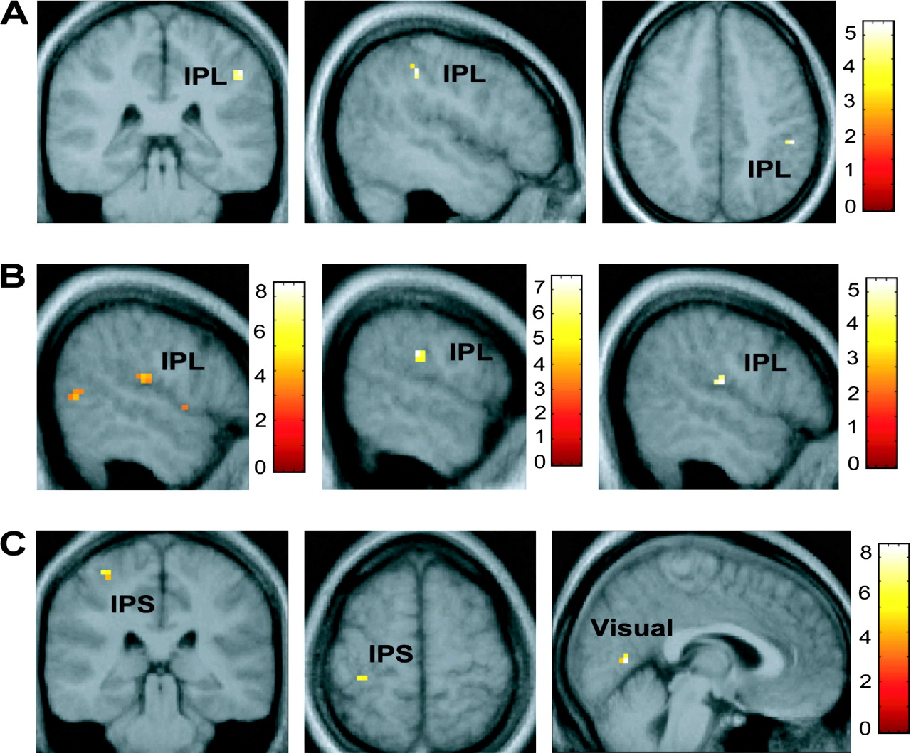
Figure 5. Visual spatial disengagement. (A) Images showing the inferior parietal lobule (IPL) regression with the cue ...
Notes:
Figure 5. Visual spatial disengagement. (A) Images showing the inferior parietal lobule (IPL) regression with the cue cost score (disengagement) collapsed across all three conditions (WIN, LOSE and NEUTRAL) in the group random effects analysis thresholded at P < 0.001. (B) From left to right, regression CCs with BOLD signal showing activations in the inferior parietal lobule in WIN + LOSE − NEUTRAL (thresholded at P < 0.005), WIN − NEUTRAL (threshold at P = 0.001), and LOSE − NEUTRAL (threshold at P < 0.001) conditions. (C) Activation in the intraparietal sulcus (IPS), and visual cortex in WIN + LOSE − NEUTRAL. Color bars represent t-values.
Unless provided in the caption above, the following copyright applies to the content of this slide: © The Author 2005. Published by Oxford University Press. All rights reserved. For permissions, please e-mail: journals.permissions@oupjournals.org

Slide 6
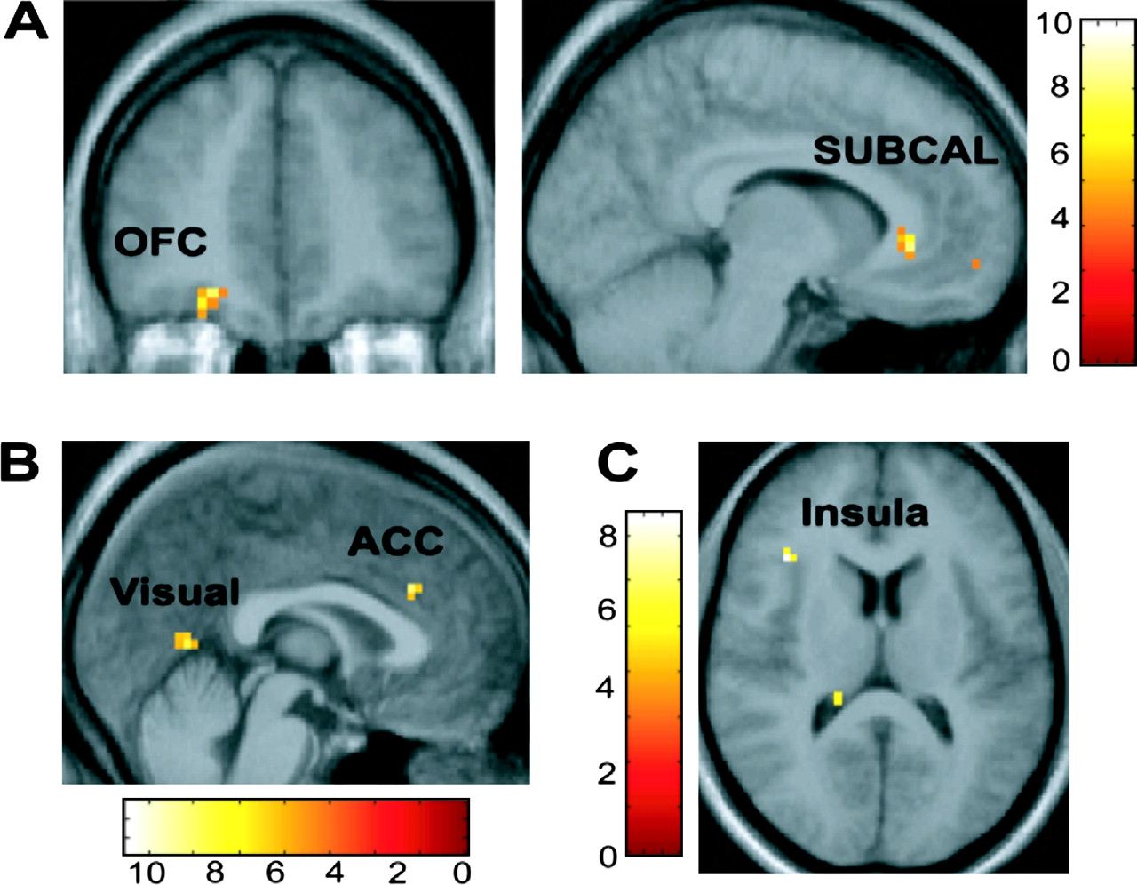
Figure 6. Valence-specific attentional modulatory effects. (A) From left to right: coronal and sagittal images depict ...
Notes:
Figure 6. Valence-specific attentional modulatory effects. (A) From left to right: coronal and sagittal images depict activation in the orbitofrontal cortex (OFC) and subcallosal region (SUBCAL) preferentially associated with degree of visual bias (indexed by the comparison of the regression of WIN > LOSE with the cue benefit score -CBs) during the possibility of winning compared to losing money. (B) Sagittal section showing activation in the dorsal anterior cingulate cortex and visual cortex preferentially associated with degree of visual bias (indexed by the comparison of the regression of LOSE > WIN with the CBs) during the possibility of losing compared to wining money. (C) Axial section showing activity in the insula preferentially associated with the degree of disengagement (as indexed by a comparison of the regression of LOSE > WIN with the cue cost score CCs). All images thresholded at P < 0.001. Color bars represent t-values.
Unless provided in the caption above, the following copyright applies to the content of this slide: © The Author 2005. Published by Oxford University Press. All rights reserved. For permissions, please e-mail: journals.permissions@oupjournals.org

