Slide 1
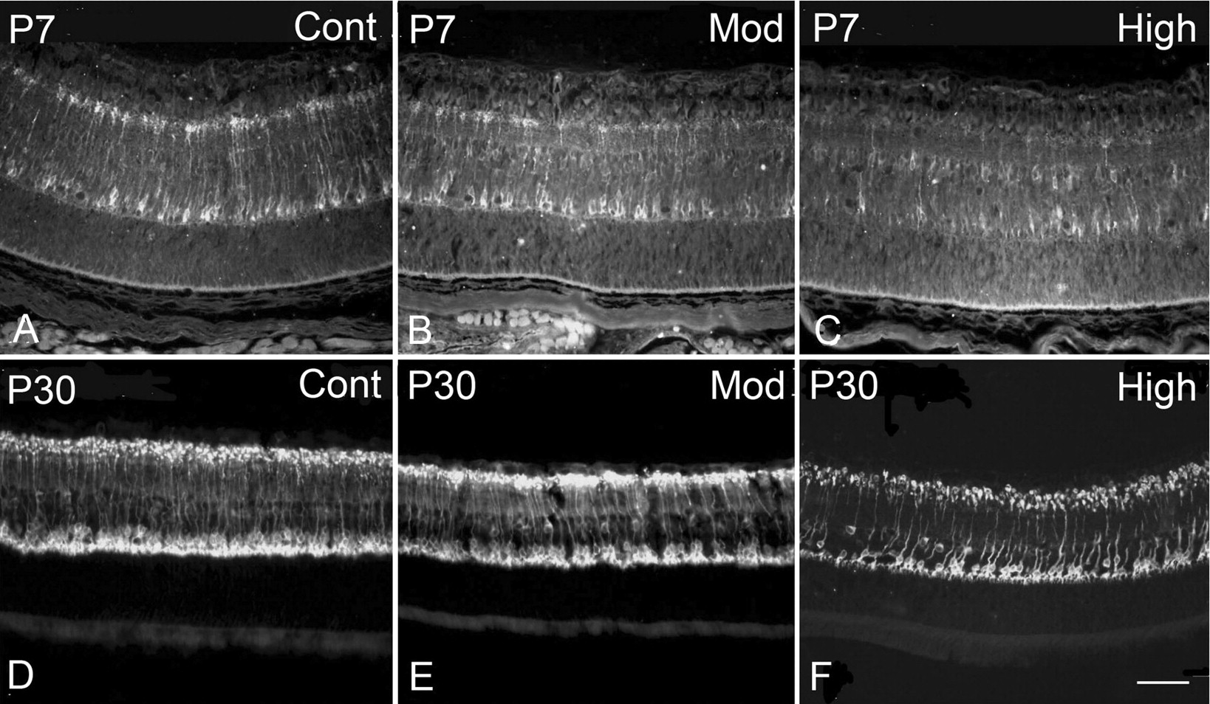
Fig. 1. The effects of PAE on the development of retinal bipolar cells (PKC-α immunofluorescent labeling). (A–C) show ...
Notes:
Fig. 1. The effects of PAE on the development of retinal bipolar cells (PKC-α immunofluorescent labeling). (A–C) show the alterations of bipolar cells of different treatment groups at P7, and (D–F) reveal the alterations of bipolar cells of different treatment groups at P30. A comparison of the different treatment groups of the same age (either P7 or P30) indicates that alcohol induced a decrease in the number of bipolar cells in a dose-dependent manner. Cont, control group; High, high-dose EtOH group; Mod, moderate-does EtOH group. Scale bar = 40 μm in A–F.
Unless provided in the caption above, the following copyright applies to the content of this slide: © The Author 2012. Medical Council on Alcohol and Oxford University Press. All rights reserved

Slide 2
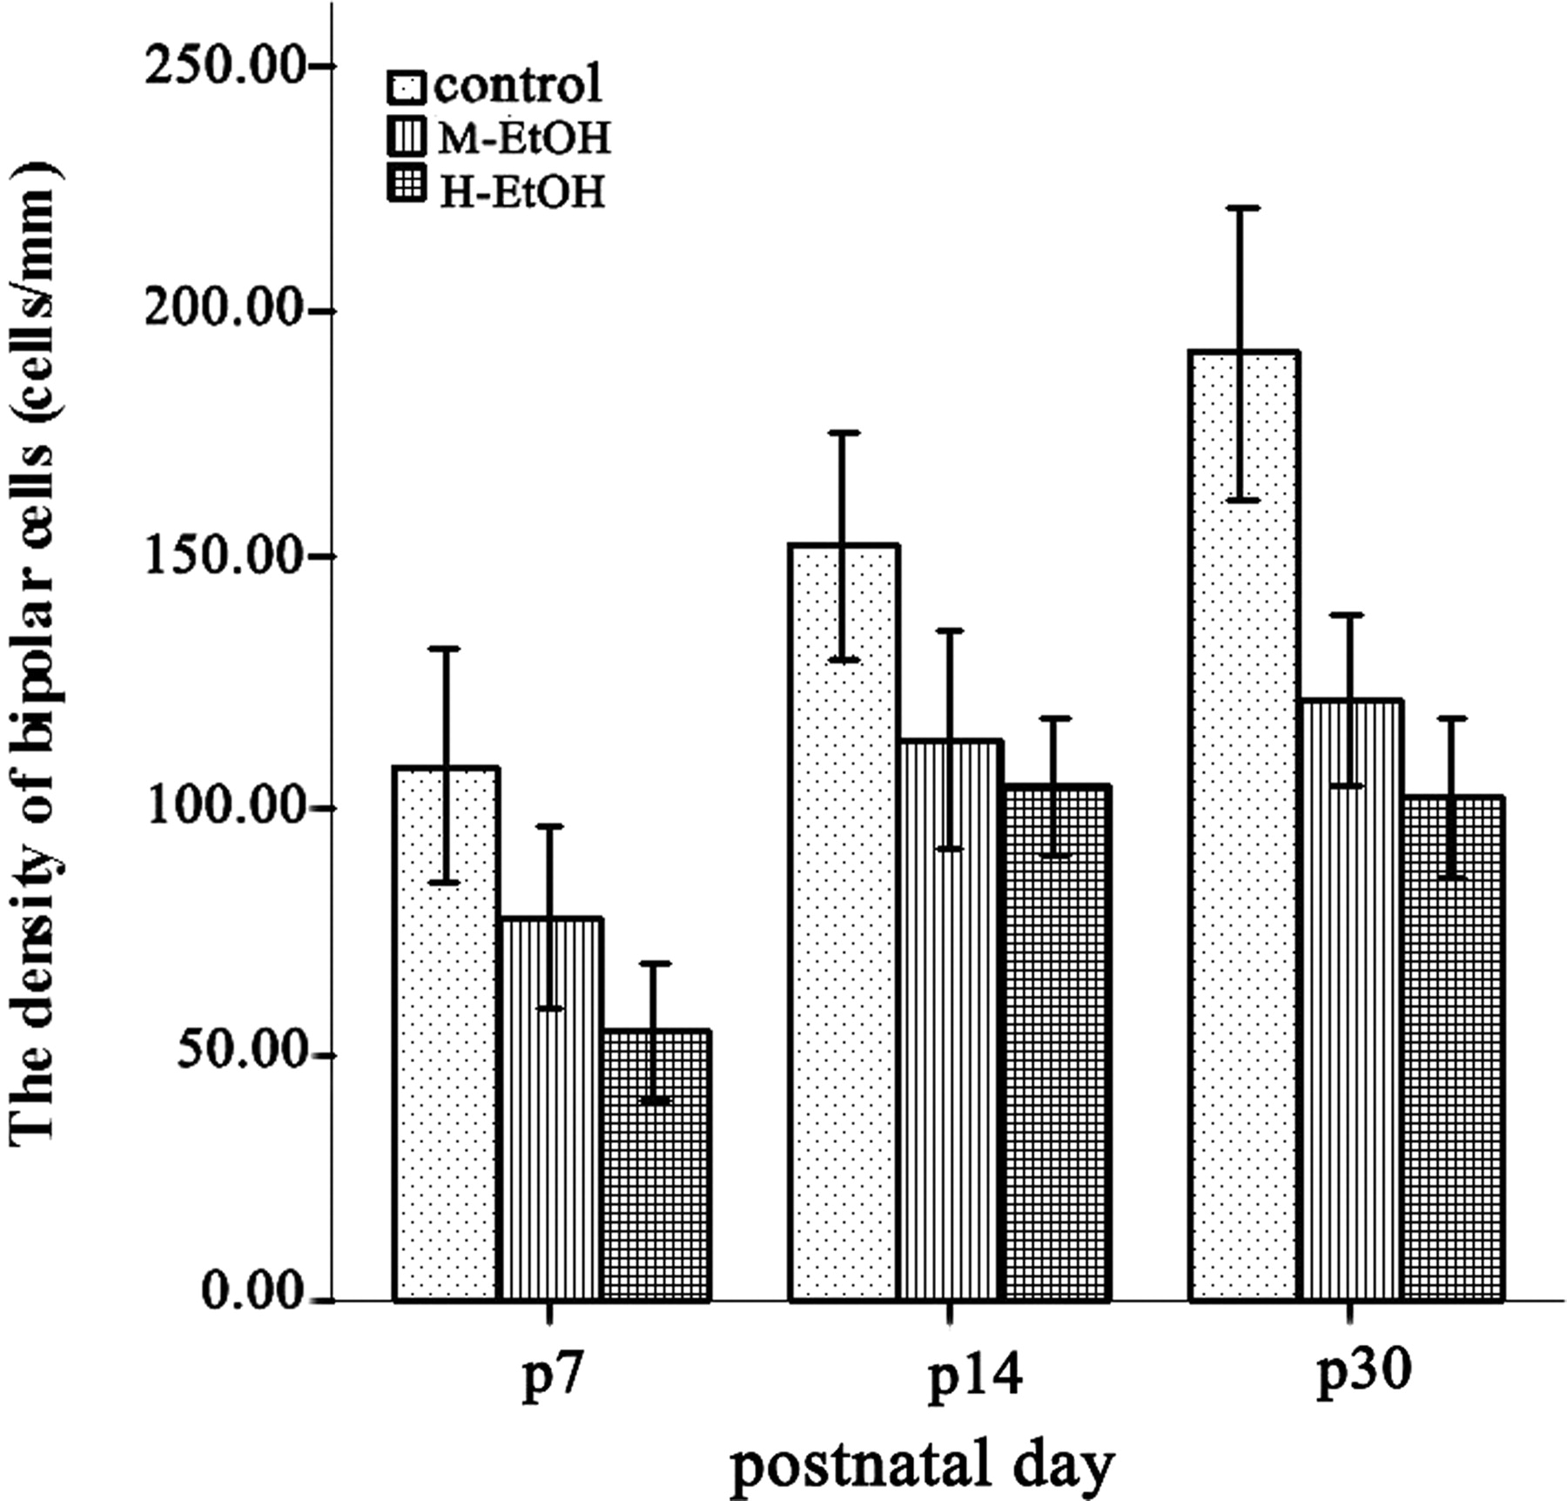
Fig. 2. The effects of PAE on the DBCs at various age points. PAE dampened the increase of bipolar cells in a ...
Notes:
Fig. 2. The effects of PAE on the DBCs at various age points. PAE dampened the increase of bipolar cells in a dose-dependent and long-term manner (P < 0.05). Control, control group; H-EtOH, high-dose EtOH group; M-EtOH, moderate-dose EtOH group.
Unless provided in the caption above, the following copyright applies to the content of this slide: © The Author 2012. Medical Council on Alcohol and Oxford University Press. All rights reserved

Slide 3
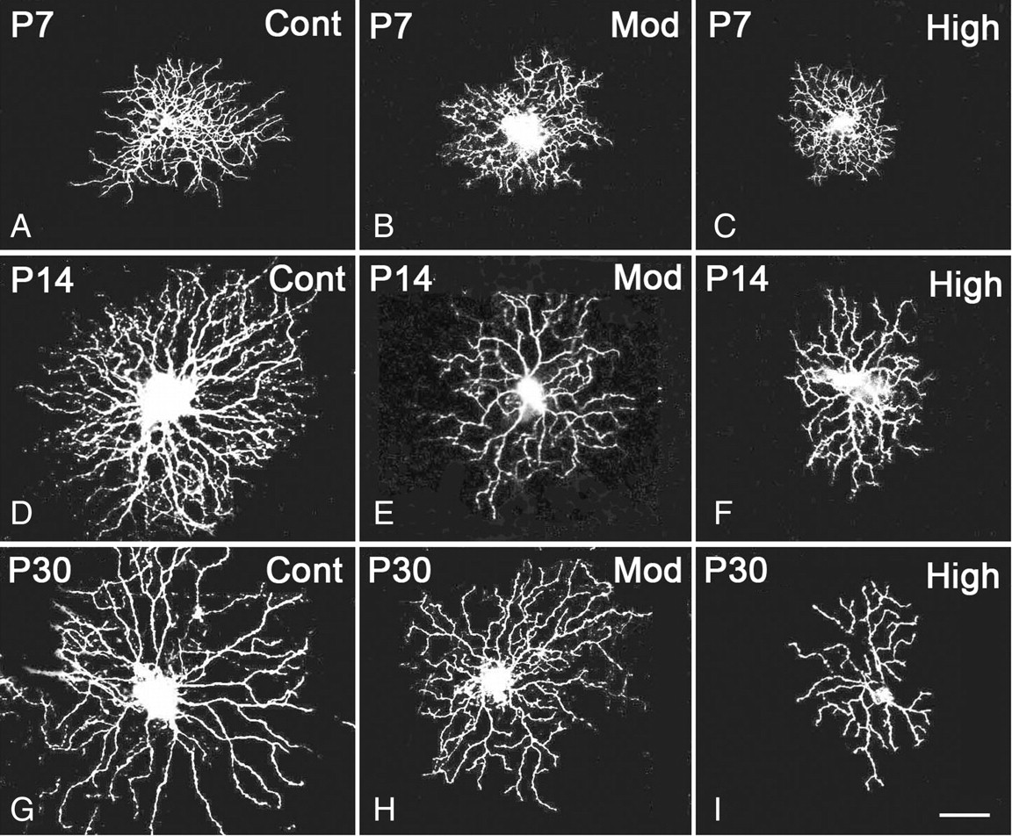
Fig. 3. The effects of PAE on the development of retinal horizontal cells (DiI doilistic assay). (A, D and G) depict ...
Notes:
Fig. 3. The effects of PAE on the development of retinal horizontal cells (DiI doilistic assay). (A, D and G) depict the normal developmental state of retinal horizontal cells of the control groups at P7, P14 and P30, and the area of dendritic receptive field increased along with age increase. (A–C) depict the horizontal cell development of different treatment groups at P7. (D–I) Also depict the alterations of horizontal cells after PAE at P14 and at P30, respectively. The results indicate that PAE retarded the development of dendritic receptive field in a dose-dependent and long-term manner. Cont, control group; High, high-dose EtOH group; Mod, moderate-does EtOH group. Scale bar represents 15 μm.
Unless provided in the caption above, the following copyright applies to the content of this slide: © The Author 2012. Medical Council on Alcohol and Oxford University Press. All rights reserved

Slide 4
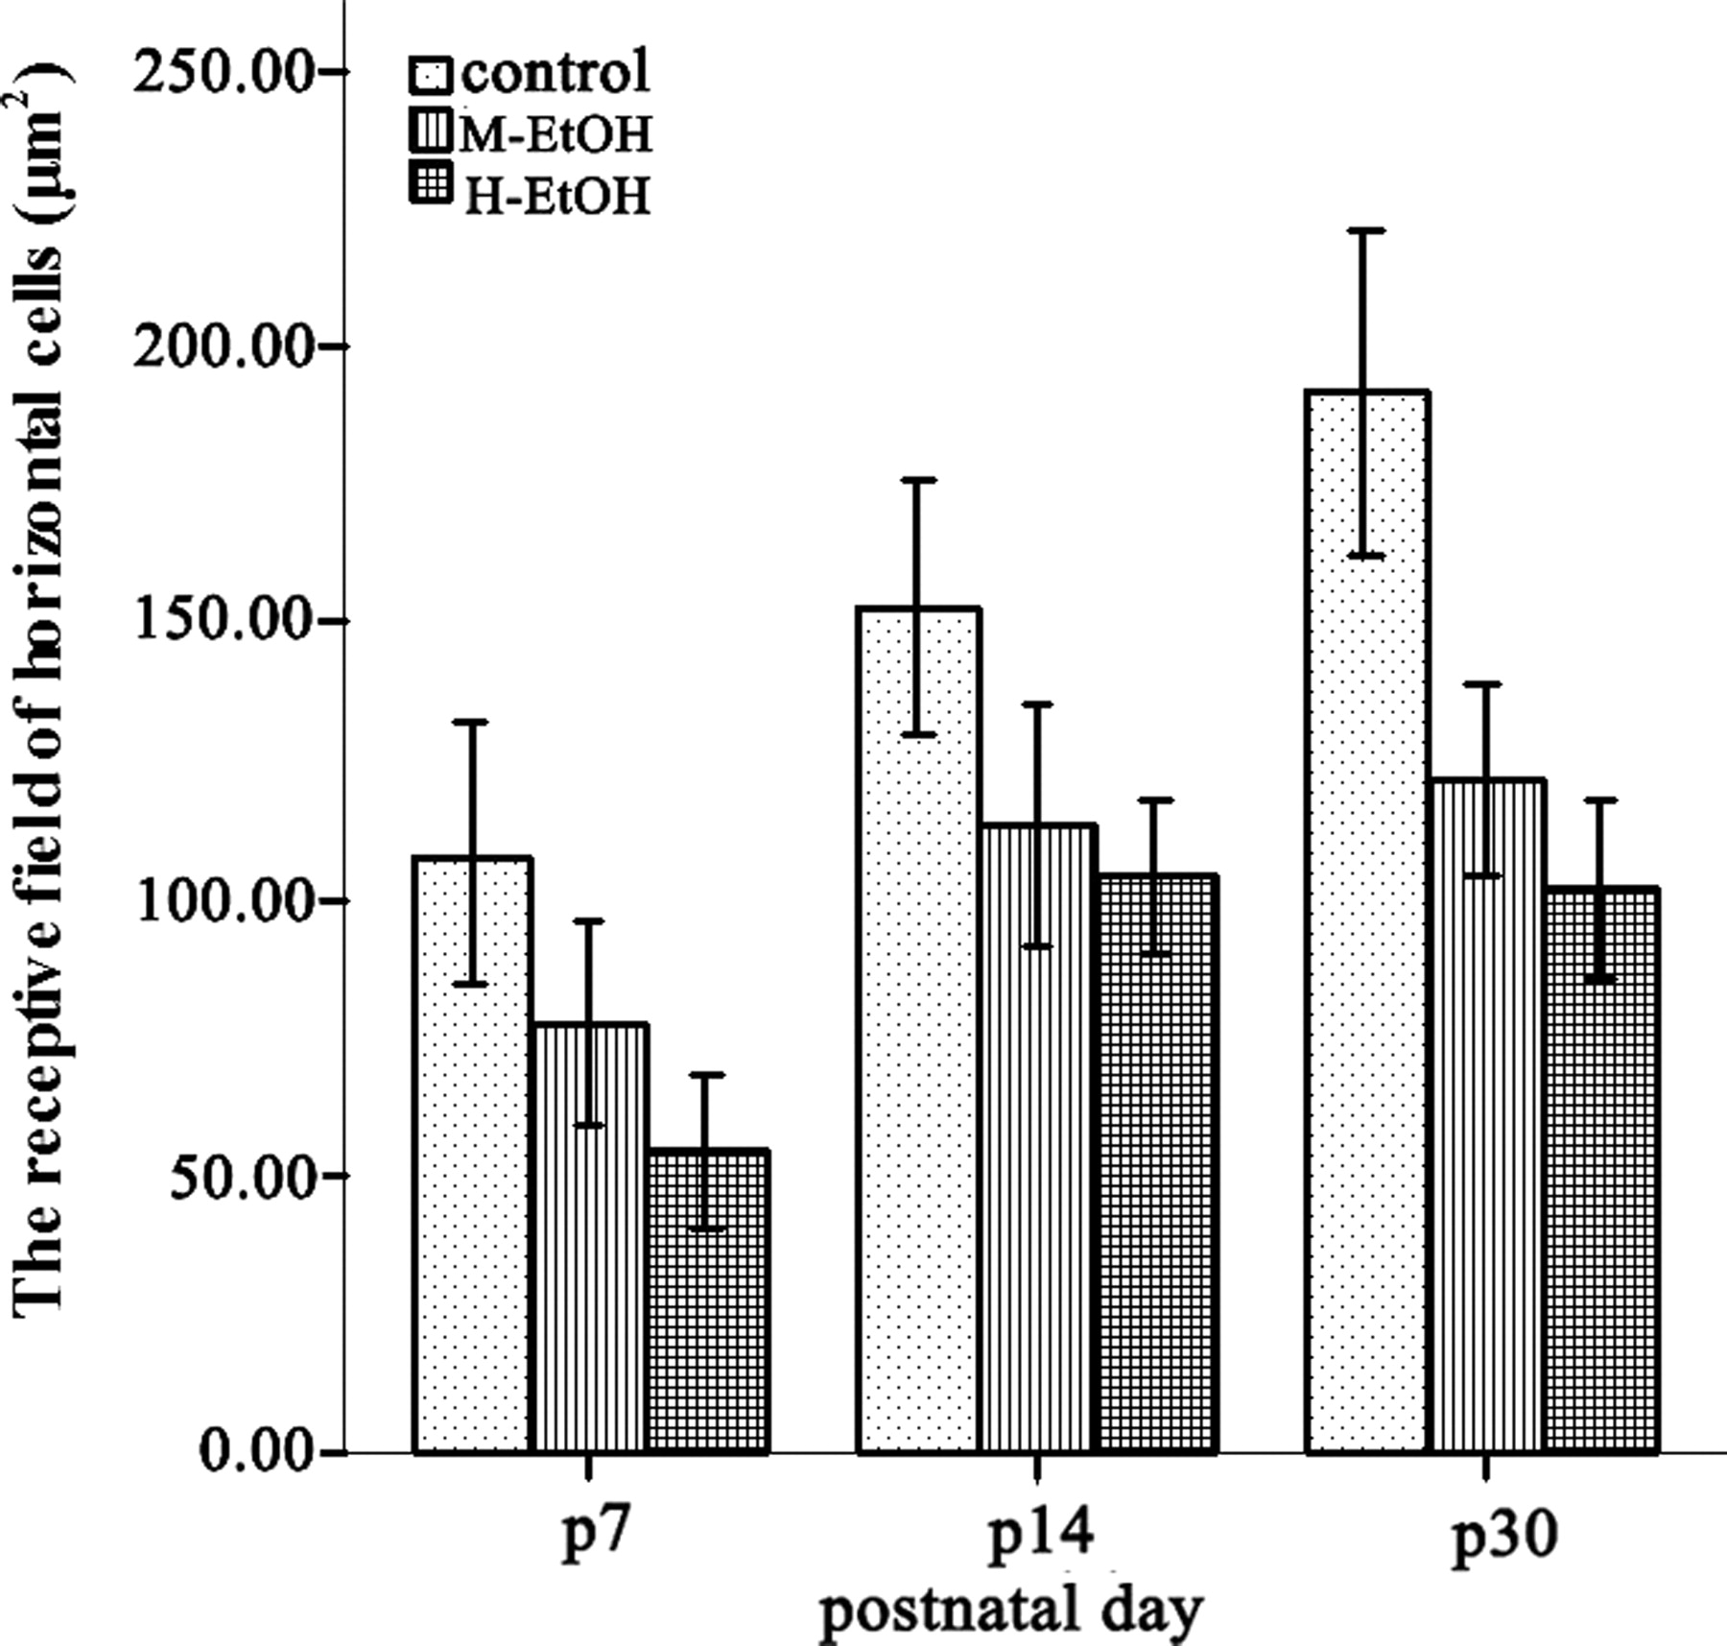
Fig. 4. The dendritic receptive field in horizontal cells increased with age, but PAE could reduce this level of ...
Notes:
Fig. 4. The dendritic receptive field in horizontal cells increased with age, but PAE could reduce this level of increase in a dose-dependent and long-term manner (P < 0.05). Control, control group; H-EtOH, high-dose EtOH group; M-EtOH: moderate-dose EtOH group.
Unless provided in the caption above, the following copyright applies to the content of this slide: © The Author 2012. Medical Council on Alcohol and Oxford University Press. All rights reserved

