Slide 1
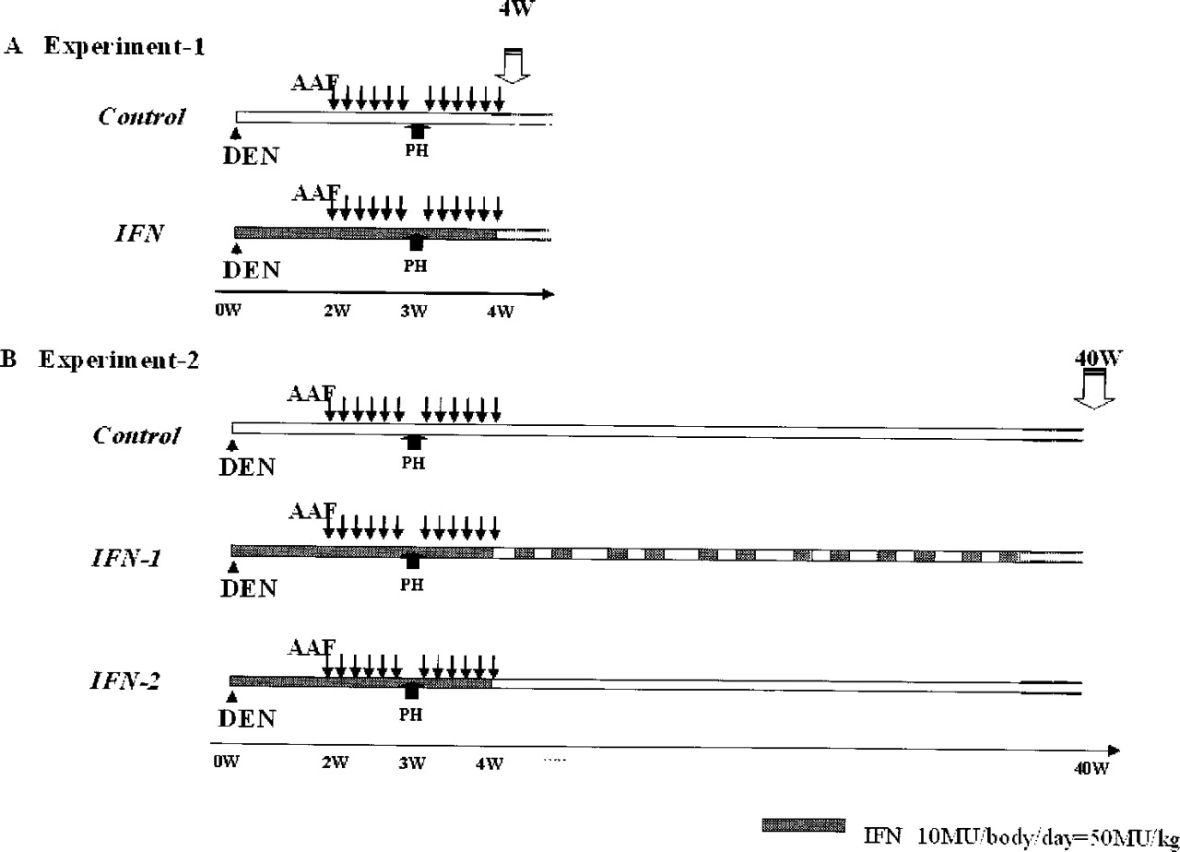
Fig. 1. Schematic diagram of the experimental design using the modified Solt and Farber protocol and IFN-alpha ...
Notes:
Fig. 1. Schematic diagram of the experimental design using the modified Solt and Farber protocol and IFN-alpha treatment schedule. ↓, 2-AAF; PH, partial hepatectomy; W, week; shading, IFN-alpha (10 MU/body/day).
Unless provided in the caption above, the following copyright applies to the content of this slide: Carcinogenesis vol.25 no.3 © Oxford University Press 2004; all rights reserved.

Slide 2
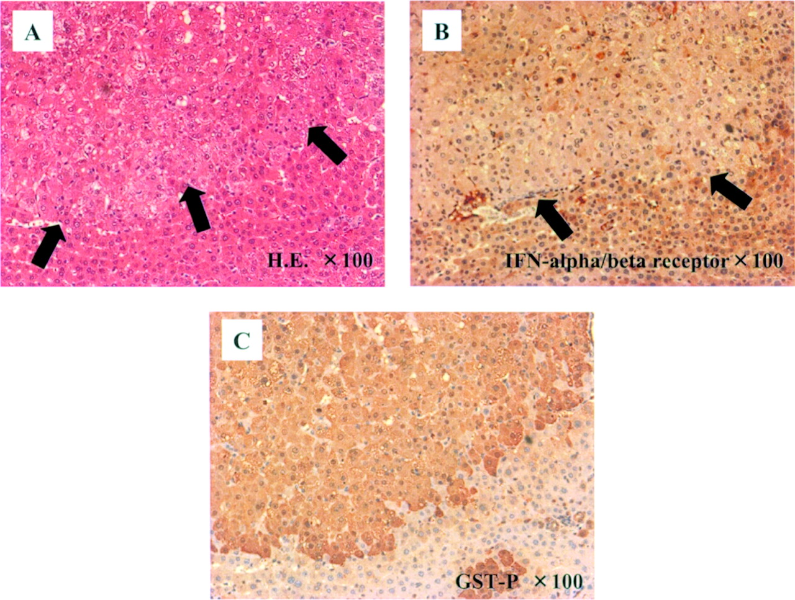
Fig. 7. Representative serial sections of HCC stained with HE ( A ), and with anti-IFN alpha/beta receptor ( B ) and ...
Notes:
Fig. 7. Representative serial sections of HCC stained with HE ( A ), and with anti-IFN alpha/beta receptor ( B ) and anti-GST-P ( C ) (original magnification ×100).
Unless provided in the caption above, the following copyright applies to the content of this slide: Carcinogenesis vol.25 no.3 © Oxford University Press 2004; all rights reserved.

Slide 3
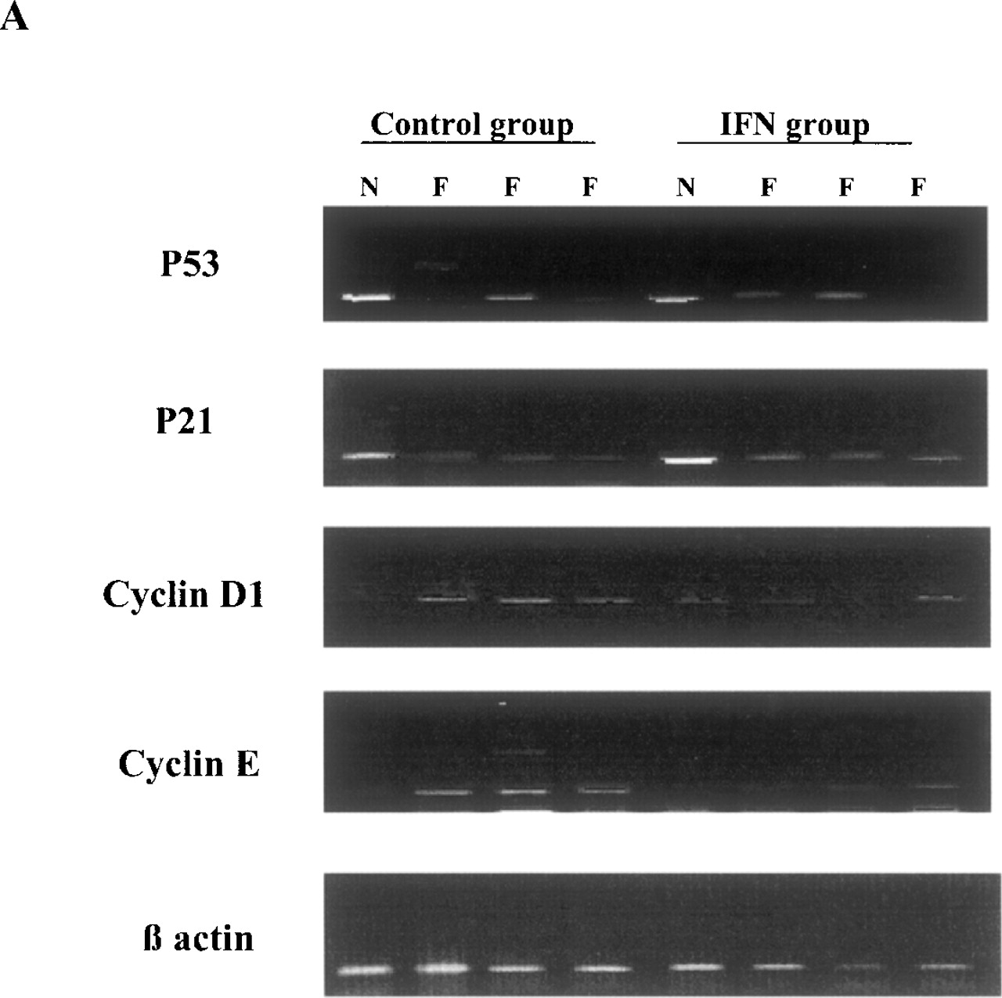
Fig. 6. Visualization of the RT–PCR amplified fragments corresponding to p53, p21, cyclin D1, cyclin E and beta ...
Notes:
Fig. 6. Visualization of the RT–PCR amplified fragments corresponding to p53, p21, cyclin D1, cyclin E and beta actin from representatives of each group of rats (N, normal hepatocyte; F, preneoplastic foci) ( A ). Densitometric analyses of the ratio of expression of various mRNAs to beta actin mRNA expression; data are presented as mean ± SD ( n = 4–7) ( B ).
Unless provided in the caption above, the following copyright applies to the content of this slide: Carcinogenesis vol.25 no.3 © Oxford University Press 2004; all rights reserved.

Slide 4
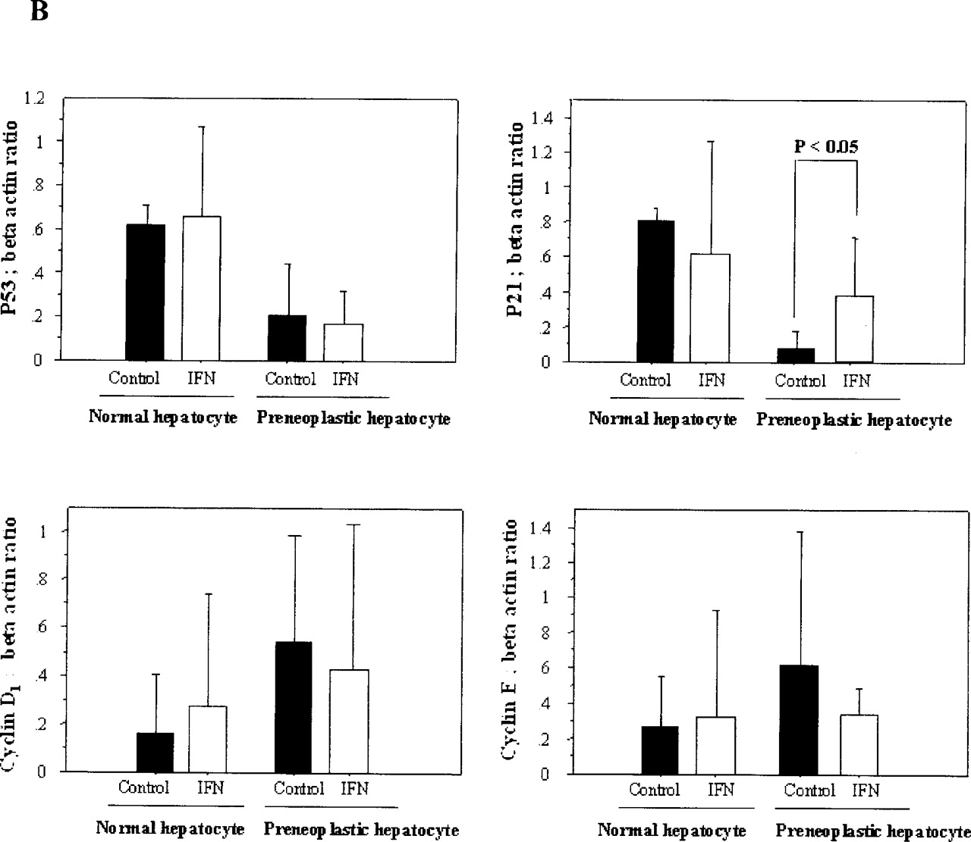
Fig. 6. Visualization of the RT–PCR amplified fragments corresponding to p53, p21, cyclin D1, cyclin E and beta ...
Notes:
Fig. 6. Visualization of the RT–PCR amplified fragments corresponding to p53, p21, cyclin D1, cyclin E and beta actin from representatives of each group of rats (N, normal hepatocyte; F, preneoplastic foci) ( A ). Densitometric analyses of the ratio of expression of various mRNAs to beta actin mRNA expression; data are presented as mean ± SD ( n = 4–7) ( B ).
Unless provided in the caption above, the following copyright applies to the content of this slide: Carcinogenesis vol.25 no.3 © Oxford University Press 2004; all rights reserved.

Slide 5
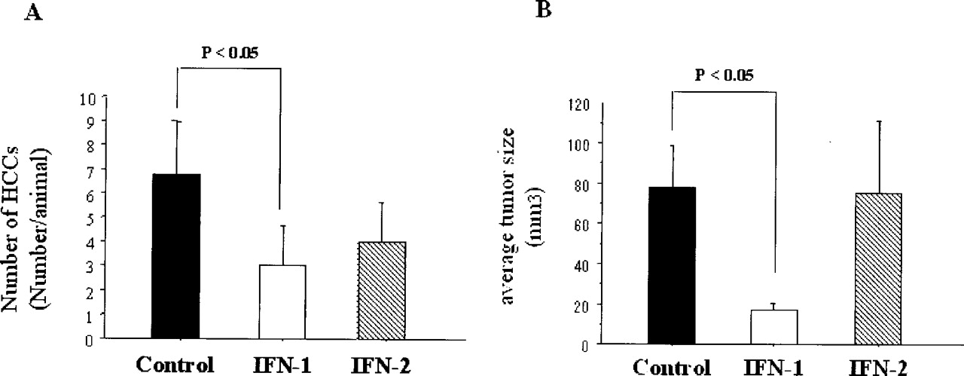
Fig. 8. Effect of IFN-alpha on the development of HCCs in experiment 2. The number of HCCs/animal ( A ) and the ...
Notes:
Fig. 8. Effect of IFN-alpha on the development of HCCs in experiment 2. The number of HCCs/animal ( A ) and the average tumor size ( B ) are shown. The number and average tumor volume in the IFN-1 group were significantly lower than those in the control group ( P < 0.05). The data are shown as the mean ± SD.
Unless provided in the caption above, the following copyright applies to the content of this slide: Carcinogenesis vol.25 no.3 © Oxford University Press 2004; all rights reserved.

Slide 6
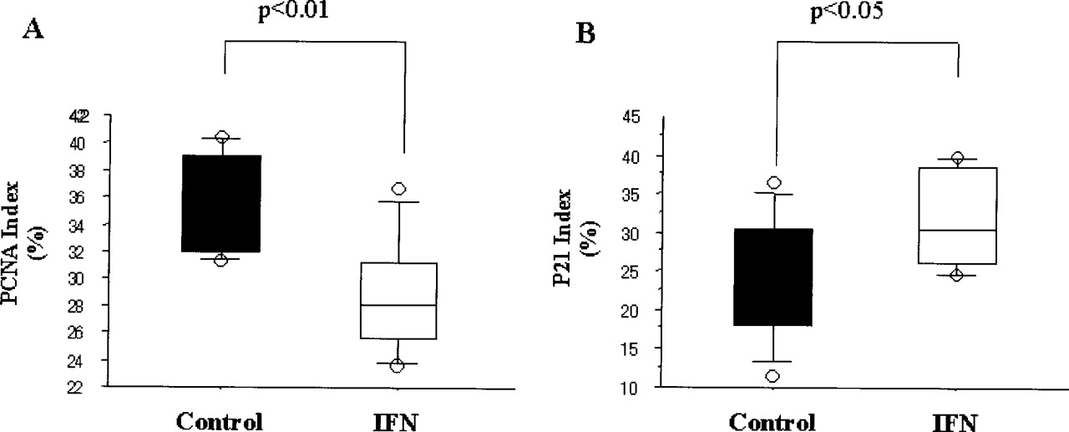
Fig. 5. Analysis of PCNA-positive rate and p21-positive rate in preneoplastic foci. The PCNA and p21 labeling ...
Notes:
Fig. 5. Analysis of PCNA-positive rate and p21-positive rate in preneoplastic foci. The PCNA and p21 labeling indices were determined as the percentage of positively stained nuclei by counting 1000–2000 cells in the preneoplastic foci. The PCNA index in the IFN-alpha treated group was significantly lower than that in the control group ( P < 0.01) ( A ), whereas the p21-positive rate in the IFN-treated group was significantly higher than that in the control group ( P < 0.05) ( B ).
Unless provided in the caption above, the following copyright applies to the content of this slide: Carcinogenesis vol.25 no.3 © Oxford University Press 2004; all rights reserved.

Slide 7
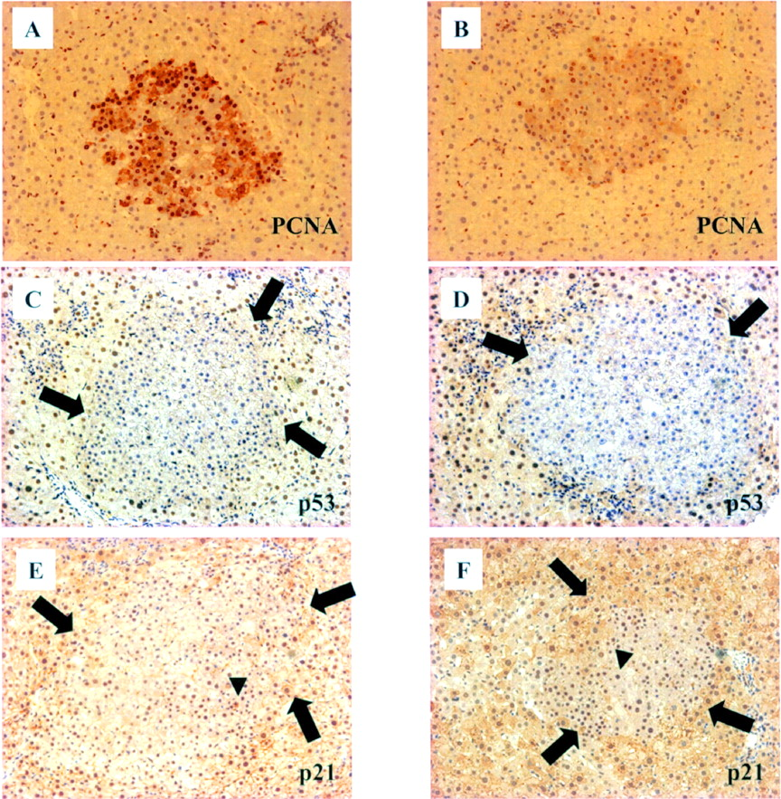
Fig. 4. Immunohistochemical study of the liver sections at the 4th week (experiment 1). The expression of PCNA was ...
Notes:
Fig. 4. Immunohistochemical study of the liver sections at the 4th week (experiment 1). The expression of PCNA was detected predominantly in the preneoplastic foci both in the control group ( A ) and IFN group ( B ), and the intensity was higher in the control group than in the IFN group. Nuclear p53 expression was hardly detected in the preneoplastic foci in both the control group ( C ) and IFN-alpha treated group ( D ) (original magnification ×200). Immunohistochemical staining with p21 in the control group ( E ) and IFN group ( F ) (original magnification ×200). p21 expression was also reduced in the preneoplastic foci, but some altered hepatocytes had it in their nuclei (arrowhead). The arrows indicate the preneoplastic foci.
Unless provided in the caption above, the following copyright applies to the content of this slide: Carcinogenesis vol.25 no.3 © Oxford University Press 2004; all rights reserved.

Slide 8
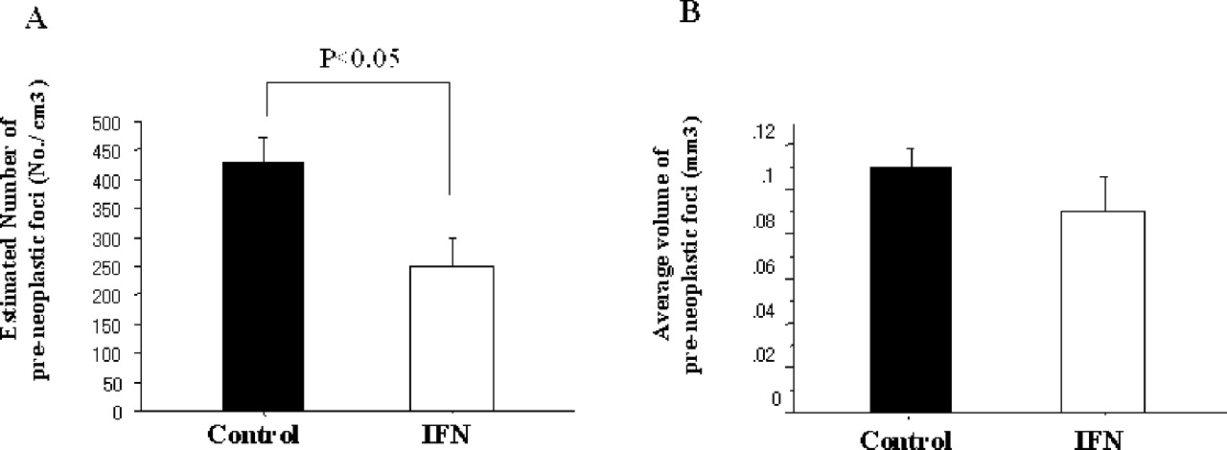
Fig. 3. Effect of IFN-alpha on the development of preneoplastic foci in experiment 1. Changes in number of ...
Notes:
Fig. 3. Effect of IFN-alpha on the development of preneoplastic foci in experiment 1. Changes in number of preneoplastic foci per cm 3 ( A ) and average volume of preneoplastic foci ( B ).
Unless provided in the caption above, the following copyright applies to the content of this slide: Carcinogenesis vol.25 no.3 © Oxford University Press 2004; all rights reserved.

Slide 9
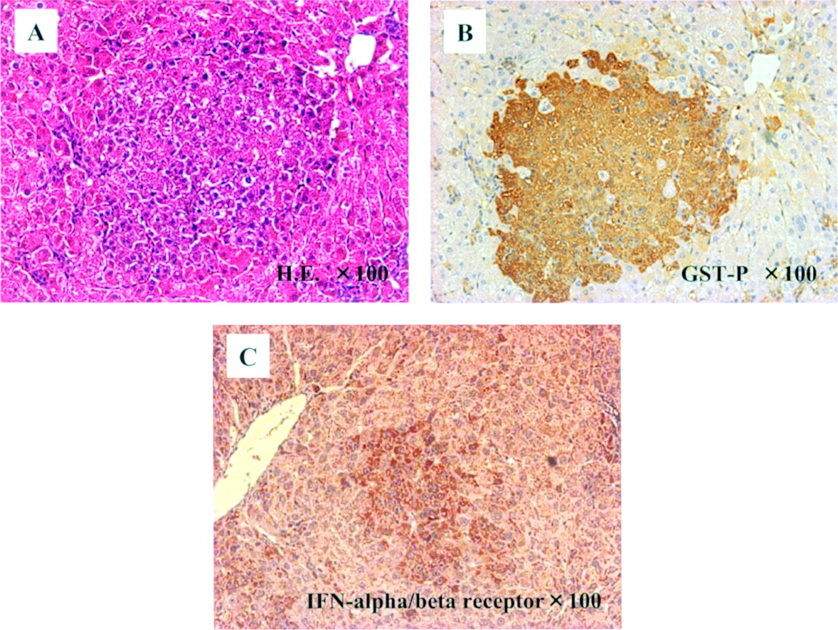
Fig. 2. Representative sections of preneoplastic foci at 4 weeks after DEN treatment. Clonal expansion of altered ...
Notes:
Fig. 2. Representative sections of preneoplastic foci at 4 weeks after DEN treatment. Clonal expansion of altered hepatocytes stained with H&E ( A ), anti-GST-P ( B ) and anti-IFN-alpha/beta receptor ( C ) are shown (original magnification ×100).
Unless provided in the caption above, the following copyright applies to the content of this slide: Carcinogenesis vol.25 no.3 © Oxford University Press 2004; all rights reserved.

