Slide 1
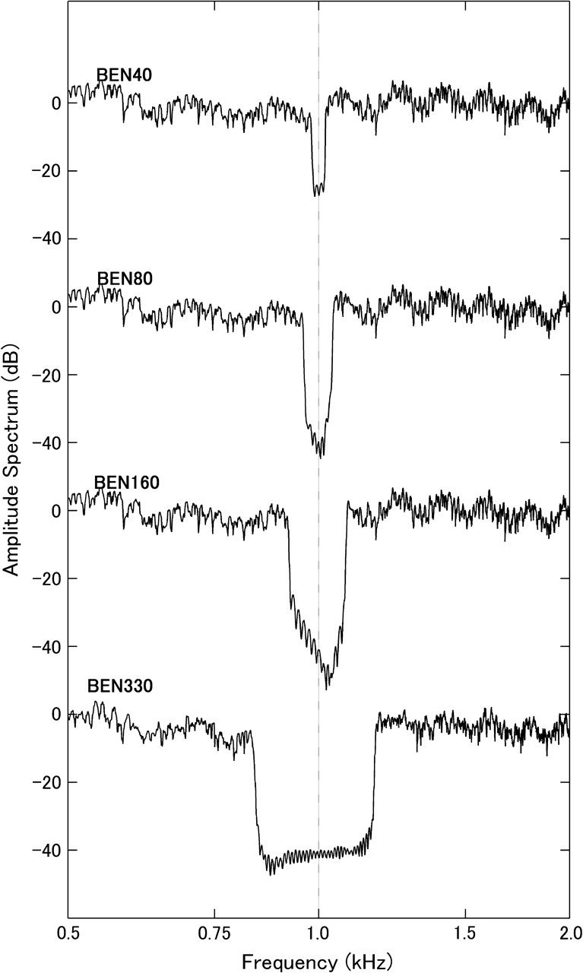
Figure 1. Amplitude spectra of the different BENs in the frequency range from 500 to 2000 Hz. BENs contain spectral ...
Notes:
Figure 1. Amplitude spectra of the different BENs in the frequency range from 500 to 2000 Hz. BENs contain spectral notches of either 40 Hz (BEN40), 80 Hz (BEN80), 160 Hz (BEN160), or 330 Hz (BEN 330) width. Notches are spectrally located symmetrically around 1000 Hz.
Unless provided in the caption above, the following copyright applies to the content of this slide: © The Author 2008. Published by Oxford University Press. All rights reserved. For permissions, please e-mail: journals.permissions@oxfordjournals.org

Slide 2
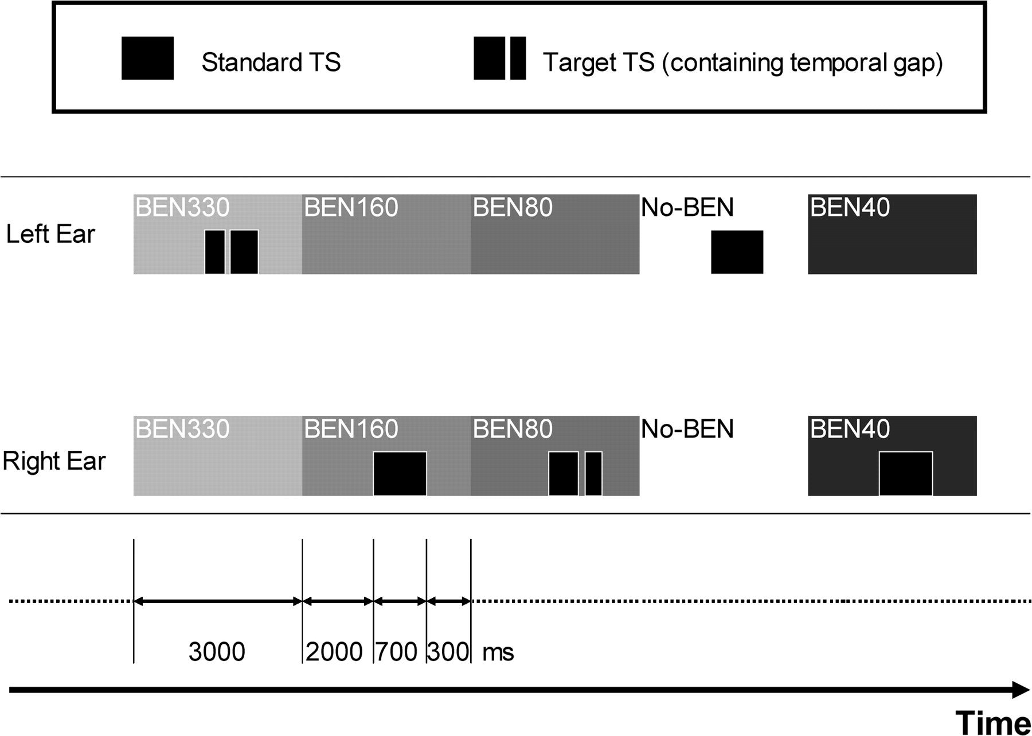
Figure 2. Concept and timing of the auditory stimulation. BENs are presented binaurally and in a random sequence. The ...
Notes:
Figure 2. Concept and timing of the auditory stimulation. BENs are presented binaurally and in a random sequence. The TS is presented monaurally randomly either to the left or the right ear. In 90% of trials, TS is continuous (standard TS). In 10% of trials, TS contains a temporal gap (target TS) at variable positions (see text for details). BENs have duration of 3.0 s, TS has duration of 0.7 s. TS onset is 2.0 s delayed compared with BEN onset. The sound onset asynchrony between 2 subsequent TSs is fixed to 3.0 s.
Unless provided in the caption above, the following copyright applies to the content of this slide: © The Author 2008. Published by Oxford University Press. All rights reserved. For permissions, please e-mail: journals.permissions@oxfordjournals.org

Slide 3
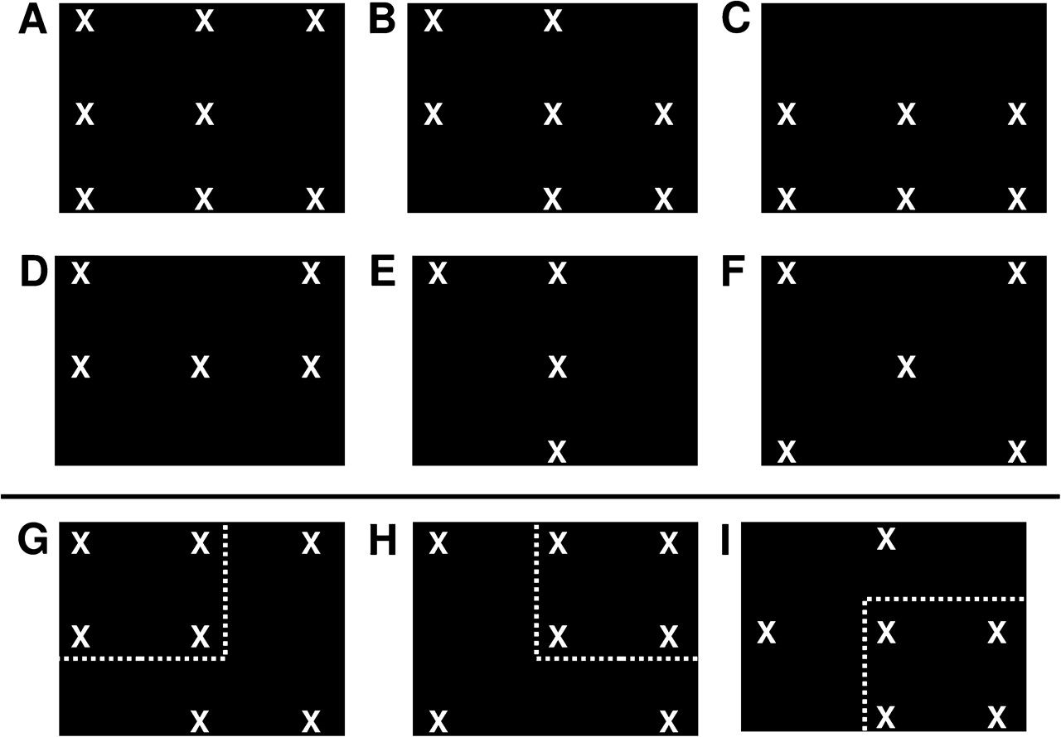
Figure 3. Concept of the visual stimulation. Stimuli are random configurations of one to 9 “X”s appearing ...
Notes:
Figure 3. Concept of the visual stimulation. Stimuli are random configurations of one to 9 “X”s appearing simultaneously in predefined locations on the screen. Visual target configurations (e.g., G, H, and I) contain exactly one small square constituted of 4 “X”s appearing in one of the 4 corners of the screen (as indicated by the white dotted lines). Nontarget configurations (e.g., A to F) did either not contain a small square (e.g. D, E, and F) or more than one small square (e.g. A, B, and C).
Unless provided in the caption above, the following copyright applies to the content of this slide: © The Author 2008. Published by Oxford University Press. All rights reserved. For permissions, please e-mail: journals.permissions@oxfordjournals.org

Slide 4
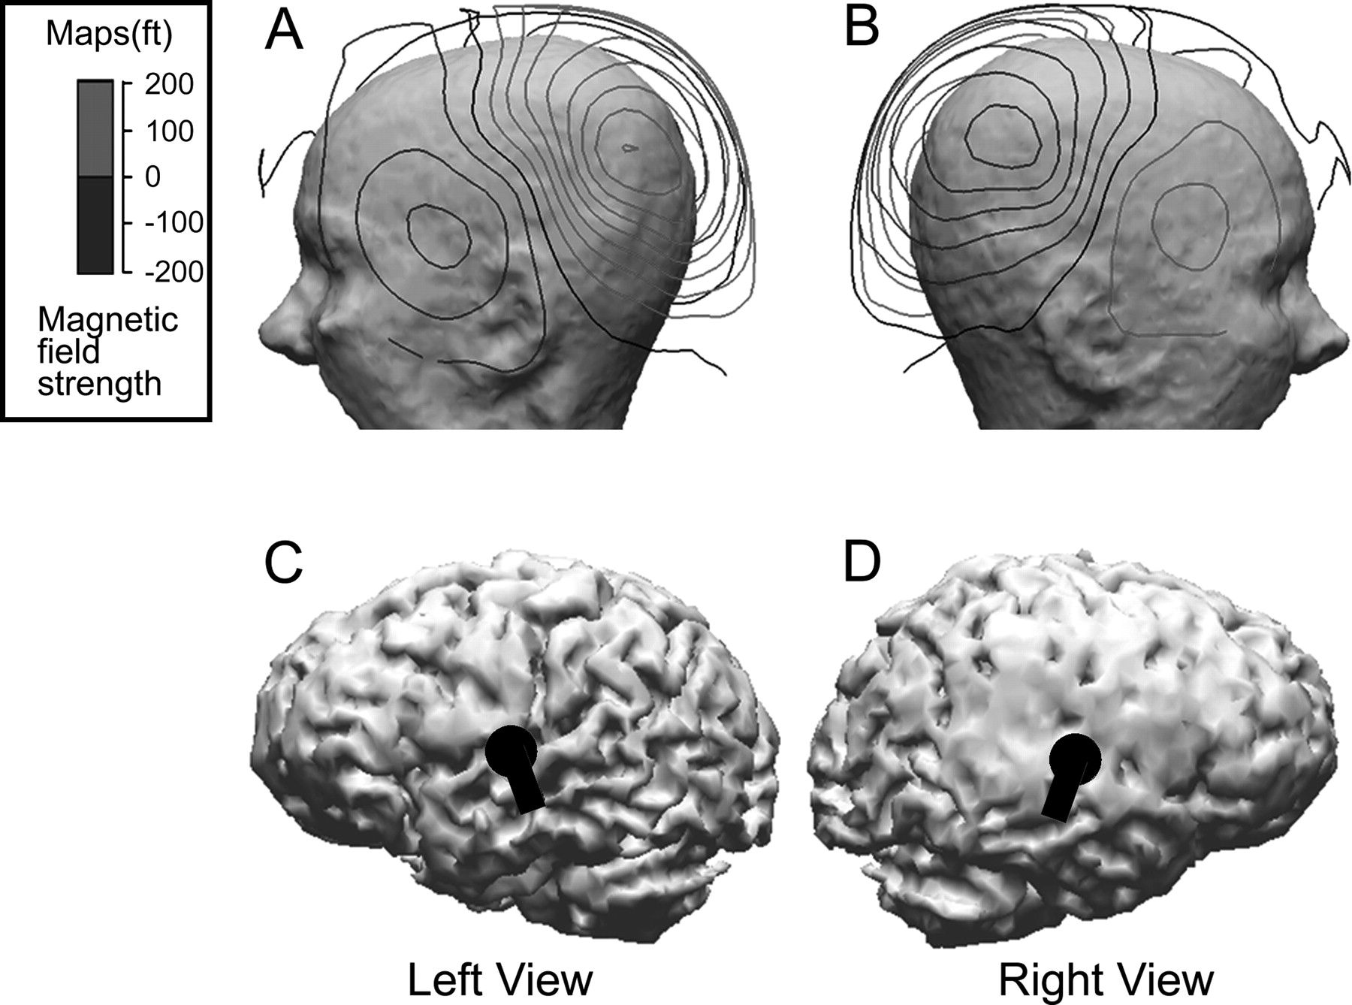
Figure 4. Contour maps (A, B) and dipole source locations and orientations (C, D) for the grand-averaged No-BEN ...
Notes:
Figure 4. Contour maps (A, B) and dipole source locations and orientations (C, D) for the grand-averaged No-BEN condition of one session of one representative subject based on the boundary element head model created on basis of the structural individual magnetic resonance image. Black lines indicate inward flow of magnetic fields; gray lines denote outward flow (A, B). The black dipoles represent left- (C) respectively right-hemispheric (D) sources.
Unless provided in the caption above, the following copyright applies to the content of this slide: © The Author 2008. Published by Oxford University Press. All rights reserved. For permissions, please e-mail: journals.permissions@oxfordjournals.org

Slide 5
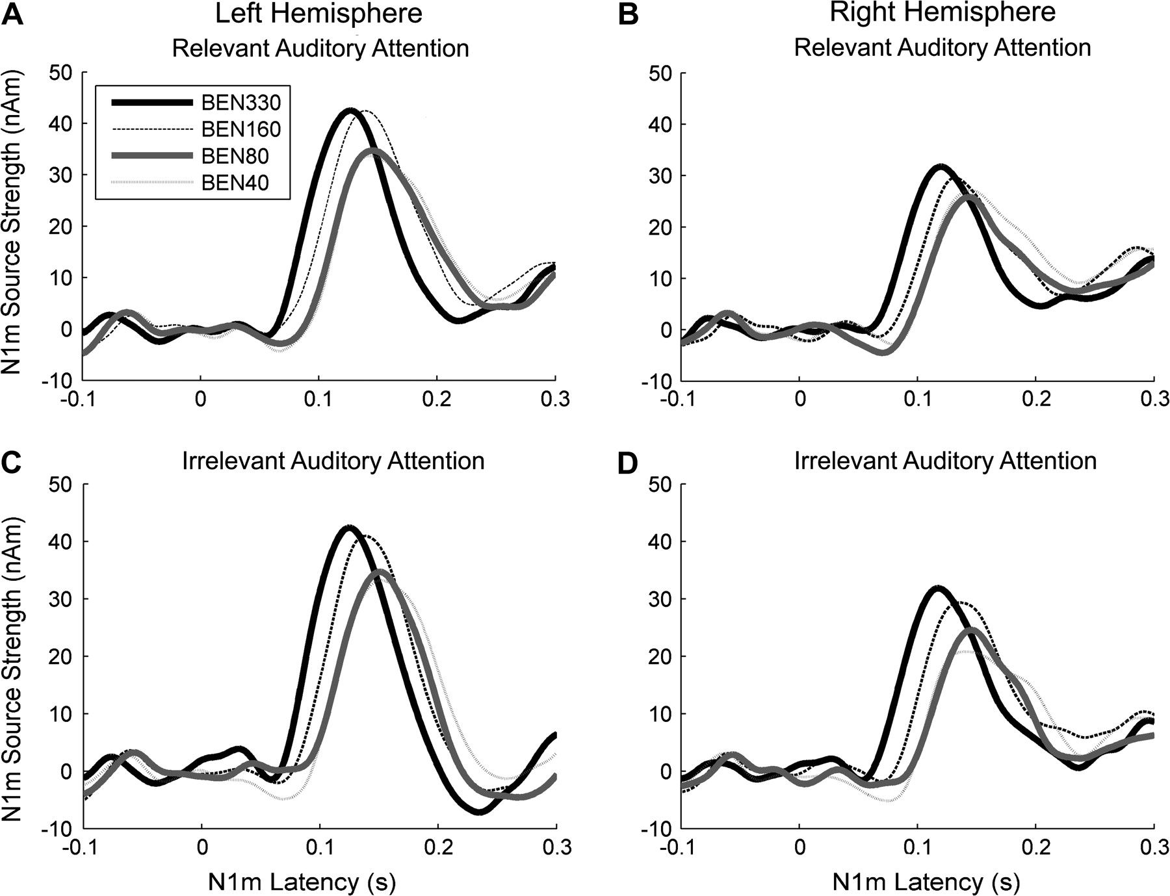
Figure 5. Source waveforms grand-averaged across all included subjects. The graphs show clear N1m responses for all ...
Notes:
Figure 5. Source waveforms grand-averaged across all included subjects. The graphs show clear N1m responses for all conditions. The left panel (A, C) displays left-hemispheric responses; the right panel (B, D) displays right-hemispheric responses. The top row (A, B) shows the relevant auditory attention condition, and the bottom row (C, D) shows the irrelevant auditory attention condition.
Unless provided in the caption above, the following copyright applies to the content of this slide: © The Author 2008. Published by Oxford University Press. All rights reserved. For permissions, please e-mail: journals.permissions@oxfordjournals.org

Slide 6
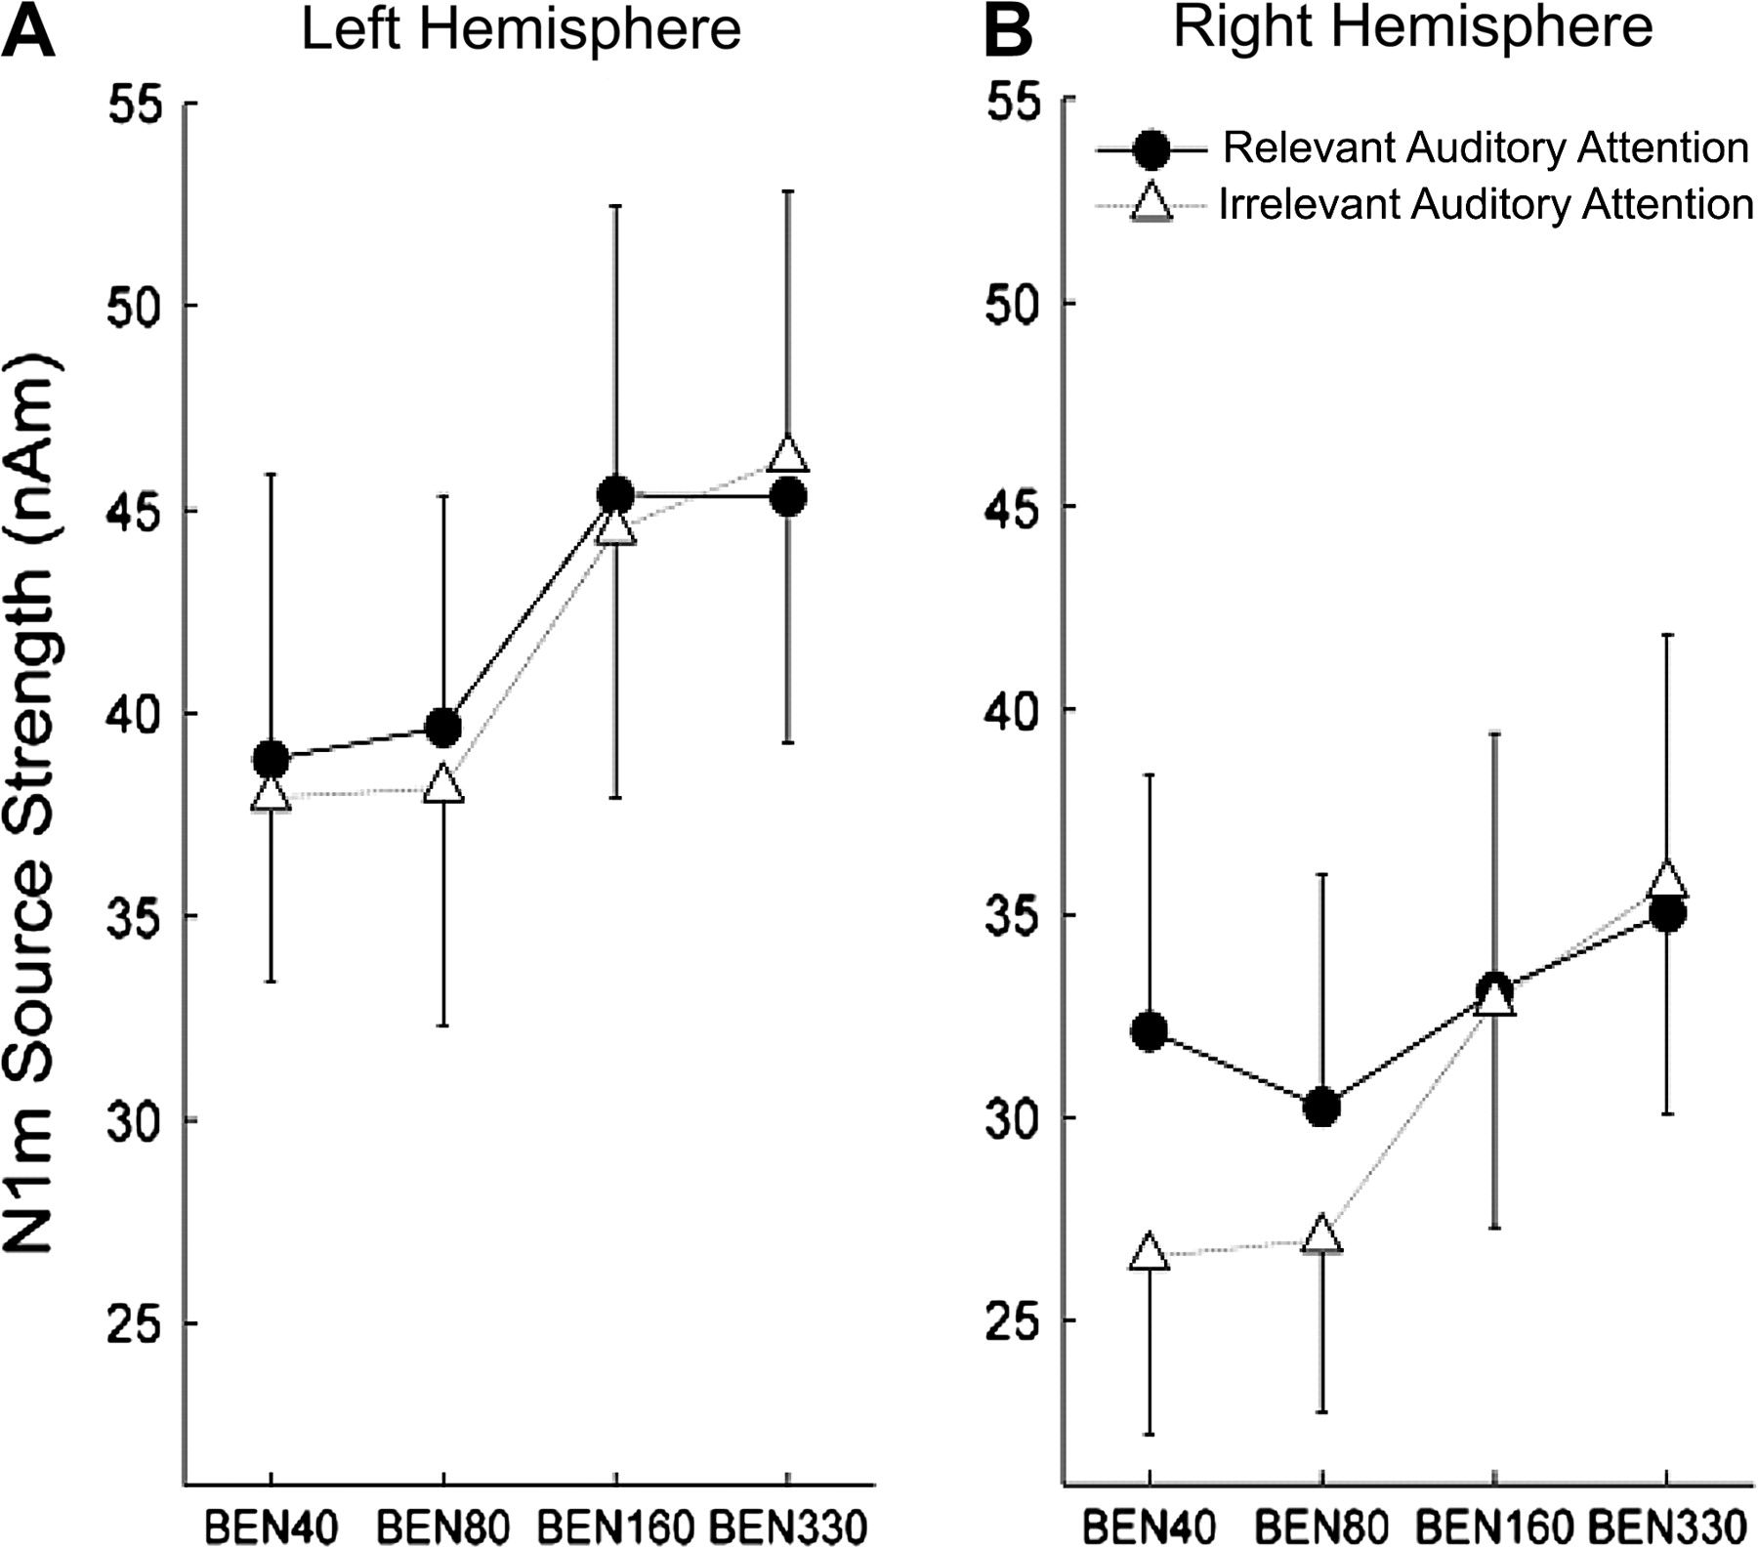
Figure 6. Interaction plots illustrating N1m source strength grand-averaged across all included subjects with respect ...
Notes:
Figure 6. Interaction plots illustrating N1m source strength grand-averaged across all included subjects with respect to relevant auditory attention and irrelevant auditory attention conditions. The left panel (A) displays left-hemispheric responses, the right panel (B) displays right-hemispheric responses. The circles (A, B) denote the relevant auditory attention condition (i.e., attention focused on the stimulated ear), and the triangles (A, B) denote the irrelevant auditory attention condition (i.e., attention focused on the not stimulated ear). Error bars indicate the 95% confidence limits of the mean.
Unless provided in the caption above, the following copyright applies to the content of this slide: © The Author 2008. Published by Oxford University Press. All rights reserved. For permissions, please e-mail: journals.permissions@oxfordjournals.org

