Slide 1
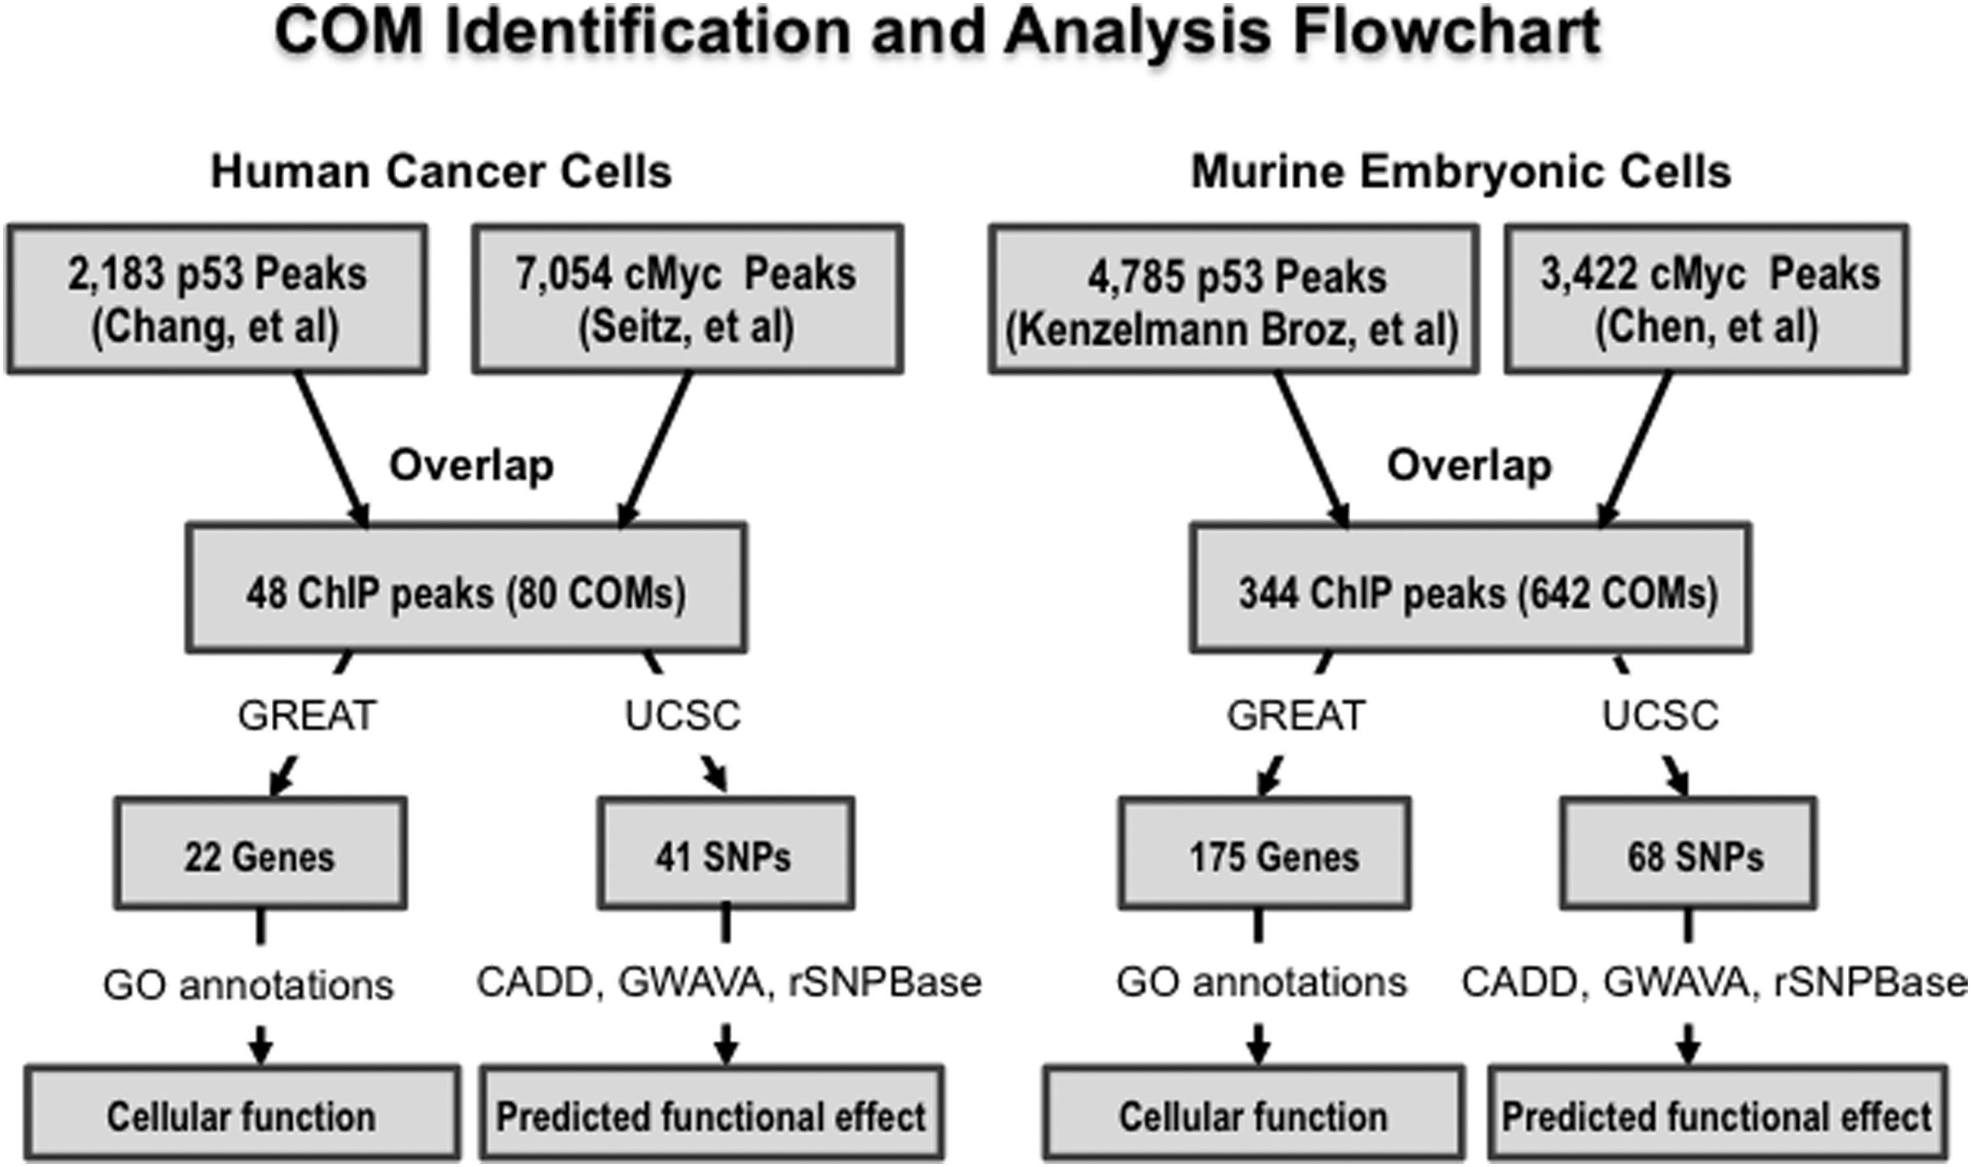
Figure 1. The flowchart illustrates the P53 and cMYC co-occupied regions found from selected ChIP-seq analysis of P53 ...
Notes:
Figure 1. The flowchart illustrates the P53 and cMYC co-occupied regions found from selected ChIP-seq analysis of P53 and cMYC within different cell lines. A program written in python was then used to identify P53 and cMYC cis-overlapping motifs (COMs) located within the co-occupied regions, and the UCSC browser was used to identify SNPs located within these COMs. Further analysis with GREAT was used to predict potential target genes regulated by elements containing P53 and cMYC co-occupied regions, and predict their function via gene ontology. The programs CADD, GWAVA and rSNPBase were used to identify potentially significant SNPs.
Unless provided in the caption above, the following copyright applies to the content of this slide: © The Author 2016. Published by Oxford University Press. All rights reserved. For Permissions, please email: journals.permissions@oup.com

Slide 2
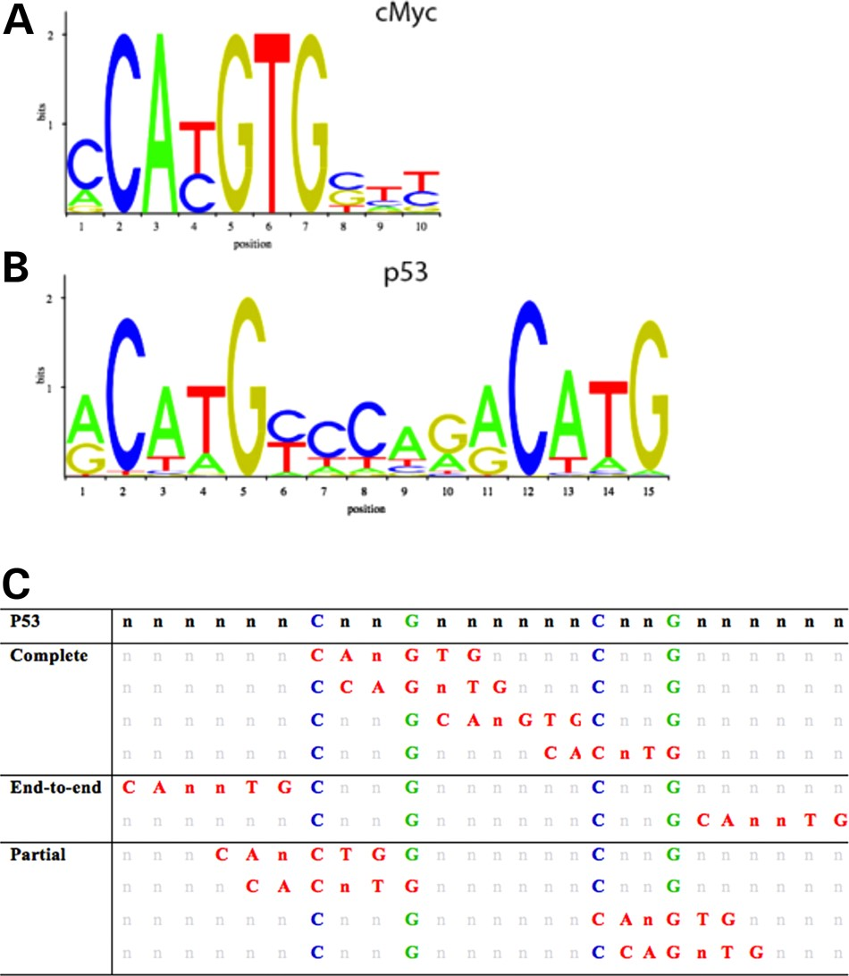
Figure 2. Position weight matrices (PWM) and all possible overlap scenarios of the P53 and cMYC. The two most highly ...
Notes:
Figure 2. Position weight matrices (PWM) and all possible overlap scenarios of the P53 and cMYC. The two most highly conserved nucleotides for cMYC (A) and P53 (B) binding sites obtained from JASPAR CORE database derived from published collections of experimentally curated set of binding sites for eukaryotes. All possible scenarios of overlap involving the P53 (with conserved nucleotides in blue and green) and cMYC binding site (in red) overlap, while retaining the conserved nucleotides of the P53 motif (C). Complementary binding motifs on the anti-sense strand are not depicted.
Unless provided in the caption above, the following copyright applies to the content of this slide: © The Author 2016. Published by Oxford University Press. All rights reserved. For Permissions, please email: journals.permissions@oup.com

Slide 3
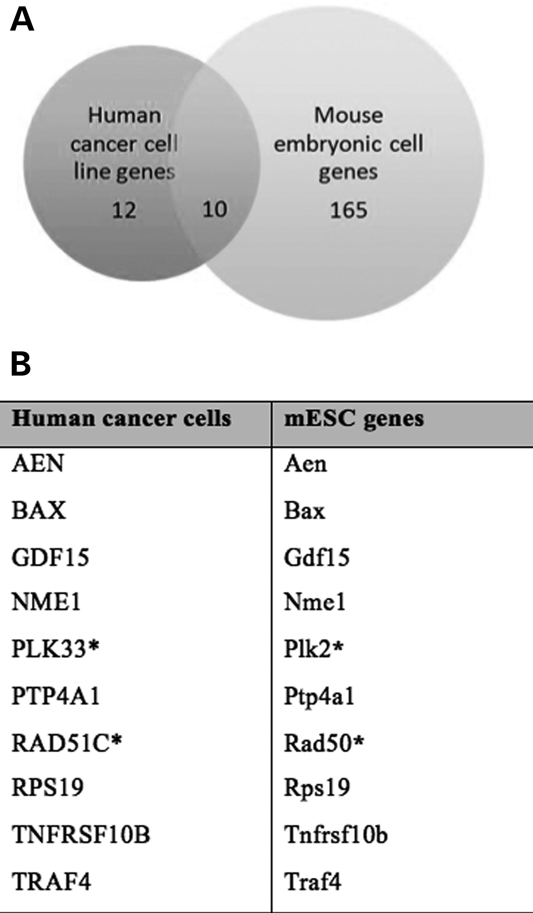
Figure 3. Number of genes that are common to both human cancer cell line analysis and mouse embryonic cell analysis ...
Notes:
Figure 3. Number of genes that are common to both human cancer cell line analysis and mouse embryonic cell analysis (A). A list of target genes predicted for enhancer elements containing P53 and cMYC cis-overlapping motifs (B).
Unless provided in the caption above, the following copyright applies to the content of this slide: © The Author 2016. Published by Oxford University Press. All rights reserved. For Permissions, please email: journals.permissions@oup.com

Slide 4
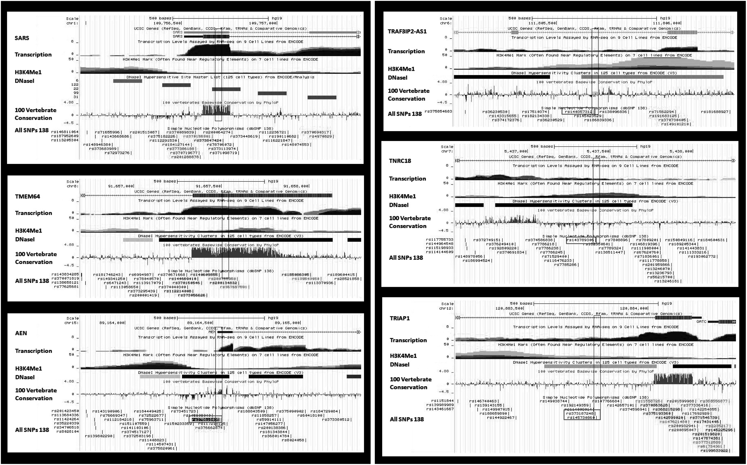
Figure 4. UCSC genome browser screenshots of the P53 and cMYC co-occupied regions. The regions on the left were ...
Notes:
Figure 4. UCSC genome browser screenshots of the P53 and cMYC co-occupied regions. The regions on the left were selected for luciferase assay based on presence of high conservation in 100 vertebrate species and signatures for putative regulatory element. The regions on the right were selected based on the presence of motif-altering SNPs, or location within a susceptibility locus for human disease.
Unless provided in the caption above, the following copyright applies to the content of this slide: © The Author 2016. Published by Oxford University Press. All rights reserved. For Permissions, please email: journals.permissions@oup.com

Slide 5
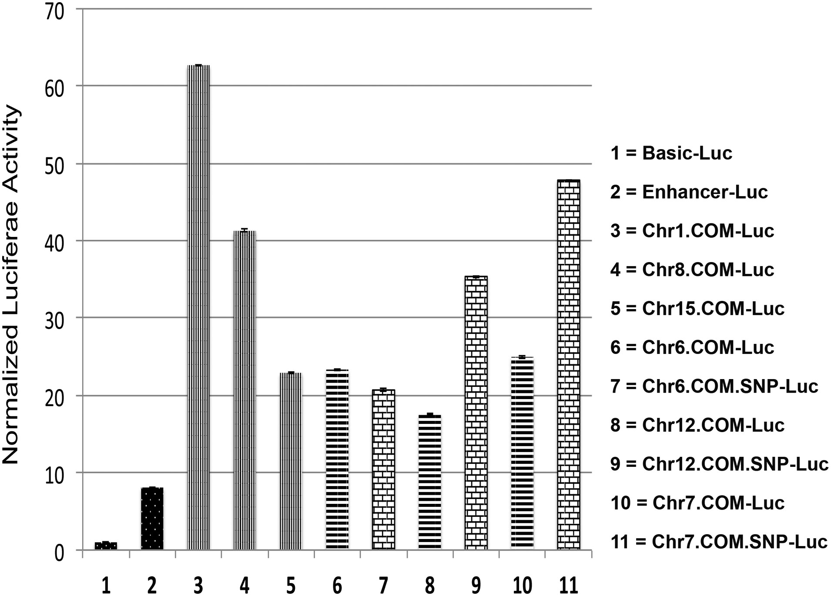
Figure 5. Luciferase activity results for co-occupied genomic regions by P53 and cMYC. The bars represent the ...
Notes:
Figure 5. Luciferase activity results for co-occupied genomic regions by P53 and cMYC. The bars represent the normalized luciferase activity driven by the co-occupied regions that contain COM elements compared with positive control construct with enhancer upstream of Luc reporter gene (black-white dots), and negative control construct with basic promoter (black-white dots). Strong luciferase activity was observed in Luc constructs driven by the co-occupied regions selected from Chr1, Chr8 and Chr15 (vertical stripes). Similarly, robust luciferase activity was observed Luc constructs driven by the co-occupied regions selected from Chr6, Chr12 and Chr7 (cross lines). After introduction of SNPs within the COMs, Luc driven by co-occupied regions from Chr12 and Chr7 showed higher activity (bricks), while the SNP within the COM in Chr6 slightly reduced luciferase activity (bricks).
Unless provided in the caption above, the following copyright applies to the content of this slide: © The Author 2016. Published by Oxford University Press. All rights reserved. For Permissions, please email: journals.permissions@oup.com

Slide 6
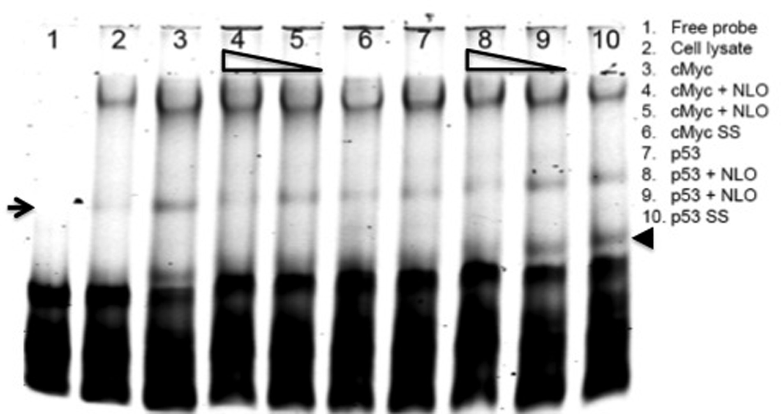
Figure 6. EMSA assay was used to test the binding of cMYC and P53 to COM of co-occupied region in Chr12. A unique shift ...
Notes:
Figure 6. EMSA assay was used to test the binding of cMYC and P53 to COM of co-occupied region in Chr12. A unique shift band of recombinant cMYC protein and tagged probe was observed (arrow, lane 3) compared with free probe alone (lane 1) and probe with only reticulocyte extract mixture (lane 2). Competitive inhibition with nonlabeled probe (NLO) that contains the SNP rs145730860 abolished the unique shift band when competed with 100-fold increase of untagged probe (lane 4), while not effect was observed with 10-fold increase (lane 5). The binding of cMYC was confirmed by using monoclonal antibodies against cMYC protein (lane 6). Lanes 7–10 were performed similar to lanes 3–6 except using P53 recombinant protein instead of cMYC, and the nonlabeled probe (NLO) contained the SNP rs373187248 instead of rs145730860. The binding of P53 was confirmed by using monoclonal antibodies against P53 protein shown by the supershift band (arrowhead) (lane 10).
Unless provided in the caption above, the following copyright applies to the content of this slide: © The Author 2016. Published by Oxford University Press. All rights reserved. For Permissions, please email: journals.permissions@oup.com

Slide 7
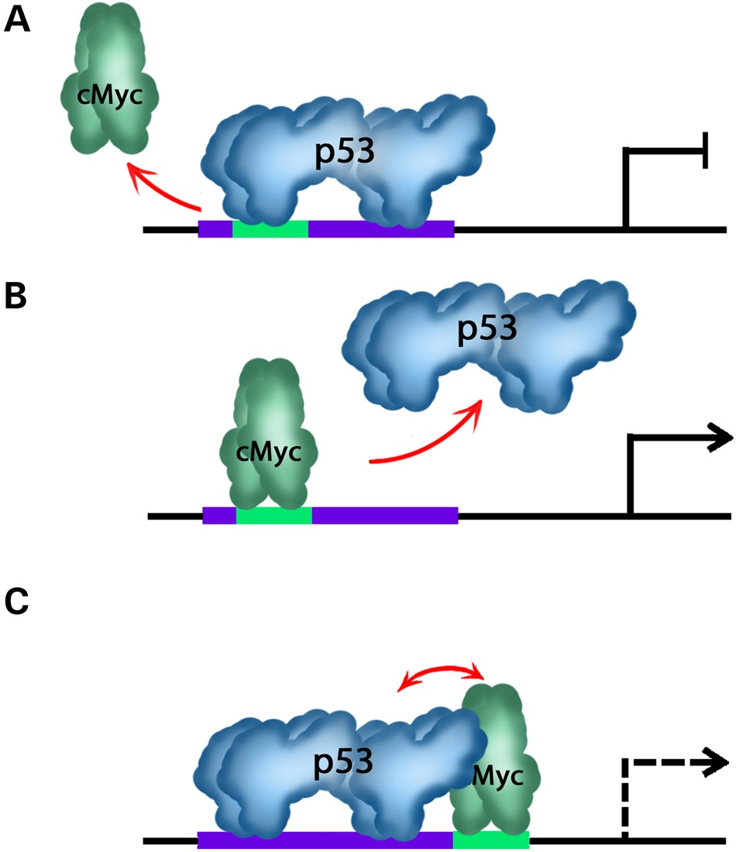
Figure 7. An illustrative diagram explains different possibilities of the competitive inhibitory mechanism at COMs. In ...
Notes:
Figure 7. An illustrative diagram explains different possibilities of the competitive inhibitory mechanism at COMs. In case of a complete or partial overlap among P53 and cMYC binding sites, P53 protein binds and prevents cMYC from binding if P53 protein is more abundant and has higher binding affinity. Consequently the expression of target gene is turned-off (A). In the second scenario, cMYC is more abundant and has higher binding affinity and subsequently drives gene expression by inhibition of P53 binding (B). In the third scenario where P53 and cMYC binding sites are head-to-head, both factors will try to compete for binding to its motif and depending on several parameters and cofactors, quenching could take place between both factors (C).
Unless provided in the caption above, the following copyright applies to the content of this slide: © The Author 2016. Published by Oxford University Press. All rights reserved. For Permissions, please email: journals.permissions@oup.com

