Slide 1
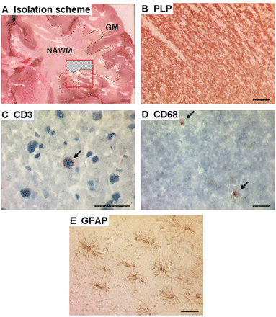
Fig. 1 Histopathological examination of subcortical MS NAWM tissue. To analyse gene expression changes in the NAWM ...
Notes:
Fig. 1 Histopathological examination of subcortical MS NAWM tissue. To analyse gene expression changes in the NAWM we isolated pure subcortical white matter (hatched area) from tissue blocks (A, red box). Immunohistochemical analyses were made to characterize the NAWM and to exclude possible lesions. NAWM stained by PLP (B) showed normal myelin. CD3 positive cells were detected rarely in the NAWM (C, arrow). We could detect some CD68 positive cells in the NAWM (D, arrows). Furthermore, staining for GFAP revealed weakly activated astrocytes (E). Bars = 50 μm.
Unless provided in the caption above, the following copyright applies to the content of this slide: © The Author (2007). Published by Oxford University Press on behalf of the Guarantors of Brain. All rights reserved. For Permissions, please email: journals.permissions@oxfordjournals.org

Slide 2
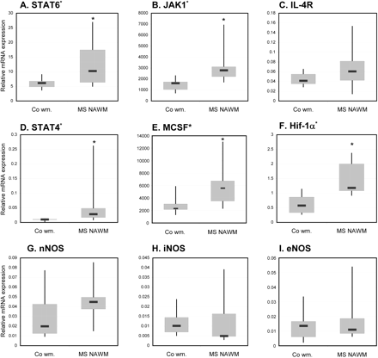
Fig. 2 Boxplots of selected differentially expressed genes analysed by quantitative RT-PCR and microarray. qRT-PCR ...
Notes:
Fig. 2 Boxplots of selected differentially expressed genes analysed by quantitative RT-PCR and microarray. qRT-PCR was performed for STAT6 (A), IL-4R (C), STAT4 (D), HIF-1α (F), nNOS (G), iNOS (H) and eNOS (I). JAK1 (B) and MCSF (E) were analysed by microarray. Boxplots show differential gene expression in control white matter and MS NAWM. Genes significantly upregulated in MS NAWM are marked with an asterisk.
Unless provided in the caption above, the following copyright applies to the content of this slide: © The Author (2007). Published by Oxford University Press on behalf of the Guarantors of Brain. All rights reserved. For Permissions, please email: journals.permissions@oxfordjournals.org

Slide 3
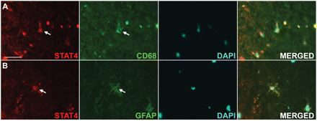
Fig. 3 Immunofluorescence localization of STAT4 in MS NAWM. Colocalization analysis showed STAT4 being expressed in ...
Notes:
Fig. 3 Immunofluorescence localization of STAT4 in MS NAWM. Colocalization analysis showed STAT4 being expressed in CD68 positive cells (A). Furthermore, we could show some astrocytes positive for STAT4 (B). We did not detect any neurons or oligodendrocytes positive for STAT4 in the NAWM. Bar = 20 μm.
Unless provided in the caption above, the following copyright applies to the content of this slide: © The Author (2007). Published by Oxford University Press on behalf of the Guarantors of Brain. All rights reserved. For Permissions, please email: journals.permissions@oxfordjournals.org

Slide 4
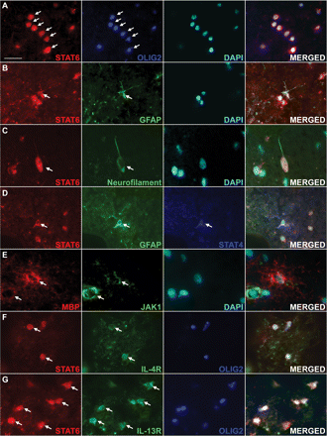
Fig. 4 Immunofluorescence localization of STAT6 and JAK1 in MS NAWM. STAT6 was mostly colocalized together with the ...
Notes:
Fig. 4 Immunofluorescence localization of STAT6 and JAK1 in MS NAWM. STAT6 was mostly colocalized together with the oligodendrocytes marker OLIG2 (A). In few cases colocalization with astrocytes (B) and subcortical white matter neurons (C) could be observed. Sporadically, we could detect some astrocytes positive for both, STAT4 and STAT6 (D). Additionally, we could show that JAK1 mostly colocalized together with the myelin protein MBP (E). Furthermore, IL-4R (F) and Il-13R (G), the main receptors leading to STAT6 activation, were detected to colocalize with STAT6 and OLIG2. Bar = 20 μm.
Unless provided in the caption above, the following copyright applies to the content of this slide: © The Author (2007). Published by Oxford University Press on behalf of the Guarantors of Brain. All rights reserved. For Permissions, please email: journals.permissions@oxfordjournals.org

Slide 5
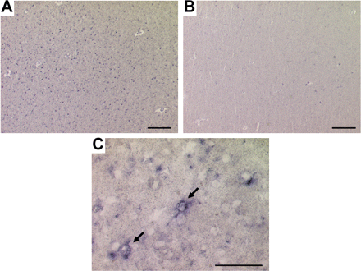
Fig. 5 In situ hybridization of HLA-DR mRNA in MS and control white matter. Many HLA-DRα positive cells were ...
Notes:
Fig. 5 In situ hybridization of HLA-DR mRNA in MS and control white matter. Many HLA-DRα positive cells were detected in the NAWM of MS cases (A) compared with white matter from control cases where the hybridization signal was below background levels (B). In situ hybridization shows that HLA-DRα mRNA expression in cells of the NAWM morphologically alike microglia cells (C, arrows). Bar = 50 μm.
Unless provided in the caption above, the following copyright applies to the content of this slide: © The Author (2007). Published by Oxford University Press on behalf of the Guarantors of Brain. All rights reserved. For Permissions, please email: journals.permissions@oxfordjournals.org

Slide 6
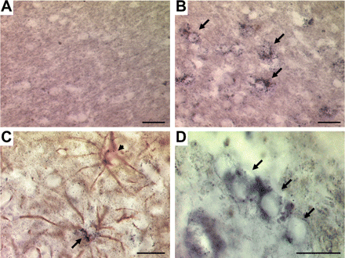
Fig. 6 In situ hybridization of HIF-1α mRNA in MS and control white matter. In subcortical white matter of control ...
Notes:
Fig. 6 In situ hybridization of HIF-1α mRNA in MS and control white matter. In subcortical white matter of control cases HIF-1α could not be detected (A). In MS NAWM, however, we could detect a hybridization signal for HIF-1α mRNA in a number of cells (B). Colocalization with anti-GFAP immunohistochemistry revealed a subpopulation of astrocytes expressing HIF-1α (C, arrow), whereas other astrocytes were negative for HIF-1α (C, arrowhead). Due to the chain-like arrangement and their morphology, we suggest that Hif-1α is also expressed by oligodendrocytes (D, arrows). Bars = 25 μm.
Unless provided in the caption above, the following copyright applies to the content of this slide: © The Author (2007). Published by Oxford University Press on behalf of the Guarantors of Brain. All rights reserved. For Permissions, please email: journals.permissions@oxfordjournals.org

