Slide 1
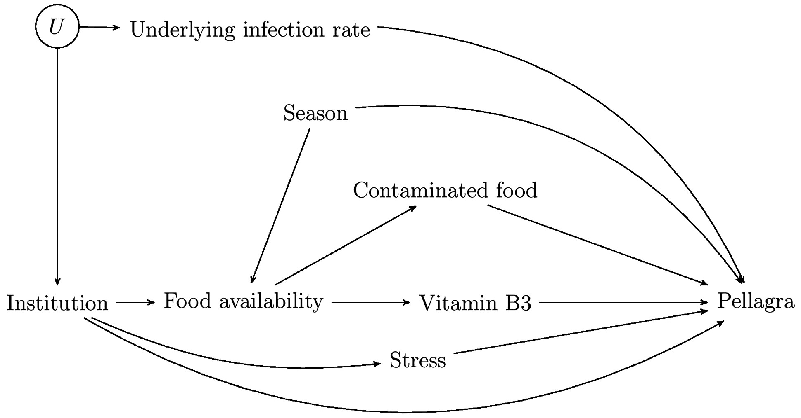
Figure 1. A casual DAG representing all the hypotheses discussed by KDS in relation to the effect of ...
Notes:
Figure 1. A casual DAG representing all the hypotheses discussed by KDS in relation to the effect of institutionalisation on pellagra infection.
Unless provided in the caption above, the following copyright applies to the content of this slide: © The Author 2017. Published by Oxford University Press on behalf of the International Epidemiological AssociationThis is an Open Access article distributed under the terms of the Creative Commons Attribution License (http://creativecommons.org/licenses/by/4.0/), which permits unrestricted reuse, distribution, and reproduction in any medium, provided the original work is properly cited.

Slide 2
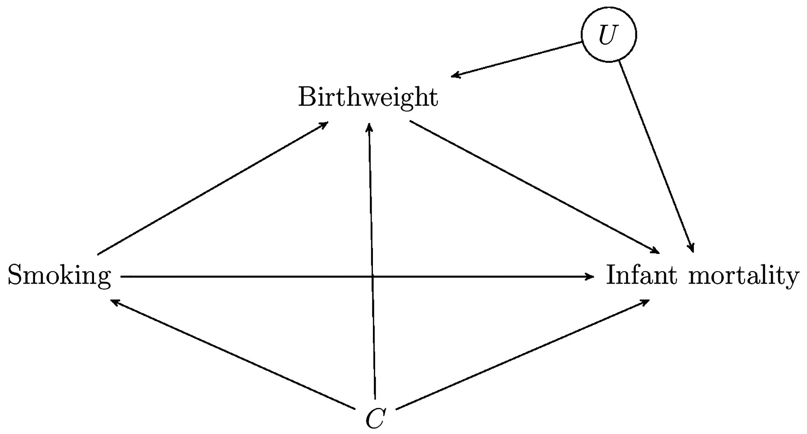
Figure 2. A casual DAG for the ‘birthweight paradox’.
Notes:
Figure 2. A casual DAG for the ‘birthweight paradox’.
Unless provided in the caption above, the following copyright applies to the content of this slide: © The Author 2017. Published by Oxford University Press on behalf of the International Epidemiological AssociationThis is an Open Access article distributed under the terms of the Creative Commons Attribution License (http://creativecommons.org/licenses/by/4.0/), which permits unrestricted reuse, distribution, and reproduction in any medium, provided the original work is properly cited.

