Slide 1
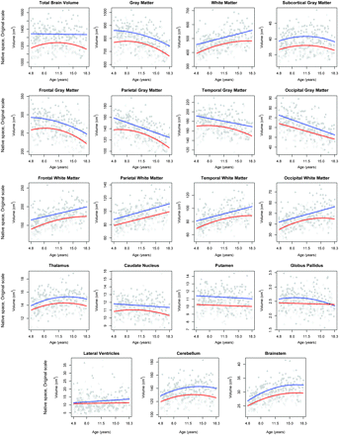
Figure 1. Individual data points and best-fitting cross-sectional age curves for males and females separately for all ...
Notes:
Figure 1. Individual data points and best-fitting cross-sectional age curves for males and females separately for all regional volumes without consideration of any other covariates.
Unless provided in the caption above, the following copyright applies to the content of this slide: Published by Oxford University Press 2011.

