Slide 1
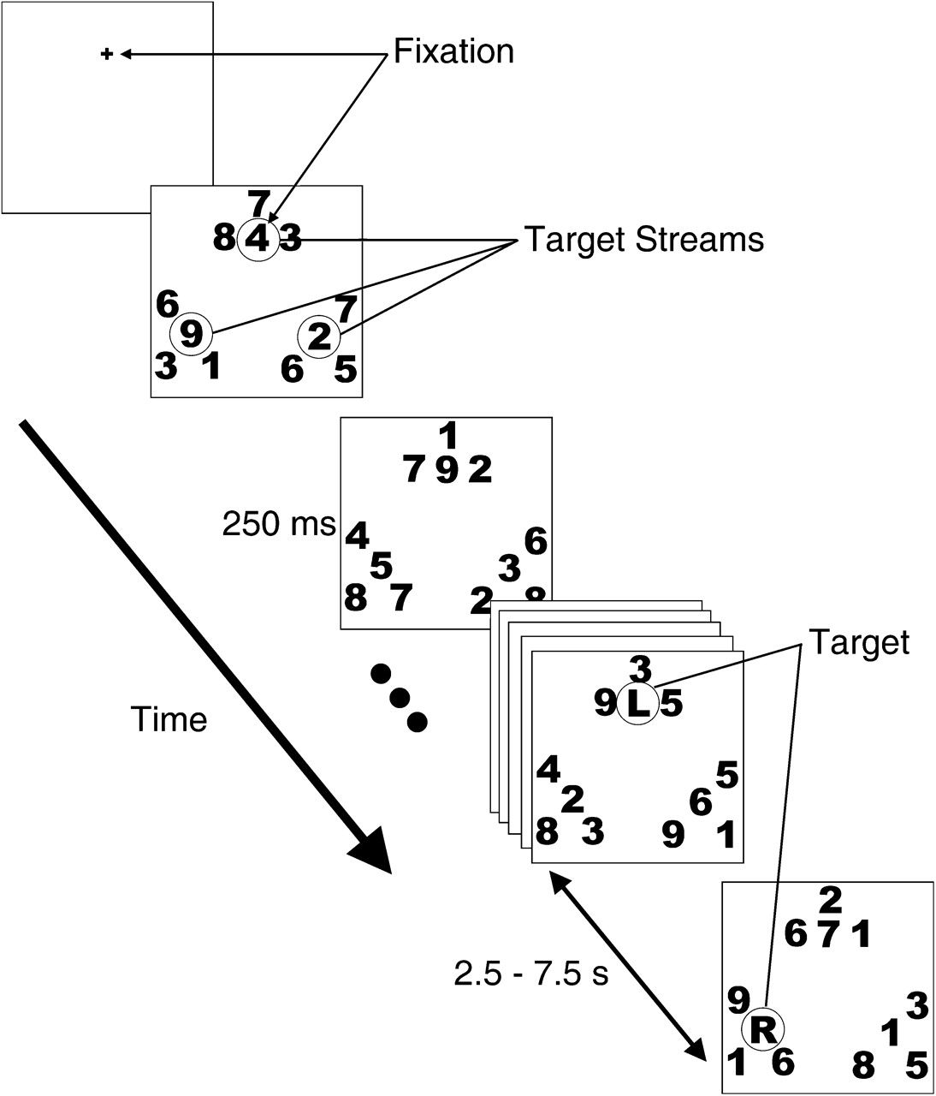
Figure 1. RSVP task. A fixation cross appeared for 1.5 s. Following the offset of the fixation cross, the 3 target and ...
Notes:
Figure 1. RSVP task. A fixation cross appeared for 1.5 s. Following the offset of the fixation cross, the 3 target and 9 distractor streams appeared. One of the target streams appeared at fixation. Digits changed identity in each stream synchronously every 250 ms. The first target item, an “L,” a “C,” or an “R,” appeared at fixation. Subjects pressed a button when a target was detected in the attended stream. The identity of the target cued the stream that should be attended next, requiring either a shift of attention or a hold. After a variable delay of 2.5–7.5 s (equaling 6–30 successive 250 ms stimulus frames), the next target appeared in the attended stream.
Unless provided in the caption above, the following copyright applies to the content of this slide: © The Author 2007. Published by Oxford University Press. All rights reserved. For permissions, please e-mail: journals.permissions@oxfordjournals.org

Slide 2
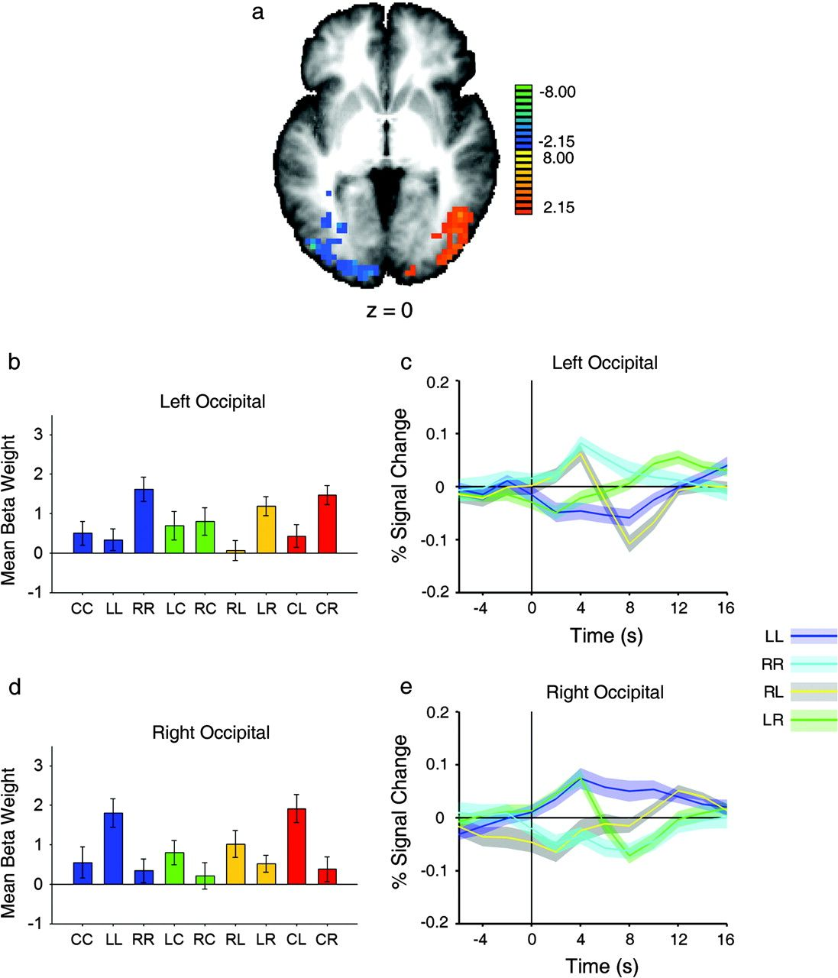
Figure 2. Attentional modulation of activity in extrastriate occipital cortex and parietal lobe (left side of the brain ...
Notes:
Figure 2. Attentional modulation of activity in extrastriate occipital cortex and parietal lobe (left side of the brain corresponds to left side of the image, for all figures). (a) Axial statistical t map showing activated regions of cortex, displayed on a group-averaged Talairach brain, for the contrast of LL versus RR (warm colors represent activity related to attending left, and cool colors represent activity related to attending right). (b, d) Beta weights for the 9 event types in left and right occipital lobe, respectively. All beta weights represent the mean of all voxels in a region, averaged across all subjects. (c, e) Event-related time courses of LL, RR, LR, and RL for left and right occipital lobe, respectively. Shaded regions represent ± 1 standard error of the mean around each time point. Percent signal change at each time point is taken from the mean signal across all voxels, averaged across all subjects.
Unless provided in the caption above, the following copyright applies to the content of this slide: © The Author 2007. Published by Oxford University Press. All rights reserved. For permissions, please e-mail: journals.permissions@oxfordjournals.org

Slide 3
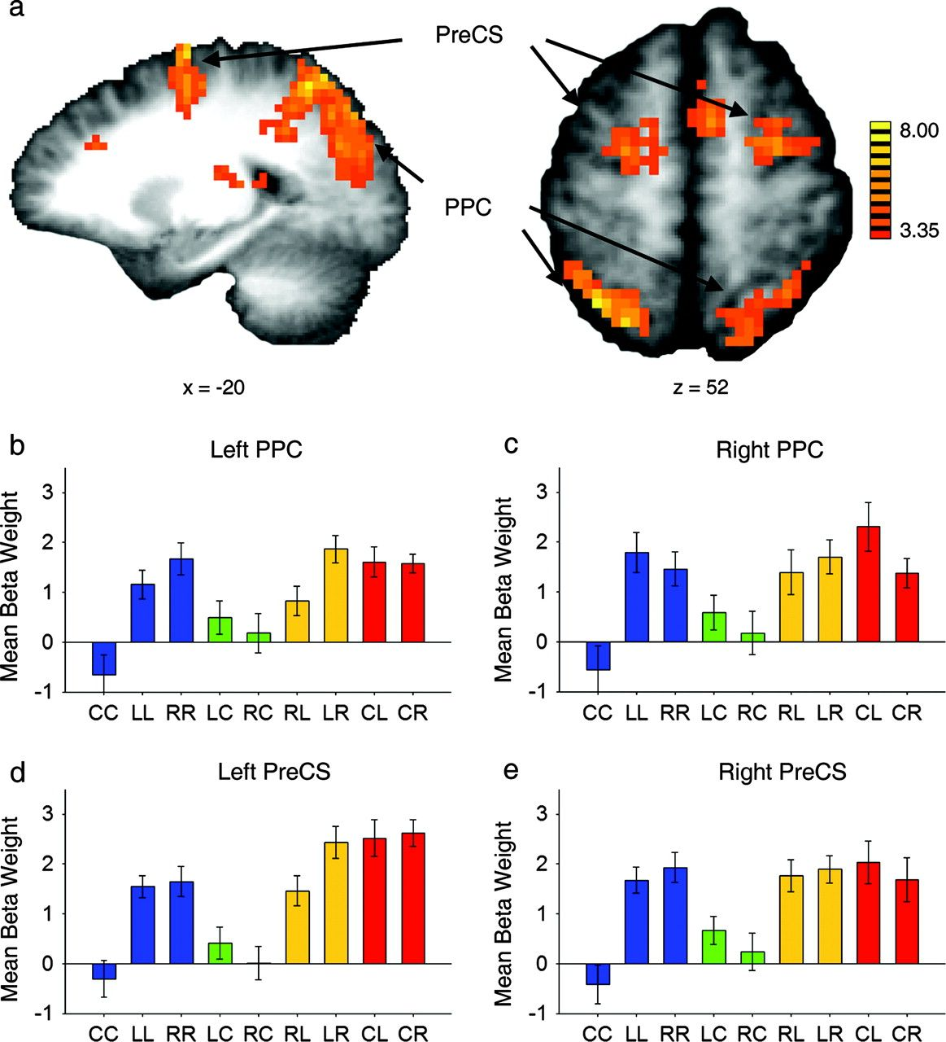
Figure 3. Increased cortical response for maintaining attention in the periphery compared with maintaining attention at ...
Notes:
Figure 3. Increased cortical response for maintaining attention in the periphery compared with maintaining attention at fixation. (a) Sagittal and axial views of statistical t map of regions active for LL and RR > CC in bilateral PPC and PreCS (refer to Table 2 for Talairach coordinates). (b–e) Beta weights for the 9 event types in left and right PPC and PreCS, respectively (see Fig. 4 for the corresponding time courses).
Unless provided in the caption above, the following copyright applies to the content of this slide: © The Author 2007. Published by Oxford University Press. All rights reserved. For permissions, please e-mail: journals.permissions@oxfordjournals.org

Slide 4
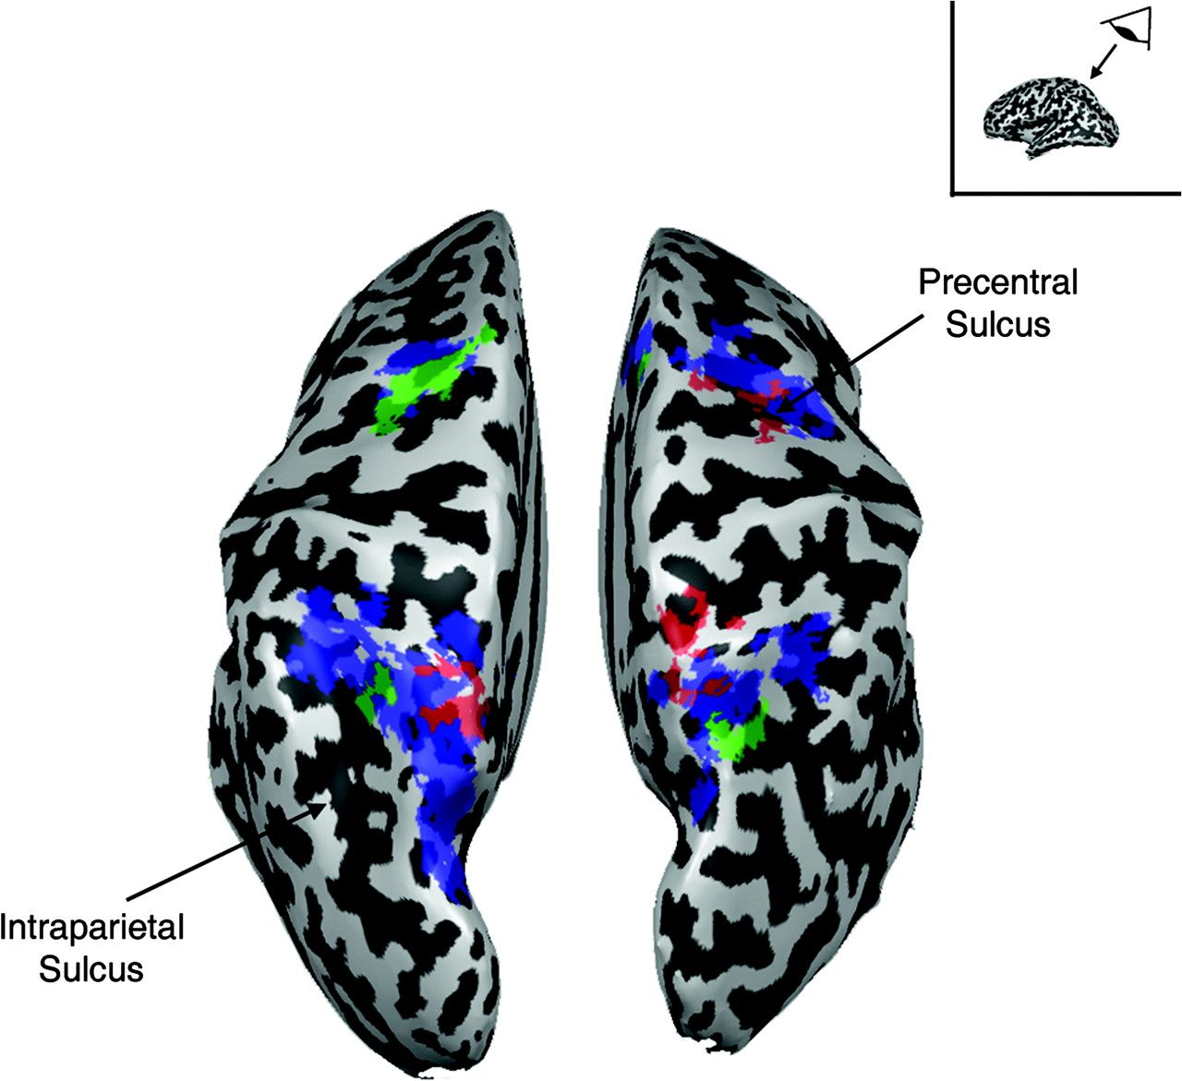
Figure 8. ROIs shown in Figures 3, 5, and 6, projected onto the inflated cortical surface of a single subject, for the ...
Notes:
Figure 8. ROIs shown in Figures 3, 5, and 6, projected onto the inflated cortical surface of a single subject, for the purpose of spatial comparison. Blue represents regions more active while attention was maintained in the periphery (LL and RR > CC); red represents areas that were transiently active for peripheral shifts of attention ([RL and LR] > [LL and RR]); green represents areas that were transiently active for decoupling attention from fixation ([CL and CR] > [RL and LR]). Of importance here is the lack of spatial overlap between the red and green areas.
Unless provided in the caption above, the following copyright applies to the content of this slide: © The Author 2007. Published by Oxford University Press. All rights reserved. For permissions, please e-mail: journals.permissions@oxfordjournals.org

Slide 5
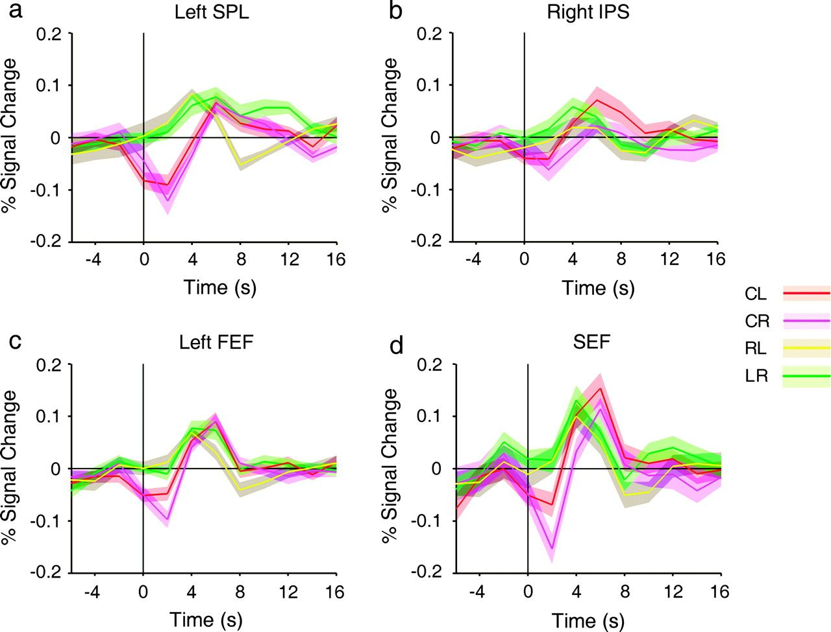
Figure 7. (a–d) Event-related time courses of CL, CR, LR, and RL in left SPL, left FEF, right IPS, and SEF, ...
Notes:
Figure 7. (a–d) Event-related time courses of CL, CR, LR, and RL in left SPL, left FEF, right IPS, and SEF, respectively.
Unless provided in the caption above, the following copyright applies to the content of this slide: © The Author 2007. Published by Oxford University Press. All rights reserved. For permissions, please e-mail: journals.permissions@oxfordjournals.org

Slide 6
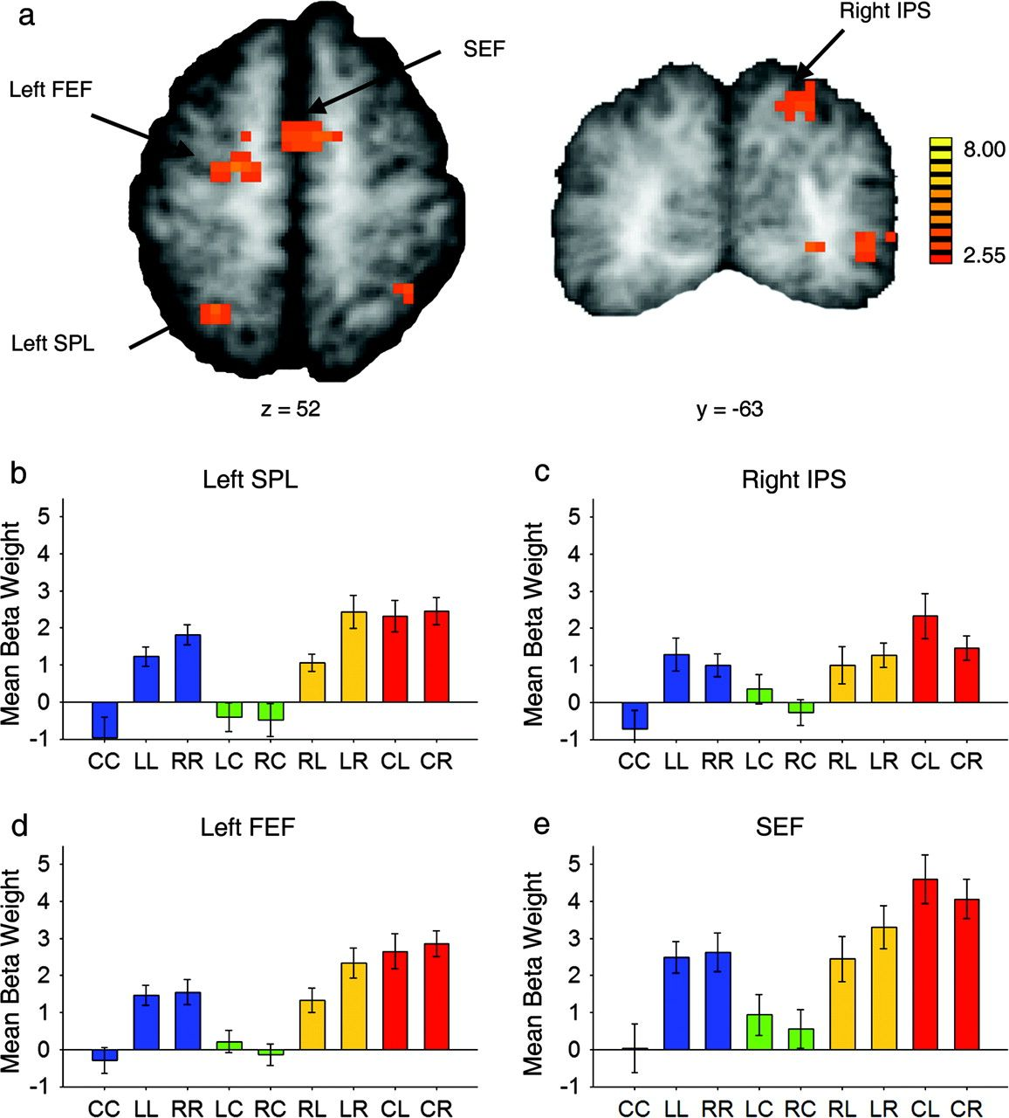
Figure 6. Increased cortical response to shift from fixation to periphery versus shift from one peripheral location to ...
Notes:
Figure 6. Increased cortical response to shift from fixation to periphery versus shift from one peripheral location to the other ([CL and CR] > [LR and RL]). (a) Axial view of statistical t map, showing left SPL, left FEF, and SEF (refer to Table 4 for Talairach coordinates). (b) Coronal view of the same contrast, showing right dorsal posterior IPS. (c–f) Beta weights for the 9 event types in left SPL, right IPS, left FEF, and SEF, respectively (see Fig. 7 for the corresponding time courses).
Unless provided in the caption above, the following copyright applies to the content of this slide: © The Author 2007. Published by Oxford University Press. All rights reserved. For permissions, please e-mail: journals.permissions@oxfordjournals.org

Slide 7
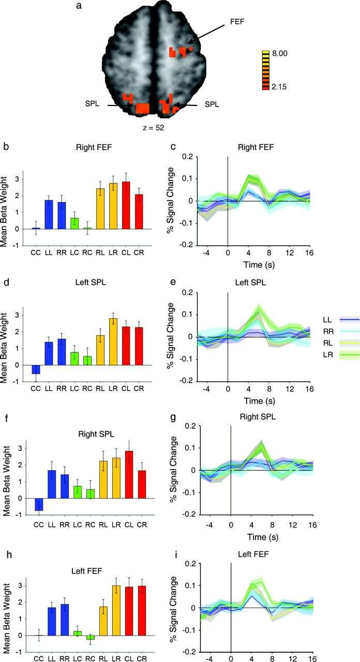
Figure 5. Increased cortical response to shift versus hold targets. (a) Statistical t map of regions active for (RL and ...
Notes:
Figure 5. Increased cortical response to shift versus hold targets. (a) Statistical t map of regions active for (RL and LR) > (LL and RR), revealing SPL and FEF activity (refer to Table 3 for Talairach coordinates). (b, d, f) Beta weights for the 9 event types in right FEF and left and right SPL, respectively. (c, e, g) Event-related time courses of LL, RR, RL, and LR for right FEF and left and right SPL, respectively. (h, i) Plots of the beta weights for the 9 event types and event-related time courses for LL, RR, RL, and LR. These data were extracted from a portion of left prefrontal cortex defined by the mirror of the right FEF ROI.
Unless provided in the caption above, the following copyright applies to the content of this slide: © The Author 2007. Published by Oxford University Press. All rights reserved. For permissions, please e-mail: journals.permissions@oxfordjournals.org

Slide 8
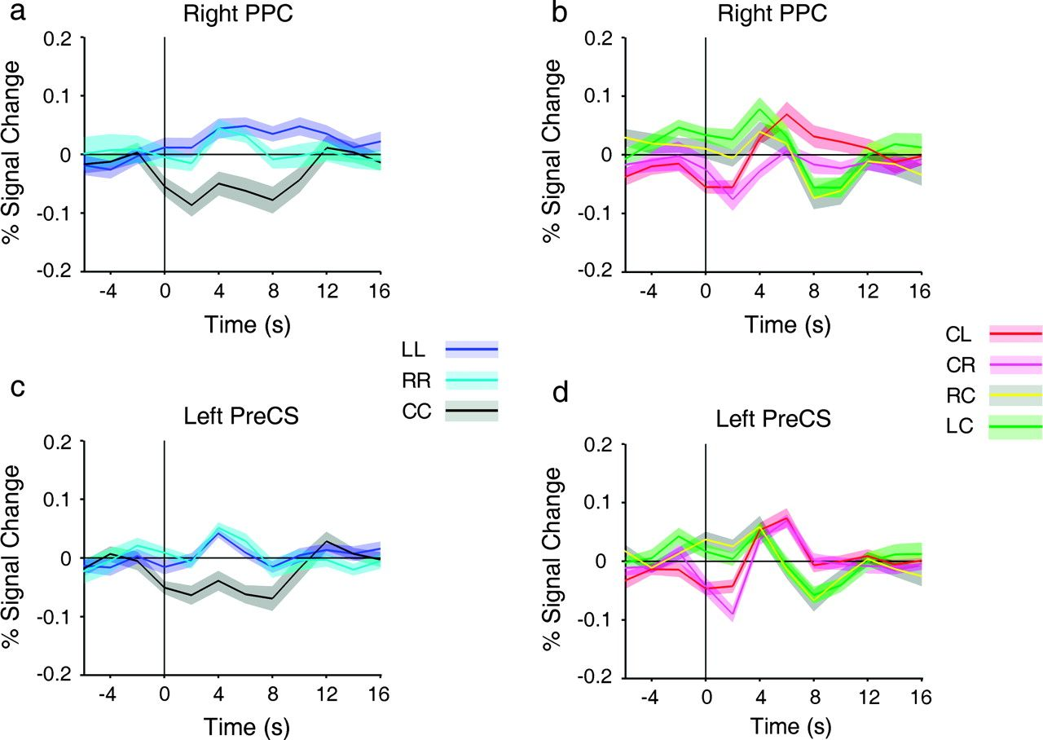
Figure 4. Event-related time courses extracted from some of the ROIs depicted in Figure 3. (a, c) Event-related time ...
Notes:
Figure 4. Event-related time courses extracted from some of the ROIs depicted in Figure 3. (a, c) Event-related time courses of LL, RR, and CC in right PPC and left PreCS, respectively, showing same pattern of activity as beta weight plots (cf., Fig. 3). (b, d) Event-related time courses of CL, CR, LC, and RC in right PPC and left PreCS, respectively.
Unless provided in the caption above, the following copyright applies to the content of this slide: © The Author 2007. Published by Oxford University Press. All rights reserved. For permissions, please e-mail: journals.permissions@oxfordjournals.org

