Slide 1
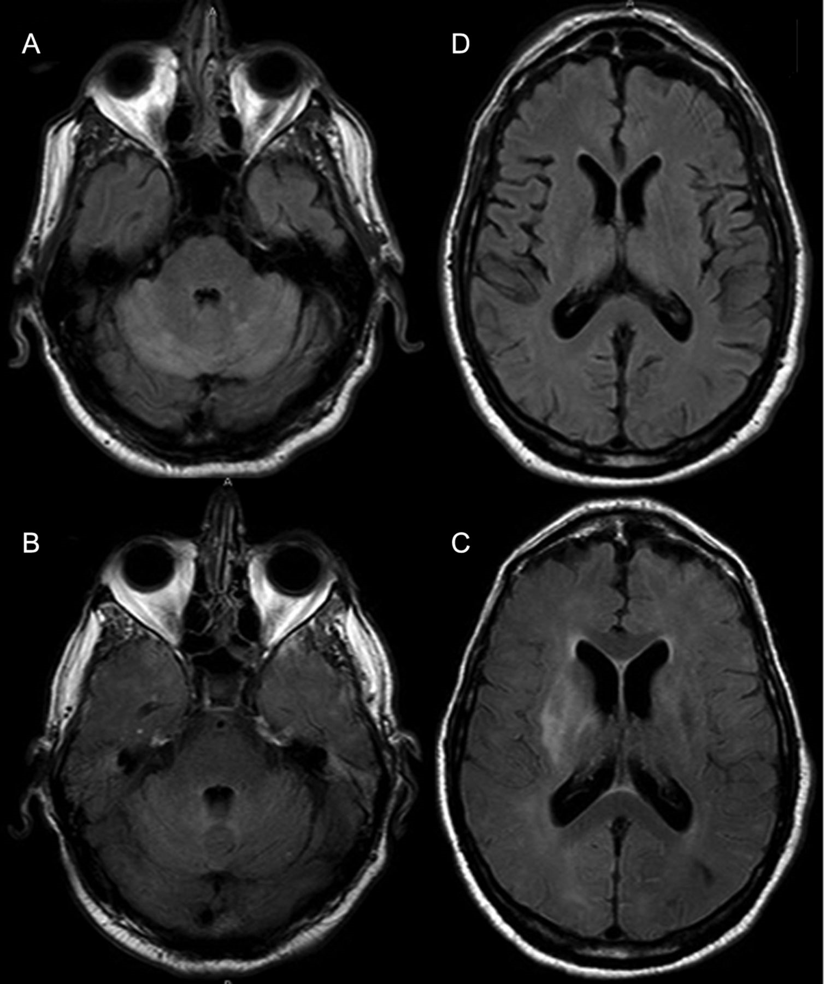
Figure 1. Magnetic resonance images of the brain with gadolinium enhancement on day 8 of hospitalization (top row) ...
Notes:
Figure 1. Magnetic resonance images of the brain with gadolinium enhancement on day 8 of hospitalization (top row) compared with day 51 (bottom row). Images demonstrate enhancement within the bilateral cerebellar hemispheres on day 8 (A), which was markedly improved on day 51 (B); however, new enhancement was seen on day 51 in the right basal ganglia (C), which had been absent at presentation (D).
Unless provided in the caption above, the following copyright applies to the content of this slide: © The Author 2012. Published by Oxford University Press on behalf of the Infectious Diseases Society of America. All rights reserved. For Permissions, please e-mail: journals.permissions@oup.com.

Slide 2
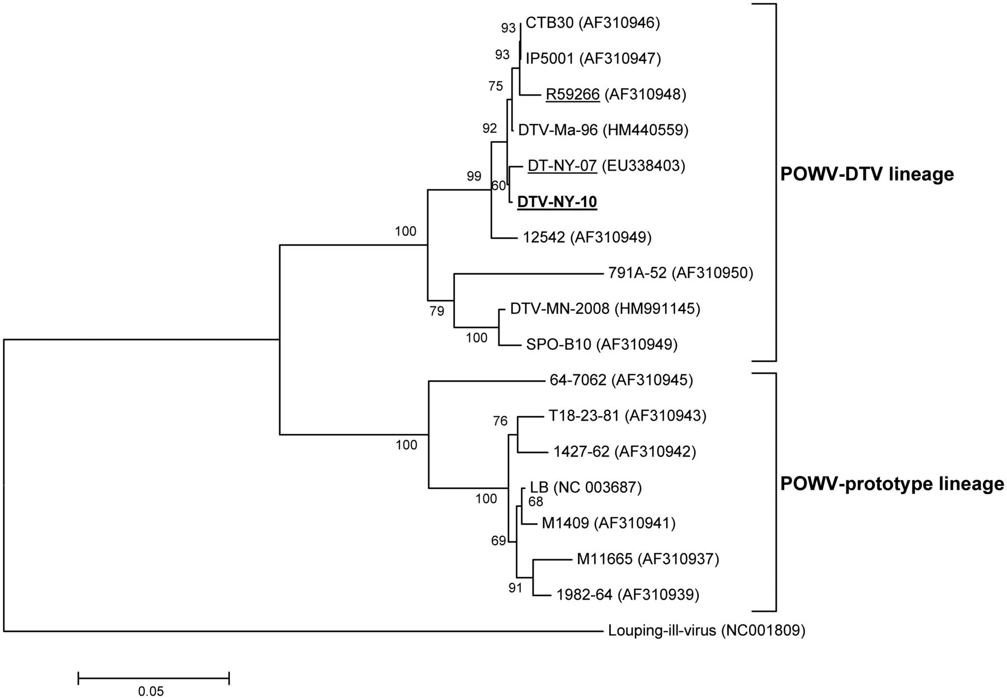
Figure 2. Evolutionary relationship of 18 taxa inferred using the neighbor-joining method [28] with bootstrap (500 ...
Notes:
Figure 2. Evolutionary relationship of 18 taxa inferred using the neighbor-joining method [28] with bootstrap (500 replicates) [29]. Relatedness was supported by analysis with the maximum parsimony method from a total of 981 positions in the final data set. Branches corresponding to partitions reproduced in <50% of bootstrap replicates are collapsed. Evolutionary distances were computed using the data-specific method [30], and units represent the number of base substitutions per site. Evolutionary analyses were conducted using MEGA4 software [31]. R59266 [2], DT-NY-07 [7], and DTV-MN-2008 (not reported) are the only known DTV strains from human cases. The newly identified strain is in bold type and underlined. DTV, deer tick virus; POWV, Powassan virus.
Unless provided in the caption above, the following copyright applies to the content of this slide: © The Author 2012. Published by Oxford University Press on behalf of the Infectious Diseases Society of America. All rights reserved. For Permissions, please e-mail: journals.permissions@oup.com.

