Slide 1
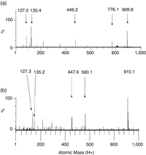
1 Electrospray ionization mass spectra for microcystin-LA standard (a) and a field sample (b) acquired using a ...
Notes:
1 Electrospray ionization mass spectra for microcystin-LA standard (a) and a field sample (b) acquired using a cone voltage of 80 V. Five diagnostic fragments and the indicative peak (atomic mass 910) are indicated for both samples. The field sample was from BBD on a colony of Siderastrea siderea, Horseshoe Reef, Lee Stocking Island, Bahamas.
Unless provided in the caption above, the following copyright applies to the content of this slide: © 2007 Federation of European Microbiological Societies

