Slide 1
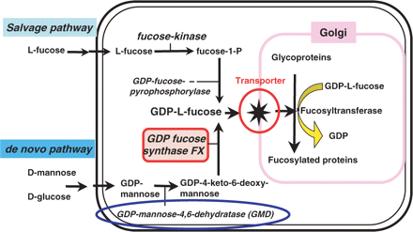
Fig. 1. A synthetic pathway for GDP-fucose. There are two different pathways for producing GDP-fucose in cells. While ...
Notes:
Fig. 1. A synthetic pathway for GDP-fucose. There are two different pathways for producing GDP-fucose in cells. While many enzymes are involved in the reaction, both GMD and FX play pivotal roles in production of the final product, GDP-fucose.
Unless provided in the caption above, the following copyright applies to the content of this slide: © 2008 The Japanese Biochemical Society

Slide 2
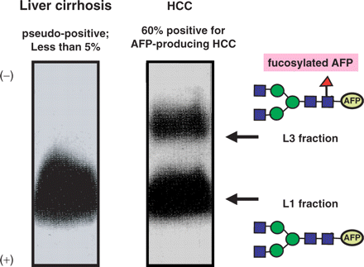
Fig. 2. LCA lectin electrophoresis to identify AFP-L3 (fucosylated AFP). WAKO Pure Chemical Industries established ...
Notes:
Fig. 2. LCA lectin electrophoresis to identify AFP-L3 (fucosylated AFP). WAKO Pure Chemical Industries established this system. The sera of patients with liver cirrhosis and HCC were elctrophoresed on an LCA agarose gel and western blot analysis was performed. Detail procedure was described previously (4, 5). Since fucosylated AFP run more slowly on the LCA agarose gel, it was identified as AFP-L3. Levels of total AFP were increased in patients with HCC (∼40–60%) as well as chronic liver diseases such as chronic hepatitis and liver cirrhosis. The AFP-L3 positive rate was ∼60% in AFP-producing HCC, but was <5% in chronic liver diseases.
Unless provided in the caption above, the following copyright applies to the content of this slide: © 2008 The Japanese Biochemical Society

Slide 3
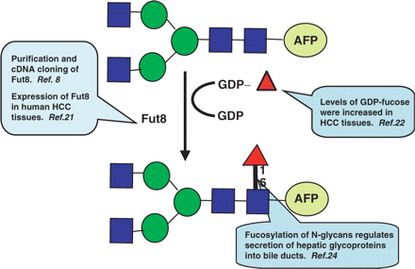
Fig. 3. Molecular mechanisms for producing fucosylated AFP in patients with HCC. The enhancement of Fut8 (8) is ...
Notes:
Fig. 3. Molecular mechanisms for producing fucosylated AFP in patients with HCC. The enhancement of Fut8 (8) is required to produce fucosylated AFP, but this enhancement is insufficient for the production of fucosylated AFP in HCC (21). A donor substrate, GDP-fucose is a more important regulatory factor for the fucosylation of HCC (22). FX plays a pivotal role in the synthesis of GDP-fucose. Another mechanism might exist in terms of an increase in fucosylated AFP in the sera of patients with HCC. Interestingly, fucosylated glycoproteins produced in hepatocytes are secreted into the bile, which is on the apical side of hepatocytes (24).
Unless provided in the caption above, the following copyright applies to the content of this slide: © 2008 The Japanese Biochemical Society

