Slide 1
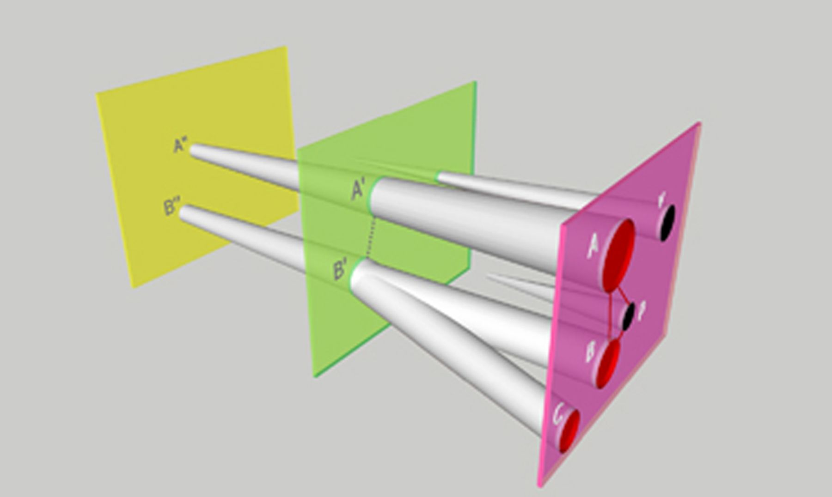
Figure 1 Representing exchange communities. Cellular or genomic lineages (depicted here as tubes) evolve in time ...
Notes:
Figure 1 Representing exchange communities. Cellular or genomic lineages (depicted here as tubes) evolve in time (here, left to right), with genetic regions continually gained and lost (for clarity, not shown here). The orthogonal planes represent successive temporal shapshots. Within each plane, the intersections with lineages represent biological entities as they existed at that point in time; thus, in the right-hand-most plane, A, B and C represent groups of bacteria, and P and V types of plasmids or phage, as they exist and are delineated today. A region of DNA 100% identical in sampled members of A, B and P and inferred to be of lateral origin is likely to have been transferred very recently, as represented by solid lines. A region 80% identical in A and B (and/or C) might be inferred to have been transferred at some point in the past (the dashed line in the middle plane) into or between A′ and B′, earlier biological groups that, especially due to LGT, may have been quite different from present-day A and B (and/or C) and should not (without cause) be labelled with present-day strain designations. Alternatively, a region of 80% identity in present-day A and B might have been transferred to both very recently from an unknown source not available to our analysis; the situation in C might favour one of these scenarios. In general, precision and density of sampling are helpful in reconstructing pathways of LGT and in delineating GECs.
Unless provided in the caption above, the following copyright applies to the content of this slide: © 2011 Federation of European Microbiological Societies.This is an Open Access article distributed under the terms of the Creative Commons Attribution-NonCommercial-NoDerivs licence (http://creativecommons.org/licenses/by-nc-nd/3.0/) which permits non-commercial reproduction and distribution of the work, in any medium, provided the original work is not altered or transformed in any way, and that the work is properly cited. For commercial re-use, please contact journals.permissions@oup.com

Slide 2
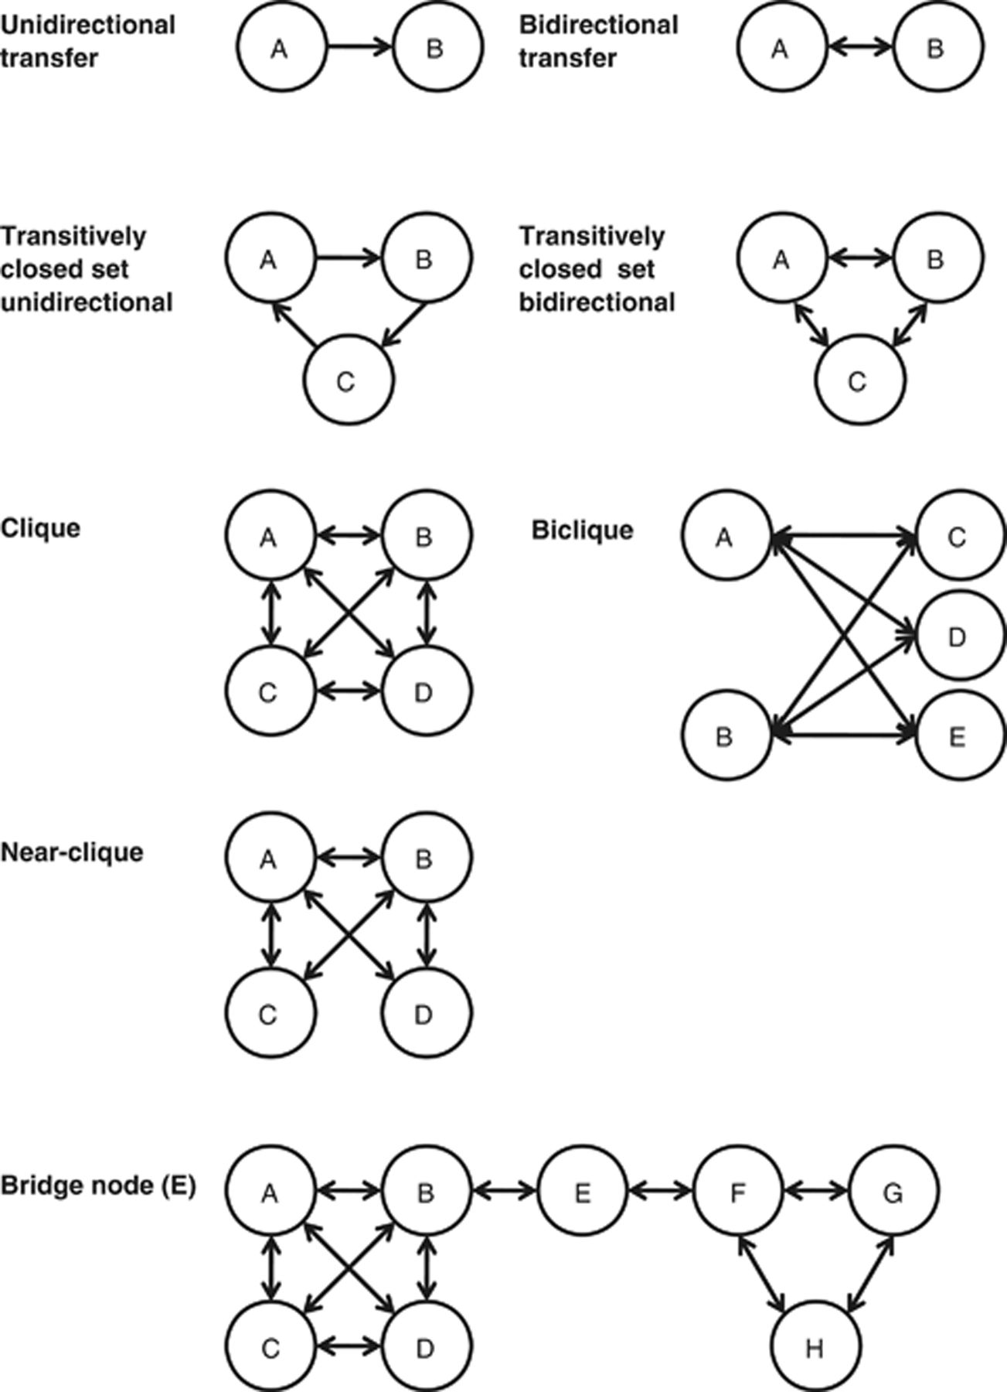
Figure 2 Graph operations and structures for delineating genetic exchange communities.
Notes:
Figure 2 Graph operations and structures for delineating genetic exchange communities.
Unless provided in the caption above, the following copyright applies to the content of this slide: © 2011 Federation of European Microbiological Societies.This is an Open Access article distributed under the terms of the Creative Commons Attribution-NonCommercial-NoDerivs licence (http://creativecommons.org/licenses/by-nc-nd/3.0/) which permits non-commercial reproduction and distribution of the work, in any medium, provided the original work is not altered or transformed in any way, and that the work is properly cited. For commercial re-use, please contact journals.permissions@oup.com

