Slide 1
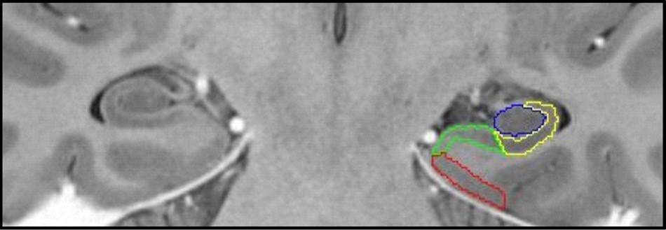
Figure 1. An example of manual tracing of the EC and hippocampal subfields: EC—red; subiculum—green; CA1–2—yellow; ...
Notes:
Figure 1. An example of manual tracing of the EC and hippocampal subfields: EC—red; subiculum—green; CA1–2—yellow; CA3–dentate gyrus—blue.
Unless provided in the caption above, the following copyright applies to the content of this slide: © The Author 2015. Published by Oxford University Press. All rights reserved. For Permissions, please e-mail: journals.permissions@oup.com

Slide 2
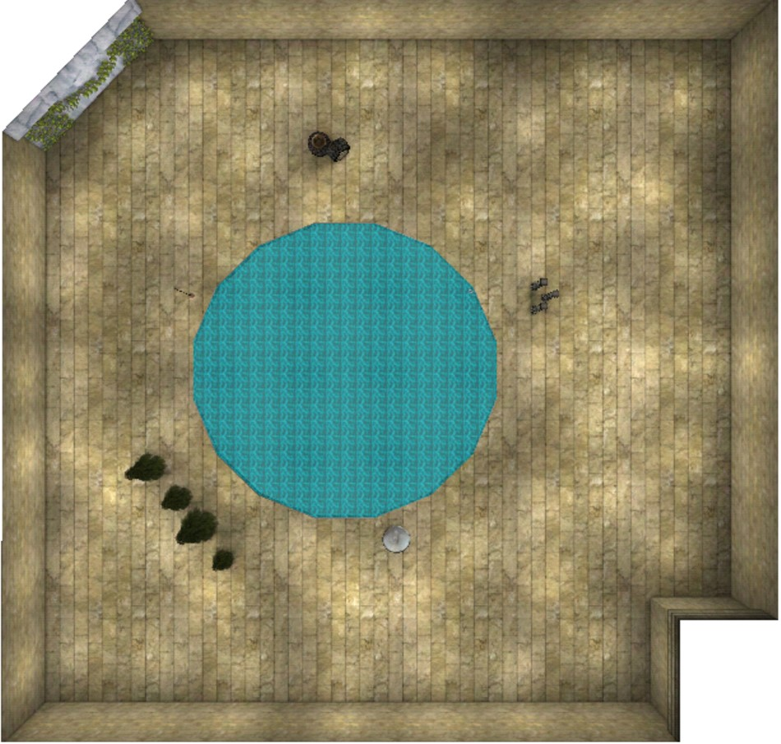
Figure 2. An overhead view of the testing vMWM environment.
Notes:
Figure 2. An overhead view of the testing vMWM environment.
Unless provided in the caption above, the following copyright applies to the content of this slide: © The Author 2015. Published by Oxford University Press. All rights reserved. For Permissions, please e-mail: journals.permissions@oup.com

Slide 3
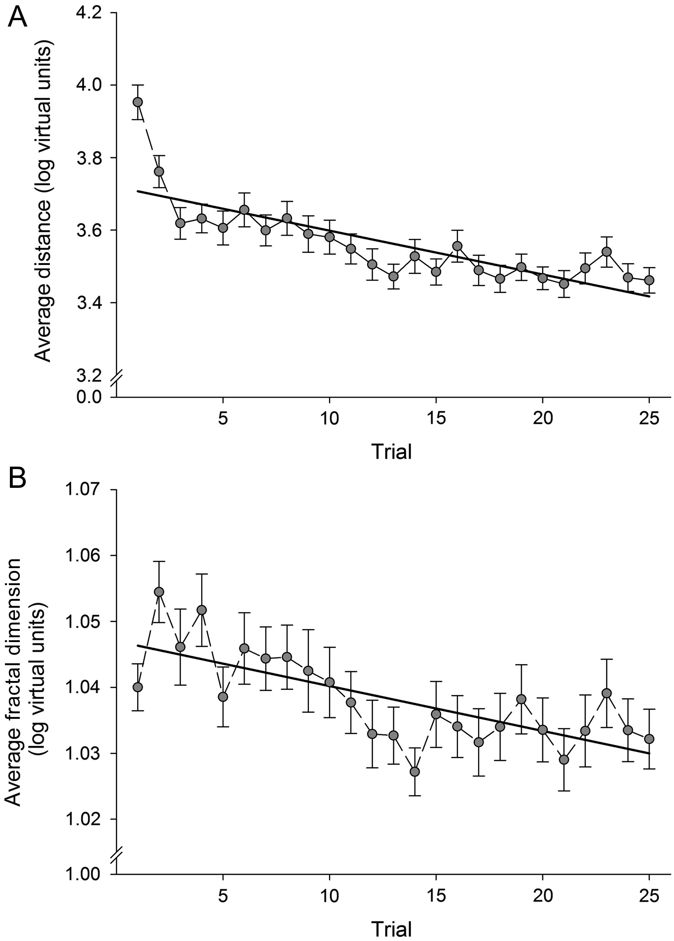
Figure 3. (A) Change in average distance traveled in search of the platform (P = 0.002) and (B) change in average ...
Notes:
Figure 3. (A) Change in average distance traveled in search of the platform (P = 0.002) and (B) change in average fractal dimension of search paths (P < 0.001) across 25 learning trials. Error bars represent standard error of the mean.
Unless provided in the caption above, the following copyright applies to the content of this slide: © The Author 2015. Published by Oxford University Press. All rights reserved. For Permissions, please e-mail: journals.permissions@oup.com

Slide 4
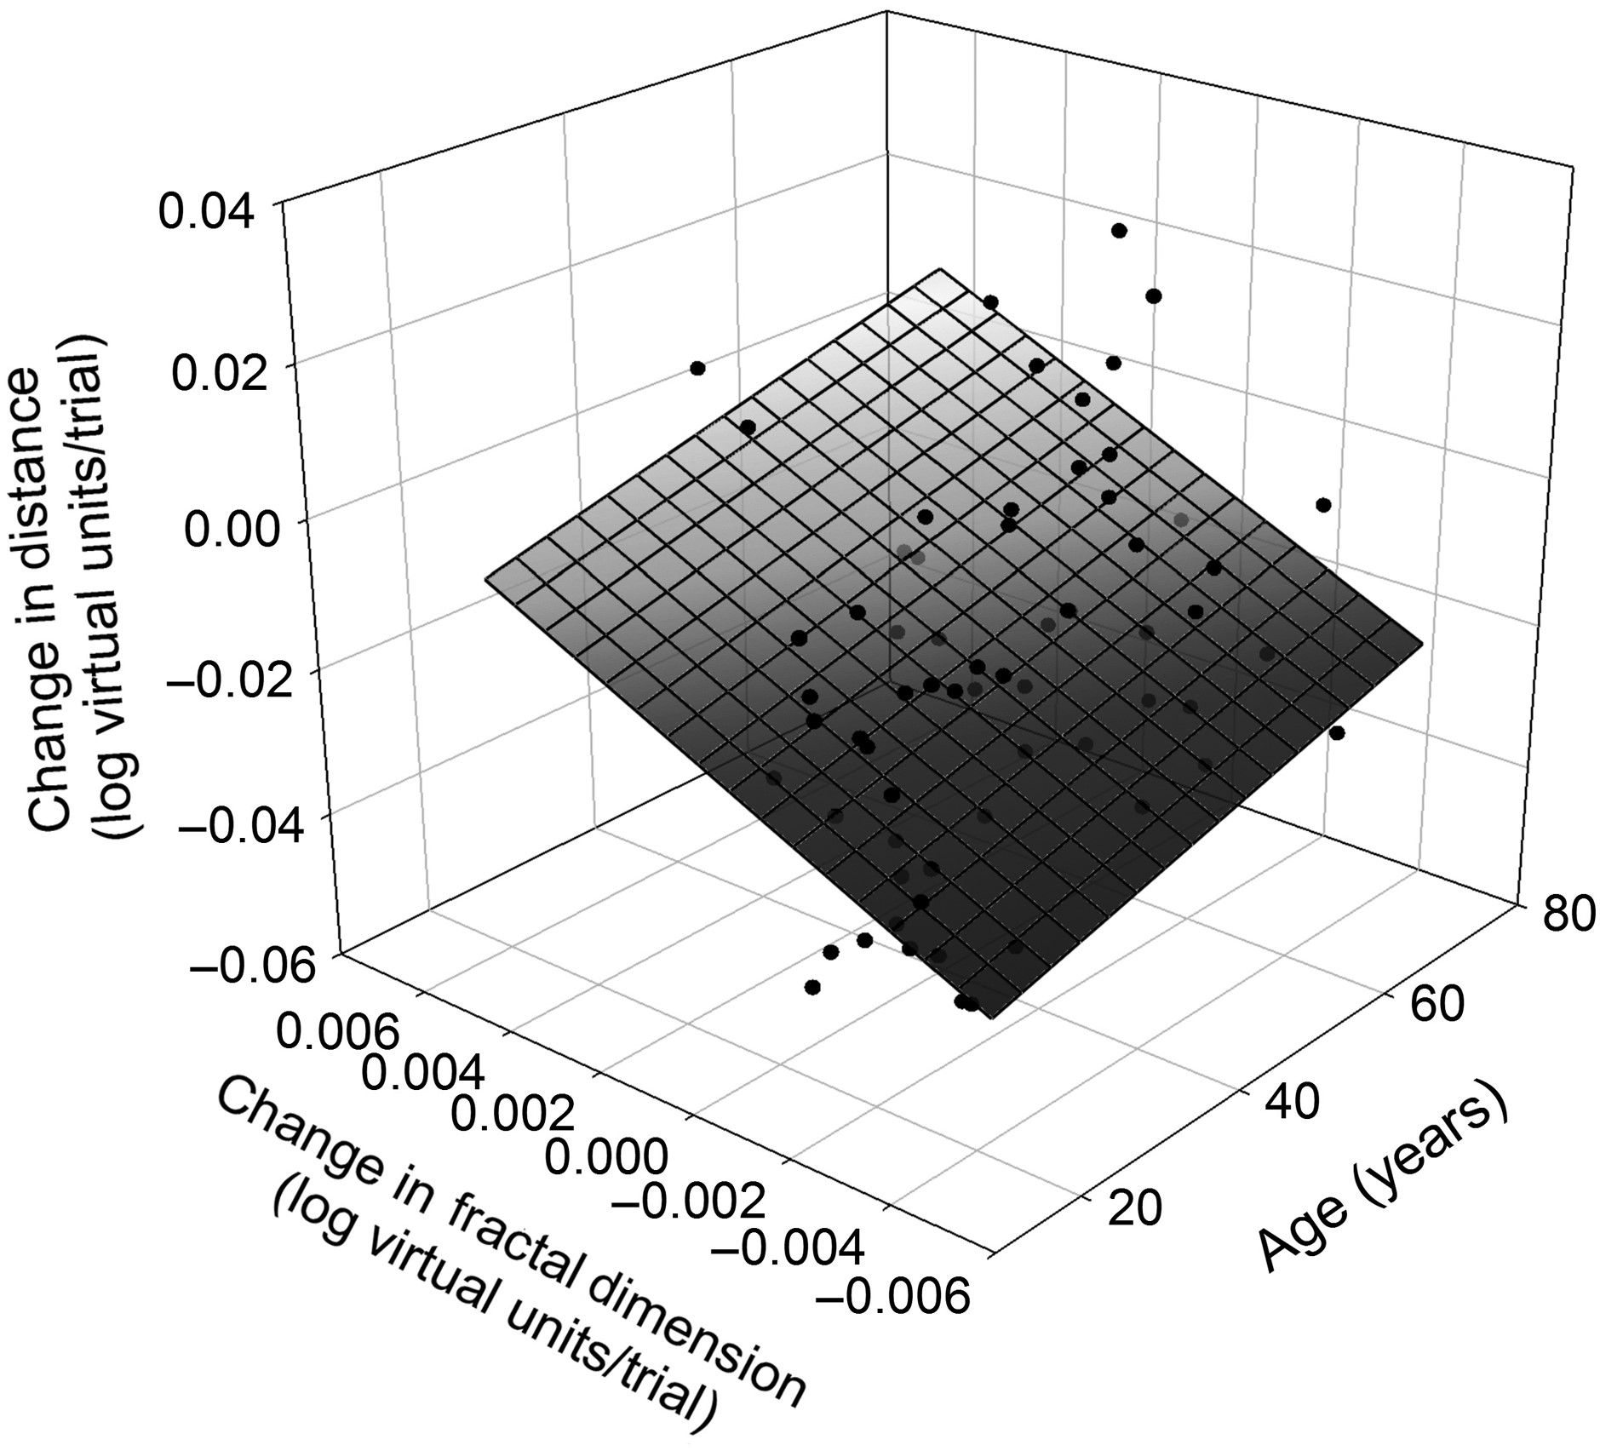
Figure 4. A 3D scatter plot of the associations among age, fractal dimension slope, and distance learning slope (P = ...
Notes:
Figure 4. A 3D scatter plot of the associations among age, fractal dimension slope, and distance learning slope (P = 0.001). The regression plane illustrates on a gray scale the three-way interaction: from black—younger age, greater improvement in fractal dimension, and greater improvement in distance to pale gray—older age, lesser improvement in fractal dimension and lesser shortening of the search path. As can be seen by the tilt of the regression plane labeled in darkening shade, older adults who had a large improvement in fractal dimension did not improve in search distance as much as their younger counterparts did.
Unless provided in the caption above, the following copyright applies to the content of this slide: © The Author 2015. Published by Oxford University Press. All rights reserved. For Permissions, please e-mail: journals.permissions@oup.com

Slide 5
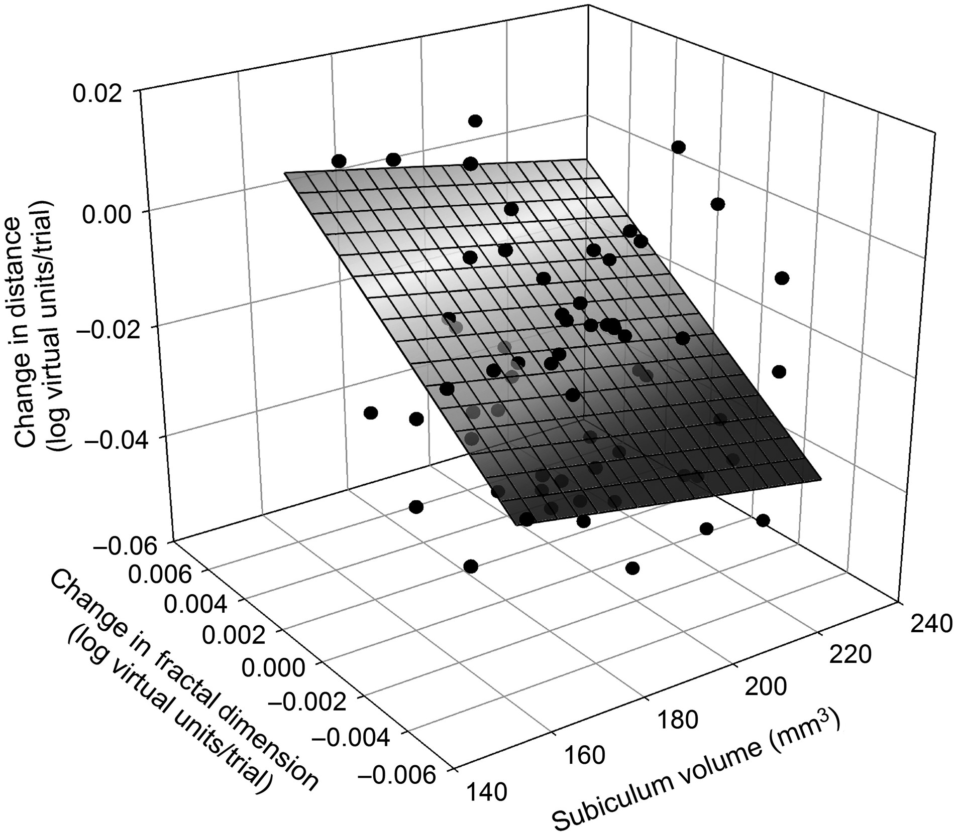
Figure 5. A 3D scatter plot of the relation between subiculum volume, fractal dimension learning slope, and distance ...
Notes:
Figure 5. A 3D scatter plot of the relation between subiculum volume, fractal dimension learning slope, and distance learning slope (P = 0.004; q = 0.01). The regression plane illustrates on a gray scale the three-way interaction: from black—larger subiculum volume, greater improvement in fractal dimension, and greater improvement in distance to pale gray—smaller subiculum volume, lesser improvement in path complexity (fractal dimension), and lesser shortening of search distance.
Unless provided in the caption above, the following copyright applies to the content of this slide: © The Author 2015. Published by Oxford University Press. All rights reserved. For Permissions, please e-mail: journals.permissions@oup.com

Slide 6
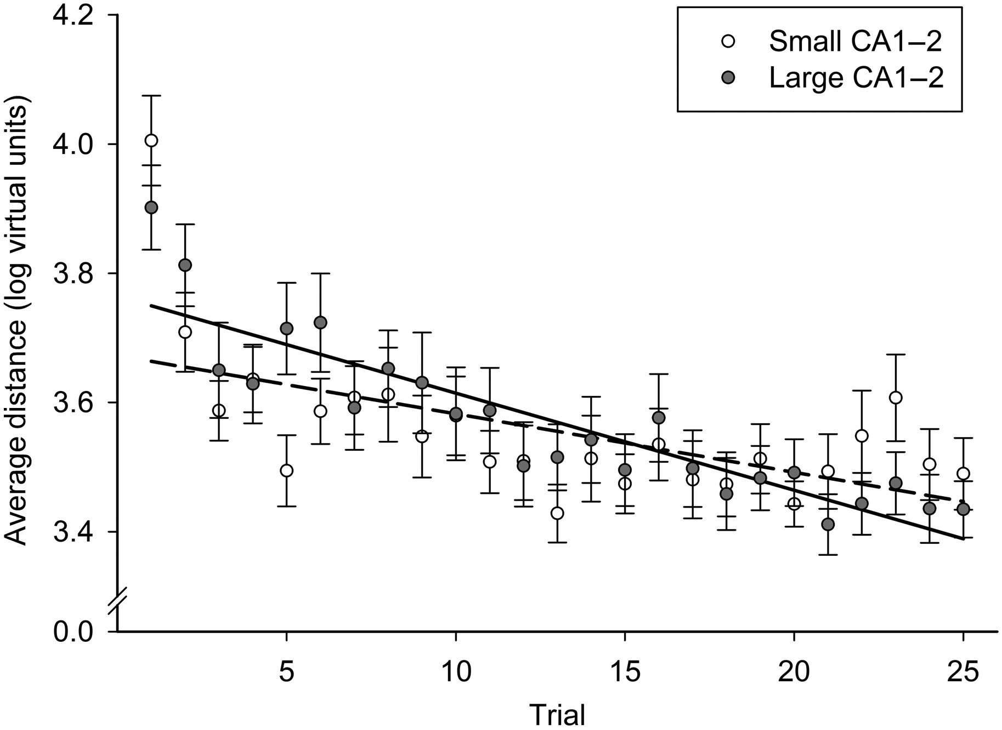
Figure 6. Differences in learning slope related to CA1–2 volumes. CA1–2 volume was treated as a continuous variable in ...
Notes:
Figure 6. Differences in learning slope related to CA1–2 volumes. CA1–2 volume was treated as a continuous variable in the analyses, and only for illustration, volumes were divided at the sample median and plotted as 2 groups: small and large volumes. Error bars represent standard error of the mean.
Unless provided in the caption above, the following copyright applies to the content of this slide: © The Author 2015. Published by Oxford University Press. All rights reserved. For Permissions, please e-mail: journals.permissions@oup.com

