Slide 1
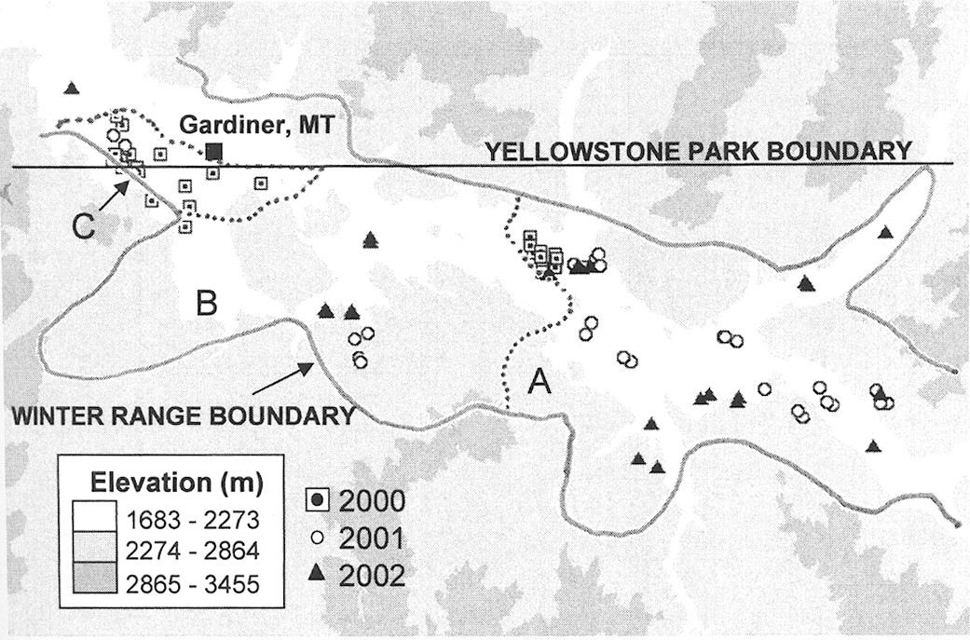
Fig. 1 Locations of cow elk captured during 2000–2002 in the northern winter range of Yellowstone National Park, ...
Notes:
Fig. 1 Locations of cow elk captured during 2000–2002 in the northern winter range of Yellowstone National Park, illustrating park boundary, A) upper winter range, B) lower winter range, and C) boundary area by Gardiner, Montana (Houston 1982). Locations of 16 elk captured in 2000 were excluded because their precise capture locations were not recorded.
Unless provided in the caption above, the following copyright applies to the content of this slide: © 2004 American Society of Mammalogists

Slide 2
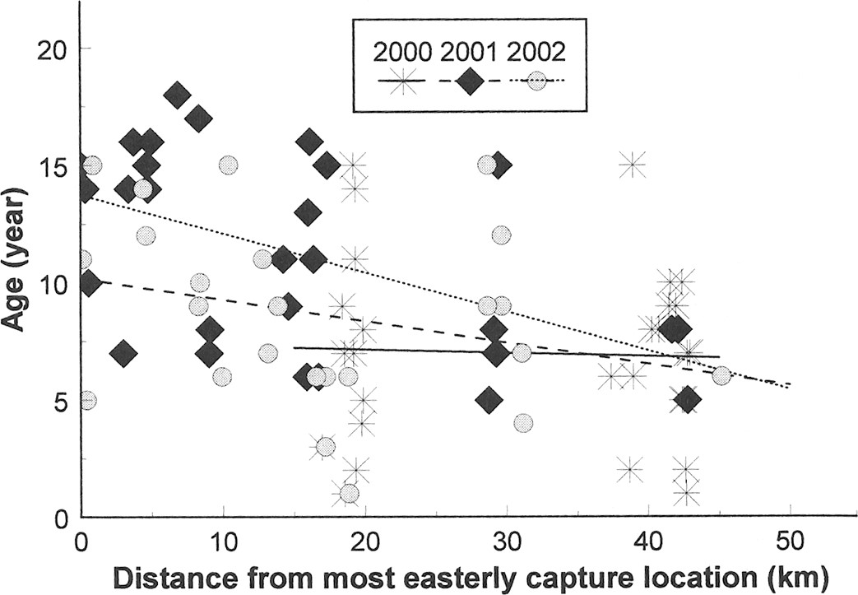
Fig. 2 Relation of capture location in km (using distance from furthest easterly capture location) to age of elk by ...
Notes:
Fig. 2 Relation of capture location in km (using distance from furthest easterly capture location) to age of elk by year for cow elk captured in northern Yellowstone National Park during winters of 2000–2002.
Unless provided in the caption above, the following copyright applies to the content of this slide: © 2004 American Society of Mammalogists

Slide 3
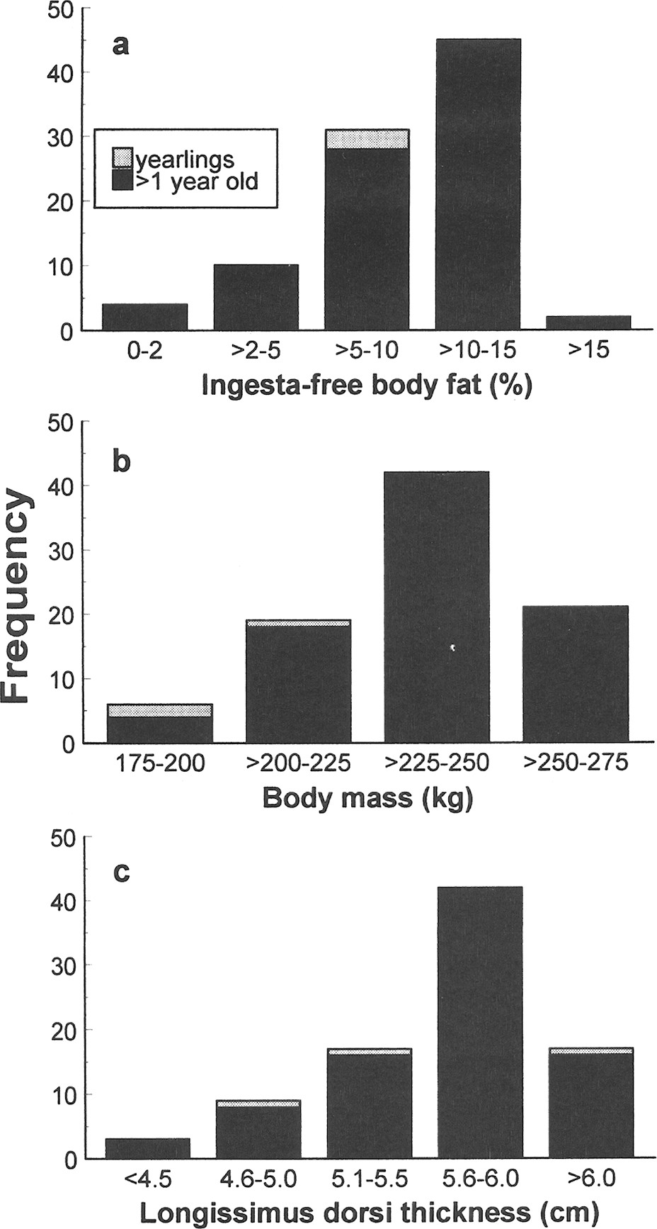
Fig. 3 Frequency of body condition values: a) ingesta-free body fat (as percentage of total body mass), b) total ...
Notes:
Fig. 3 Frequency of body condition values: a) ingesta-free body fat (as percentage of total body mass), b) total body mass estimated from girth measurements and regression equations from Cook et al. (2003), and c) thickness of longissimus dorsi muscle for 96 cow elk captured in northern Yellowstone National Park during winters of 2000–2002.
Unless provided in the caption above, the following copyright applies to the content of this slide: © 2004 American Society of Mammalogists

Slide 4
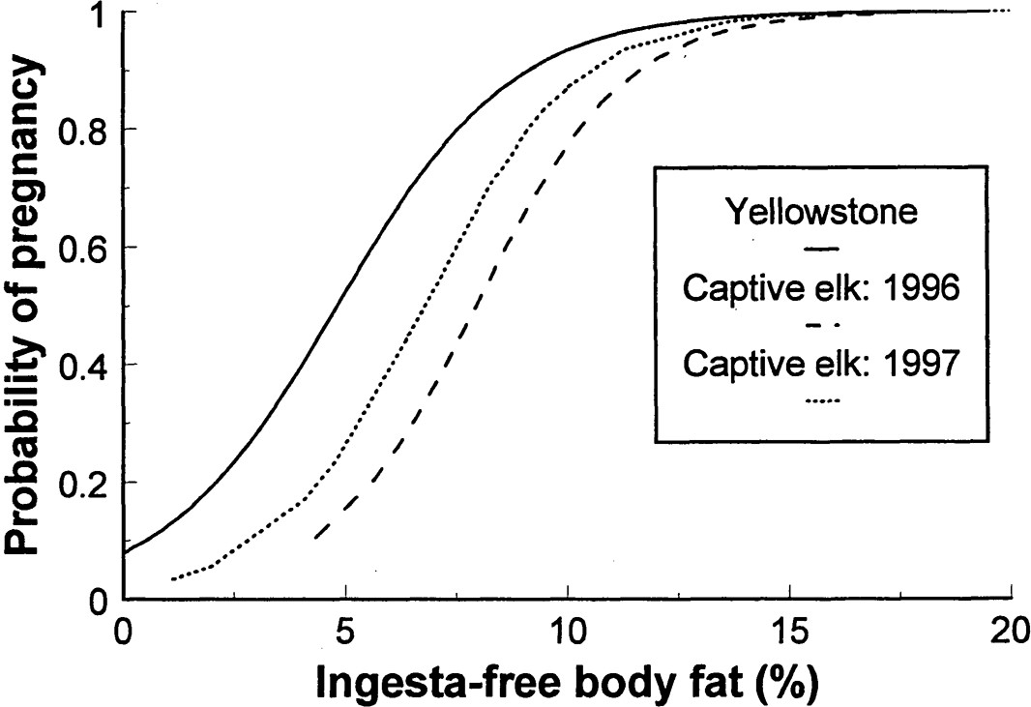
Fig. 4 Logistic regression of probability of pregnancy (y) on ingesta-free body fat (x) for northern Yellowstone elk ...
Notes:
Fig. 4 Logistic regression of probability of pregnancy (y) on ingesta-free body fat (x) for northern Yellowstone elk during midwinter 2001–2002 [y = e(2.462−0.511x) ÷ (1 + e(2.462−0.511x)], captive Rocky Mountain elk during the 1996 breeding season, and captive Rocky Mountain elk during the 1997 breeding season (data on captive elk are from Cook et al. [2004] and were based on body fat measured in October each year). Higher pregnancy rates relative to body condition of Yellowstone elk most likely are due to later data collection and the resulting depletion of fat from October to February.
Unless provided in the caption above, the following copyright applies to the content of this slide: © 2004 American Society of Mammalogists

Slide 5
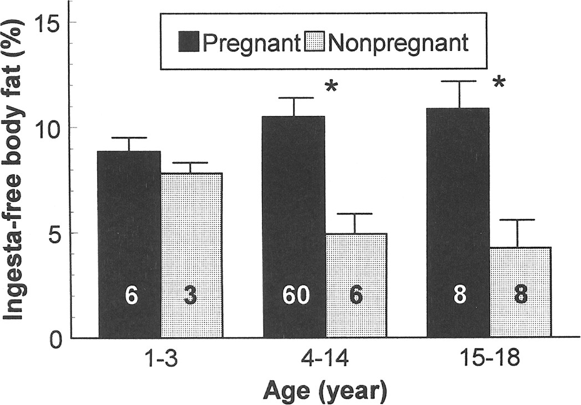
Fig. 5 Ingesta-free body fat content of young (≤3 years old), prime (4–14 years), and old (≥15 years) cow elk ...
Notes:
Fig. 5 Ingesta-free body fat content of young (≤3 years old), prime (4–14 years), and old (≥15 years) cow elk captured in northern Yellowstone National Park by pregnancy status and age class, shown as mean + SE. Sample sizes are given for each classification; significant differences (P ≤ 0.05) within age classes are denoted with asterisks.
Unless provided in the caption above, the following copyright applies to the content of this slide: © 2004 American Society of Mammalogists

Slide 6
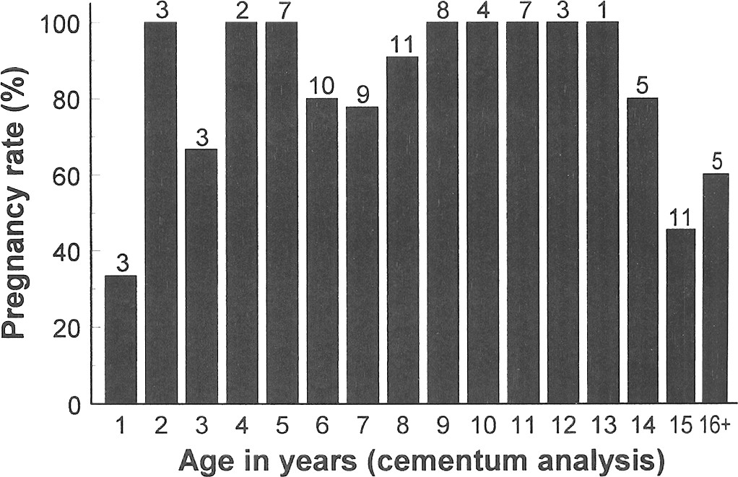
Fig. 6 Pregnancy rates by age for northern Yellowstone cow elk in 2001–2002. Sample sizes for each age class are ...
Notes:
Fig. 6 Pregnancy rates by age for northern Yellowstone cow elk in 2001–2002. Sample sizes for each age class are shown above bars.
Unless provided in the caption above, the following copyright applies to the content of this slide: © 2004 American Society of Mammalogists

