Slide 1
Figure 1 Lesion probability maps for lacunar lesions (A) and white matter hyperintensities (B) in Montreal ...
Notes:
Figure 1 Lesion probability maps for lacunar lesions (A) and white matter hyperintensities (B) in Montreal Neurological Institute (MNI) 152 standard space (n = 215). The statistical maps are superimposed onto the MNI T1 template. R = right.
Unless provided in the caption above, the following copyright applies to the content of this slide: © The Author (2011). Published by Oxford University Press on behalf of the Guarantors of Brain. All rights reserved. For Permissions, please email: journals.permissions@oup.com

Slide 2
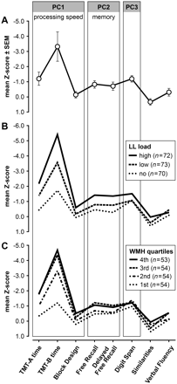
Figure 2 (A) Cognitive profile of the study cohort (n = 215; TMT = Trail Making Test). (B) Profiles in subgroups ...
Notes:
Figure 2 (A) Cognitive profile of the study cohort (n = 215; TMT = Trail Making Test). (B) Profiles in subgroups stratified for the normalized lacunar lesion (LL) volume (low = first and second quartile of patients with lesions; high = third and fourth quartile). (C) Profiles in subgroups stratified for normalized white matter hyperintensities (WMH) volume (in quartiles). Compound scores for processing speed (PC1), memory (PC2) and a score represented by digit span (PC3) were derived from principal component analysis.
Unless provided in the caption above, the following copyright applies to the content of this slide: © The Author (2011). Published by Oxford University Press on behalf of the Guarantors of Brain. All rights reserved. For Permissions, please email: journals.permissions@oup.com

Slide 3
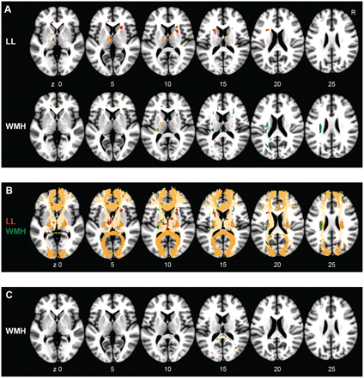
Figure 3 Voxel-based lesion-symptom mapping results for processing speed (A and B) and memory (C) in MNI space. (A) ...
Notes:
Figure 3 Voxel-based lesion-symptom mapping results for processing speed (A and B) and memory (C) in MNI space. (A) Significant clusters for processing speed after non-parametric mapping and correction for multiple testing. Orange indicates voxels remaining significant after adding normalized LL volume and normalized white matter hyperintensity (WMH) volume as a covariate. (B) Significant clusters for lacunar lesions (red) and white matter hyperintensities (green) projected on major white matter tracts (JHU-ICBM-DTI atlas). Depicted are the forceps minor, the anterior thalamic radiation, the forceps major and the corticospinal tract. (C) Significant clusters (white matter hyperintensities) for memory. Voxels that remained significant after correction for global normalized white matter hyperintensity volume are depicted in orange. The statistical maps are superimposed onto the MNI T1 template. There were no significant clusters in slices outside the region shown in A–C.
Unless provided in the caption above, the following copyright applies to the content of this slide: © The Author (2011). Published by Oxford University Press on behalf of the Guarantors of Brain. All rights reserved. For Permissions, please email: journals.permissions@oup.com

Slide 4
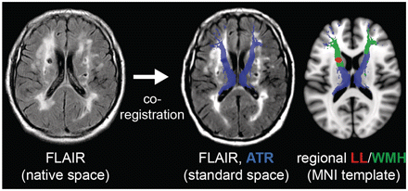
Figure 4 Segmentation of lesions projecting on the anterior thalamic radiation (ATR). (Left) Fluid-attenuated ...
Notes:
Figure 4 Segmentation of lesions projecting on the anterior thalamic radiation (ATR). (Left) Fluid-attenuated inversion recovery image of a patient in native space (resliced according to MNI template); (middle) same image after co-registration to MNI standard space with the anterior thalamic radiation superimposed in half transparency; (right) MNI T1 template illustrating the segmentation of lacunar lesions (LL) and white matter hyperintensities (WMH) inside the anterior thalamic radiation. The regional lesion volumes were used in multivariate analyses.
Unless provided in the caption above, the following copyright applies to the content of this slide: © The Author (2011). Published by Oxford University Press on behalf of the Guarantors of Brain. All rights reserved. For Permissions, please email: journals.permissions@oup.com

