Slide 1
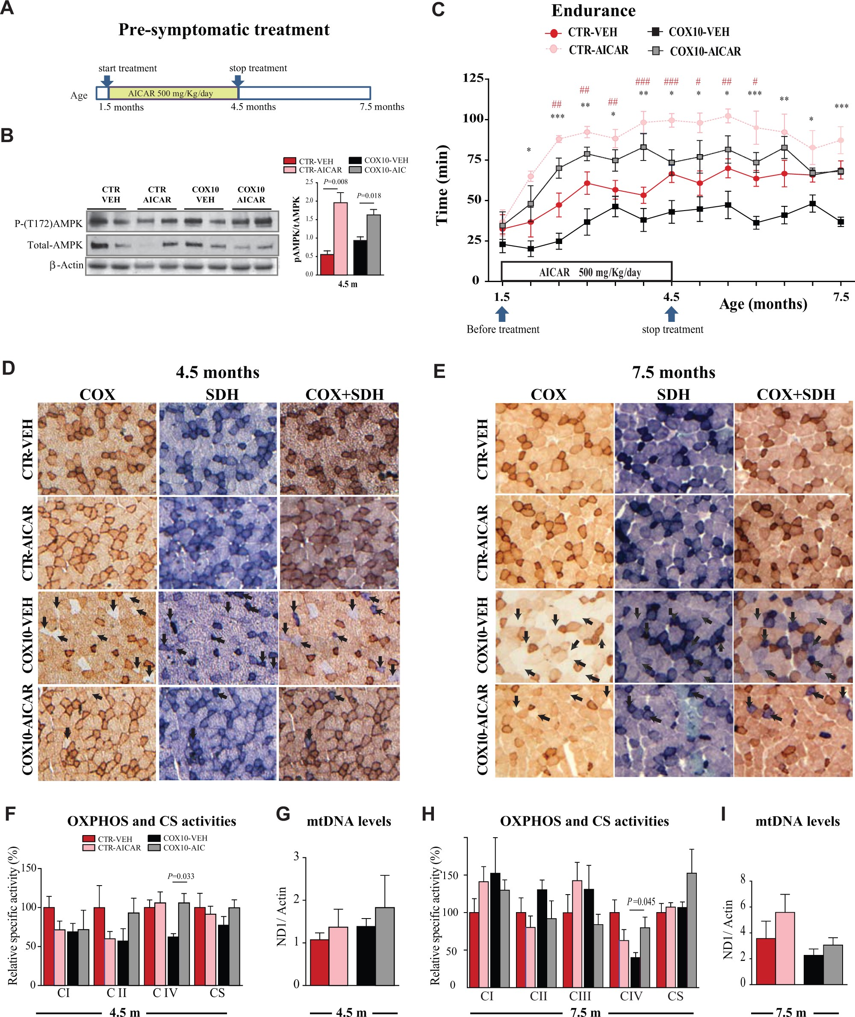
Figure 1. Pre-symptomatic AICAR treatment improved a mitochondrial myopathy and the effect was still observed 3 months ...
Notes:
Figure 1. Pre-symptomatic AICAR treatment improved a mitochondrial myopathy and the effect was still observed 3 months after the end of the treatment. (A) Scheme of the Pre-symptomatic AICAR treatment. (B) Representative western blots showing levels of phospho-AMPK and total-AMPK in quadriceps at the age of 4.5 months. (C) Running endurance measured as a function of time. Control littermate mice were treated with vehicle or AICAR (500 mg/kg/day, 12 weeks). Cox10-Mef2c mice were treated with vehicle or AICAR (500 mg/kg/day, 12 weeks). (D and E) COX, SDH and COX/SDH histochemical double staining in cross sections of quadriceps. Arrows show COX-deficient fibers that stain strong for the SDH activity (blue) and weakly for the COX activity (light brown/white). (F and H) OXPHOS complex activities and CS activity expressed as percentage of the control-vehicle group in homogenates from skeletal muscle (quadriceps). (G and I) mtDNA levels in homogenates from quadriceps. Data in (C) (n = 10), (B, D, E, G and I) (n = 5), and (F and H)) (n= 6) are presented as mean ± SEM, and unpaired Student’s two-tailed t-test was done for statistical significance. * P< 0.05, ** P< 0.001 and *** P< 0.0001 represents the difference between Cox10-vehicle and Cox10-AICAR; #P< 0.05 ##P< 0.001 and ###P< 0.0001 represents the difference between control (CTR)-vehicle and CTR-AICAR group.
Unless provided in the caption above, the following copyright applies to the content of this slide: © The Author 2016. Published by Oxford University Press. All rights reserved. For permissions, please e-mail: journals.permissions@oup.com

