Slide 1
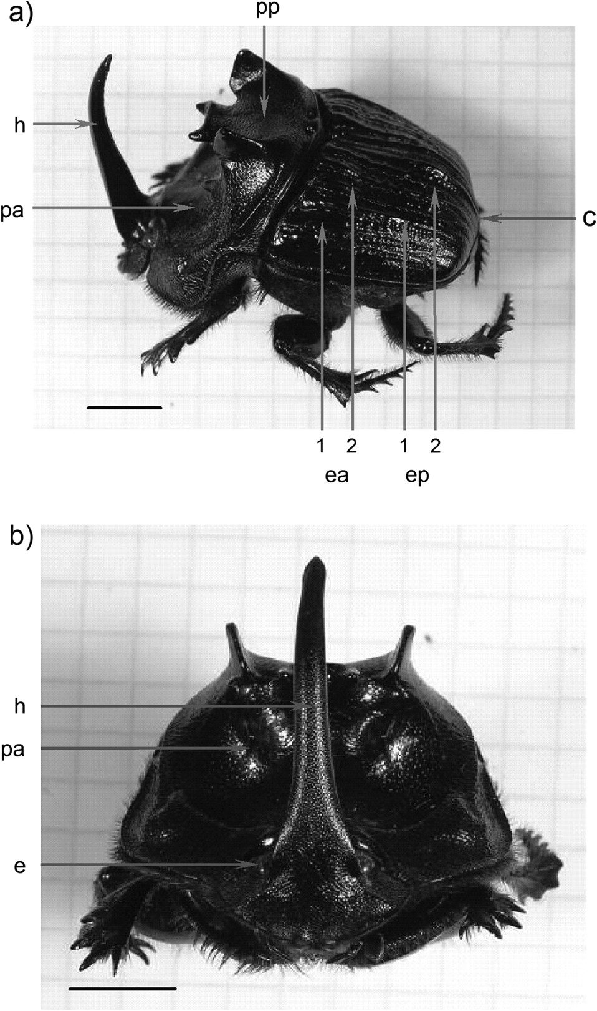
Figure 1 (a) Lateral view of Coprophanaeus lancifer with the locations of reflectance measurements. h, horn; pa, ...
Notes:
Figure 1 (a) Lateral view of Coprophanaeus lancifer with the locations of reflectance measurements. h, horn; pa, pronotum anterior; pp, pronotum posterior; ea 1 and 2, elytron anterior; ep 1 and 2, elytron posterior; c, caudal part. (b) Frontal view of C. lancifer. h, horn; pa, pronotum anterior; e, eye (not measured). Scale bar = 1 cm.
Unless provided in the caption above, the following copyright applies to the content of this slide: © The Author 2008. Published by Oxford University Press on behalf of the International Society for Behavioral Ecology. All rights reserved. For permissions, please e-mail: journals.permissions@oxfordjournals.org

Slide 2
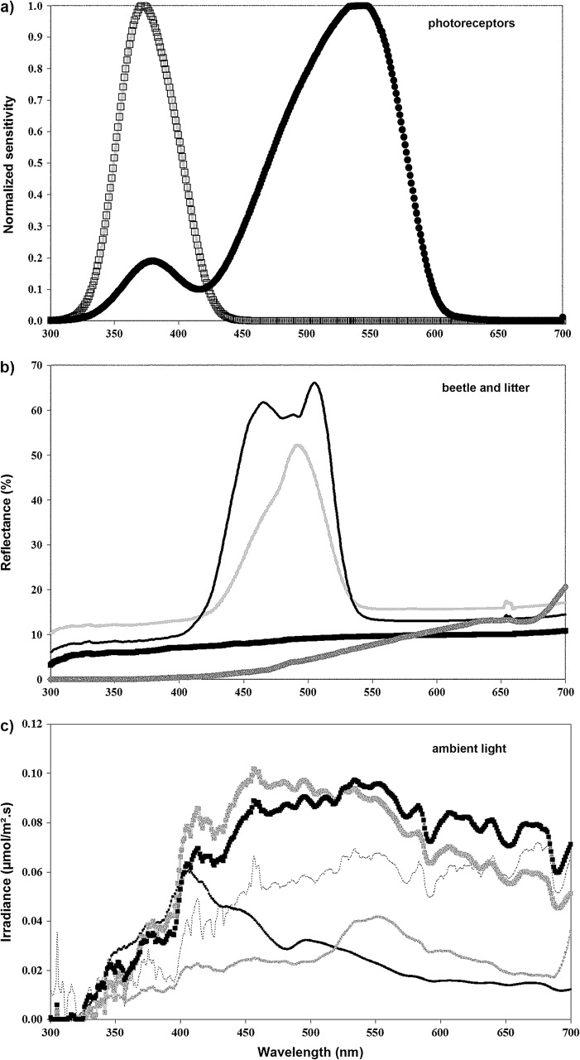
Figure 2 (a) Normalized sensitivity of Onitis alexis photoreceptors (after Warrant and McIntyre 1990). White squares, ...
Notes:
Figure 2 (a) Normalized sensitivity of Onitis alexis photoreceptors (after Warrant and McIntyre 1990). White squares, UV type and black circles, G type. (b) Reflectance spectra of Coprophanaeus lancifer and the litter visual background used in the vision model. Thin black line, pronotum; thin gray line, mean coloration; thick black line, horn; thick gray line, litter. (c) Irradiance spectra of the forest light environments; to allow comparison the intensity of dusk irradiance has been multiplied by 10, that of large gaps divided by 50, and that of small gaps divided by 10. Thick gray line, woodland shade; thick black line, large gap; dotted line, small gap; thin black line, dusk; thin gray line, forest shade.
Unless provided in the caption above, the following copyright applies to the content of this slide: © The Author 2008. Published by Oxford University Press on behalf of the International Society for Behavioral Ecology. All rights reserved. For permissions, please e-mail: journals.permissions@oxfordjournals.org

Slide 3
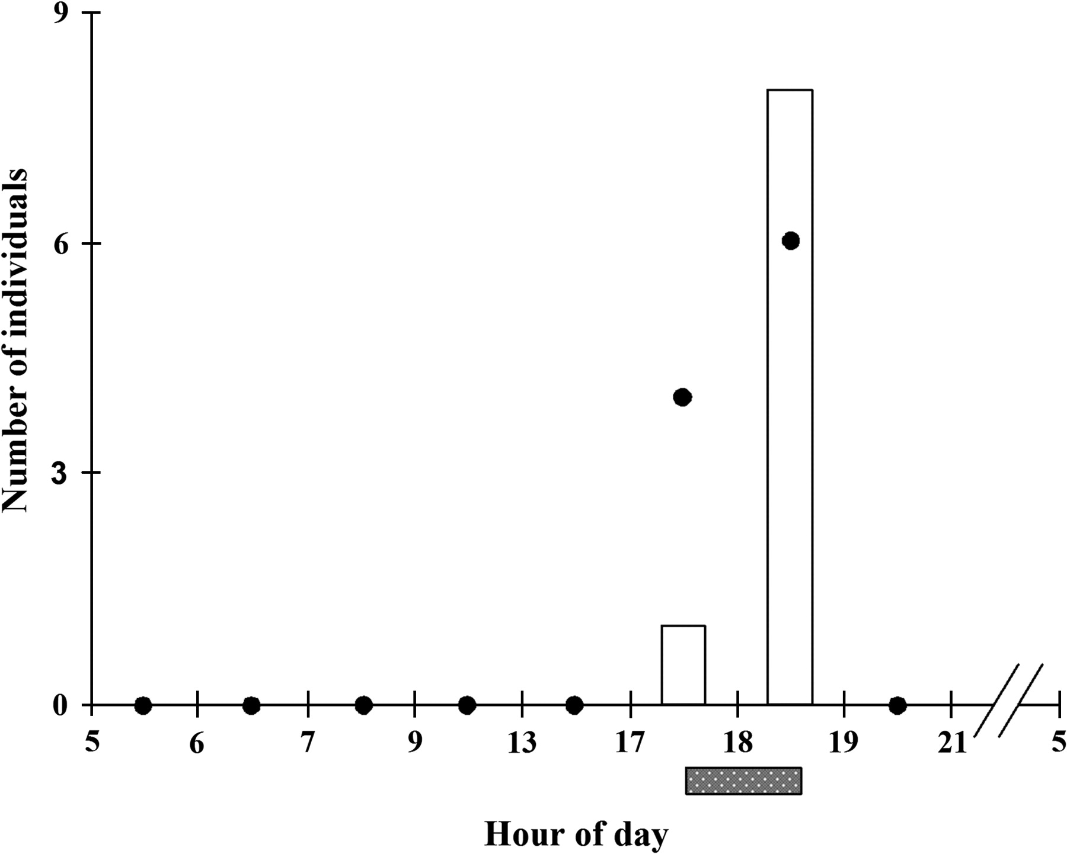
Figure 3 Daily flight activity of Coprophanaeus lancifer determined using both a specific trapping method (number of ...
Notes:
Figure 3 Daily flight activity of Coprophanaeus lancifer determined using both a specific trapping method (number of captured individuals, bars) and visual observation of individuals flying through the forest (number of observations, dots). The x axis represents each hour interval of trapping method. The nocturnal part is not represented (beetle has been neither trapped nor seen in flight during the night). The hatched gray bar shows the dusk period.
Unless provided in the caption above, the following copyright applies to the content of this slide: © The Author 2008. Published by Oxford University Press on behalf of the International Society for Behavioral Ecology. All rights reserved. For permissions, please e-mail: journals.permissions@oxfordjournals.org

Slide 4
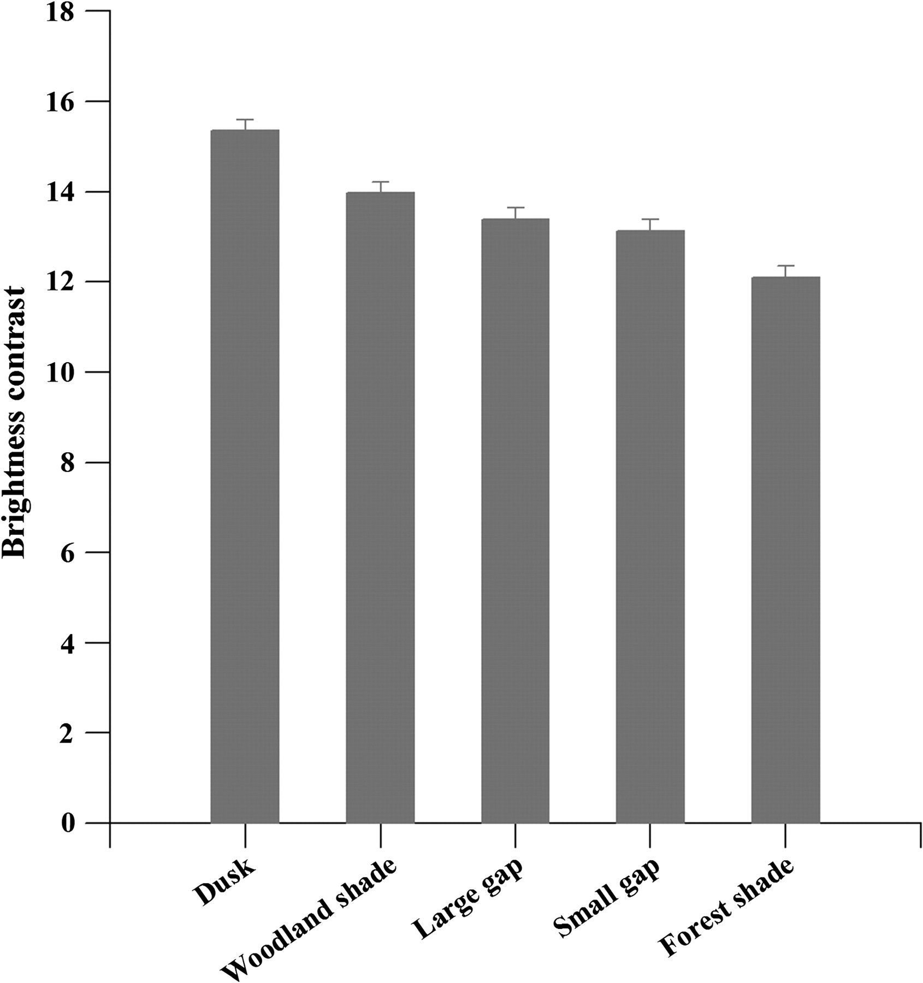
Figure 4 Brightness contrasts (mean ± standard deviation) of the mean beetle coloration against the visual background ...
Notes:
Figure 4 Brightness contrasts (mean ± standard deviation) of the mean beetle coloration against the visual background in the different light environments (n = 22 individuals).
Unless provided in the caption above, the following copyright applies to the content of this slide: © The Author 2008. Published by Oxford University Press on behalf of the International Society for Behavioral Ecology. All rights reserved. For permissions, please e-mail: journals.permissions@oxfordjournals.org

Slide 5
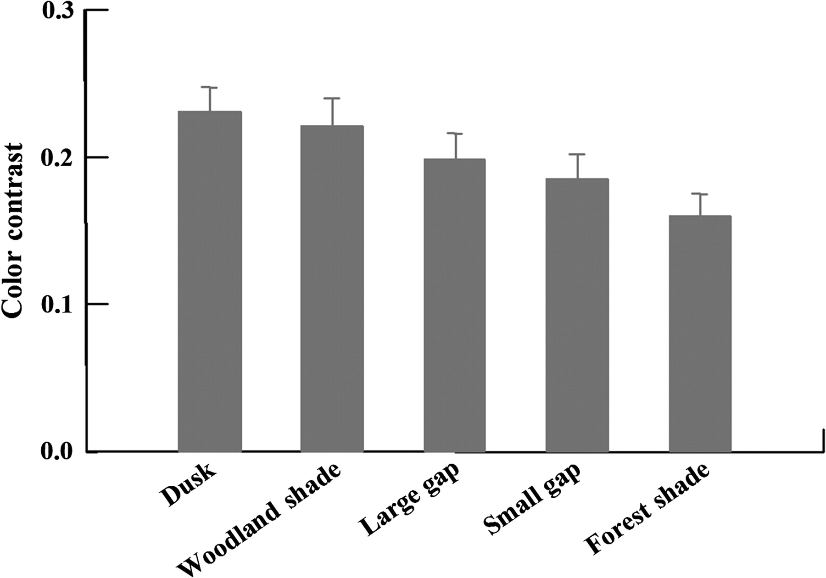
Figure 5 Color contrasts (mean ± standard deviation) of the horn seen against the pronotum in the different light ...
Notes:
Figure 5 Color contrasts (mean ± standard deviation) of the horn seen against the pronotum in the different light environments (n = 22 individuals).
Unless provided in the caption above, the following copyright applies to the content of this slide: © The Author 2008. Published by Oxford University Press on behalf of the International Society for Behavioral Ecology. All rights reserved. For permissions, please e-mail: journals.permissions@oxfordjournals.org

