Slide 1
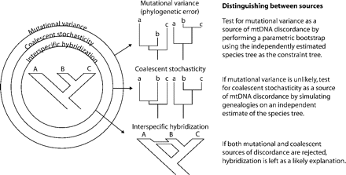
Figure 1. Testing hypotheses of lineage sorting and introgression in Tamias.
Notes:
Figure 1. Testing hypotheses of lineage sorting and introgression in Tamias.
Unless provided in the caption above, the following copyright applies to the content of this slide: © The Author(s) 2011. Published by Oxford University Press, on behalf of the Society of Systematic Biologists. All rights reserved. For Permissions, please email: journals.permissions@oup.com

Slide 2
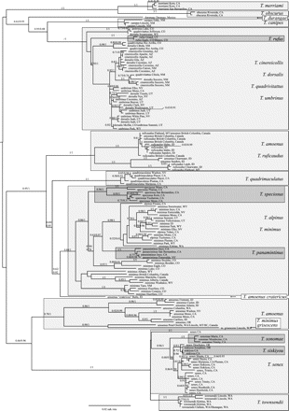
Figure 2. ML tree, midpoint rooted, estimated from Cytb. Values on branches are ML bootstraps followed by Bayesian ...
Notes:
Figure 2. ML tree, midpoint rooted, estimated from Cytb. Values on branches are ML bootstraps followed by Bayesian posterior probabilities. Species are indicated by shaded boxes, followed by country/state and province/county locales.
Unless provided in the caption above, the following copyright applies to the content of this slide: © The Author(s) 2011. Published by Oxford University Press, on behalf of the Society of Systematic Biologists. All rights reserved. For Permissions, please email: journals.permissions@oup.com

Slide 3
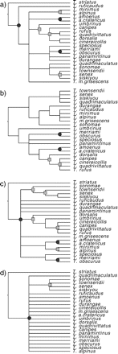
Figure 3. Simplified nuclear gene-tree estimates. All species collapsed to a single tip. Only branches with either 0.7 ...
Notes:
Figure 3. Simplified nuclear gene-tree estimates. All species collapsed to a single tip. Only branches with either 0.7 bootstrap proportion or 0.95 posterior probability are retained. Partitions occurring in three gene trees marked with a circle, and two gene trees marked with a square. Tips contained in polytomies may be monophyletic or paraphyletic species (see supplementary figures).
Unless provided in the caption above, the following copyright applies to the content of this slide: © The Author(s) 2011. Published by Oxford University Press, on behalf of the Society of Systematic Biologists. All rights reserved. For Permissions, please email: journals.permissions@oup.com

Slide 4
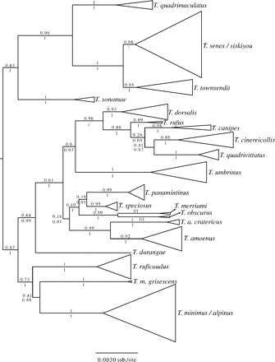
Figure 4. Phylogeny estimate from the concatenated nuclear data. The topology is the ML tree from GARLI and is midpoint ...
Notes:
Figure 4. Phylogeny estimate from the concatenated nuclear data. The topology is the ML tree from GARLI and is midpoint rooted. Support values are ML bootstraps (above branches) and Bayesian posterior probabilities (below branches). Samples within species are collapsed for clarity. The full tree is in Supplementary Data).
Unless provided in the caption above, the following copyright applies to the content of this slide: © The Author(s) 2011. Published by Oxford University Press, on behalf of the Society of Systematic Biologists. All rights reserved. For Permissions, please email: journals.permissions@oup.com

Slide 5
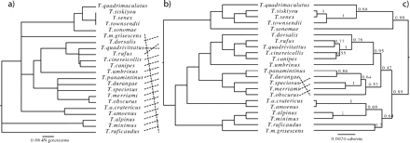
Figure 5. Species-tree estimates derived from STEM (a), MDC(b), and the maximum clade credibility tree from *BEAST (c) ...
Notes:
Figure 5. Species-tree estimates derived from STEM (a), MDC(b), and the maximum clade credibility tree from *BEAST (c) using three nuclear genes, ACR, Anon, and ZAN. Support values on the MDC and STEM trees are *BEAST posterior probabilities mapped onto the trees using SumTrees.
Unless provided in the caption above, the following copyright applies to the content of this slide: © The Author(s) 2011. Published by Oxford University Press, on behalf of the Society of Systematic Biologists. All rights reserved. For Permissions, please email: journals.permissions@oup.com

Slide 6
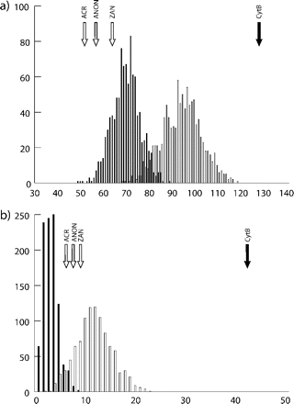
Figure 6. Null distributions for number of deep coalescences expected absent introgression and empirical test ...
Notes:
Figure 6. Null distributions for number of deep coalescences expected absent introgression and empirical test statistics for the full tree (a) and for the southern Rocky Mountains clade (b). Distributions and test statistics for nuclear DNA with a total species tree depth of 8.6 N generations are denoted by clear bars and arrows, those for mtDNA, with a total tree depth of 34.4 N generations, indicated by black bars and arrows.
Unless provided in the caption above, the following copyright applies to the content of this slide: © The Author(s) 2011. Published by Oxford University Press, on behalf of the Society of Systematic Biologists. All rights reserved. For Permissions, please email: journals.permissions@oup.com

