Slide 1
Figure 1. Study design. (A) The personalities of the 4 protagonists were varied high low on 2 trait dimensions, ...
Notes:
Figure 1. Study design. (A) The personalities of the 4 protagonists were varied high low on 2 trait dimensions, extraversion and agreeableness, to create a 2 × 2 factorial relationship between the 4 personalities. (B) Timeline showing the experimental design of a single trial. The text instruction cue is presented for 5 s containing the location and vignette information. The name of the protagonist is then displayed (“Dave” in this example trial), and the participant imagines that event happening to that person in that location for 10 s. Finally, participants give feedback on their imagined events via vividness and accuracy ratings followed by a rest period.
Unless provided in the caption above, the following copyright applies to the content of this slide: © The Author 2013. Published by Oxford University Press. All rights reserved. For Permissions, please e-mail: journals.permissions@oup.com

Slide 2
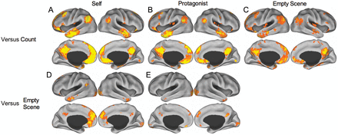
Figure 2. Pairwise contrasts of the experimental conditions. (A) Self > Count; (B) Protagonists > Count; and (C) Empty ...
Notes:
Figure 2. Pairwise contrasts of the experimental conditions. (A) Self > Count; (B) Protagonists > Count; and (C) Empty Scene > Count all demonstrate default network engagement across simulation conditions. (D) Self > Empty Scene and (E) Protagonists > Empty Scene show specific activity for social simulations. Images are displayed from TR 3 (7.5 s) and thresholded at P < 0.005 (PLS identifies whole-brain patterns of activity in a single analytic step and, thus, no correction for multiple comparisons is required). See Supplementary Table 1 for peak coordinates.
Unless provided in the caption above, the following copyright applies to the content of this slide: © The Author 2013. Published by Oxford University Press. All rights reserved. For Permissions, please e-mail: journals.permissions@oup.com

Slide 3
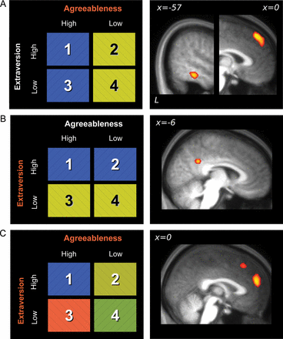
Figure 3. MVPA results showing significant voxels at the group level after the application of whole-brain searchlight ...
Notes:
Figure 3. MVPA results showing significant voxels at the group level after the application of whole-brain searchlight classification techniques, overlaid on an averaged structural image. (A) Left LTC and dorsal mPFC discriminate between protagonists with high or low agreeableness. (B) pCC discriminates between protagonists with high or low extraversion. (C) mPFC discriminates between the 4 protagonists. All voxels significant at P < 0.05 corrected for multiple comparisons. See Supplementary Table 1 for peak coordinates.
Unless provided in the caption above, the following copyright applies to the content of this slide: © The Author 2013. Published by Oxford University Press. All rights reserved. For Permissions, please e-mail: journals.permissions@oup.com

Slide 4
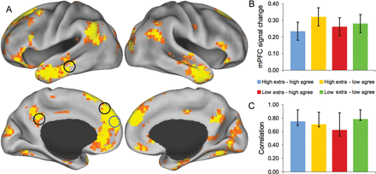
Figure 4. Functional connectivity analysis. (A) Whole-brain pattern of functional connectivity with the mPFC seed ...
Notes:
Figure 4. Functional connectivity analysis. (A) Whole-brain pattern of functional connectivity with the mPFC seed region identified by the MVPA analysis as discriminating between the 4 protagonists. Seed region is circled in blue. Black circles designate that regions identified by the personality classification are functionally connected with the mPFC region. Results displayed from TR 3 (7.5 s) and thresholded at P < 0.005 (PLS identifies whole-brain patterns of activity in a single analytic step and, thus, no correction for multiple comparisons is required). (B) BOLD signal change, relative to the trial onset, for the 4 protagonist conditions (error bars are the within-subject SEM). (C) Correlation between mPFC seed activity and composite measures of the distributed voxel response across the brain (confidence intervals were derived from bootstrap resampling). See Supplementary Table 1 for peak coordinates.
Unless provided in the caption above, the following copyright applies to the content of this slide: © The Author 2013. Published by Oxford University Press. All rights reserved. For Permissions, please e-mail: journals.permissions@oup.com

