Slide 1
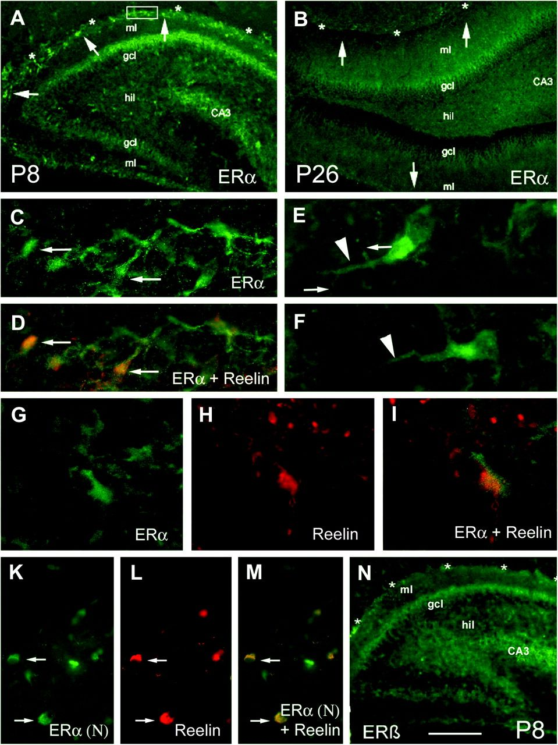
Figure 1. CR cells in DG express estrogen receptor α. Immunostaining for ERs α and β in DG at different stages of ...
Notes:
Figure 1. CR cells in DG express estrogen receptor α. Immunostaining for ERs α and β in DG at different stages of development: (A) Using an antibody against ERα C-terminus, strong immunoreactivity was detected early postnatally, and this immunoreactivity was particularly evident in cells located in DG ML and aligning to the hippocampal fissure (arrows; asterisks indicate the hippocampal fissure). (B) At a later developmental stage (P26), ERα immunoreactivity was generally weaker and absent in ML (arrows). (C) A higher magnification view of the area marked with a square in (A) reveals ERα immunostaining of cells with a distinct appearance. Many of these cells coexpress reelin (D, arrows; reelin was detected using red-fluorescent Cy3; shown here is the overlay with green-fluorescent Alexa-488) and show a morphology characteristic for CR cells (E, F), that is, one prominent dendrite extending from the soma (arrowheads) and fine appendages radiating in perpendicular direction away from the dendrite (arrows in E). (G–I) High magnification view of a cell coexpressing ERα (G, detected with Alexa-488) and reelin (H, detected with Cy3); (I) shows the overlay. (K–M) Similar results were found when an antibody against ERα N-terminus was used: Immunoreactive cells were detected in ML (K) and a large proportion of those coexpressed reelin (L, M). (N) No immunoreactivity was observed in ML with an antibody against ERβ. Scale bar: 250 μm (A, B, N), 40 μm (K, L, M), 20 μm (C, D), 10 μm (E–I).
Unless provided in the caption above, the following copyright applies to the content of this slide: © The Author 2010. Published by Oxford University Press. All rights reserved. For permissions, please e-mail: journals.permissions@oxfordjournals.org

Slide 2
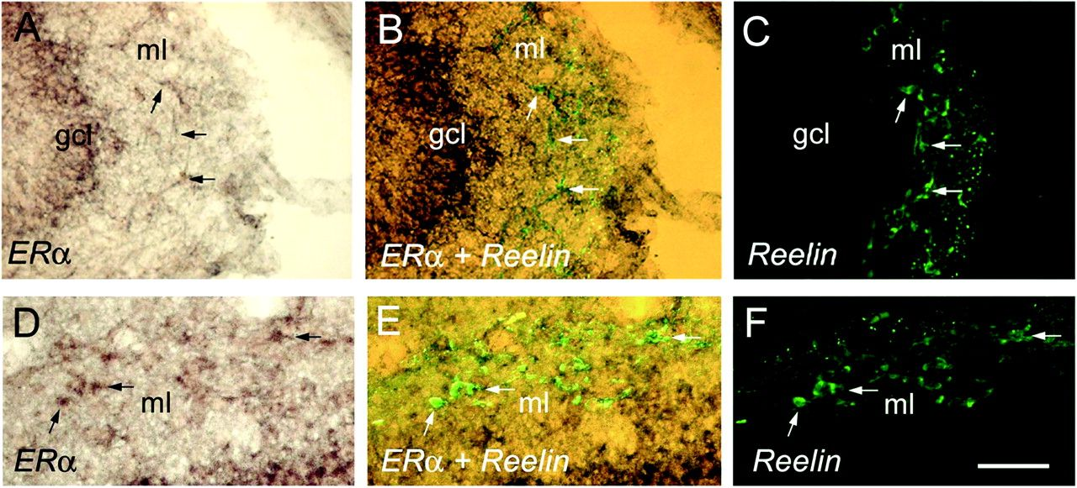
Figure 2. Colocalization of ERα mRNA and reelin. Nonradioactive ISH for ERα mRNA revealed a very similar expression ...
Notes:
Figure 2. Colocalization of ERα mRNA and reelin. Nonradioactive ISH for ERα mRNA revealed a very similar expression pattern than the one that was obtained with ERα IHC (compare to Fig. 1A,C,D): In P5 rats, ERα mRNA expression was strong in DG granule cells (GCL) and was further observed in cells located in ML (A and D). These cells frequently coexpress reelin (B, E, arrows; reelin was detected with Alexa-488, C, F). Scale bar: 40 μm.
Unless provided in the caption above, the following copyright applies to the content of this slide: © The Author 2010. Published by Oxford University Press. All rights reserved. For permissions, please e-mail: journals.permissions@oxfordjournals.org

Slide 3
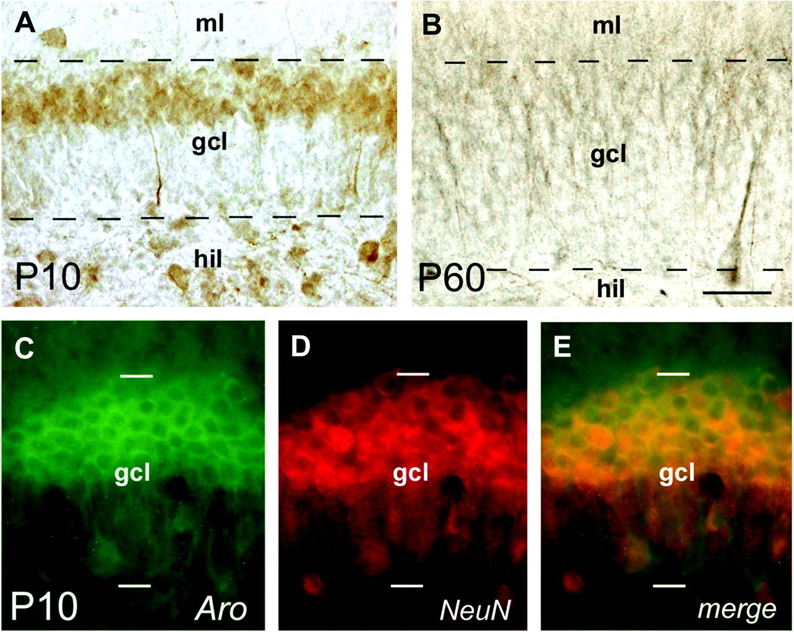
Figure 3. Expression of aromatase in DG. (A) Distribution of aromatase in DG of an early postnatal (P10) rat as ...
Notes:
Figure 3. Expression of aromatase in DG. (A) Distribution of aromatase in DG of an early postnatal (P10) rat as determined by immunostaining using a polyclonal antiserum derived from rabbit (Dr Azcoitia, Madrid). Note: Immunoreactivity was robust in the outer part of the GCL. In contrast, little signal was detected in the inner part of GCL, which contains immature granule cells (Bender et al. 2001). Strong immunoreactivity for aromatase was also found in hilar (hil) neurons. (B) In mature DG (P60), aromatase immunoreactivity is more diffusely distributed and appears to mainly localize to granule cell dendrites. (C) A similar staining pattern was found with a different, monoclonal anti-aromatase antibody (Acris). Colocalization of aromatase with NeuN, a marker for mature neurons, further confirmed that the enzyme is mainly expressed by mature granule cells in immature DG (D, E). Scale bar: 25 μm (A), 20 μm (B–E).
Unless provided in the caption above, the following copyright applies to the content of this slide: © The Author 2010. Published by Oxford University Press. All rights reserved. For permissions, please e-mail: journals.permissions@oxfordjournals.org

Slide 4
Figure 4. Spine synapse density is reduced in DG ML of immature rats after letrozole treatment in vivo. (A, B) ...
Notes:
Figure 4. Spine synapse density is reduced in DG ML of immature rats after letrozole treatment in vivo. (A, B) Representative electron micrographs from ML of immature female rats (P16), showing spine synapses (arrows). Rats were injected for 7 days with either vehicle (A) or letrozole (B). (C) Quantification of spine synapses revealed a reduced synapse density after letrozole treatment compared with vehicle-injected controls (vehicle: 1.98 ± 0.02, n = 4; letrozole: 1.77 ± 0.07 synapses per μm3, n = 5; P = 0.04, unpaired t-test). Scale bar: 0.2 μm.
Unless provided in the caption above, the following copyright applies to the content of this slide: © The Author 2010. Published by Oxford University Press. All rights reserved. For permissions, please e-mail: journals.permissions@oxfordjournals.org

Slide 5
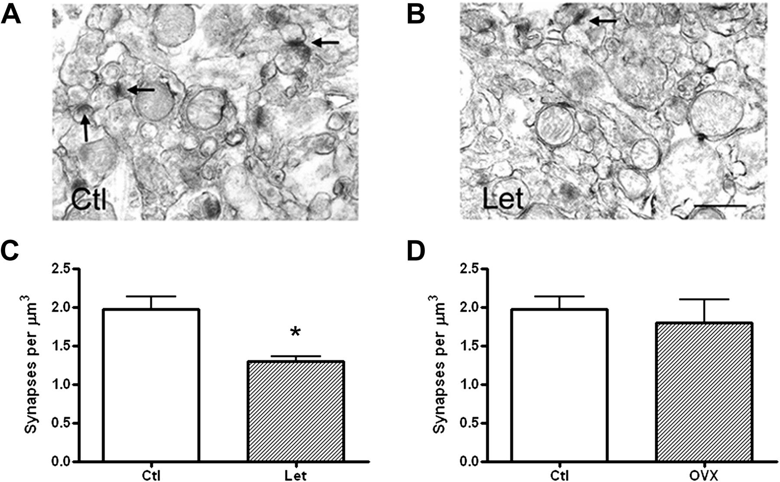
Figure 5. Spine synapse density is reduced in DG ML of adult mice after letrozole treatment but not after ovariectomy. ...
Notes:
Figure 5. Spine synapse density is reduced in DG ML of adult mice after letrozole treatment but not after ovariectomy. (A, B) Representative electron micrographs from ML of adult (12-week old) female mice, injected for 7 days either with vehicle (A) or letrozole (B). (C) As in the immature rats, letrozole treatment caused a significant reduction of spine synapse density (vehicle: 1.97 ± 0.16, n = 4; letrozole: 1.29 ± 0.06 synapses per μm3, n = 3; P = 0.02, unpaired t-test), whereas no effect of ovariectomy on spine synapse density was detectable (1.8 ± 0.29 synapses per μm3, n = 3; P > 0.05). Scale bar: 0.2 μm.
Unless provided in the caption above, the following copyright applies to the content of this slide: © The Author 2010. Published by Oxford University Press. All rights reserved. For permissions, please e-mail: journals.permissions@oxfordjournals.org

Slide 6
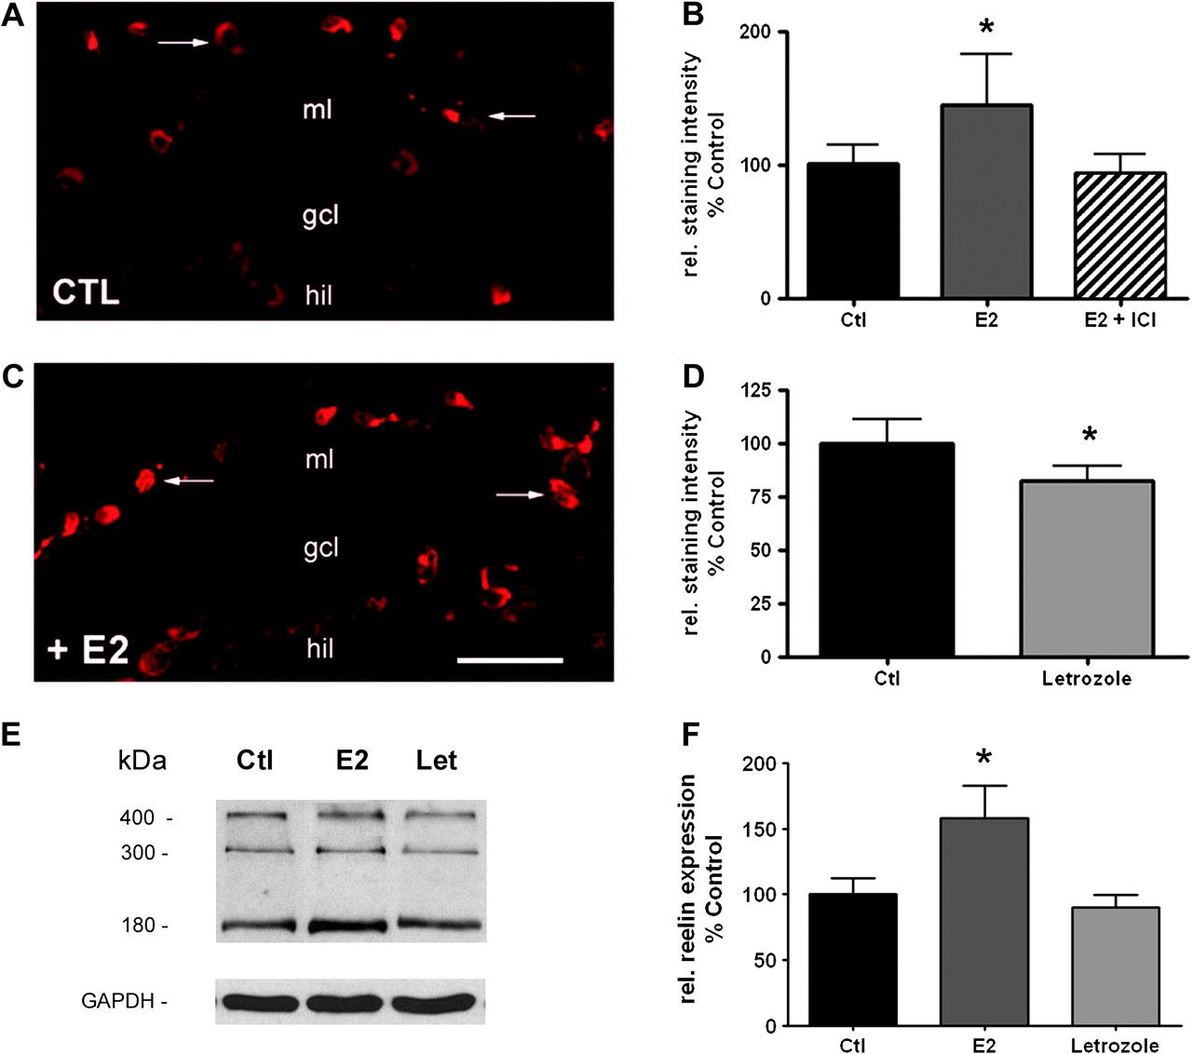
Figure 6. Reelin expression in CR cells is regulated by estrogen. (A–C) Adding 17β-estradiol (E2, 100 nM) to the ...
Notes:
Figure 6. Reelin expression in CR cells is regulated by estrogen. (A–C) Adding 17β-estradiol (E2, 100 nM) to the culture medium of organotypic hippocampal slice cultures for 6 days (5th to 11th day in vitro) resulted in stronger reelin immunoreactivity in CR cells of the DG ML (A, C, arrows). (B) Quantification of reelin immunosignal using image analysis revealed a significant increase of reelin immunoreactivity to 143 ± 35% of control values after E2-treatment (n = 16, P = 0.019, paired t-test). This increase was abolished when the estrogen receptor blocker ICI182,780 was coapplied (94 ± 14%, n = 12, P > 0.05). (D) Changes were also observed when letrozole, an inhibitor of aromatase, was supplemented. Here, a significant decrease of reelin immunosignal (82 ± 7%, n = 25, P = 0.048) resulted, suggesting that E2 produced within the hippocampus participates in the regulation of reelin. (E–F) Western blot analyses of reelin protein expression after E2 or letrozole treatment revealed similar results than the image analysis: E2 induced a significant increase of reelin expression to 158 ± 25% of control levels (n = 5, P = 0.044, paired t-test), whereas letrozole resulted in a slight but nonsignificant decrease of reelin expression (90 ± 9% of control, n = 5, P > 0.05). Scale bar: 30 μm.
Unless provided in the caption above, the following copyright applies to the content of this slide: © The Author 2010. Published by Oxford University Press. All rights reserved. For permissions, please e-mail: journals.permissions@oxfordjournals.org

Slide 7
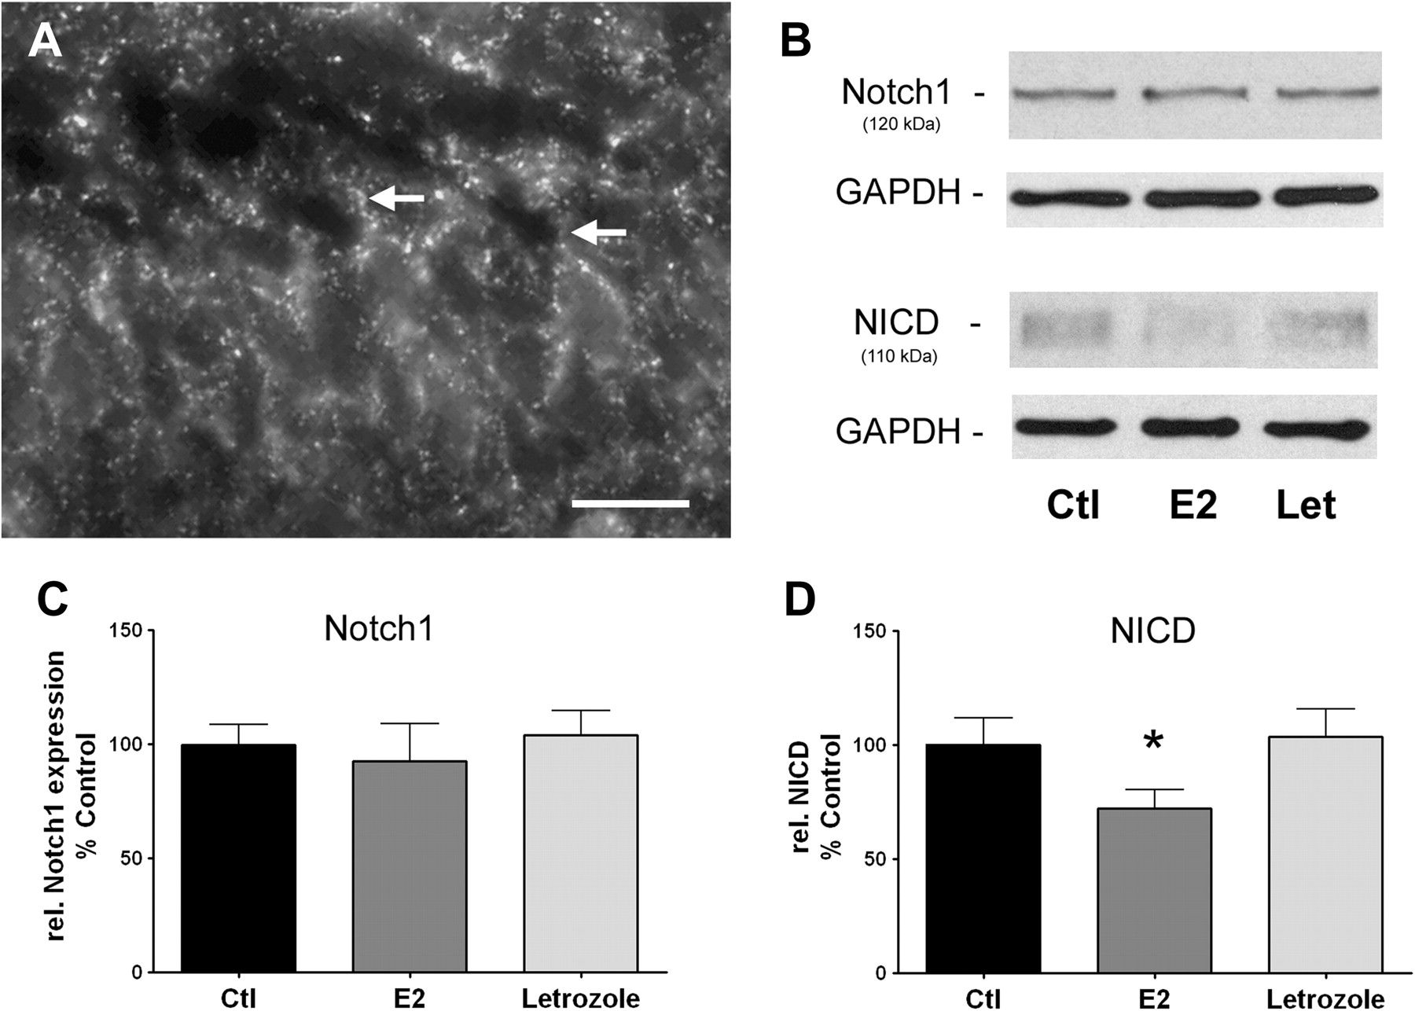
Figure 7. Estradiol influences Notch1 regulation. (A) IHC of Notch1 in DG shows a punctate staining surrounding the ...
Notes:
Figure 7. Estradiol influences Notch1 regulation. (A) IHC of Notch1 in DG shows a punctate staining surrounding the granule cells, concordant with a membranous location of Notch1 receptors. Note: Notch1-positive punctae also extend into the dendrites of granule cells (arrows). (B–D) Western blot analyses of 120 kDa membrane-tethered Notch1 and 110 kDa intracellularly cleaved Notch1 domain (NICD), with GAPDH as internal standard, showed no effect of E2 or letrozole on levels of membrane-tethered Notch1 (E2: 92 ± 16%, letrozole: 104 ± 11% of control, n = 5, P > 0.05, paired t-test; B, C). However, E2-treatment significantly reduced NICD levels (to 72 ± 8% of control, n = 6, P = 0.02, paired t-test; B, D), suggesting a regulatory influence of E2 on the cleavage of Notch1. No effect of letrozole on NICD levels was detectable under these conditions (104 ± 12% of control, n = 6 P > 0.05; B, D). Scale bar: 10 μm.
Unless provided in the caption above, the following copyright applies to the content of this slide: © The Author 2010. Published by Oxford University Press. All rights reserved. For permissions, please e-mail: journals.permissions@oxfordjournals.org

