Slide 1
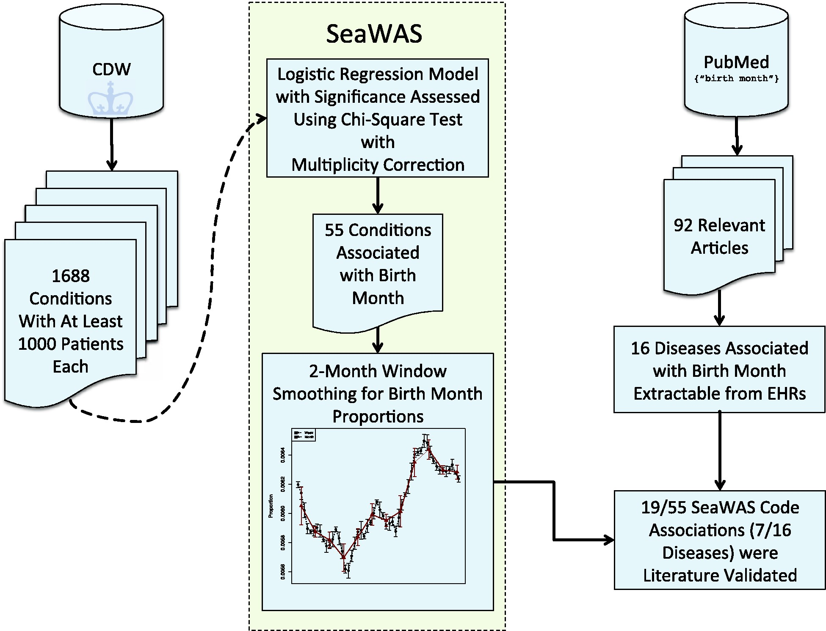
Figure 1: Overview of the SeaWAS algorithm. The algorithm takes all 1688 conditions as initial input, finds significant ...
Notes:
Figure 1: Overview of the SeaWAS algorithm. The algorithm takes all 1688 conditions as initial input, finds significant associations over all months, then it models each birth month’s association with the condition by smoothing the birth month proportions using a 2-month window. We then extracted all relevant birth month articles from PubMed (n = 92) and mapped the results to extractable codes from electronic health records. SeaWAS found 7 of the 16 diseases reported as associated with birth month in the literature corresponding to 19/55 associated codes.
Unless provided in the caption above, the following copyright applies to the content of this slide: © The Author 2015. Published by Oxford University Press on behalf of the American Medical Informatics Association.This is an Open Access article distributed under the terms of the Creative Commons Attribution Non-Commercial License (http://creativecommons.org/licenses/by-nc/4.0/), which permits non-commercial re-use, distribution, and reproduction in any medium, provided the original work is properly cited. For commercial re-use, please contact journals.permissions@oup.com

Slide 2
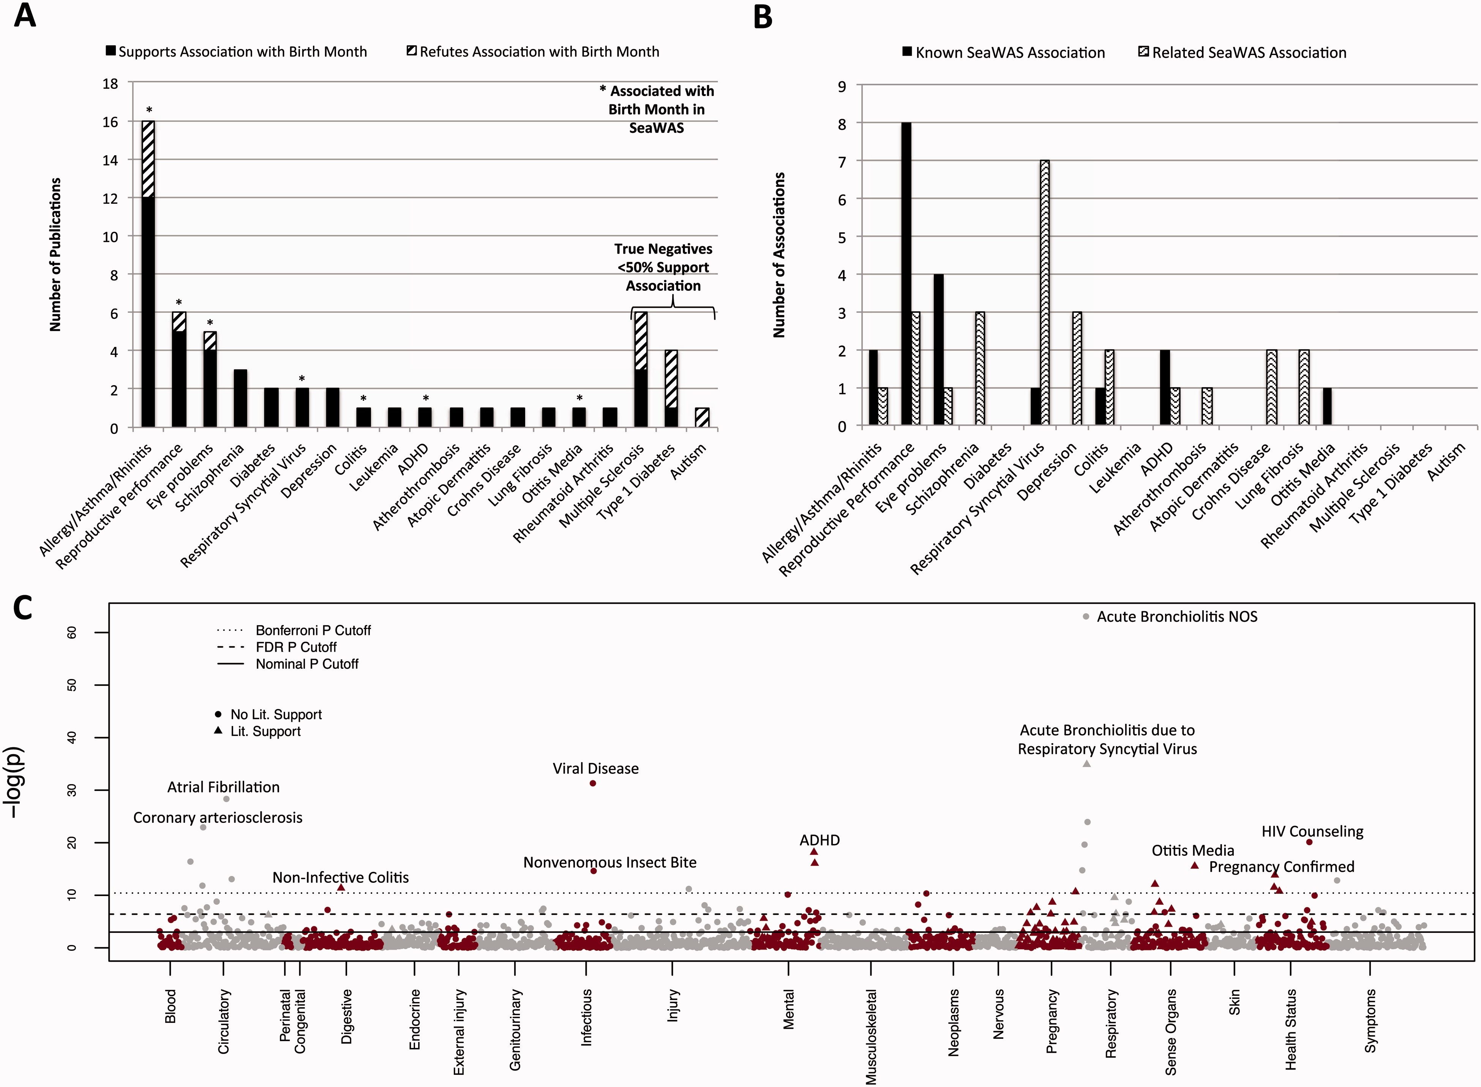
Figure 2: SeaWAS Results Show Enrichments for Literature Associations. (A) shows the breakdown of SeaWAS results by ...
Notes:
Figure 2: SeaWAS Results Show Enrichments for Literature Associations. (A) shows the breakdown of SeaWAS results by number of publications demonstrating a relationship. (B) shows the number of SeaWAS associations known to be related to disease from the literature (solid black), and those that are closely related to known diseases (curvy lines). (C) Depicts all birth month–disease associations in a Manhattan plot organized by their respective ICD-9 disease categories (x axis). A significant SeaWAS association is a disease–birth month association remaining significant after FDR adjustment.
Unless provided in the caption above, the following copyright applies to the content of this slide: © The Author 2015. Published by Oxford University Press on behalf of the American Medical Informatics Association.This is an Open Access article distributed under the terms of the Creative Commons Attribution Non-Commercial License (http://creativecommons.org/licenses/by-nc/4.0/), which permits non-commercial re-use, distribution, and reproduction in any medium, provided the original work is properly cited. For commercial re-use, please contact journals.permissions@oup.com

Slide 3
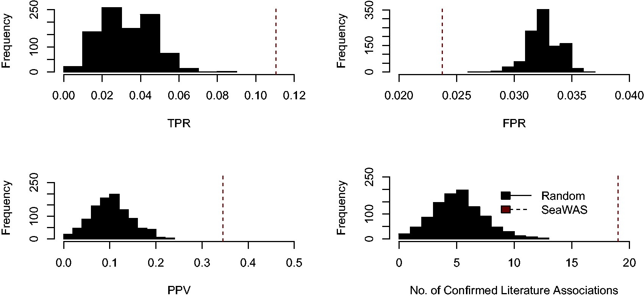
Figure 3: SeaWAS vs random reveals higher true positive rate, lower false positive rate, higher positive predictive ...
Notes:
Figure 3: SeaWAS vs random reveals higher true positive rate, lower false positive rate, higher positive predictive value, and more confirmed literature associations. We used 1000 randomly generated samples. For each sample, 55 random codes were pulled (from the set of 1688), and then the number of confirmed literature associations was measured. SeaWAS consistently performed better than random across all measures.
Unless provided in the caption above, the following copyright applies to the content of this slide: © The Author 2015. Published by Oxford University Press on behalf of the American Medical Informatics Association.This is an Open Access article distributed under the terms of the Creative Commons Attribution Non-Commercial License (http://creativecommons.org/licenses/by-nc/4.0/), which permits non-commercial re-use, distribution, and reproduction in any medium, provided the original work is properly cited. For commercial re-use, please contact journals.permissions@oup.com

Slide 4
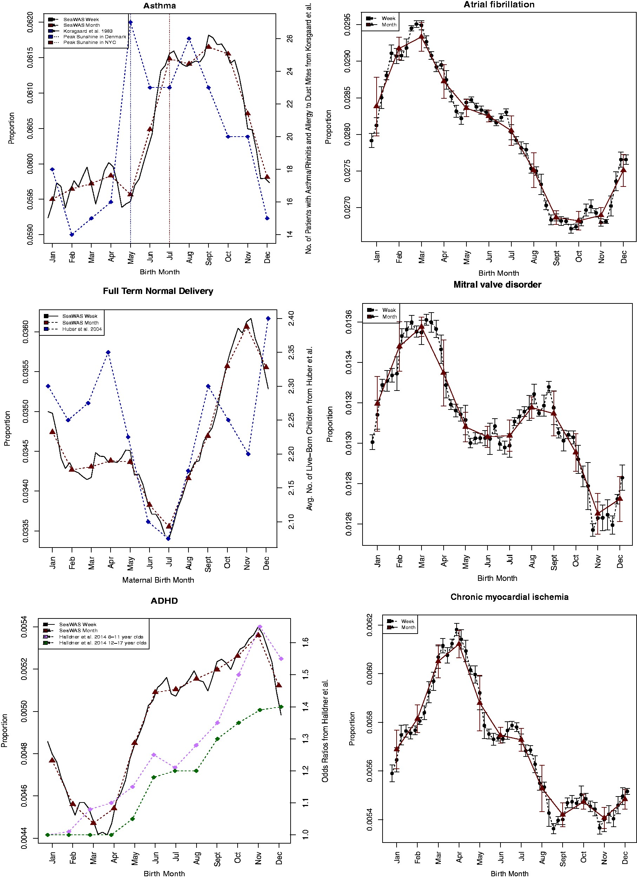
Figure 4: Birth month distribution plots for 3 literature validated SeaWAS results and 3 discovered SeaWAS ...
Notes:
Figure 4: Birth month distribution plots for 3 literature validated SeaWAS results and 3 discovered SeaWAS associations. We selected 3 well-known literature associations: asthma, ADHD, and reproductive performance to compare with SeaWAS birth month trends. We compared our results to findings published in articles for each of these diseases: 1) for asthma we used a Denmark study by Korsgaard et al.13; 2) for reproductive performance we used an Austrian study by Huber et al.,8 which we compared to full-term normal delivery (i.e., general birth code); and 3) for ADHD we used a Swedish study by Halldner et al.3 To facilitate comparison between asthma studies from different locales, we used data on the average monthly sunshine exposure for New York, USA and Skagen, Denmark obtained from World Weather and Climate Information.48,49 We also found 3 interesting new associations: atrial fibrillation, mitral valve disorder, and chronic myocardial ischemia.
Unless provided in the caption above, the following copyright applies to the content of this slide: © The Author 2015. Published by Oxford University Press on behalf of the American Medical Informatics Association.This is an Open Access article distributed under the terms of the Creative Commons Attribution Non-Commercial License (http://creativecommons.org/licenses/by-nc/4.0/), which permits non-commercial re-use, distribution, and reproduction in any medium, provided the original work is properly cited. For commercial re-use, please contact journals.permissions@oup.com

Slide 5
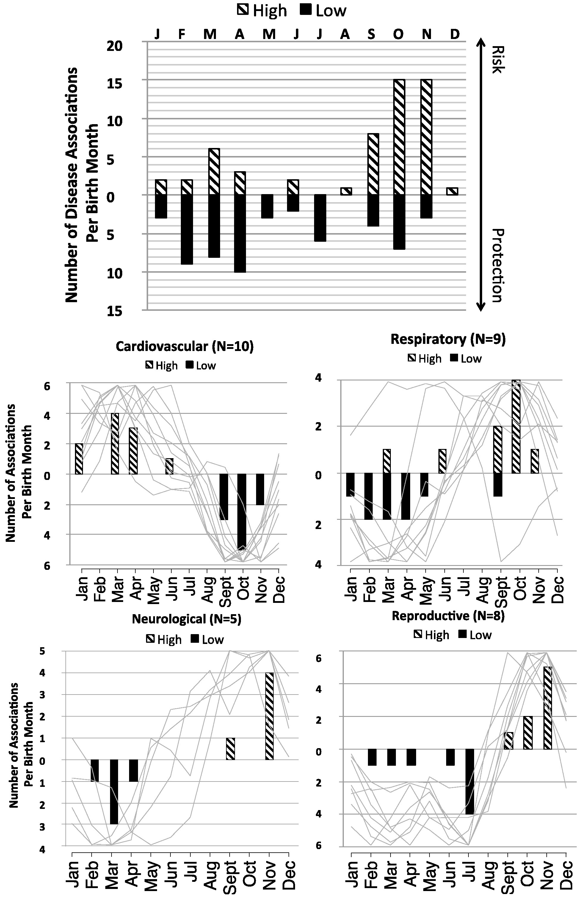
Figure 5: Disease risk status breakdown by birth month illustrates disease category dependency. Some months, e.g., May, ...
Notes:
Figure 5: Disease risk status breakdown by birth month illustrates disease category dependency. Some months, e.g., May, June, August, January, and December, provide no overall advantage or disadvantage to those born in that particular month (Figure 5, top). Other months, e.g., November, are more likely to be associated with increased disease risk while others, e.g., February, tend to be associated with decreased disease risk. The relationship between birth month and disease risk depends on disease category, and this is shown in the 4 lower subplots. Light gray lines represent risk curves for diseases belonging to a particular category. For example, individuals born in October are at increased risk for respiratory conditions and at the same time are at decreased risk for cardiovascular conditions.
Unless provided in the caption above, the following copyright applies to the content of this slide: © The Author 2015. Published by Oxford University Press on behalf of the American Medical Informatics Association.This is an Open Access article distributed under the terms of the Creative Commons Attribution Non-Commercial License (http://creativecommons.org/licenses/by-nc/4.0/), which permits non-commercial re-use, distribution, and reproduction in any medium, provided the original work is properly cited. For commercial re-use, please contact journals.permissions@oup.com

Slide 6
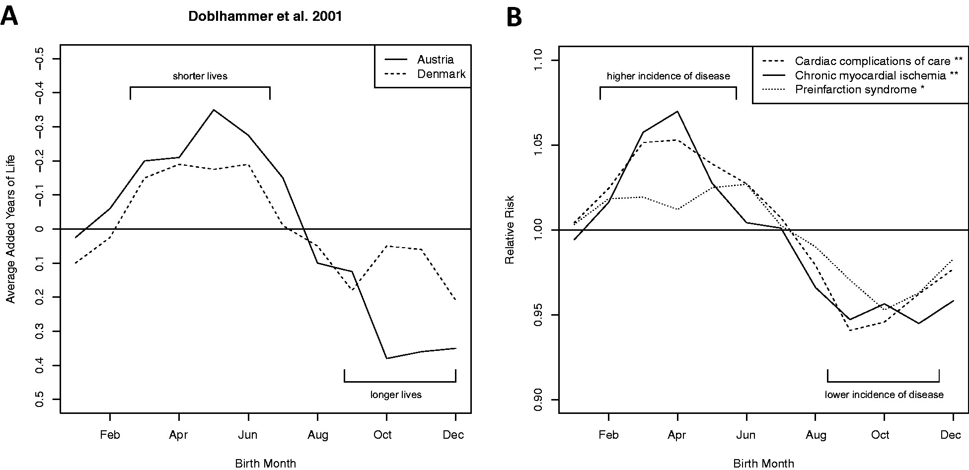
Figure 6: SeaWAS cardiovascular condition-birth month proportions correlate with published lifespan-birth month results ...
Notes:
Figure 6: SeaWAS cardiovascular condition-birth month proportions correlate with published lifespan-birth month results from Doblhammer et al. 2001. All 10 (9 novel) cardiovascular disease–birth month associations found by SeaWAS were compared to Doblhammer et al.’s lifespan-birth month dependencies for Denmark and Austria12 The lifespan-birth month associations are shown in Figure 6a. Six of the 10 were anti-correlated (i.e., months with low cardiovascular disease risk were also months with longer life expectancies from Doblhammer et al.’s study.12 The top 3 anti-correlated cardiovascular diseases are shown in Figure 6b, cardiac complications of care (Denmark: r = −0.815, P = .001; Austria: r = −0.863, P < .001); chronic myocardial ischemia (Denmark: r = −0.810, P = .001; Austria: r = −0.826, P < .001); and pre-infarction syndrome (Denmark: r = −0.712, P = .009; Austria: r = −0.918, P < .001). In Figure 6b, **denotes P ≤ 0.001 and *denotes P < .01 for both comparisons (Austria and Denmark).
Unless provided in the caption above, the following copyright applies to the content of this slide: © The Author 2015. Published by Oxford University Press on behalf of the American Medical Informatics Association.This is an Open Access article distributed under the terms of the Creative Commons Attribution Non-Commercial License (http://creativecommons.org/licenses/by-nc/4.0/), which permits non-commercial re-use, distribution, and reproduction in any medium, provided the original work is properly cited. For commercial re-use, please contact journals.permissions@oup.com

