Slide 1
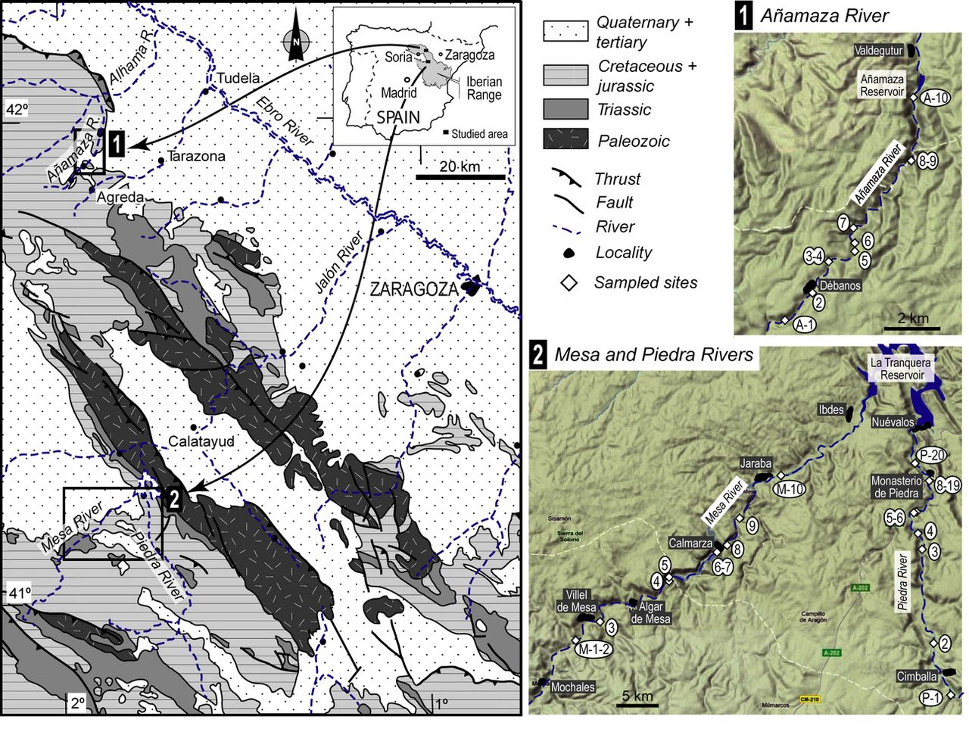
Geographical location of the Iberian Range in Spain, indicating the distribution of the studied rivers and ...
Notes:
Geographical location of the Iberian Range in Spain, indicating the distribution of the studied rivers and the regional geology. Sampling sites are sequentially numbered for the Añamaza (inset ‘1’ A-1 through A-10) and Piedra and Mesa rivers (inset ‘2’ P-1 through P-20, and M-1 through M-10, respectively), along with the main human settlements along the rivers.
Unless provided in the caption above, the following copyright applies to the content of this slide: © 2012 Federation of European Microbiological Societies

Slide 2
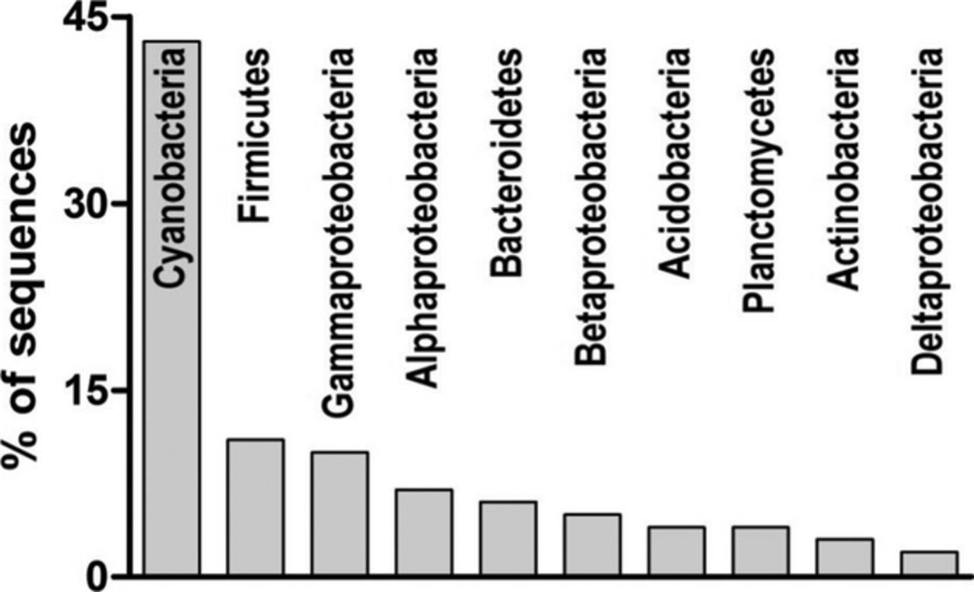
Percentage of bacterial sequences within bacteria divisions retrieved from DGGEs and according to their ...
Notes:
Percentage of bacterial sequences within bacteria divisions retrieved from DGGEs and according to their closest GenBank relative.
Unless provided in the caption above, the following copyright applies to the content of this slide: © 2012 Federation of European Microbiological Societies

Slide 3
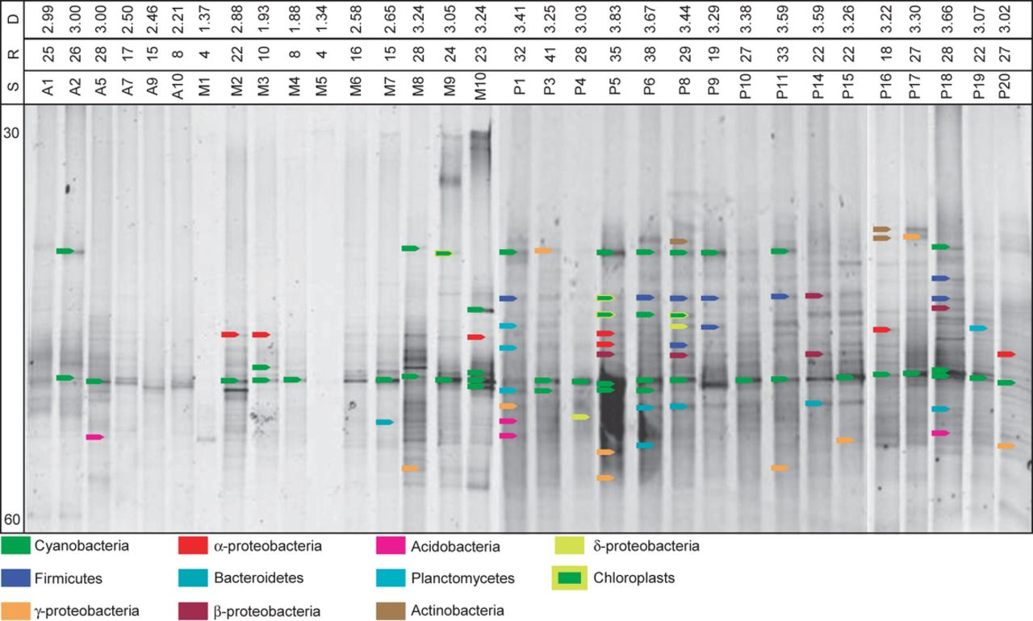
Composite image of DGGE gels displaying the banding pattern of bacterial phylotypes from the Añamaza, Mesa ...
Notes:
Composite image of DGGE gels displaying the banding pattern of bacterial phylotypes from the Añamaza, Mesa and Piedra rivers’ sites (named A, M, P, respectively). Coloured arrows indicate excised bands and bacterial phylotypes after blast (see Table ). The urea gradient used to run the gels is indicated as 30 and 60 (%). Site, richness and diversity are indicated as S, R, D, respectively.
Unless provided in the caption above, the following copyright applies to the content of this slide: © 2012 Federation of European Microbiological Societies

Slide 4
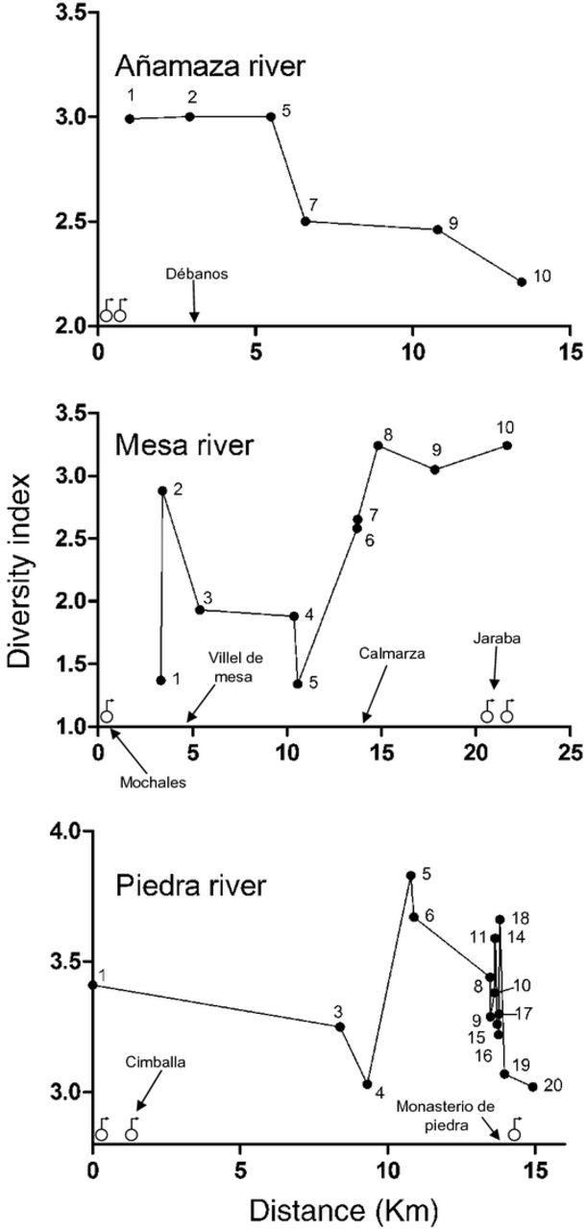
Variation of the diversity indices along the rivers. Water flow goes from left to right. Sampling sites are ...
Notes:
Variation of the diversity indices along the rivers. Water flow goes from left to right. Sampling sites are numbered (see Fig. ). Underground discharges are indicated with symbols at their approximate locations. Reference towns are indicated with arrows.
Unless provided in the caption above, the following copyright applies to the content of this slide: © 2012 Federation of European Microbiological Societies

Slide 5
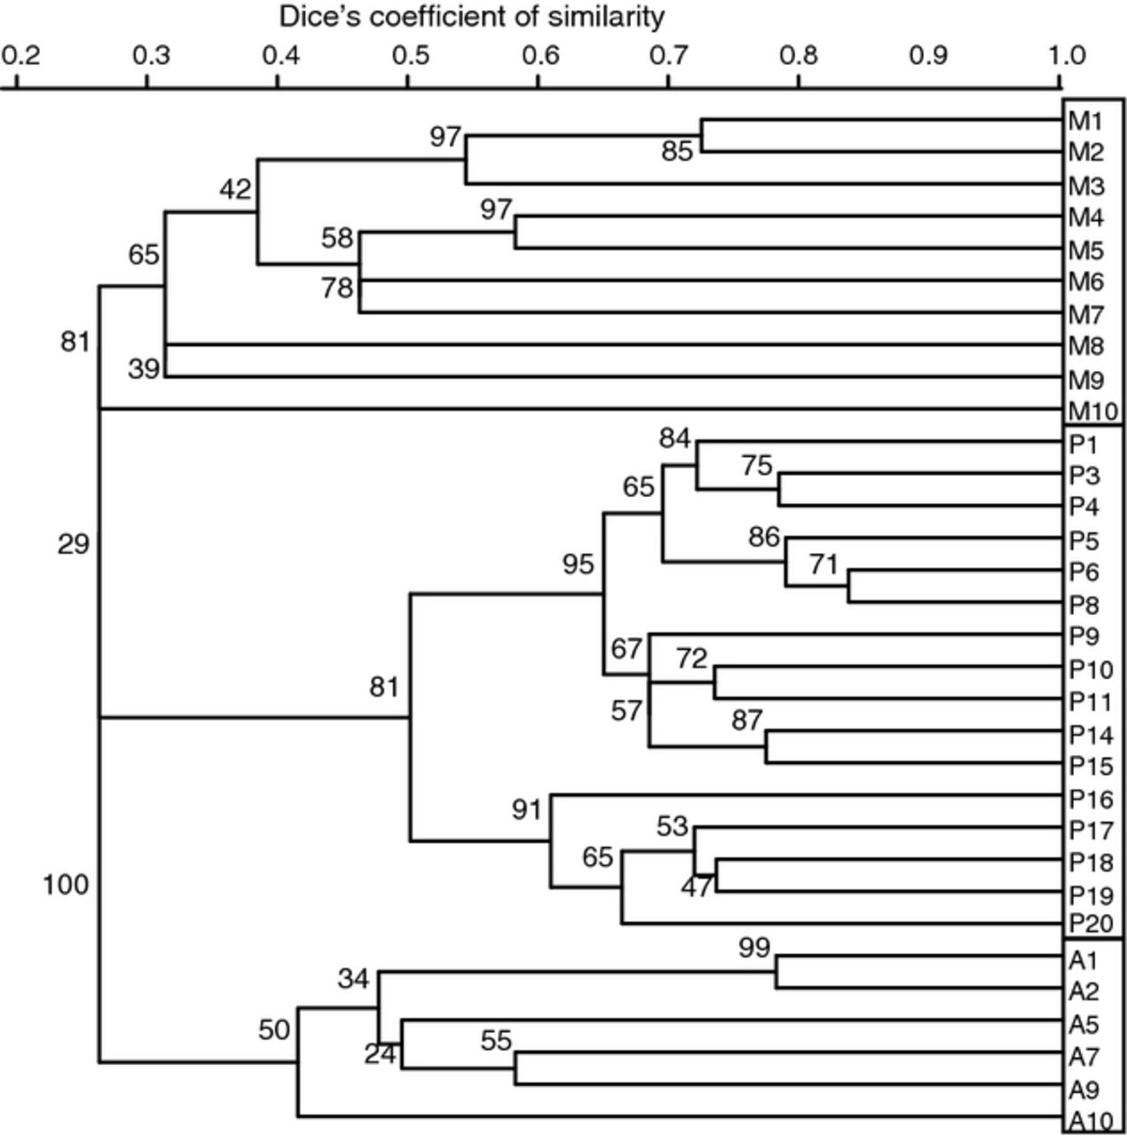
upgma cluster analysis applied to the banding pattern of individual lanes of the DGGE images. Letters A, M ...
Notes:
upgma cluster analysis applied to the banding pattern of individual lanes of the DGGE images. Letters A, M and P correspond to Añamaza, Mesa and Piedra rivers, respectively. Boxed areas show main clustering pattern of the sites. Bootstrap values correspond to 1000 sampling replicates.
Unless provided in the caption above, the following copyright applies to the content of this slide: © 2012 Federation of European Microbiological Societies

Slide 6
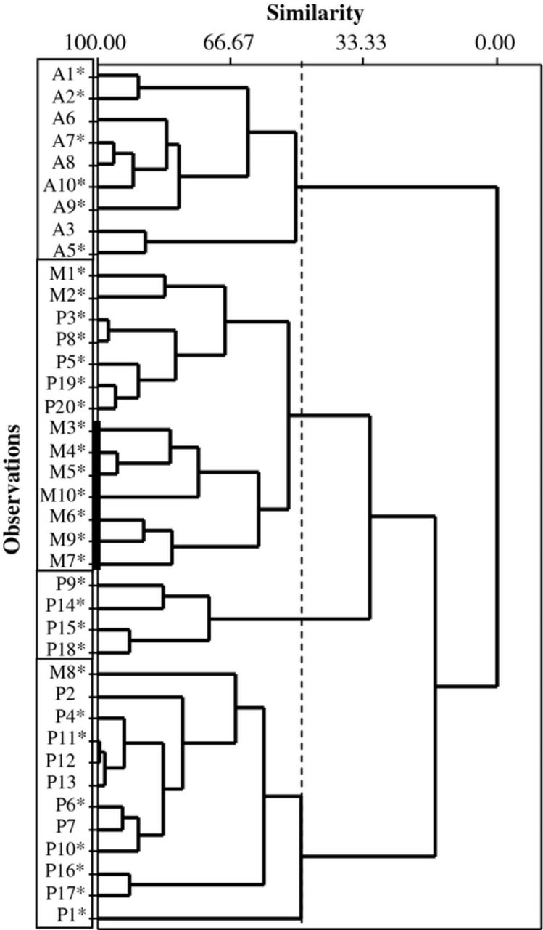
Dendrograms of the physicochemical variables measured at the sites. Similarity index is given in percentage. ...
Notes:
Dendrograms of the physicochemical variables measured at the sites. Similarity index is given in percentage. Boxed areas correspond to clustered sites at the 50% similarity index (dashed vertical line). Dark vertical line indicates clustering of the M sites at the 60% similarity index. Letters A, M and P correspond to Añamaza, Mesa and Piedra rivers, respectively.
Unless provided in the caption above, the following copyright applies to the content of this slide: © 2012 Federation of European Microbiological Societies

Slide 7
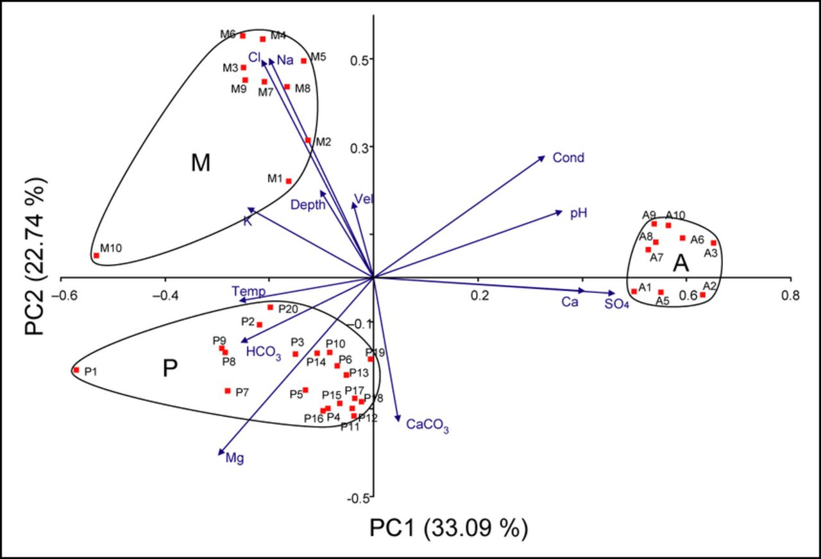
Biplot of the first two PCA components. Clustering distinguishes sites from the same river [Mesa (Mr), Piedra ...
Notes:
Biplot of the first two PCA components. Clustering distinguishes sites from the same river [Mesa (Mr), Piedra (Pr), and Añamaza (Ar)]. The arrows represent the original variables, their length represents the variance and the angle between arrows represents their correlation. Closer and longer vectors indicate higher loadings for the indicated variables, in this case and Ca2+ for the Ar sites, Na+ and Cl− for the Mr sites, and Mg2+, , and CaCO3 for the Pr sites.
Unless provided in the caption above, the following copyright applies to the content of this slide: © 2012 Federation of European Microbiological Societies

Slide 8
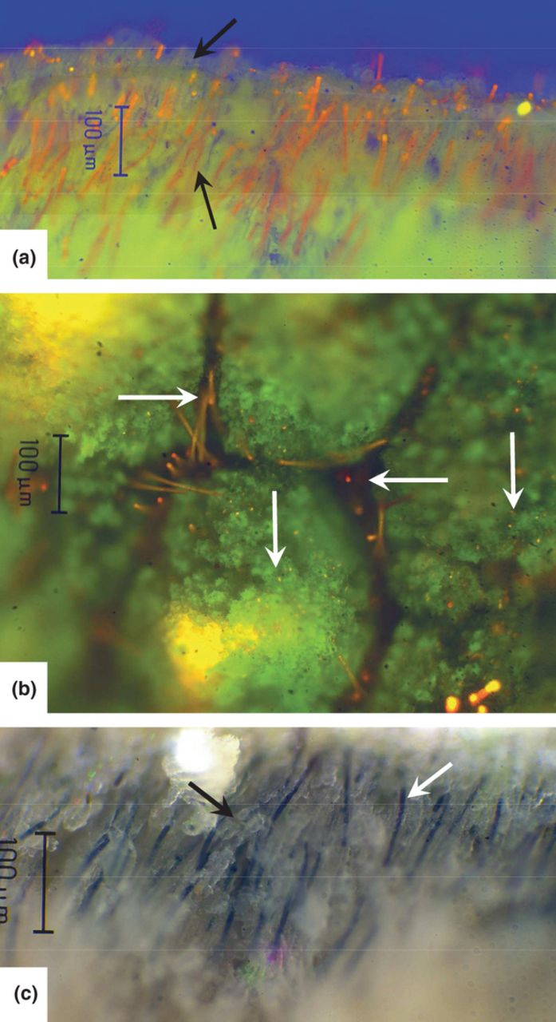
Tufa surface infested with filamentous cyanobacteria (Oscillatoriaceae). (a) Perspective of filaments (in ...
Notes:
Tufa surface infested with filamentous cyanobacteria (Oscillatoriaceae). (a) Perspective of filaments (in orange owing to chlorophyll autofluorescence) in erect position, perpendicular to the calcified tufa surface (green), as seen with epifluorescence microscopy. Note the difference between the bright-orange (noncalcite-coated filaments), the dull-orange calcite-coated filaments (lower arrow) and the partially degraded, nonfluorescent and coated filaments (upper arrow). (b) Plan view of the tufa surface showing noncoated filaments occupying the crevasses (horizontal arrows) and already-calcified filaments in micritic micromounds (vertical arrows). (c) Dense population of cyanobacteria showing selective calcite precipitation around filaments (white arrow). Some filaments were able to migrate away (upward) from the calcification zone, leaving behind cylindrical tubes in calcite chunks (black arrow). All scale bars = 100 μm.
Unless provided in the caption above, the following copyright applies to the content of this slide: © 2012 Federation of European Microbiological Societies

