Slide 1
Figure 1. ROI analyses across healthy controls, moderate- and severe TBI survivors. The figure shows the results of ...
Notes:
Figure 1. ROI analyses across healthy controls, moderate- and severe TBI survivors. The figure shows the results of planned polynomial contrasts following statistically significant MANCOVAs. Only statistically significant results are shown. Results are adjusted for age, education, and Not-X CPT performance (Δ Not-X CPT performance for TOT effects). TOT, time-on-task; ROI, region of interest; MFC, medial frontal cortex; IPL, inferior parietal cortex; PFC, prefrontal cortex. Error bars represent ± standard error of estimated marginal means.
Unless provided in the caption above, the following copyright applies to the content of this slide: © The Author 2014. Published by Oxford University Press.This is an Open Access article distributed under the terms of the Creative Commons Attribution Non-Commercial License (http://creativecommons.org/licenses/by-nc/3.0/), which permits non-commercial re-use, distribution, and reproduction in any medium, provided the original work is properly cited. For commercial re-use, please contact journals.permissions@oup.com

Slide 2
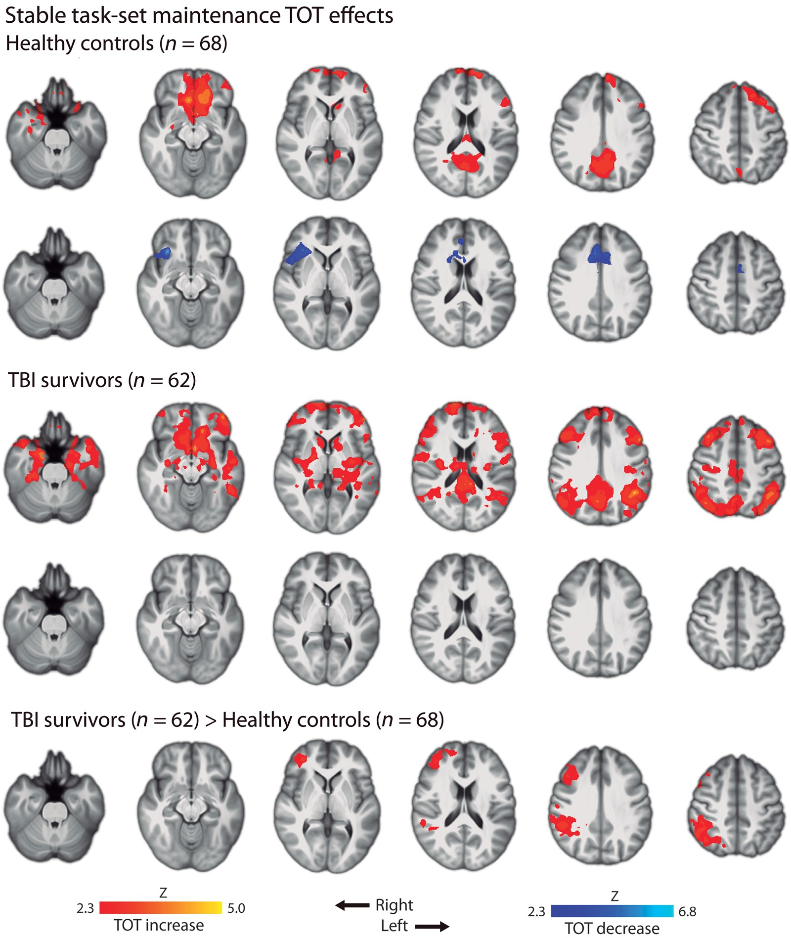
Figure 2. Whole-brain TOT effects for stable task-set maintenance. SPMs are corrected for multiple comparisons using a ...
Notes:
Figure 2. Whole-brain TOT effects for stable task-set maintenance. SPMs are corrected for multiple comparisons using a cluster threshold of Z > 2.3, P = 0.05. Results are presented on a 1-mm MNI standard space template. SPM, Statistical Parametric Mapping; MNI, Montreal Neurological Institute.
Unless provided in the caption above, the following copyright applies to the content of this slide: © The Author 2014. Published by Oxford University Press.This is an Open Access article distributed under the terms of the Creative Commons Attribution Non-Commercial License (http://creativecommons.org/licenses/by-nc/3.0/), which permits non-commercial re-use, distribution, and reproduction in any medium, provided the original work is properly cited. For commercial re-use, please contact journals.permissions@oup.com

