Slide 1
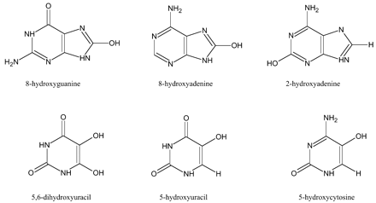
Fig. 1. Some oxidative DNA adducts.
Notes:
Fig. 1. Some oxidative DNA adducts.
Unless provided in the caption above, the following copyright applies to the content of this slide: Oxford University Press

Slide 2
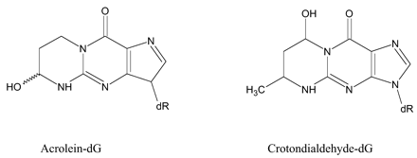
Fig. 2. Propano adducts.
Notes:
Fig. 2. Propano adducts.
Unless provided in the caption above, the following copyright applies to the content of this slide: Oxford University Press

Slide 3
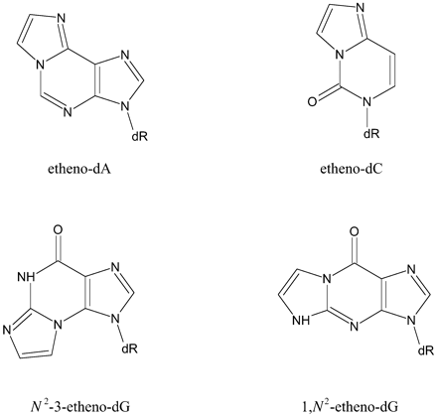
Fig. 3. Etheno adducts.
Notes:
Fig. 3. Etheno adducts.
Unless provided in the caption above, the following copyright applies to the content of this slide: Oxford University Press

Slide 4
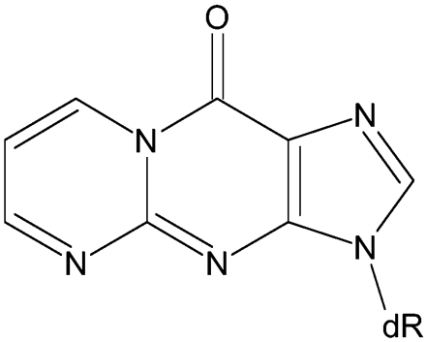
Fig. 4. M1G.
Notes:
Fig. 4. M1G.
Unless provided in the caption above, the following copyright applies to the content of this slide: Oxford University Press

Slide 5
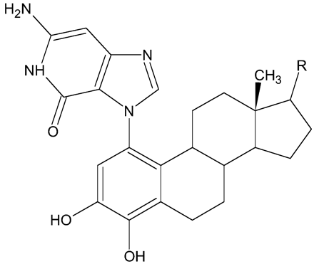
Fig. 5. 4‐OHE1(E2)‐1‐(α,β)‐N7Gua (E1, R is =O; E2, R is –OH).
Notes:
Fig. 5. 4‐OHE1(E2)‐1‐(α,β)‐N7Gua (E1, R is =O; E2, R is –OH).
Unless provided in the caption above, the following copyright applies to the content of this slide: Oxford University Press

Slide 6
Fig. 6. Metabolic redox cycling of catechol oestrogens.
Notes:
Fig. 6. Metabolic redox cycling of catechol oestrogens.
Unless provided in the caption above, the following copyright applies to the content of this slide: Oxford University Press

Slide 7
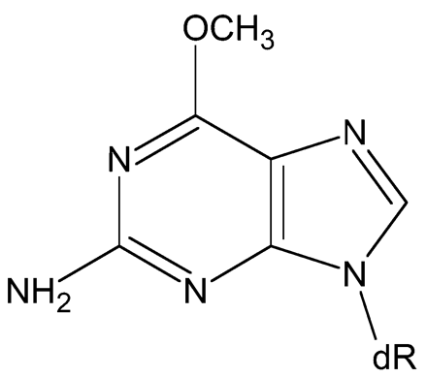
Fig. 7.O⁶‐methylguanine.
Notes:
Fig. 7.O6‐methylguanine.
Unless provided in the caption above, the following copyright applies to the content of this slide: Oxford University Press

