Slide 1
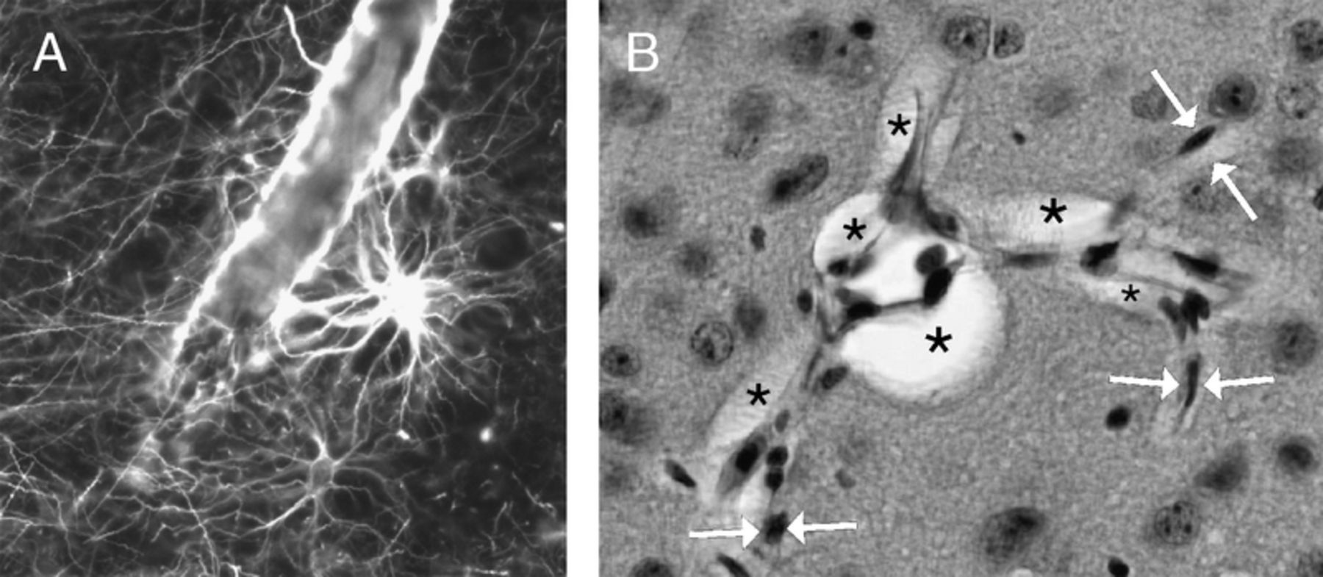
FIGURE 1. Glia limitans and perivascular spaces. (A) Immunostaining for glial fibrillary acidic protein highlights the ...
Notes:
FIGURE 1. Glia limitans and perivascular spaces. (A) Immunostaining for glial fibrillary acidic protein highlights the “glia limitans perivascularis” in a human brain. (B) In standard histologic sections, perivascular spaces are not apparent around capillaries (arrows) but are evident (asterisk) where capillaries merge to form postcapillary venules.
Unless provided in the caption above, the following copyright applies to the content of this slide: Copyright © 2008 by the American Association of Neuropathologists, Inc.

Slide 2
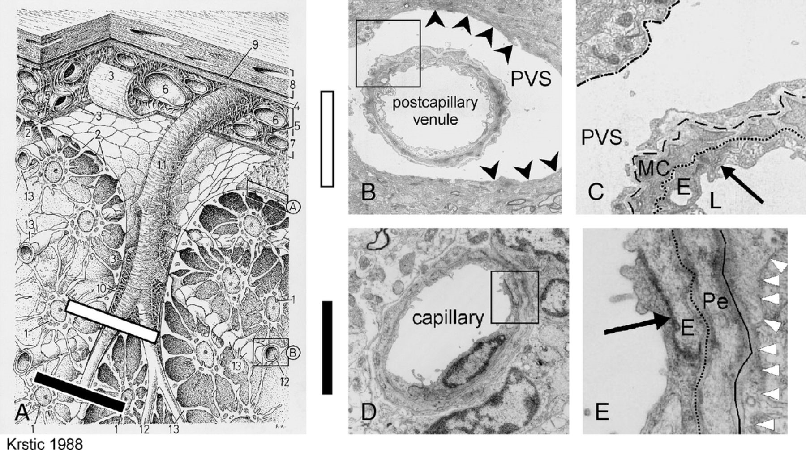
FIGURE 2. (A) Schematic diagram of different anatomic regions from brain parenchyma to skull. Superficial vessels of ...
Notes:
FIGURE 2. (A) Schematic diagram of different anatomic regions from brain parenchyma to skull. Superficial vessels of the brain [6] are located in the subarachnoid space [7]. This compartment is delineated by the arachnoid mater [4] and the pia mater [3]. The surface of the brain is completely covered by the astrocytic endfeet of the glia limitans [2]. Toward the subarachnoid space, these endfeet are designated as glia limitans superficialis (A); toward the vessels inside of the brain, they are termed glia limitans perivascularis (B). On their way from the surface to the deep areas of the brain, the vessels take leptomeningeal connective tissue with them, thereby forming perivascular spaces [10], which remain connected to the subarachnoid space. 1 indicates perikaryon of an astrocyte; 2, glia limitans superficialis; 3, connective tissue of the pia mater (inner layer of the leptomeninges); 4, arachnoid mater (outer layer of the leptomeninges); 5, subarachnoid connective tissue (trabeculae arachnoideae); 6, subarachnoid vessel; 7, subarachnoid space; 8, dura mater (pachymeninges); 9, neurothelium; 10, perivascular space; 11, penetrating vessel; 12, capillary; 13, glia limitans perivascularis. (B, C) Ultrastructure of the PVS, which is bordered by the other walls of a postcapillary venule and the glia limitans (arrowheads) or their basement membranes. The field corresponds to the white bar (A). (C) Higher magnification of the field depicted (B) shows the basement membranes. In noncapillary vessels, at least 3 basement membranes can be distinguished: the endothelial membrane (dotted line), the outer vascular membrane (dashed line), and the membrane of the glia limitans (dotted and dashed). (D) Ultrastructure of the region corresponding to the black bar (A). (D) In capillaries (12 in [A]), the basement membranes are merged to form a “fused gliovascular membrane” that occludes the perivascular space. (E) Higher magnification of the field depicted (D). The capillary wall consists of endothelium [E], endothelial basement membrane (dotted line), and Pe. The fused gliovascular membrane is shown by a continuous black line. It is directly apposed to the glia limitans. Astrocyte processes of the glia limitans are indicated by arrowheads. The arrows (C, E) point to tight junctions between endothelial cells. The overlap of adjacent endothelial cells is a hallmark of the BBB and is evident in the capillary, but not in the venule. E, endothelial cell; L, lumen; MC, mural cell, an intermediate form between smooth muscle cell and pericyte; Pe, pericytes; PVS, perivascular space. Figure reprinted from Radivoj V. Krstic: Die Gewebe des Menschen und der Säugetiere (Human and Mammalian Tissues), 1988, with kind permission of Springer Science + Business Media.
Unless provided in the caption above, the following copyright applies to the content of this slide: Copyright © 2008 by the American Association of Neuropathologists, Inc.

Slide 3
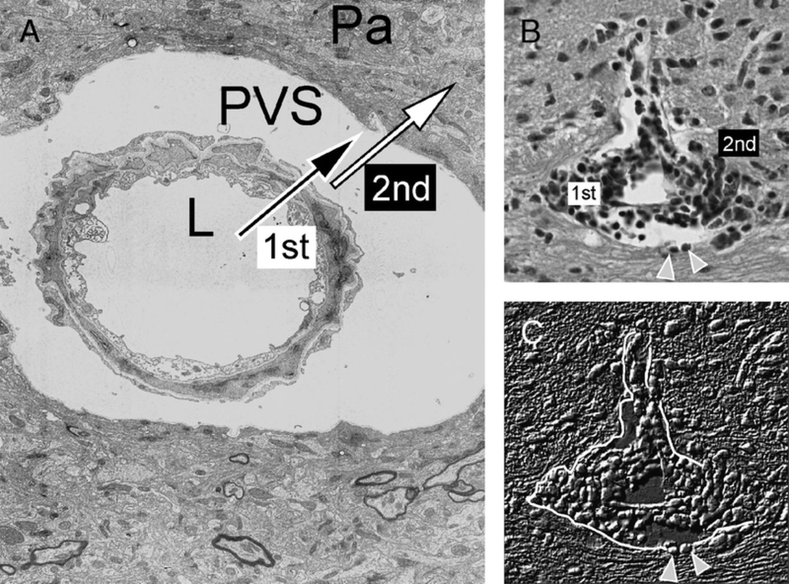
FIGURE 3. The 2 steps to neuroinflammation. (A) In the first step of neuroinflammation (1st), circulating immune cells ...
Notes:
FIGURE 3. The 2 steps to neuroinflammation. (A) In the first step of neuroinflammation (1st), circulating immune cells cross the microvascular central nervous system (CNS) endothelium to reach the PVS. In the second step (2nd), immune cells progress across the glia limitans to enter the CNS Pa. (B, C) The distinction between perivascular and intraparenchymal infiltration in standard histologic sections in the spinal cord of a mouse with EAE. (B) In a paraffin section, the border built by the glia limitans has been traversed by inflammatory cells on the right side (2nd), whereas cells are restricted to the perivascular space on the left side (1st). (C) Phase-contrast microscopy highlights the distinction. The arrowheads point to 2 cells that appear to “digest” or otherwise “open” the basement membrane of the glia limitans (white line), which is not visible at the light microscopic level. Pa, parenchyma; PVS, perivascular space.
Unless provided in the caption above, the following copyright applies to the content of this slide: Copyright © 2008 by the American Association of Neuropathologists, Inc.

Slide 4
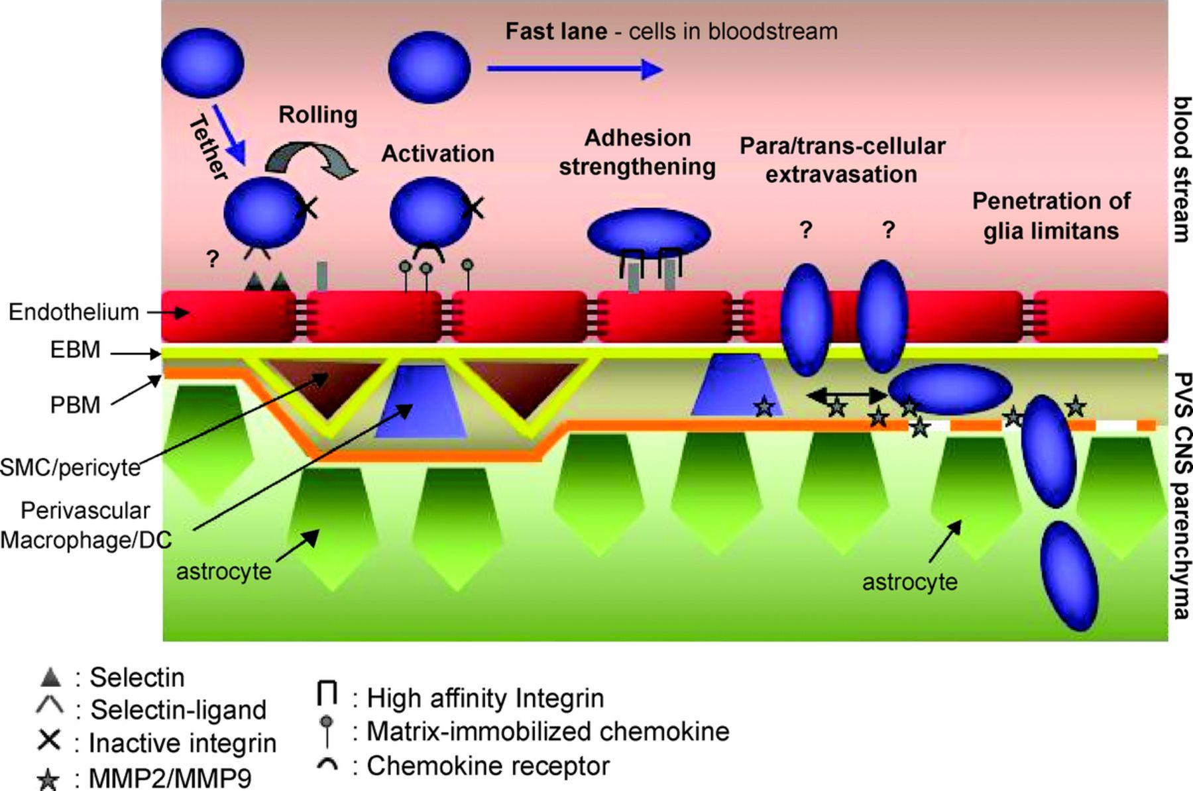
FIGURE 4. Multistep paradigm for leukocyte entry to the central nervous system (CNS). In the first step of ...
Notes:
FIGURE 4. Multistep paradigm for leukocyte entry to the central nervous system (CNS). In the first step of neuroinflammation circulating, immune cells engage in a multistep interaction with CNS microvascular endothelial cells that they cross by either transcellular or paracellular routes. After passing through the endothelial basement membrane (EBM), they reach the perivascular space (PVS). After additional activation triggers that are probably provided by perivascular macrophages or dendritic cells, MMP-2 and MMP-9 are produced and allow the second-step immune cell entry across the glia limitans or pavenchymal basement membrane (PBM) into the CNS parenchyma.
Unless provided in the caption above, the following copyright applies to the content of this slide: Copyright © 2008 by the American Association of Neuropathologists, Inc.

