Slide 1
Table 1 Indications and considerations for LSA revascularisation in TEVAR with LSA coverage.
Notes:
Table 1 Indications and considerations for LSA revascularisation in TEVAR with LSA coverage.
Unless provided in the caption above, the following copyright applies to the content of this slide: © European Association for Cardio-Thoracic Surgery 2011

Slide 2
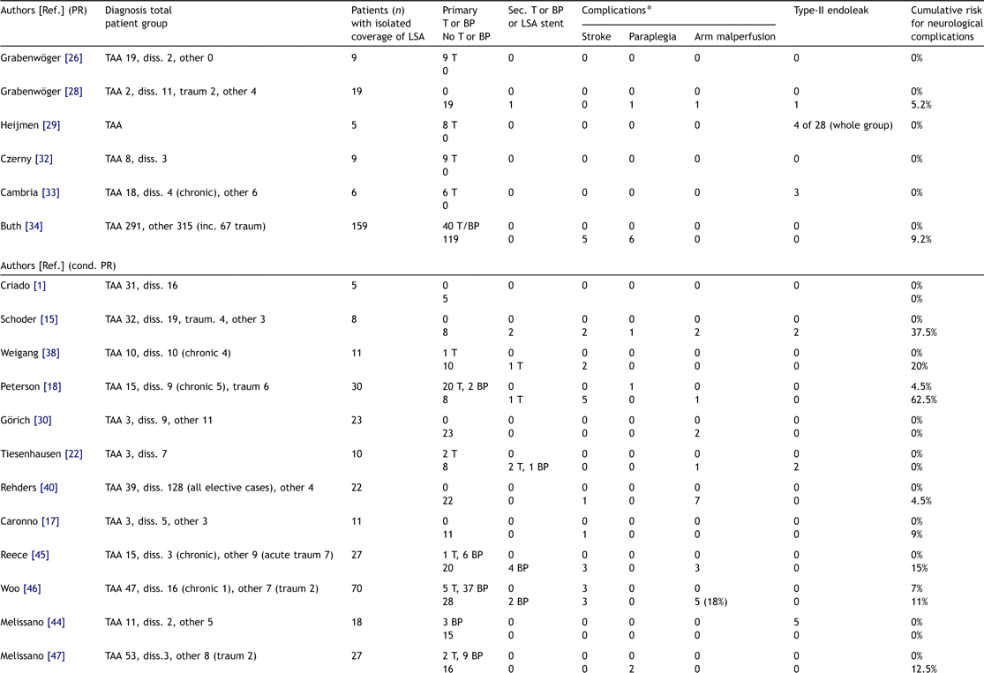
Table 2 Relevant studies concerning endograft coverage of the LSA and prophylactic LSA revascularisation: Diagnoses, ...
Notes:
Table 2 Relevant studies concerning endograft coverage of the LSA and prophylactic LSA revascularisation: Diagnoses, surgical therapy, complications (all in number of patients) and cumulative risk (in %) for neurological complications as related to treatment option.
Unless provided in the caption above, the following copyright applies to the content of this slide: © European Association for Cardio-Thoracic Surgery 2011

Slide 3
Table 2 Relevant studies concerning endograft coverage of the LSA and prophylactic LSA revascularisation: Diagnoses, ...
Notes:
Table 2 Relevant studies concerning endograft coverage of the LSA and prophylactic LSA revascularisation: Diagnoses, surgical therapy, complications (all in number of patients) and cumulative risk (in %) for neurological complications as related to treatment option.
Unless provided in the caption above, the following copyright applies to the content of this slide: © European Association for Cardio-Thoracic Surgery 2011

