Slide 1
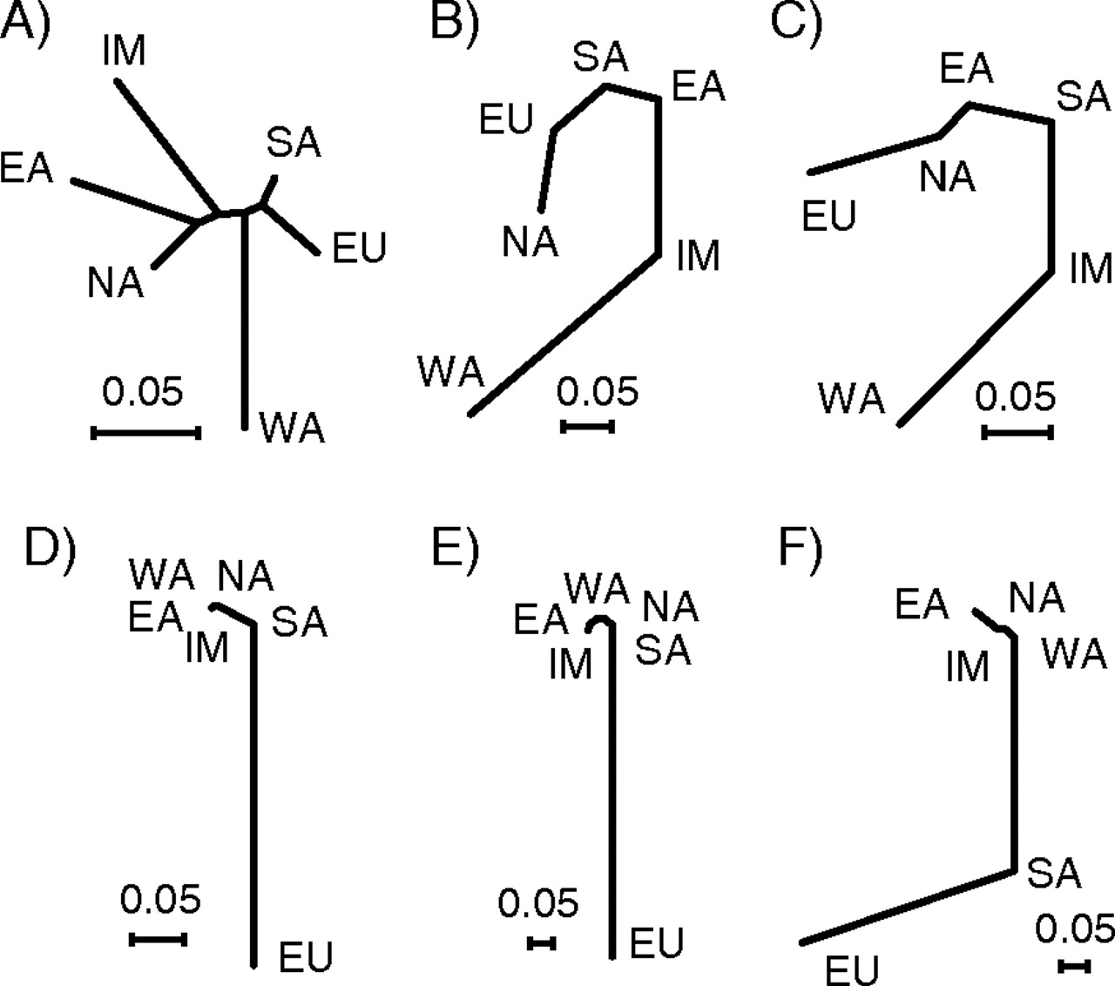
FIG. 1.— Neighbor-Joining trees based on (a) average F_{ST} values among the 6 populations typed on the ...
Notes:
FIG. 1.— Neighbor-Joining trees based on (a) average FST values among the 6 populations typed on the Affymetrix 10K WGSA chip and locus-specific FST values at (b) ASIP A8818G, (c) OCA2 A355G, (d) TYR A192C, (e) MATP C374G, and (f) SLC24A5 A111G. Populations are abbreviated as follows: WA, West African; SA, South Asian; NA, Native American; EU, European; EA, East Asian; IM, Island Melanesian.
Unless provided in the caption above, the following copyright applies to the content of this slide: © The Author 2006. Published by Oxford University Press on behalf of the Society for Molecular Biology and Evolution. All rights reserved. For permissions, please e-mail: journals.permissions@oxfordjournals.org

Slide 2
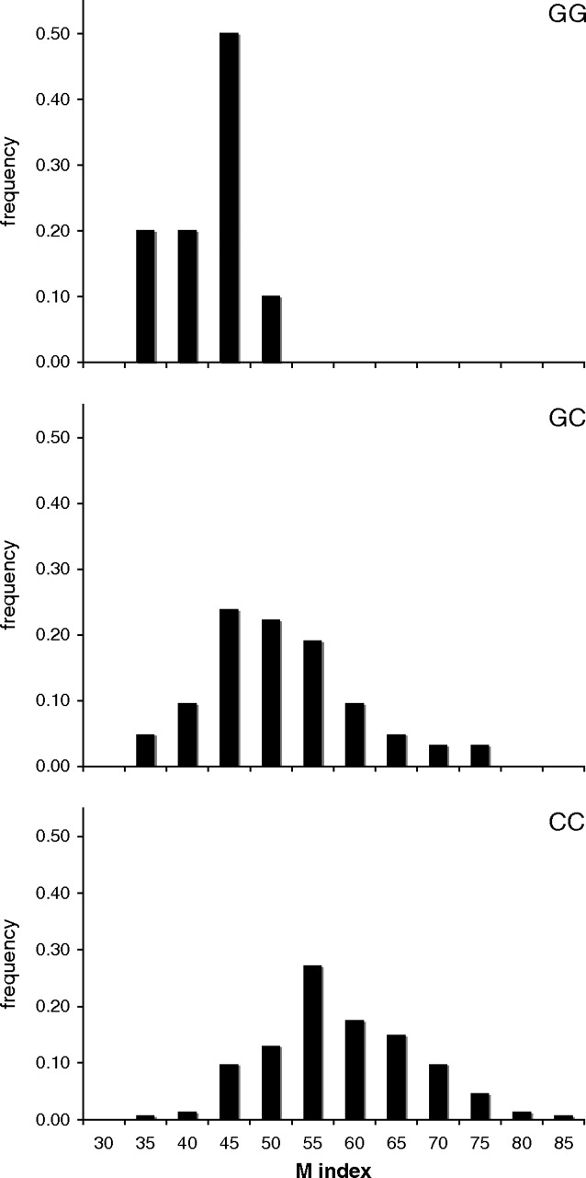
FIG. 2.— Distribution of M index values for each of the 3 genotype classes at MATP C374G in a sample of 202 ...
Notes:
FIG. 2.— Distribution of M index values for each of the 3 genotype classes at MATP C374G in a sample of 202 African-American individuals. The ancestral allele, C, has an effect size per allele of +5 melanin units (95% CI: +2.5 to +8), and its effects are consistent with an additive mode of inheritance.
Unless provided in the caption above, the following copyright applies to the content of this slide: © The Author 2006. Published by Oxford University Press on behalf of the Society for Molecular Biology and Evolution. All rights reserved. For permissions, please e-mail: journals.permissions@oxfordjournals.org

Slide 3
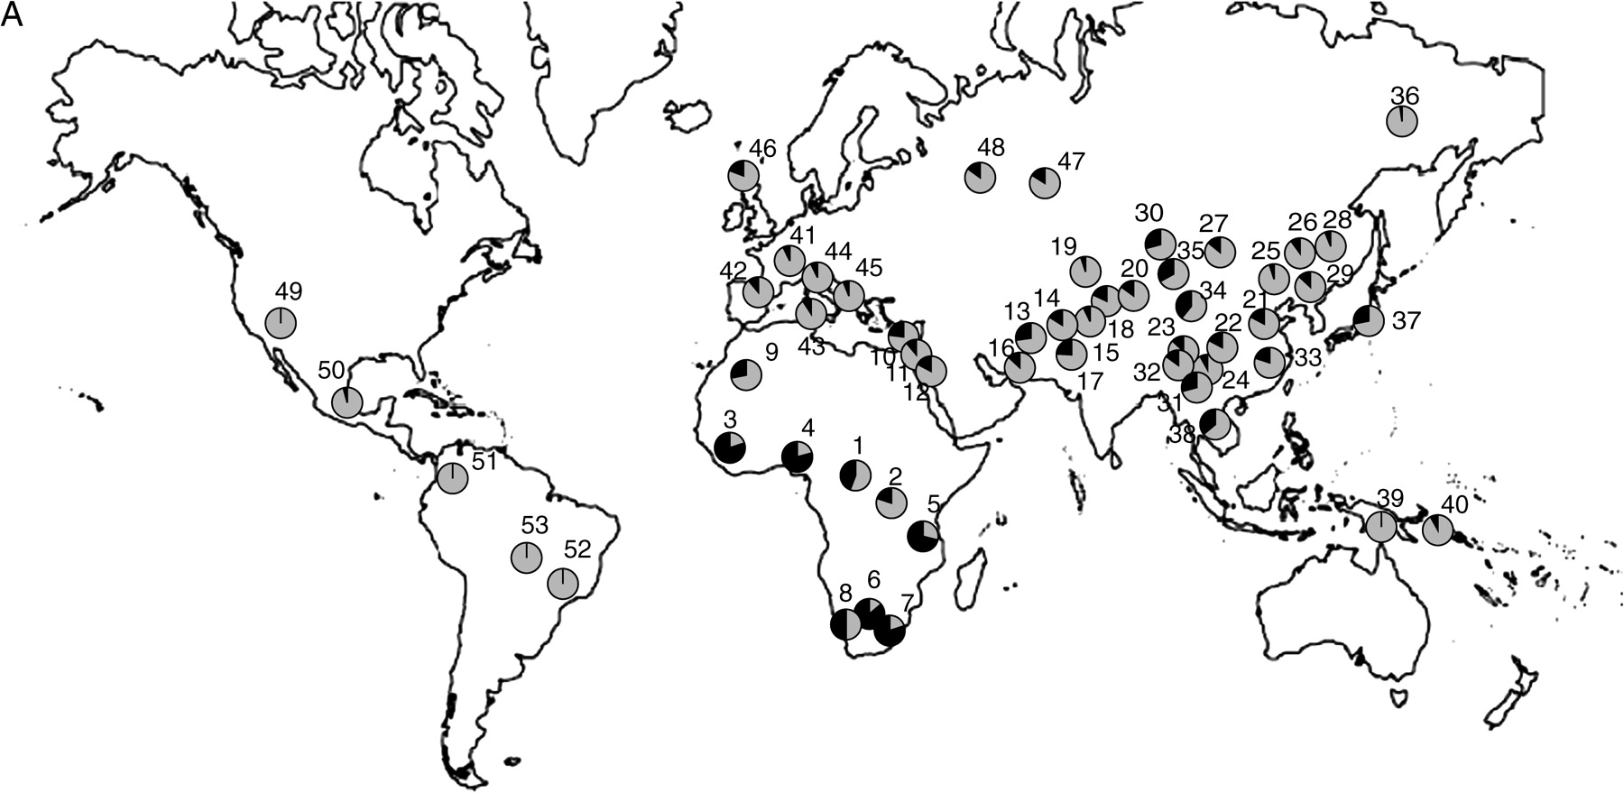
FIG. 3.— Distribution of allele frequencies in the CEPH-Diversity Panel for the 5 SNP showing elevated pairwise ...
Notes:
FIG. 3.— Distribution of allele frequencies in the CEPH-Diversity Panel for the 5 SNP showing elevated pairwise FST values for at least one population pair in our original population screen: (A) ASIP A8818G, (B) OCA2 A355G, (C) TYR A192C, (D) MATP C374G, and (E) SLC24A5 A111G. On all maps, gray shading corresponds to the frequency of the allele associated with lighter pigmentation. The numbered populations correspond to the following: 1) Biaka pygmies, 2) Mbuti pygmies, 3) Mandenka, 4) Yoruba, 5) Bantu N.E., 6) San, 7) Bantu S.E., 8) Bantu S.W., 9) Mozabite, 10) Bedouin, 11) Druze, 12) Palestinian, 13) Brahui, 14) Balochi, 15) Hazara, 16) Makrani, 17) Sindhi, 18) Pathan, 19) Kalesh, 20) Burusho, 21) Han, 22) Tujia, 23) Yizu, 24) Miaozu, 25) Orogen, 26) Daur, 27) Mongola, 28) Hezhen, 29) Xibo, 30) Uygur, 31) Dai, 32) Lahu, 33) She, 34) Naxi, 35) Tu, 36) Yakut, 37) Japanese, 38) Cambodian, 39) Papuan, 40) NAN Melanesian, 41) French, 42) French Basque, 43) Sardinian, 44) Northern Italian, 45) Tuscan, 46) Orcadian, 47) Adygei, 48) Russian, 49) Pima, 50) Maya, 51) Columbian, 52) Karitiana, 53) Surui.
Unless provided in the caption above, the following copyright applies to the content of this slide: © The Author 2006. Published by Oxford University Press on behalf of the Society for Molecular Biology and Evolution. All rights reserved. For permissions, please e-mail: journals.permissions@oxfordjournals.org

Slide 4
FIG. 3.— Distribution of allele frequencies in the CEPH-Diversity Panel for the 5 SNP showing elevated pairwise ...
Notes:
FIG. 3.— Distribution of allele frequencies in the CEPH-Diversity Panel for the 5 SNP showing elevated pairwise FST values for at least one population pair in our original population screen: (A) ASIP A8818G, (B) OCA2 A355G, (C) TYR A192C, (D) MATP C374G, and (E) SLC24A5 A111G. On all maps, gray shading corresponds to the frequency of the allele associated with lighter pigmentation. The numbered populations correspond to the following: 1) Biaka pygmies, 2) Mbuti pygmies, 3) Mandenka, 4) Yoruba, 5) Bantu N.E., 6) San, 7) Bantu S.E., 8) Bantu S.W., 9) Mozabite, 10) Bedouin, 11) Druze, 12) Palestinian, 13) Brahui, 14) Balochi, 15) Hazara, 16) Makrani, 17) Sindhi, 18) Pathan, 19) Kalesh, 20) Burusho, 21) Han, 22) Tujia, 23) Yizu, 24) Miaozu, 25) Orogen, 26) Daur, 27) Mongola, 28) Hezhen, 29) Xibo, 30) Uygur, 31) Dai, 32) Lahu, 33) She, 34) Naxi, 35) Tu, 36) Yakut, 37) Japanese, 38) Cambodian, 39) Papuan, 40) NAN Melanesian, 41) French, 42) French Basque, 43) Sardinian, 44) Northern Italian, 45) Tuscan, 46) Orcadian, 47) Adygei, 48) Russian, 49) Pima, 50) Maya, 51) Columbian, 52) Karitiana, 53) Surui.
Unless provided in the caption above, the following copyright applies to the content of this slide: © The Author 2006. Published by Oxford University Press on behalf of the Society for Molecular Biology and Evolution. All rights reserved. For permissions, please e-mail: journals.permissions@oxfordjournals.org

Slide 5
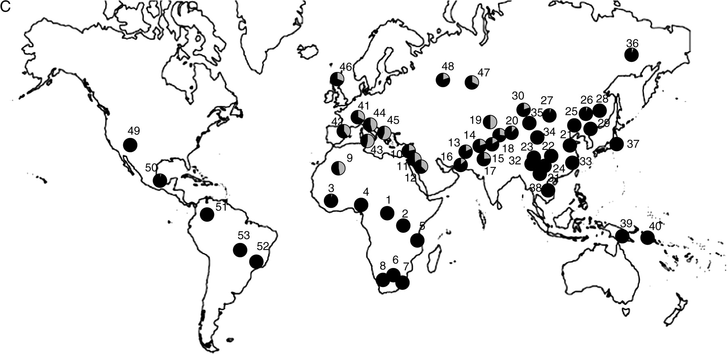
FIG. 3.— Distribution of allele frequencies in the CEPH-Diversity Panel for the 5 SNP showing elevated pairwise ...
Notes:
FIG. 3.— Distribution of allele frequencies in the CEPH-Diversity Panel for the 5 SNP showing elevated pairwise FST values for at least one population pair in our original population screen: (A) ASIP A8818G, (B) OCA2 A355G, (C) TYR A192C, (D) MATP C374G, and (E) SLC24A5 A111G. On all maps, gray shading corresponds to the frequency of the allele associated with lighter pigmentation. The numbered populations correspond to the following: 1) Biaka pygmies, 2) Mbuti pygmies, 3) Mandenka, 4) Yoruba, 5) Bantu N.E., 6) San, 7) Bantu S.E., 8) Bantu S.W., 9) Mozabite, 10) Bedouin, 11) Druze, 12) Palestinian, 13) Brahui, 14) Balochi, 15) Hazara, 16) Makrani, 17) Sindhi, 18) Pathan, 19) Kalesh, 20) Burusho, 21) Han, 22) Tujia, 23) Yizu, 24) Miaozu, 25) Orogen, 26) Daur, 27) Mongola, 28) Hezhen, 29) Xibo, 30) Uygur, 31) Dai, 32) Lahu, 33) She, 34) Naxi, 35) Tu, 36) Yakut, 37) Japanese, 38) Cambodian, 39) Papuan, 40) NAN Melanesian, 41) French, 42) French Basque, 43) Sardinian, 44) Northern Italian, 45) Tuscan, 46) Orcadian, 47) Adygei, 48) Russian, 49) Pima, 50) Maya, 51) Columbian, 52) Karitiana, 53) Surui.
Unless provided in the caption above, the following copyright applies to the content of this slide: © The Author 2006. Published by Oxford University Press on behalf of the Society for Molecular Biology and Evolution. All rights reserved. For permissions, please e-mail: journals.permissions@oxfordjournals.org

Slide 6
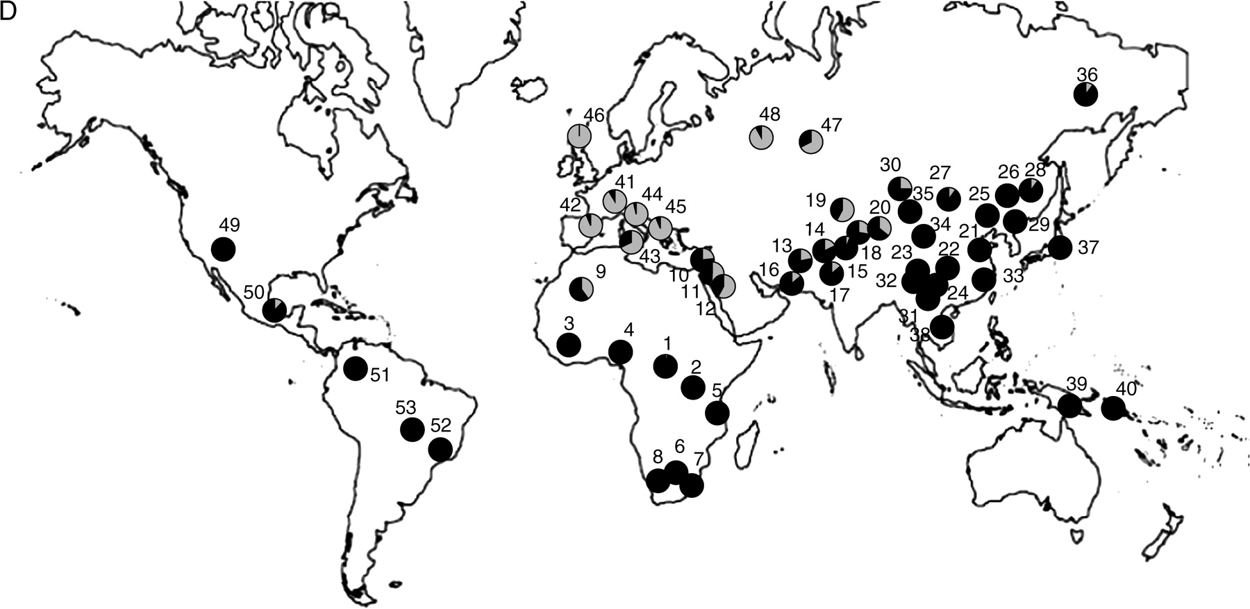
FIG. 3.— Distribution of allele frequencies in the CEPH-Diversity Panel for the 5 SNP showing elevated pairwise ...
Notes:
FIG. 3.— Distribution of allele frequencies in the CEPH-Diversity Panel for the 5 SNP showing elevated pairwise FST values for at least one population pair in our original population screen: (A) ASIP A8818G, (B) OCA2 A355G, (C) TYR A192C, (D) MATP C374G, and (E) SLC24A5 A111G. On all maps, gray shading corresponds to the frequency of the allele associated with lighter pigmentation. The numbered populations correspond to the following: 1) Biaka pygmies, 2) Mbuti pygmies, 3) Mandenka, 4) Yoruba, 5) Bantu N.E., 6) San, 7) Bantu S.E., 8) Bantu S.W., 9) Mozabite, 10) Bedouin, 11) Druze, 12) Palestinian, 13) Brahui, 14) Balochi, 15) Hazara, 16) Makrani, 17) Sindhi, 18) Pathan, 19) Kalesh, 20) Burusho, 21) Han, 22) Tujia, 23) Yizu, 24) Miaozu, 25) Orogen, 26) Daur, 27) Mongola, 28) Hezhen, 29) Xibo, 30) Uygur, 31) Dai, 32) Lahu, 33) She, 34) Naxi, 35) Tu, 36) Yakut, 37) Japanese, 38) Cambodian, 39) Papuan, 40) NAN Melanesian, 41) French, 42) French Basque, 43) Sardinian, 44) Northern Italian, 45) Tuscan, 46) Orcadian, 47) Adygei, 48) Russian, 49) Pima, 50) Maya, 51) Columbian, 52) Karitiana, 53) Surui.
Unless provided in the caption above, the following copyright applies to the content of this slide: © The Author 2006. Published by Oxford University Press on behalf of the Society for Molecular Biology and Evolution. All rights reserved. For permissions, please e-mail: journals.permissions@oxfordjournals.org

Slide 7
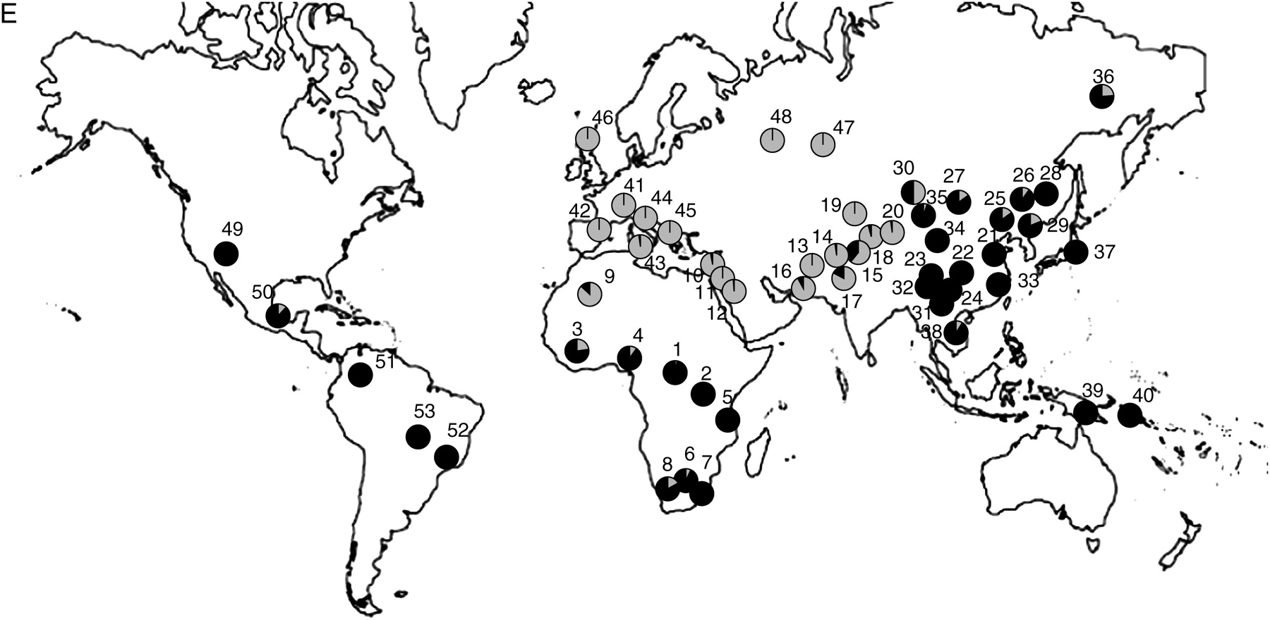
FIG. 3.— Distribution of allele frequencies in the CEPH-Diversity Panel for the 5 SNP showing elevated pairwise ...
Notes:
FIG. 3.— Distribution of allele frequencies in the CEPH-Diversity Panel for the 5 SNP showing elevated pairwise FST values for at least one population pair in our original population screen: (A) ASIP A8818G, (B) OCA2 A355G, (C) TYR A192C, (D) MATP C374G, and (E) SLC24A5 A111G. On all maps, gray shading corresponds to the frequency of the allele associated with lighter pigmentation. The numbered populations correspond to the following: 1) Biaka pygmies, 2) Mbuti pygmies, 3) Mandenka, 4) Yoruba, 5) Bantu N.E., 6) San, 7) Bantu S.E., 8) Bantu S.W., 9) Mozabite, 10) Bedouin, 11) Druze, 12) Palestinian, 13) Brahui, 14) Balochi, 15) Hazara, 16) Makrani, 17) Sindhi, 18) Pathan, 19) Kalesh, 20) Burusho, 21) Han, 22) Tujia, 23) Yizu, 24) Miaozu, 25) Orogen, 26) Daur, 27) Mongola, 28) Hezhen, 29) Xibo, 30) Uygur, 31) Dai, 32) Lahu, 33) She, 34) Naxi, 35) Tu, 36) Yakut, 37) Japanese, 38) Cambodian, 39) Papuan, 40) NAN Melanesian, 41) French, 42) French Basque, 43) Sardinian, 44) Northern Italian, 45) Tuscan, 46) Orcadian, 47) Adygei, 48) Russian, 49) Pima, 50) Maya, 51) Columbian, 52) Karitiana, 53) Surui.
Unless provided in the caption above, the following copyright applies to the content of this slide: © The Author 2006. Published by Oxford University Press on behalf of the Society for Molecular Biology and Evolution. All rights reserved. For permissions, please e-mail: journals.permissions@oxfordjournals.org

