Slide 1
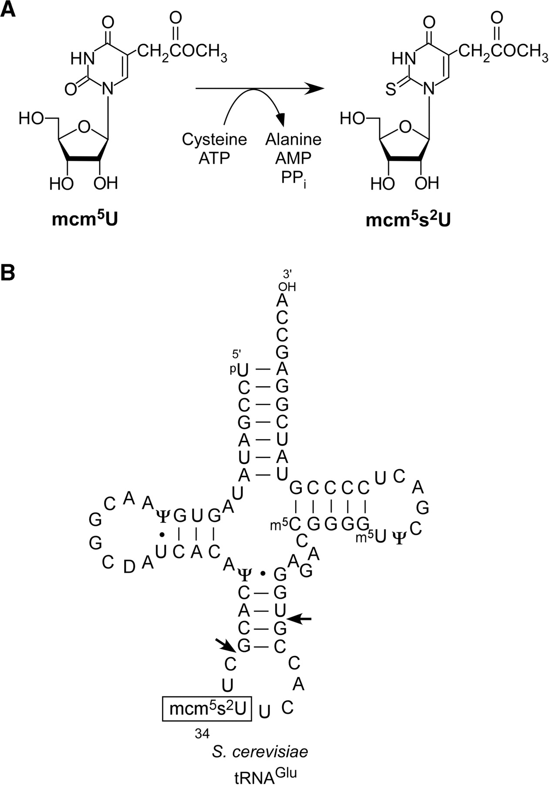
Figure 1. Chemical structure of 5-methoxycarmonylmethyl-2-thiouridene (mcm ⁵ s ² U) and ...
Notes:
Figure 1. Chemical structure of 5-methoxycarmonylmethyl-2-thiouridene (mcm 5 s 2 U) and secondary structure of tRNA Glu . ( A ) Chemical structures of mcm 5 U and mcm 5 s 2 U. 2-thiolation of mcm 5 s 2 U utilizes cysteine and ATP as substrates. ( B ) Secondary structure of S. cerevisiae tRNA Glu with modified nucleosides: 5-methoxycarmonylmethyl-2-thiouridine (mcm 5 s 2 U), pseudouridine (Ψ), dihydrouridine (D), 5-methylcytidine (m 5 C) and 5-methyluridine (m 5 U). Arrows indicate the sites for RNase T 1 cleavage needed to produce the anticodon-containing fragment.
Unless provided in the caption above, the following copyright applies to the content of this slide: © 2009 The Author(s)This is an Open Access article distributed under the terms of the Creative Commons Attribution Non-Commercial License (http://creativecommons.org/licenses/by-nc/2.0/uk/) which permits unrestricted non-commercial use, distribution, and reproduction in any medium, provided the original work is properly cited.

Slide 2
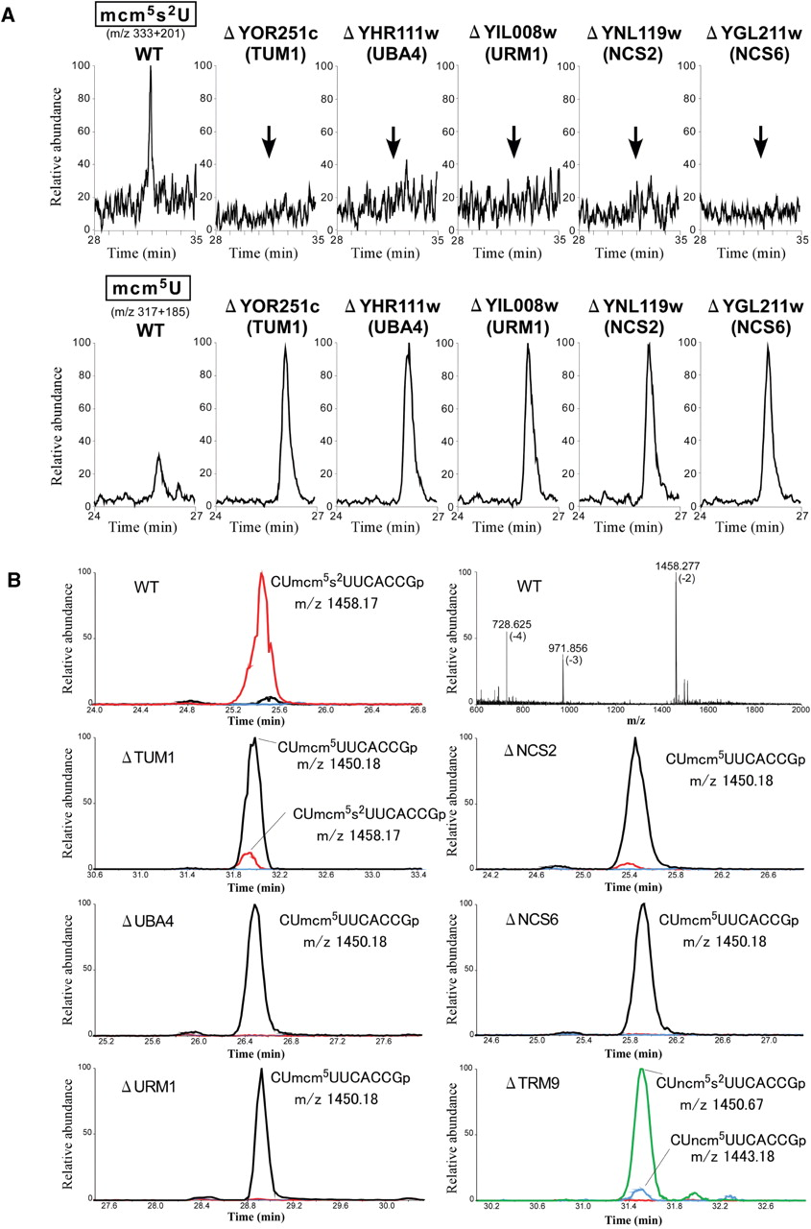
Figure 2. Mass spectrometric analyses of total nucleosides and purified tRNAs ^{Glu} from S. cerevisiae ...
Notes:
Figure 2. Mass spectrometric analyses of total nucleosides and purified tRNAs Glu from S. cerevisiae wild-type and mutant cells. ( A ) LC/MS analyses of total nucleosides from strains of wild-type (WT), Δ YOR251c ( TUM1 ), Δ YHR111w ( UBA4 ), Δ YIL008w ( URM1 ), Δ YNL119w ( NCS2 ) and Δ YGL211w ( NCS6 ). The upper panels show the merged mass chromatograms detecting MH + (m/z 333) and BH 2+ (m/z 201) of mcm 5 s 2 U. The lower panels show the mass chromatograms detecting MH + (m/z 317) and BH 2+ (m/z 185) of mcm 5 U. Arrows in the upper panels indicate the retention time for mcm 5 s 2 U. ( B ) LC/MS fragment analyses of RNase T 1 -digested tRNAs Glu obtained from wild-type strains: Δ TUM1 , Δ UBA4 , Δ URM1 , Δ NCS2 , Δ NCS6 and Δ TRM9 . A graph on the top-right represents the mass spectrum for the anticodon-containing fragment (CUmcm 5 s 2 UUCACCGp) (Figure 1B) from the wild-type strain. Charge states of multiply charged ions are indicated in parentheses. Other graphs describe the mass chromatograms shown by triply charged ions of anticodon-containing fragments bearing mcm 5 s 2 U (m/z 1458.17, red line), mcm 5 U (m/z 1450.18, black line), ncm 5 s 2 U (m/z 1450.67, green line) and ncm 5 U (m/z 1443.18, blue line). The RNA sequence including the wobble modification is indicated on each graph.
Unless provided in the caption above, the following copyright applies to the content of this slide: © 2009 The Author(s)This is an Open Access article distributed under the terms of the Creative Commons Attribution Non-Commercial License (http://creativecommons.org/licenses/by-nc/2.0/uk/) which permits unrestricted non-commercial use, distribution, and reproduction in any medium, provided the original work is properly cited.

Slide 3
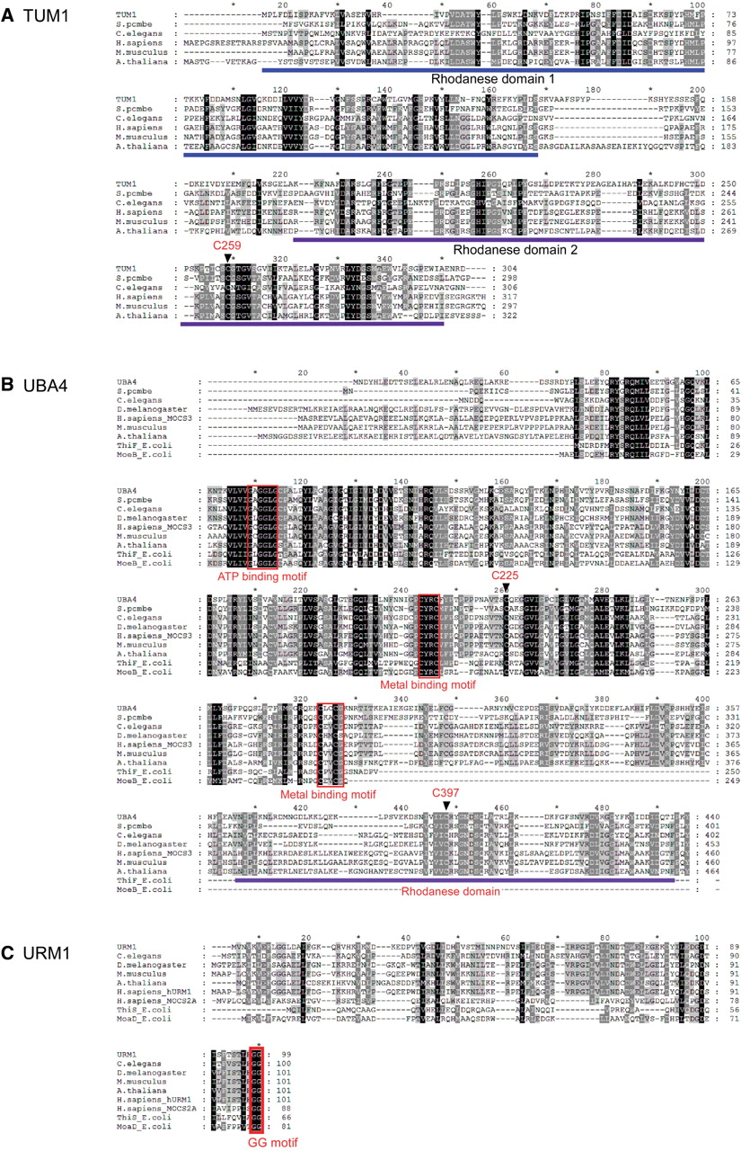
Figure 3. Sequence alignments of TUM1 , UBA4 and URM1 . Each protein is aligned with its homologs. Multiple alignment ...
Notes:
Figure 3. Sequence alignments of TUM1 , UBA4 and URM1 . Each protein is aligned with its homologs. Multiple alignment of each sequence was carried out by Clustal X analysis ( 82 ) and displayed using the Genedoc multiple sequence alignment editor. White letters in black boxes represent amino-acid residues identical in all species, while white letters in gray boxes represent residues with ∼80% homology. Black letters in gray boxes represent restudies with ∼60% homology. ( A ) Sequence alignment of TUM1 with its homologs. Two conserved rhodanese domains are underlined. The conserved C259 is indicated. ( B ) Sequence alignment of UBA4 with its homologs and E. coli ThiF and MoeB . The boxed regions are the ATP-binding motif (GxGxxG) and the metal-binding motif (CxxC, CxxCG). The conserved C225 and C397 are indicated. The rhodanese-like domain in the C-terminal region is underlined. ( C ) Sequence alignment of URM1 with its homologs and E. coli ThiS and MoaD . The conserved C-terminal GG motif is boxed.
Unless provided in the caption above, the following copyright applies to the content of this slide: © 2009 The Author(s)This is an Open Access article distributed under the terms of the Creative Commons Attribution Non-Commercial License (http://creativecommons.org/licenses/by-nc/2.0/uk/) which permits unrestricted non-commercial use, distribution, and reproduction in any medium, provided the original work is properly cited.

Slide 4
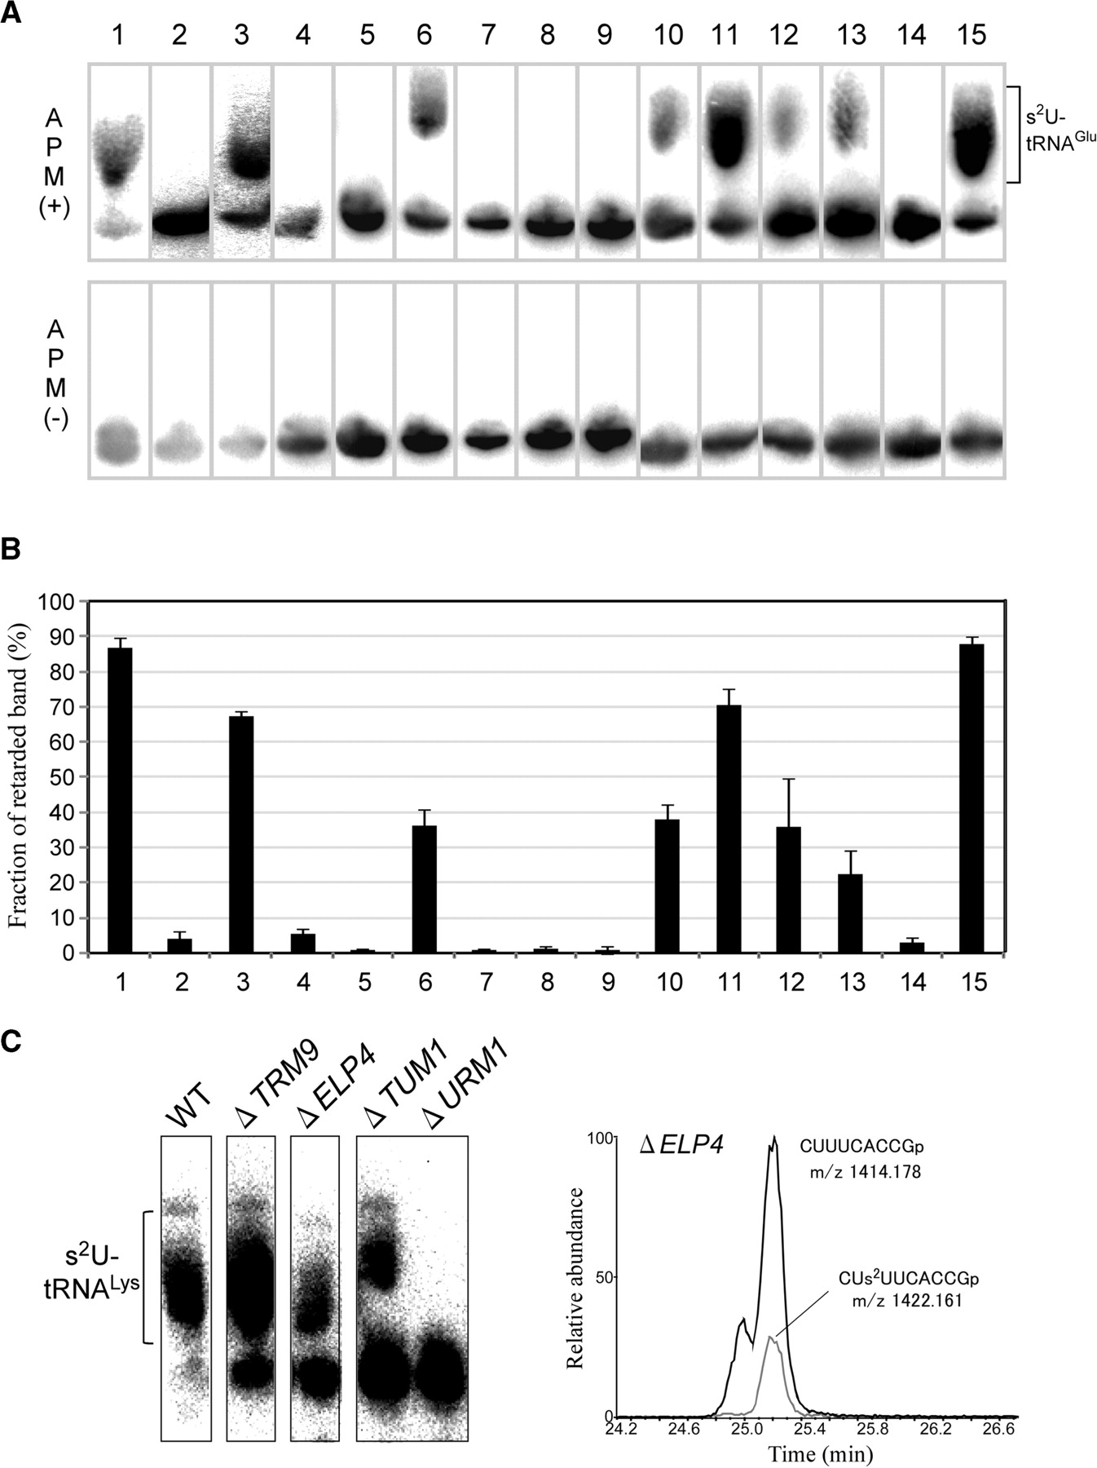
Figure 4. APM Northern analyses of thiolation-status of tRNAs in mutant strains and transformants. ( A ) APM northern ...
Notes:
Figure 4. APM Northern analyses of thiolation-status of tRNAs in mutant strains and transformants. ( A ) APM northern analyses of tRNA Glu in the s 2 U-deficient strains by introducing a series of mutant plasmids. Total RNA from each strain was resolved by denaturing polyacrylamide-gel electrophoresis in the presence (upper panels) or absence (lower panels) of APM. 2-thiolated tRNA Glu in each strain was detected as a shifted band only in the presence of APM, by northern blotting. Lanes 1 to 12 correspond to wild-tye ( 1 ), Δ URM1 ( 2 ), Δ URM1 harboring pURM1 ( 3 ), Δ URM1 harboring pURM1ΔGG ( 4 ), Δ UBA4 ( 5 ), Δ UBA4 harboring pUBA4 ( 6 ), Δ UBA4 harboring pUBA4 C225S ( 7 ), Δ UBA4 harboring pUBA4 C225A ( 8 ), Δ UBA4 harboring pUBA4 C397S ( 9 ),Δ TUM1 ( 10 ), Δ TUM1 harboring pTUM1 ( 11 ), Δ TUM1 harboring pTUM1 C259S ( 12 ), Δ TUM1 harboring pTUM1 C259A ( 13 ), Δ NCS2 ( 14 ) and Δ NCS2 harboring pNCS2 ( 15 ), respectively. ( B ) Quantification of the thiolation-status of tRNA Glu by APM/northern analyses. The fraction of the retarded band in the total intensity of the bands was calculated. Data are shown as values ± SD and reflect the average of four independent experiments. ( C ) APM/northern analyses of tRNAs Lys from wild-type, Δ TRM9 , Δ ELP4 , Δ TUM1 and Δ URM1 . The right panel represents a mass chromatogram shown by triply charged ions of the anticodon-containing fragments of tRNA Glu isolated from Δ ELP4 . The unmodified fragment (m/z 1414.18, black line) and the s 2 U-containing fragment (m/z 1422.16, gray line) are specifically detected.
Unless provided in the caption above, the following copyright applies to the content of this slide: © 2009 The Author(s)This is an Open Access article distributed under the terms of the Creative Commons Attribution Non-Commercial License (http://creativecommons.org/licenses/by-nc/2.0/uk/) which permits unrestricted non-commercial use, distribution, and reproduction in any medium, provided the original work is properly cited.

Slide 5
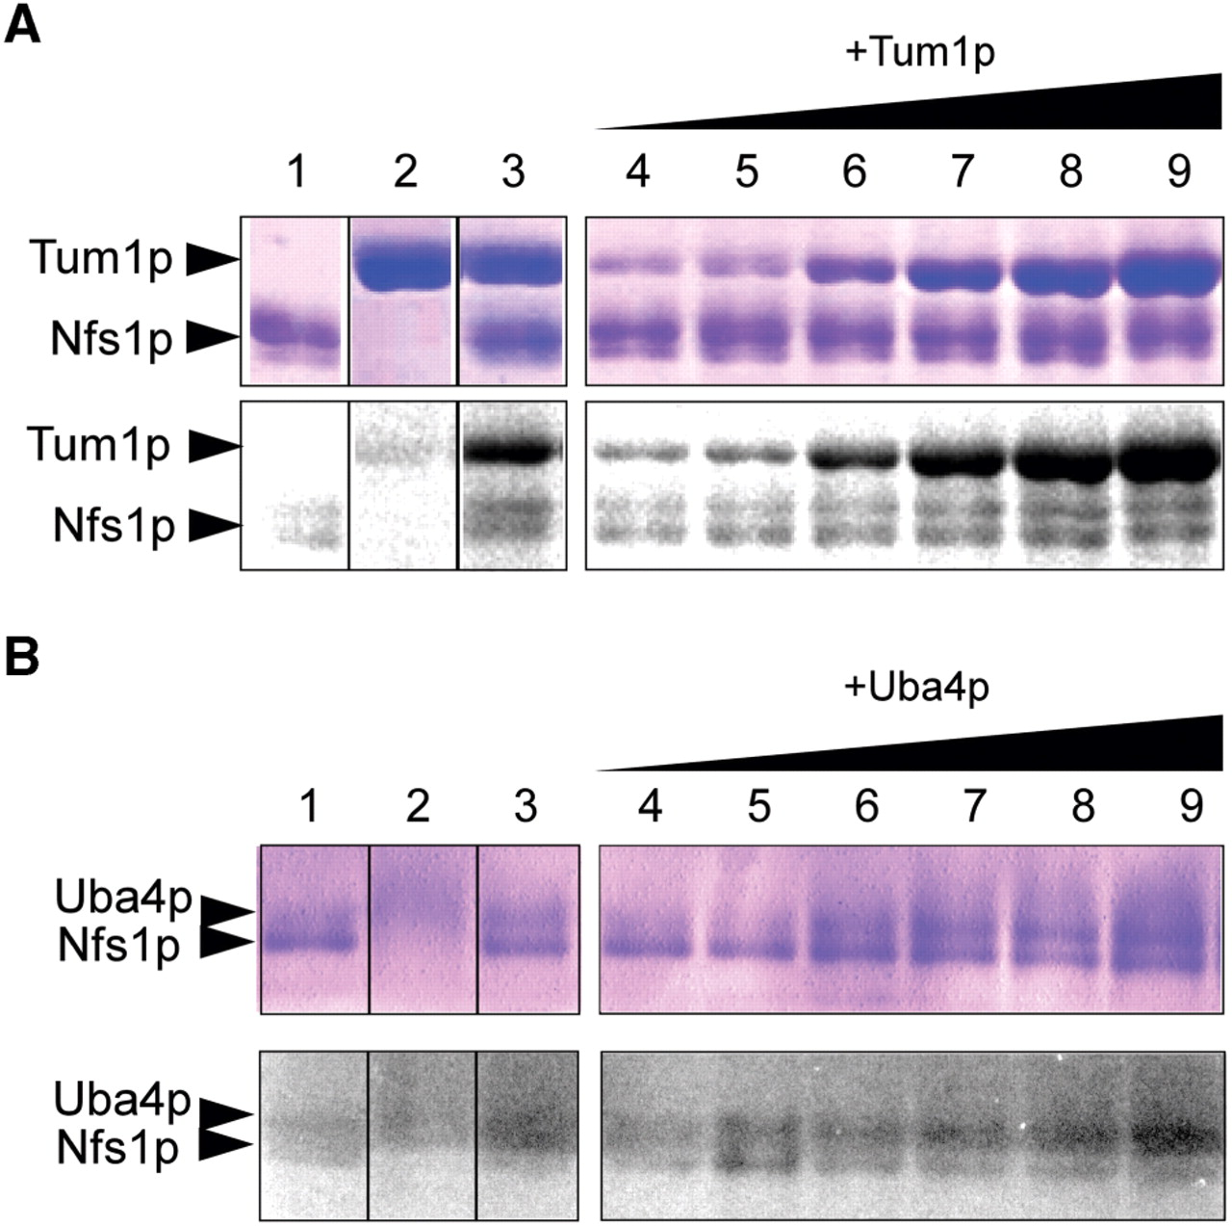
Figure 5. In vitro sulfur transfer from Nfs1p to Tum1p and Uba4p. ( A ) Sulfur transfer from Nfs1p to Tum1p. The gel ...
Notes:
Figure 5. In vitro sulfur transfer from Nfs1p to Tum1p and Uba4p. ( A ) Sulfur transfer from Nfs1p to Tum1p. The gel was stained with Coomassie brilliant blue (CBB) (upper panel) and [ 35 S] radioactivity was visualized on a phosphor-imaging plate (lower panel). Lane 1, Nfs1p (25 pmol); lane 2, Tum1p (25 pmol); lane 3, Nfs1p (25 pmol) and Tum1p (25 pmol), lanes 4–9, Nfs1p (25 pmol) and Tum1p (2.5, 5, 12.5, 25, 37.5, 50 pmol). ( B ) Sulfur transfer from Nfs1p to Uba4p. The gel was stained with Coomassie brilliant blue (CBB) (upper panel) and [ 35 S] radioactivity was visualized on a phosphor-imaging plate (lower panel). Lane 1, Nfs1p (25 pmol); lane 2, Uba4p (25 pmol); lane 3, Nfs1p (25 pmol) and Uba4p (25 pmol), lanes 4–9, Nfs1p (25 pmol) and Uba4p (2.5, 5, 12.5, 25, 37.5, 50 pmol).
Unless provided in the caption above, the following copyright applies to the content of this slide: © 2009 The Author(s)This is an Open Access article distributed under the terms of the Creative Commons Attribution Non-Commercial License (http://creativecommons.org/licenses/by-nc/2.0/uk/) which permits unrestricted non-commercial use, distribution, and reproduction in any medium, provided the original work is properly cited.

Slide 6
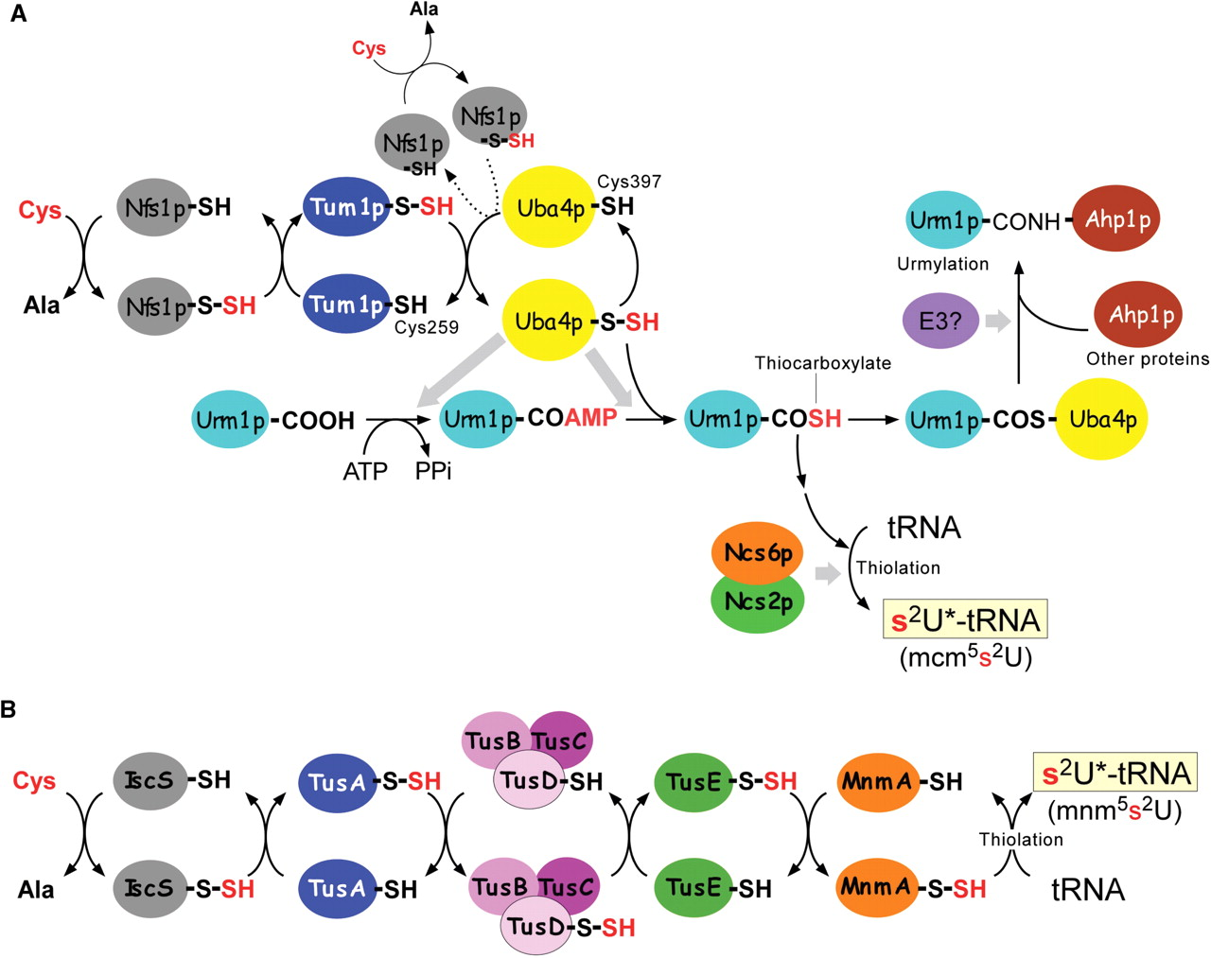
Figure 8. Comparison of cellular sulfur trafficking related to thiouridine formation of tRNA anticodon in S. ...
Notes:
Figure 8. Comparison of cellular sulfur trafficking related to thiouridine formation of tRNA anticodon in S. cerevisiae and E. coli . (A) Proposed sulfur flow system for 2-thiouridine formation of mcm 5 s 2 U. Nfs1p accepts sulfur from Cys to form a persulfide using PLP as a cofactor. The persulfide sulfur is mainly transferred to the RLD2 (Cys259) of Tum1p, and partially to the RLD (Cys397) of Uba4p. Uba4p, as an E1-like enzyme in the ubiquitin-related pathway, activates the C-terminus of Urm1p to form the acyl-adenylated intermediate, then transfers the persulfide sulfur from the RLD to form thiocarboxylated Urm1p (Urm1p-COSH) by releasing AMP. Urm1p-COSH is a substrate of 2-thiouridine formation catalyzed by Ncs2p and Ncs6p. For protein urmylation, Urm1p-COSH is conjugated with Uba4p, then the putative E3 enzyme transfers Urm1p to target proteins such as Ahp1p. (B) Sulfur-relay system by Tus-proteins in E. coli . IscS accepts sulfur from Cys to form a persulfide using PLP as a cofactor. TusA interacts with IscS to stimulate its desulfurase activity, and accepts the persulfide sulfur. The sulfur is transferred to TusD in the TusBCD complex. It is then transferred to TusE. TusE interacts with MnmA to transfer the sulfur. MnmA recognizes the tRNA and activates the wobble uridine by forming an adenylated intermediate, then the persulfide sulfur attacks this position to release the AMP resulting in the synthesis of the 2-thiouridine of mnm 5 s 2 U.
Unless provided in the caption above, the following copyright applies to the content of this slide: © 2009 The Author(s)This is an Open Access article distributed under the terms of the Creative Commons Attribution Non-Commercial License (http://creativecommons.org/licenses/by-nc/2.0/uk/) which permits unrestricted non-commercial use, distribution, and reproduction in any medium, provided the original work is properly cited.

Slide 7
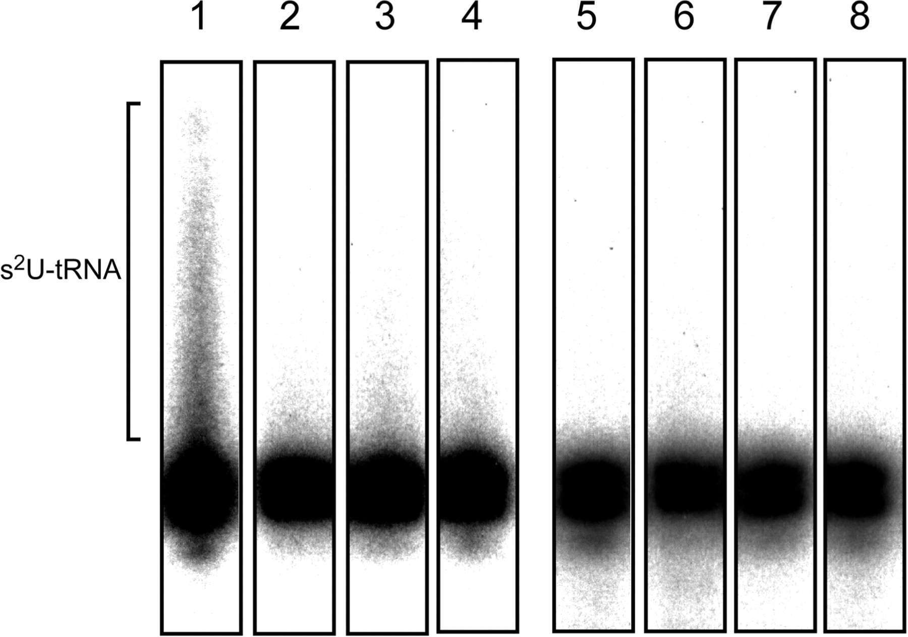
Figure 7. Reconstitution of 2-thiouridine formation in vitro using recombinant proteins. Thiouridine formation was ...
Notes:
Figure 7. Reconstitution of 2-thiouridine formation in vitro using recombinant proteins. Thiouridine formation was detected by retardation of the tRNA band on the gel in the presence (lanes 1–4) or absence (lanes 5–8) of APM. 2-thiouridine formation of [ 32 P]-labeled tRNA Lys2 was carried out with recombinant proteins (Nfs1p, Tum1p, Uba4p and Urm1p) in the presence (lanes 1and 5) or absence (lanes 2 and 6) of IgG beads retaining the Ncs6p, or in the presence of IgG beads treated with wild-type cell lysate (lanes 4 and 8) as a negative control. The reaction was also performed only in the presence of IgG beads retaining the Ncs6p without recombinant proteins (lanes 3 and 7).
Unless provided in the caption above, the following copyright applies to the content of this slide: © 2009 The Author(s)This is an Open Access article distributed under the terms of the Creative Commons Attribution Non-Commercial License (http://creativecommons.org/licenses/by-nc/2.0/uk/) which permits unrestricted non-commercial use, distribution, and reproduction in any medium, provided the original work is properly cited.

Slide 8
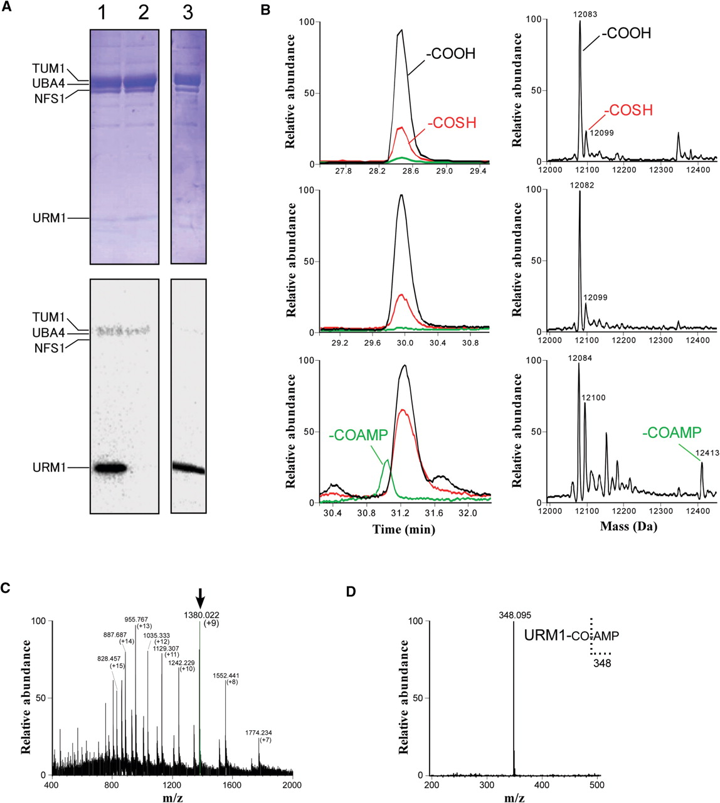
Figure 6. Thiocarboxylation of Urm1p through an acyl-adenylated intermediate. ( A ) In vitro sulfur transfer from ...
Notes:
Figure 6. Thiocarboxylation of Urm1p through an acyl-adenylated intermediate. ( A ) In vitro sulfur transfer from Nfs1p to Urm1p. Recombinant Nfs1p, Tum1p, Urm1p and Uba4p were mixed and incubated with [ 35 S] cysteine in the presence (lane 1) or absence (lane 2) of ATP. The reaction mixture was further incubated with 50 mM DTT (lane 3). The gel was stained with CBB (upper panels) and [ 35 S] radioactivity was visualized on a phosphor-imaging plate (lower panels). The band for each protein is indicated. ( B ) Whole-mass analysis of the thiocarboxylation of Urm1p. Left panels are mass chromatograms for detecting +9-charged ions of Urm1p with unmodified C-terminus (-COOH, black line), Urm1- with thiocarboxylated C-terminus (-COSH, red line) and Urm1p with acyl-adenylated C-terminus (-COAMP, green line). Right panels are deconvoluted mass spectra for Urm1p detecting unmodified Urm1p (-COOH, 12 083 Da), thiocarboxylated Urm1p (-COSH, 12099 Da) and acyl-adenylated Urm1p (-COAMP, 12 413 Da). Top panels show whole-mass analysis of purified Urm1p used in this study. In vitro thiocarboxylation of Urm1p by Uba4p was carried out in the absence (middle panels) or presence (bottom panels) of ATP. ( C ) Mass spectrum of Urm1p with an acyl-adenylated C-terminus (-COAMP). A series of multiply charged ions are detected. The parent ion (m/z 1380.022, +9) for collision-induced dissociation (CID) analysis is indicated. ( D ) CID spectrum of Urm1p-COAMP. The product ion (m/z 348.095) for AMP originated from Urm1p-COAMP is shown.
Unless provided in the caption above, the following copyright applies to the content of this slide: © 2009 The Author(s)This is an Open Access article distributed under the terms of the Creative Commons Attribution Non-Commercial License (http://creativecommons.org/licenses/by-nc/2.0/uk/) which permits unrestricted non-commercial use, distribution, and reproduction in any medium, provided the original work is properly cited.

