Slide 1
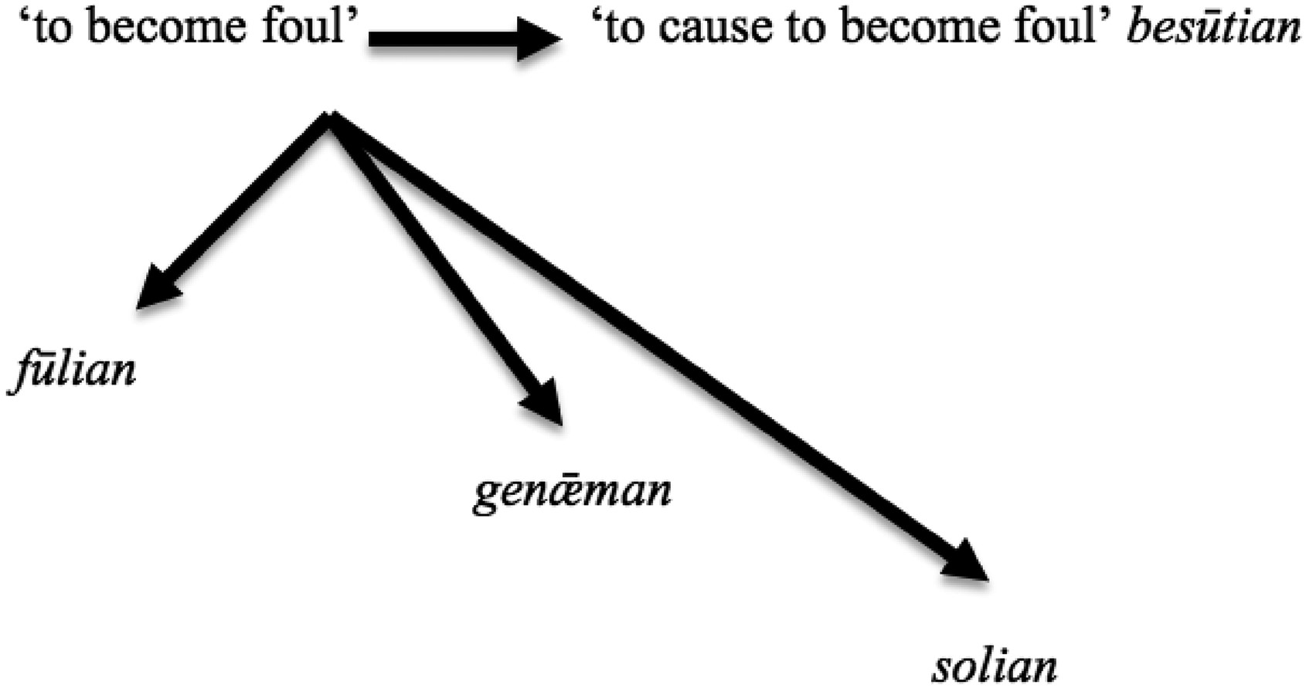
Fig. 1 ‘Foul’ verbs in graph theory
Notes:
Fig. 1 ‘Foul’ verbs in graph theory
Unless provided in the caption above, the following copyright applies to the content of this slide: © The Author 2017. Published by Oxford University Press on behalf of EADH. All rights reserved. For Permissions, please email: journals.permissions@oup.comThis article is published and distributed under the terms of the Oxford University Press, Standard Journals Publication Model (https://academic.oup.com/journals/pages/about_us/legal/notices)

Slide 2
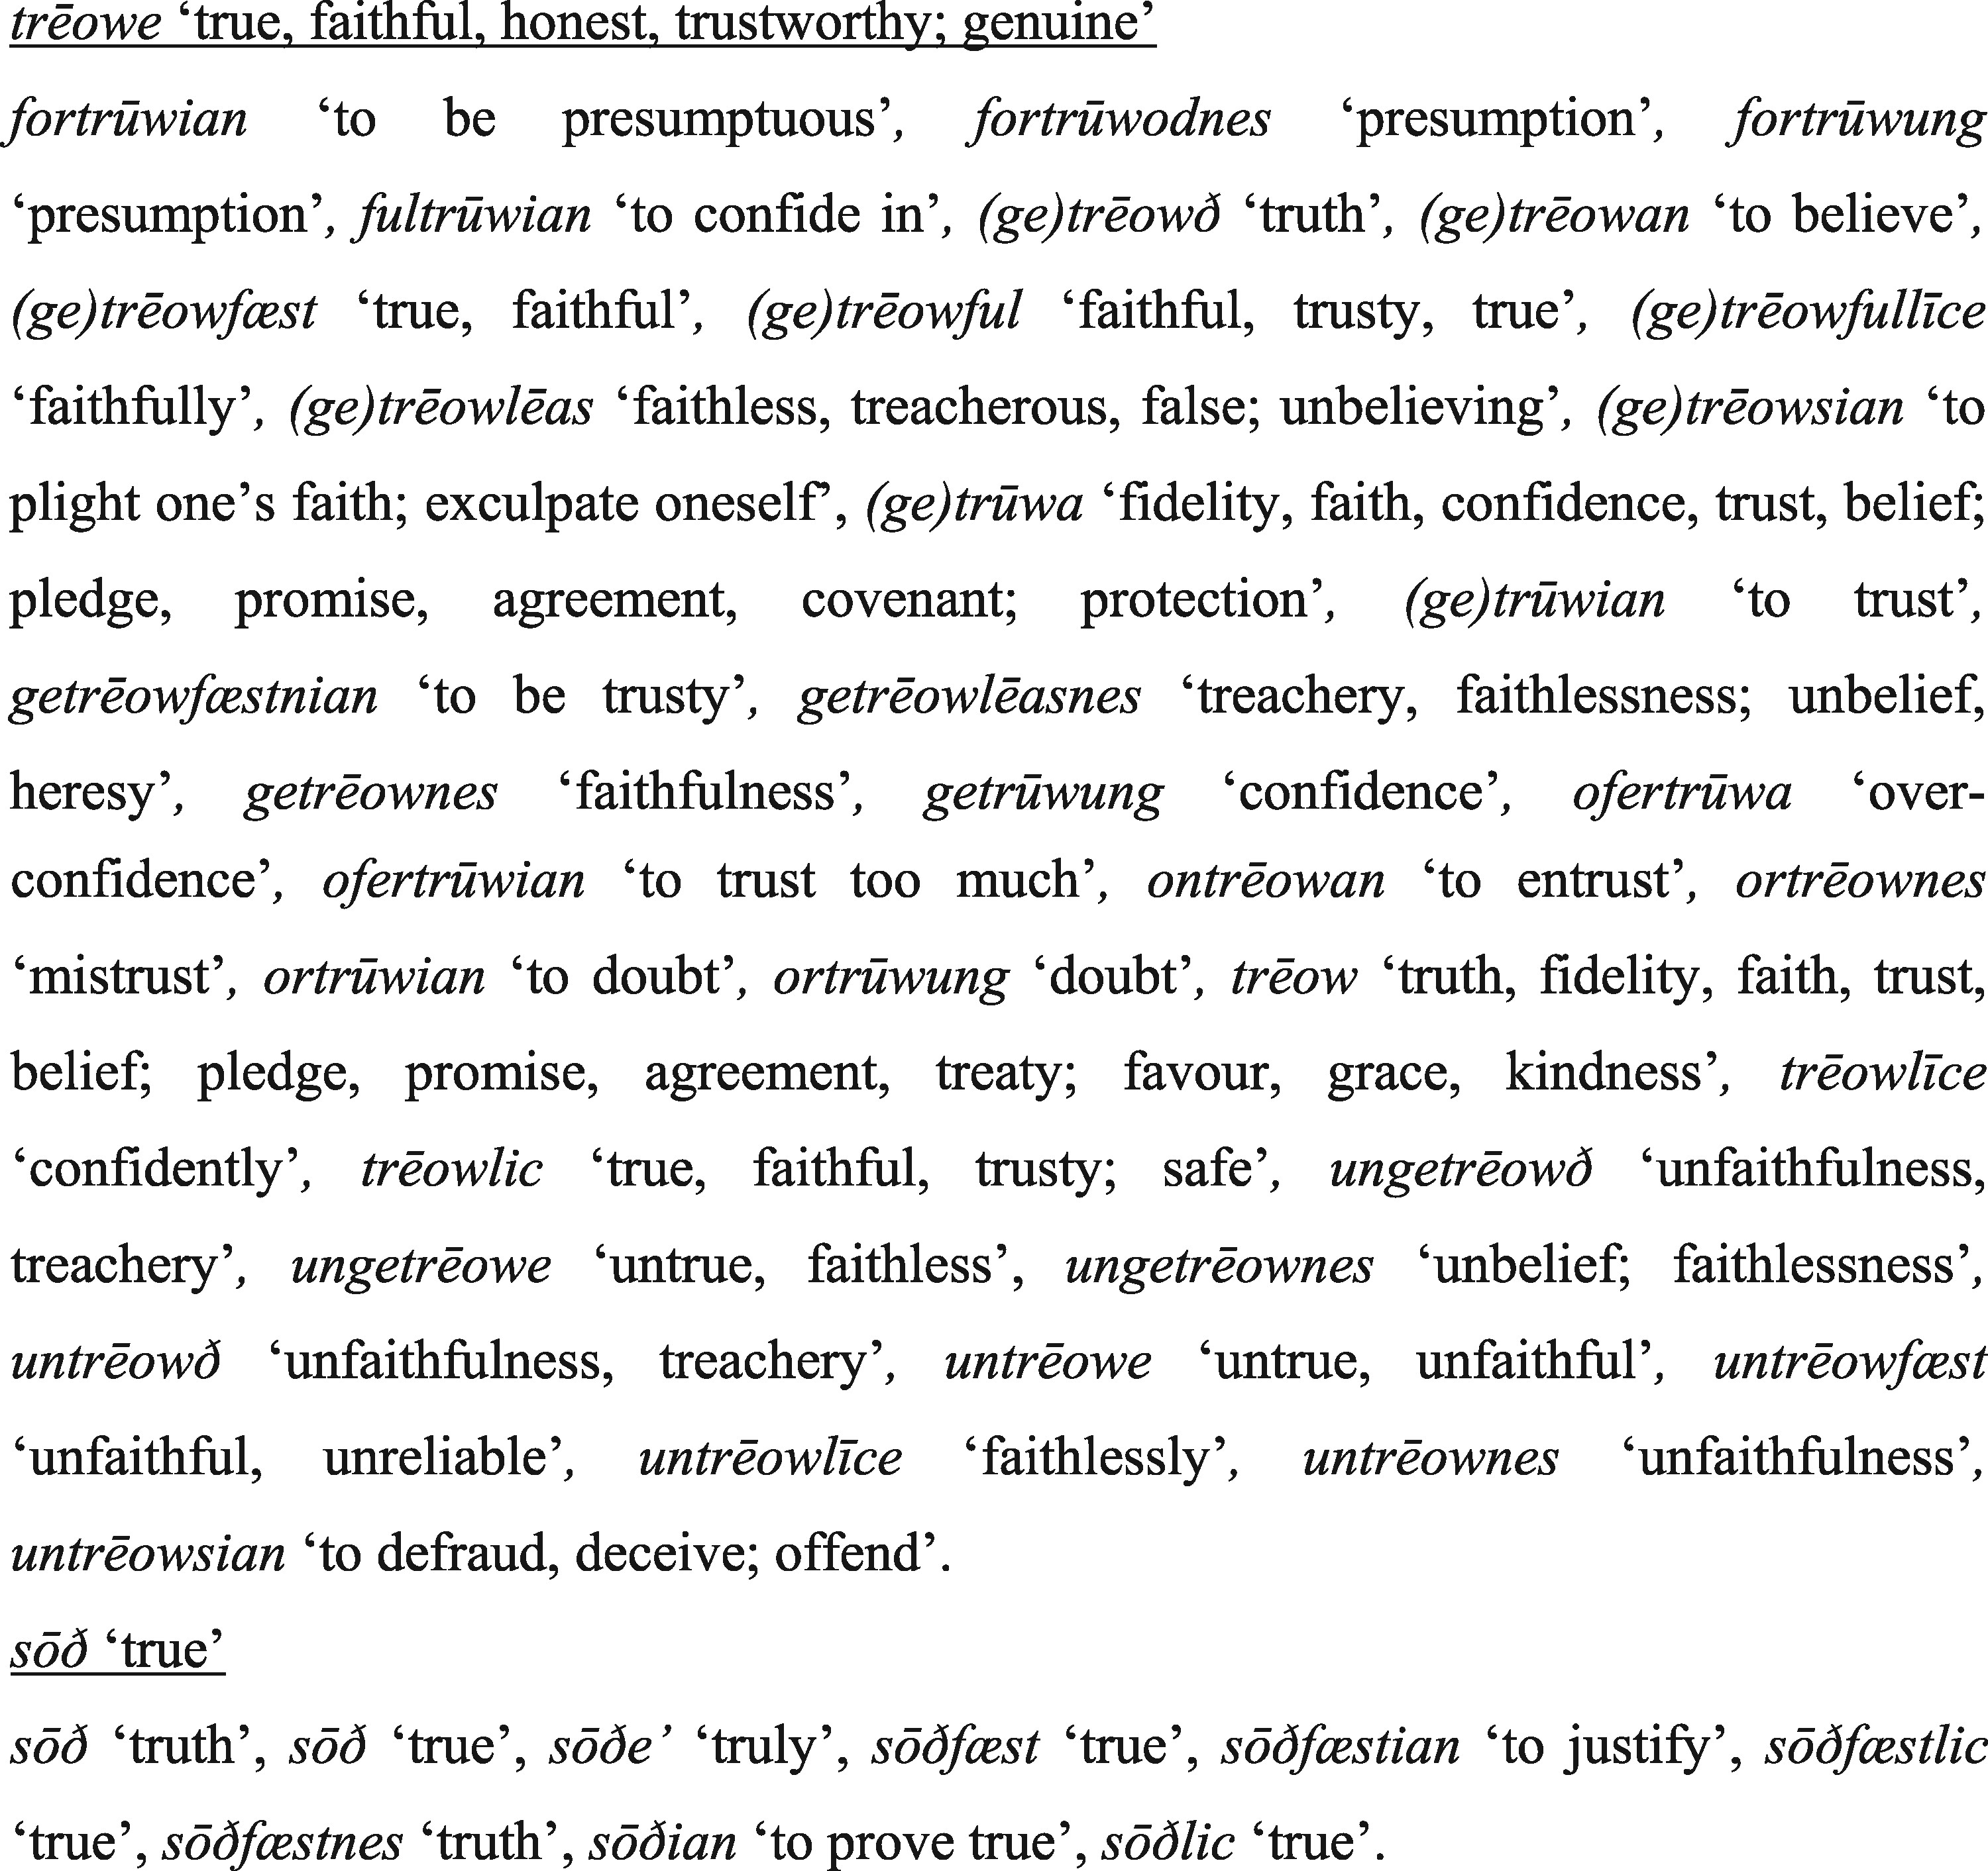
Fig. 2 The major exponents for TRUE in Old English
Notes:
Fig. 2 The major exponents for TRUE in Old English
Unless provided in the caption above, the following copyright applies to the content of this slide: © The Author 2017. Published by Oxford University Press on behalf of EADH. All rights reserved. For Permissions, please email: journals.permissions@oup.comThis article is published and distributed under the terms of the Oxford University Press, Standard Journals Publication Model (https://academic.oup.com/journals/pages/about_us/legal/notices)

Slide 3
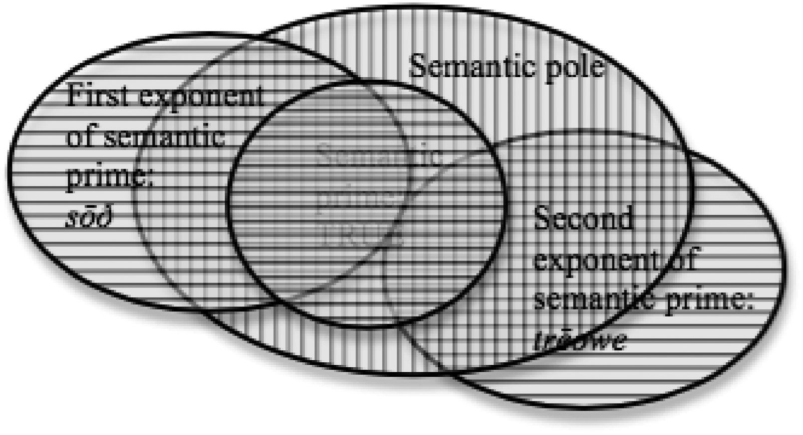
Fig. 3 The semantic map of the pole sōð-trēowe in Old English
Notes:
Fig. 3 The semantic map of the pole sōð-trēowe in Old English
Unless provided in the caption above, the following copyright applies to the content of this slide: © The Author 2017. Published by Oxford University Press on behalf of EADH. All rights reserved. For Permissions, please email: journals.permissions@oup.comThis article is published and distributed under the terms of the Oxford University Press, Standard Journals Publication Model (https://academic.oup.com/journals/pages/about_us/legal/notices)

Slide 4
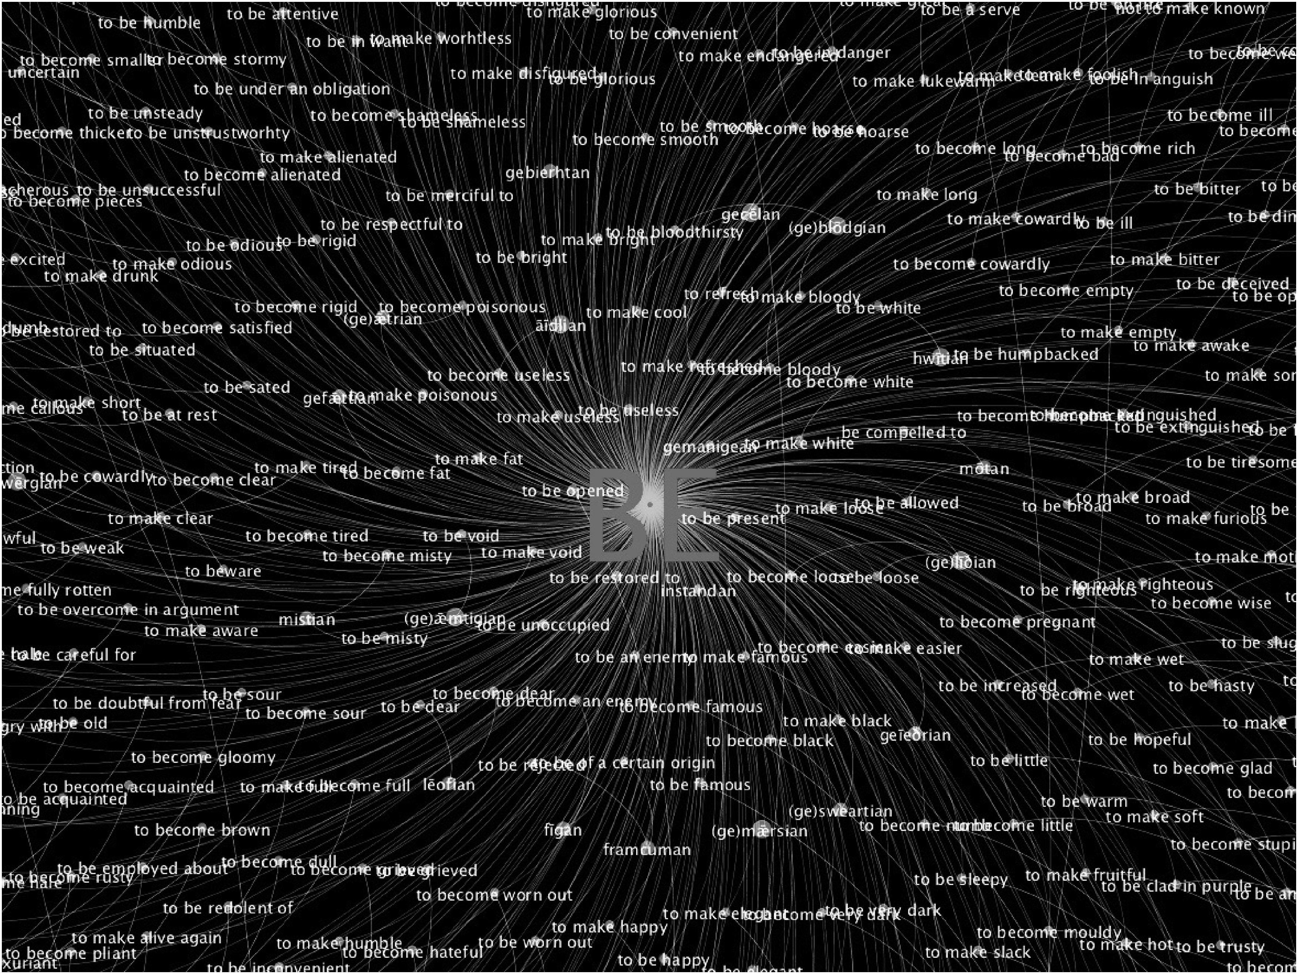
Fig. 4 Detail of the semantic pole BE
Notes:
Fig. 4 Detail of the semantic pole BE
Unless provided in the caption above, the following copyright applies to the content of this slide: © The Author 2017. Published by Oxford University Press on behalf of EADH. All rights reserved. For Permissions, please email: journals.permissions@oup.comThis article is published and distributed under the terms of the Oxford University Press, Standard Journals Publication Model (https://academic.oup.com/journals/pages/about_us/legal/notices)

Slide 5
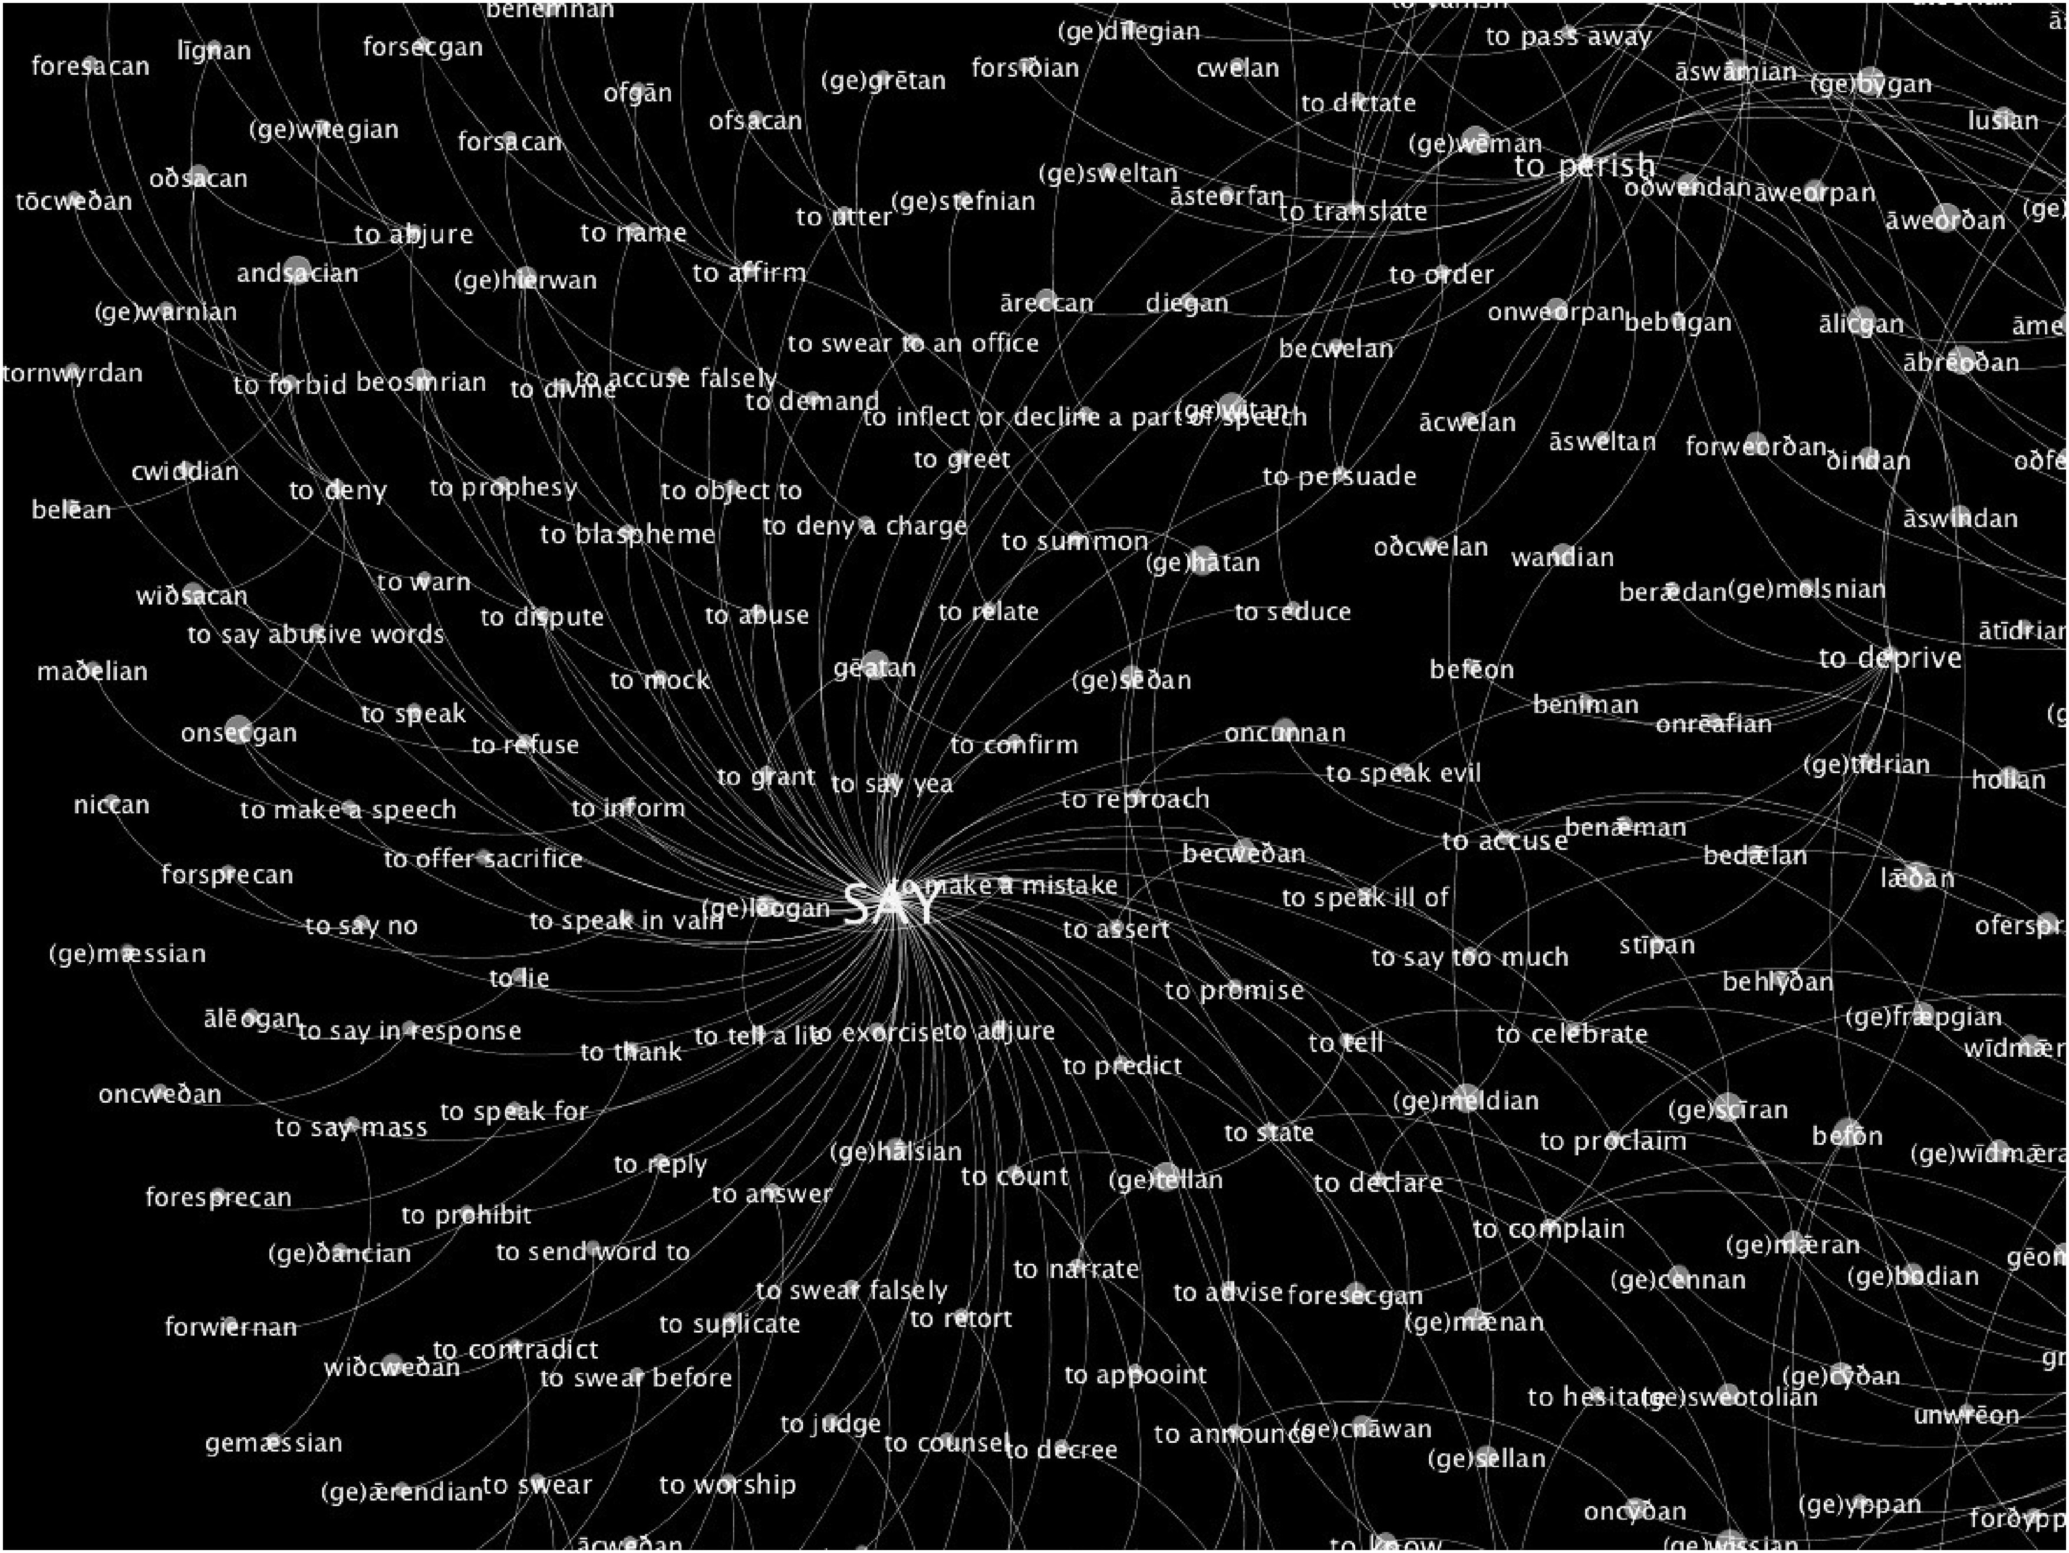
Fig. 5 Detail of the semantic pole SAY
Notes:
Fig. 5 Detail of the semantic pole SAY
Unless provided in the caption above, the following copyright applies to the content of this slide: © The Author 2017. Published by Oxford University Press on behalf of EADH. All rights reserved. For Permissions, please email: journals.permissions@oup.comThis article is published and distributed under the terms of the Oxford University Press, Standard Journals Publication Model (https://academic.oup.com/journals/pages/about_us/legal/notices)

Slide 6
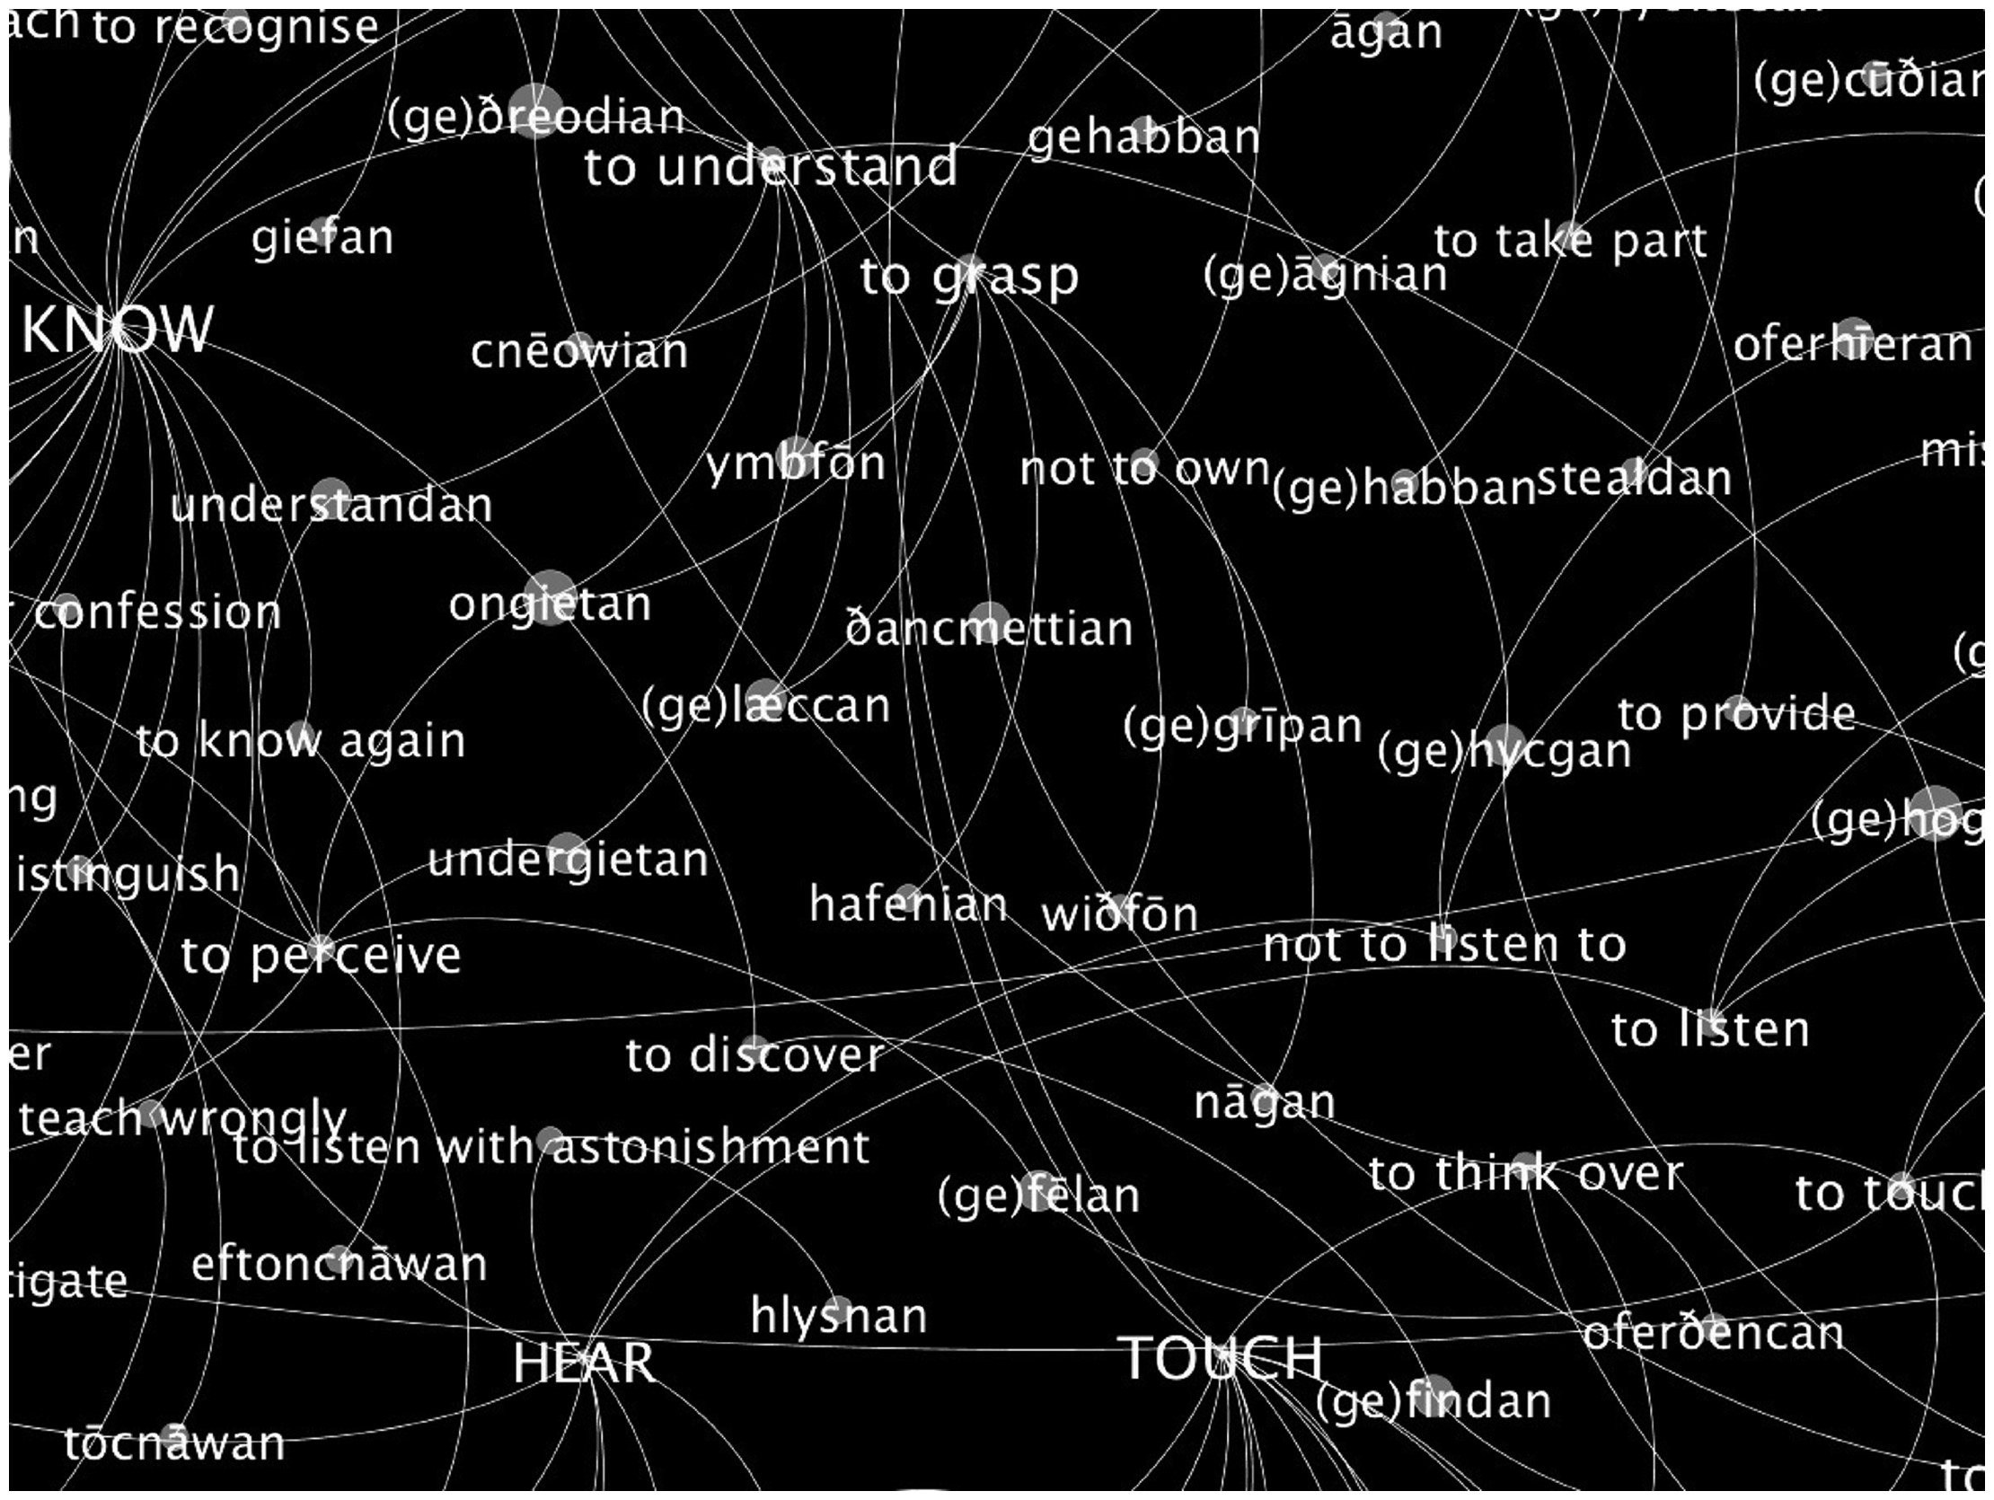
Fig. 6 Detail of the area of intersection between the semantic poles of TOUCH and KNOW
Notes:
Fig. 6 Detail of the area of intersection between the semantic poles of TOUCH and KNOW
Unless provided in the caption above, the following copyright applies to the content of this slide: © The Author 2017. Published by Oxford University Press on behalf of EADH. All rights reserved. For Permissions, please email: journals.permissions@oup.comThis article is published and distributed under the terms of the Oxford University Press, Standard Journals Publication Model (https://academic.oup.com/journals/pages/about_us/legal/notices)

