Slide 1
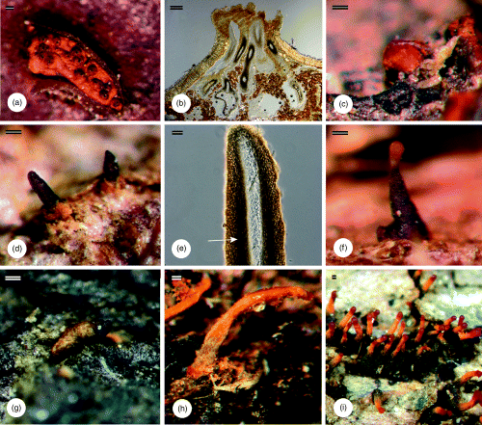
1 Fruiting structures of Cryphonectria and related genera. (a) Ascostroma of Cryphonectria. (b) Longitudinal ...
Notes:
1 Fruiting structures of Cryphonectria and related genera. (a) Ascostroma of Cryphonectria. (b) Longitudinal section through ascostroma of Cryphonectria. (c) Conidioma of Cryphonectria. (d) Ascostromata of Chrysoporthe. (e) Perithecial neck of Chrysoporthe (arrow) with brown surrounding tissue. (f) Conidioma of Chrysoporthe. (g) Conidioma of Amphilogia. (h) Conidioma of Rostraureum. (i) Conidiomata of Aurapex. Scale bars: a–h=100 μm, i=200 μm.
Unless provided in the caption above, the following copyright applies to the content of this slide: © 2006 Federation of European Microbiological Societies Published by Blackwell Publishing Ltd. All rights reserved

Slide 2
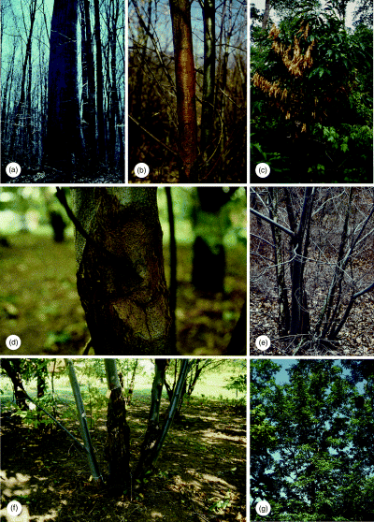
2 Disease symptoms of chestnut blight caused by Cryphonectria parasitica. (a) A relic Castanea dentata tree ...
Notes:
2 Disease symptoms of chestnut blight caused by Cryphonectria parasitica. (a) A relic Castanea dentata tree still standing long after being killed by chestnut blight after its introduction into the USA. (b) Diffuse canker on Castanea dentata. (c) Die-back of branches with dead leaves still attached. (d) Sunken canker on Castanea dentata with fruiting structures visible. (e) Numerous stump sprouts from Castanea dentata roots of tree killed earlier by chestnut blight. (f) Multiple cankers on stump sprouts. (g) One of the few large and surviving specimens of Castanea dentata in the USA today.
Unless provided in the caption above, the following copyright applies to the content of this slide: © 2006 Federation of European Microbiological Societies Published by Blackwell Publishing Ltd. All rights reserved

Slide 3
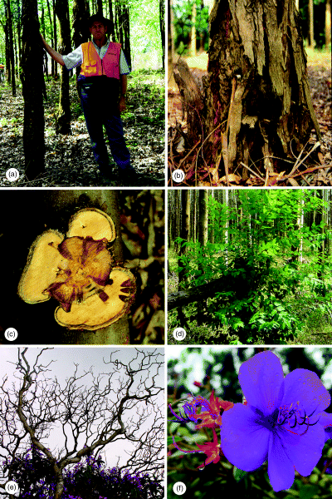
3 Disease symptoms of Chrysoporthe canker caused by various Chrysoporthe species. (a and b) Cankers on the ...
Notes:
3 Disease symptoms of Chrysoporthe canker caused by various Chrysoporthe species. (a and b) Cankers on the trunks and bases of Eucalyptus trees. (c) Cross section of canker showing killed vascular tissue. (d) Stem breakage due to girdling cankers. (e) Die-back of Tibouchina spp. (f).
Unless provided in the caption above, the following copyright applies to the content of this slide: © 2006 Federation of European Microbiological Societies Published by Blackwell Publishing Ltd. All rights reserved

Slide 4
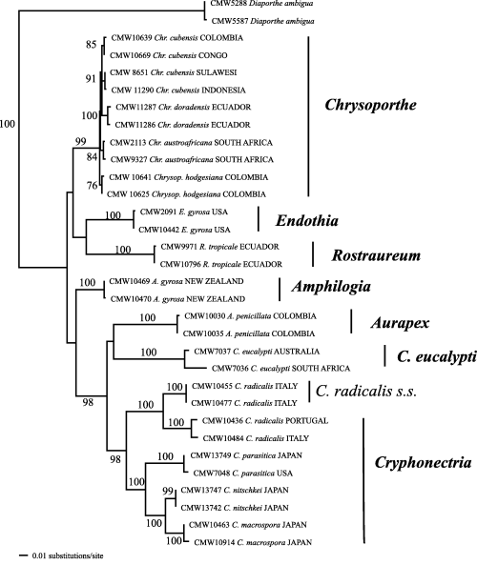
4 A phylogenetic tree showing the grouping of Cryphonectria and related genera. The tree was obtained from a ...
Notes:
4 A phylogenetic tree showing the grouping of Cryphonectria and related genera. The tree was obtained from a combined DNA sequence data set of the ITS1, 5.8S rRNA gene and ITS2 regions of the ribosomal operon, and β-tubulin genes, respectively. Alignment was obtained using the web interface (http://timpani.genome.ad.jp/%7Emafft/server/) of the alignment program MAFFT ver. 5.667 (Katoh et al., 2002). Distance analyses using the Tamura–Nei model, which was shown by Modeltest to be the appropriate model, were employed. The following parameters were used: G=0.2301, freqA=0.1936, freqC=0.3312, freqG=0.2287, freqT=0.2465; rate matrix 1, 3.1964, 1, 1, 3.8818, 1. Bootstrap confidence levels (>70%, 1000 replicates) are indicated on the branches. Diaporthe ambigua, another species in the Diaporthales, was used as an outgroup taxon.
Unless provided in the caption above, the following copyright applies to the content of this slide: © 2006 Federation of European Microbiological Societies Published by Blackwell Publishing Ltd. All rights reserved

