Slide 1
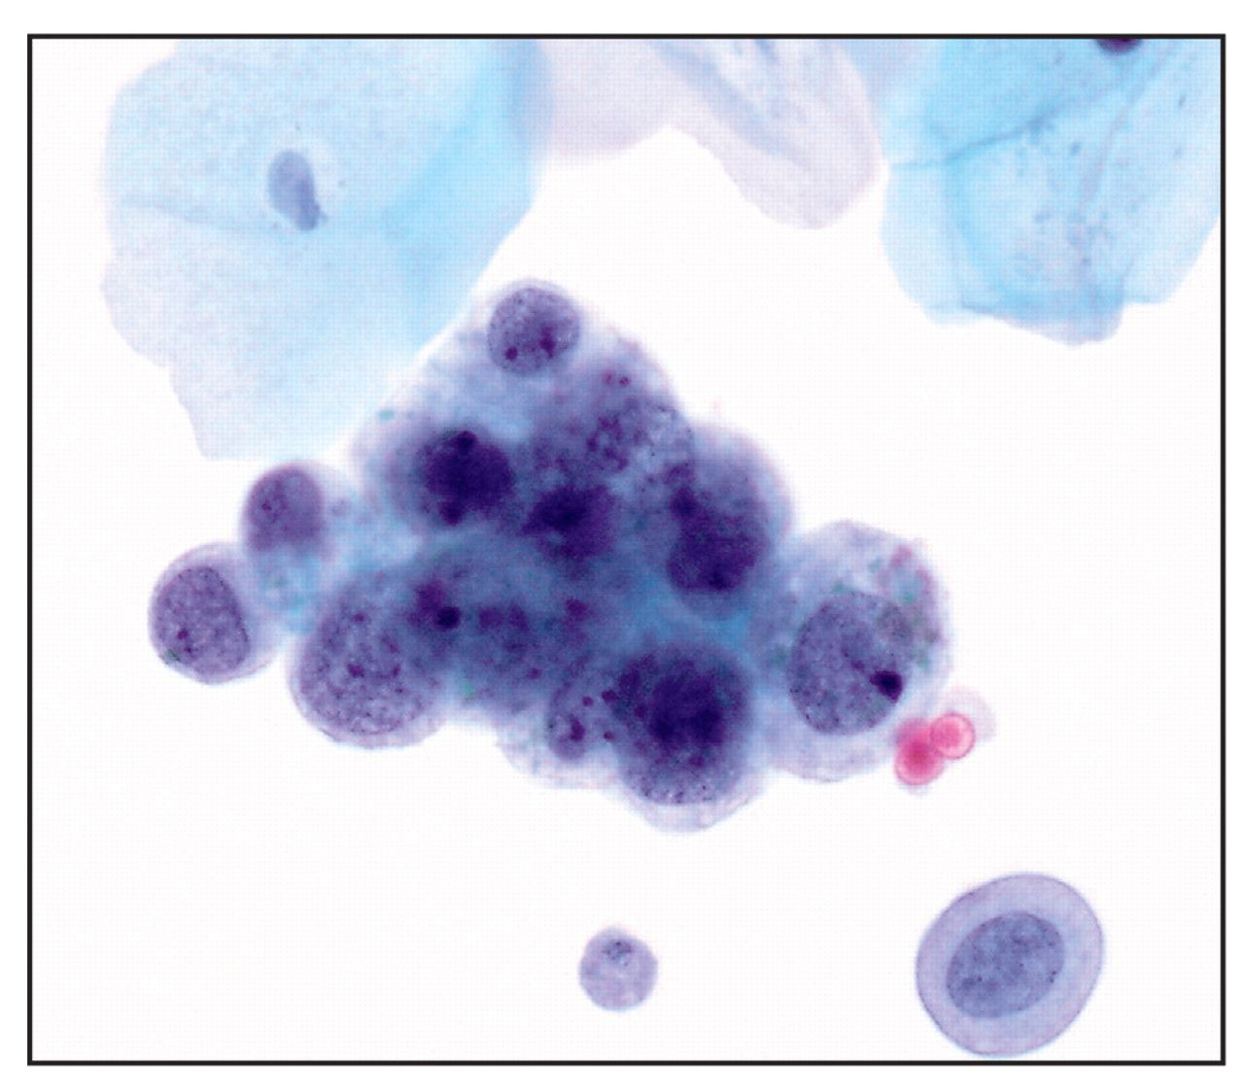
Image 1 Urine cytology from a voided urine specimen diagnosed as “atypical urothelial cells, favor a reactive ...
Notes:
Image 1 Urine cytology from a voided urine specimen diagnosed as “atypical urothelial cells, favor a reactive process.” Note the nuclear/cytoplasmic ratio that exceeds 50%, the bubbly cytoplasm, and the presence of conspicuous nucleoli (Cytospin preparation, Papanicolaou stain, ×600).
Unless provided in the caption above, the following copyright applies to the content of this slide: © American Society for Clinical Pathology

Slide 2
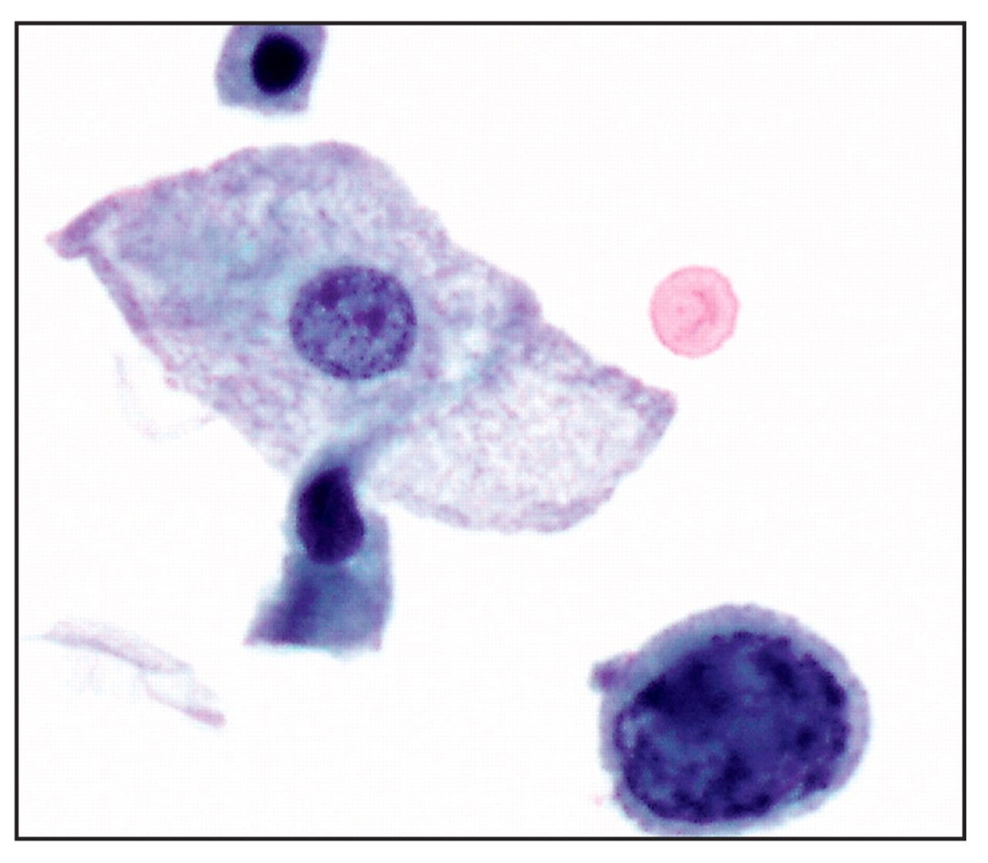
Image 2 Urine cytology from a voided urine specimen diagnosed as “atypical urothelial cells, unclear if reactive or ...
Notes:
Image 2 Urine cytology from a voided urine specimen diagnosed as “atypical urothelial cells, unclear if reactive or neoplastic.” Note the very high nuclear/cytoplasmic ratio, the intact but irregular nuclear membranes, and the clumpy chromatin pattern (Cytospin preparation, Papanicolaou stain, ×600).
Unless provided in the caption above, the following copyright applies to the content of this slide: © American Society for Clinical Pathology

Slide 3
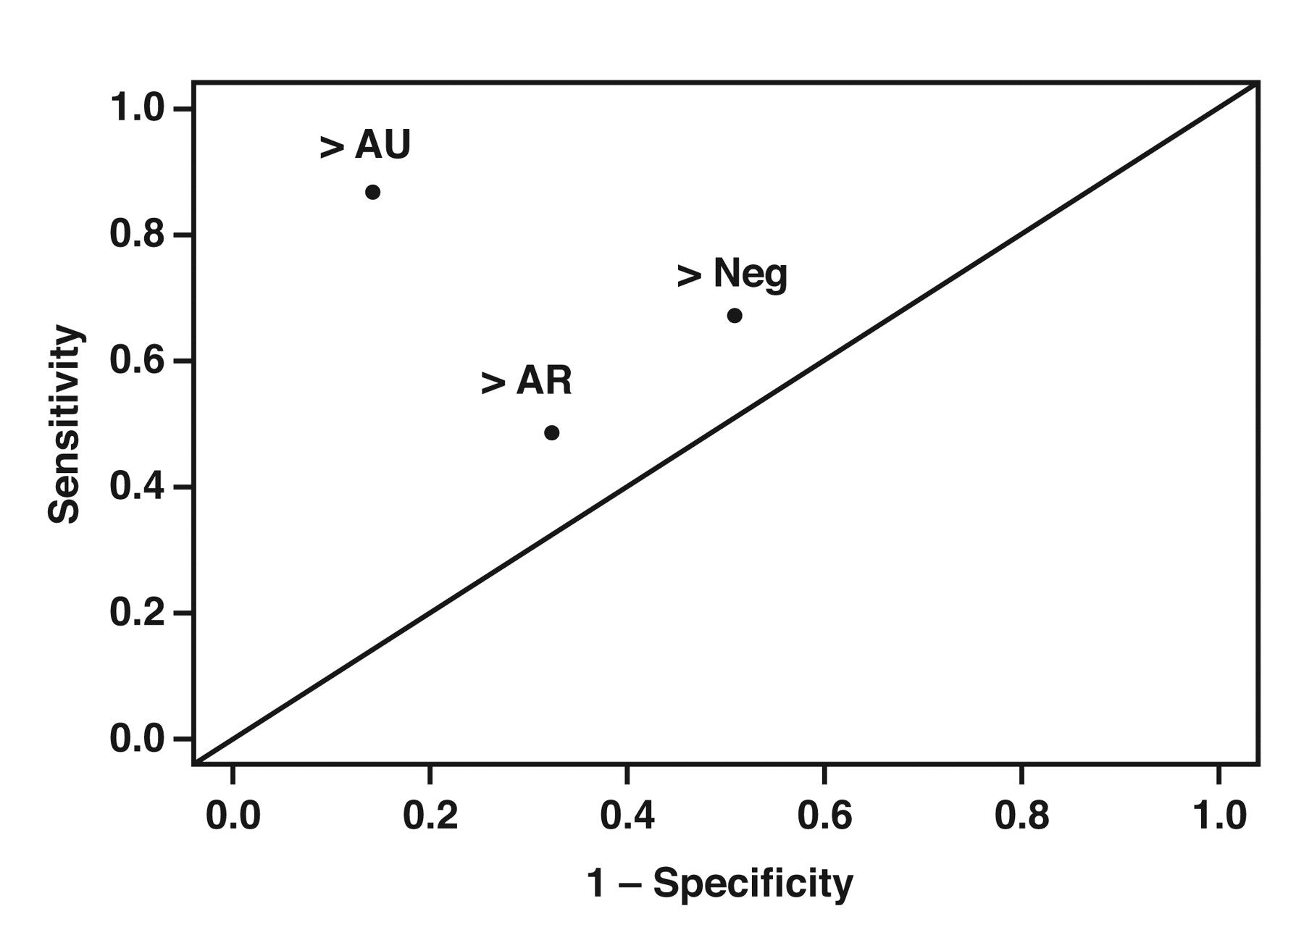
Figure 1 Receiver operating characteristic plot (sensitivity vs 1 – specificity) for 3 cut points of urine cytology ...
Notes:
Figure 1 Receiver operating characteristic plot (sensitivity vs 1 – specificity) for 3 cut points of urine cytology results for the histologic diagnosis of low- or high-grade tumor. The cut points are as follows: >Neg (negative vs AR, AU, and carcinoma), >AR (negative and AR vs AU and carcinoma), and >AU (negative, AR, and AU vs suspicion for or positive for carcinoma). The line on the curve shows where nondiagnostic test results should lie. AR, atypical reactive; AU, atypical unclear; Neg, negative.
Unless provided in the caption above, the following copyright applies to the content of this slide: © American Society for Clinical Pathology

