Slide 1
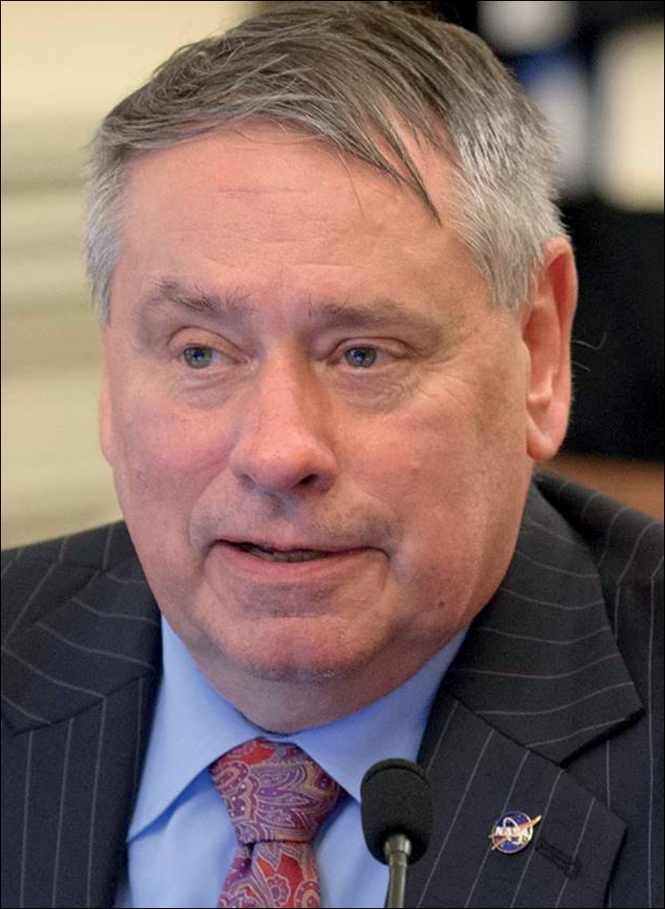
1 Pete Worden is chair of the Breakthrough Prize Foundation and runs the Breakthrough Initiatives. He is an ...
Notes:
1 Pete Worden is chair of the Breakthrough Prize Foundation and runs the Breakthrough Initiatives. He is an astrophysicist who has served in the US Air Force, been a research professor at the University of Arizona and director of NASA Ames Research Center. (Breakthough Initiatives)
Unless provided in the caption above, the following copyright applies to the content of this slide: © 2017 Royal Astronomical Society

Slide 2
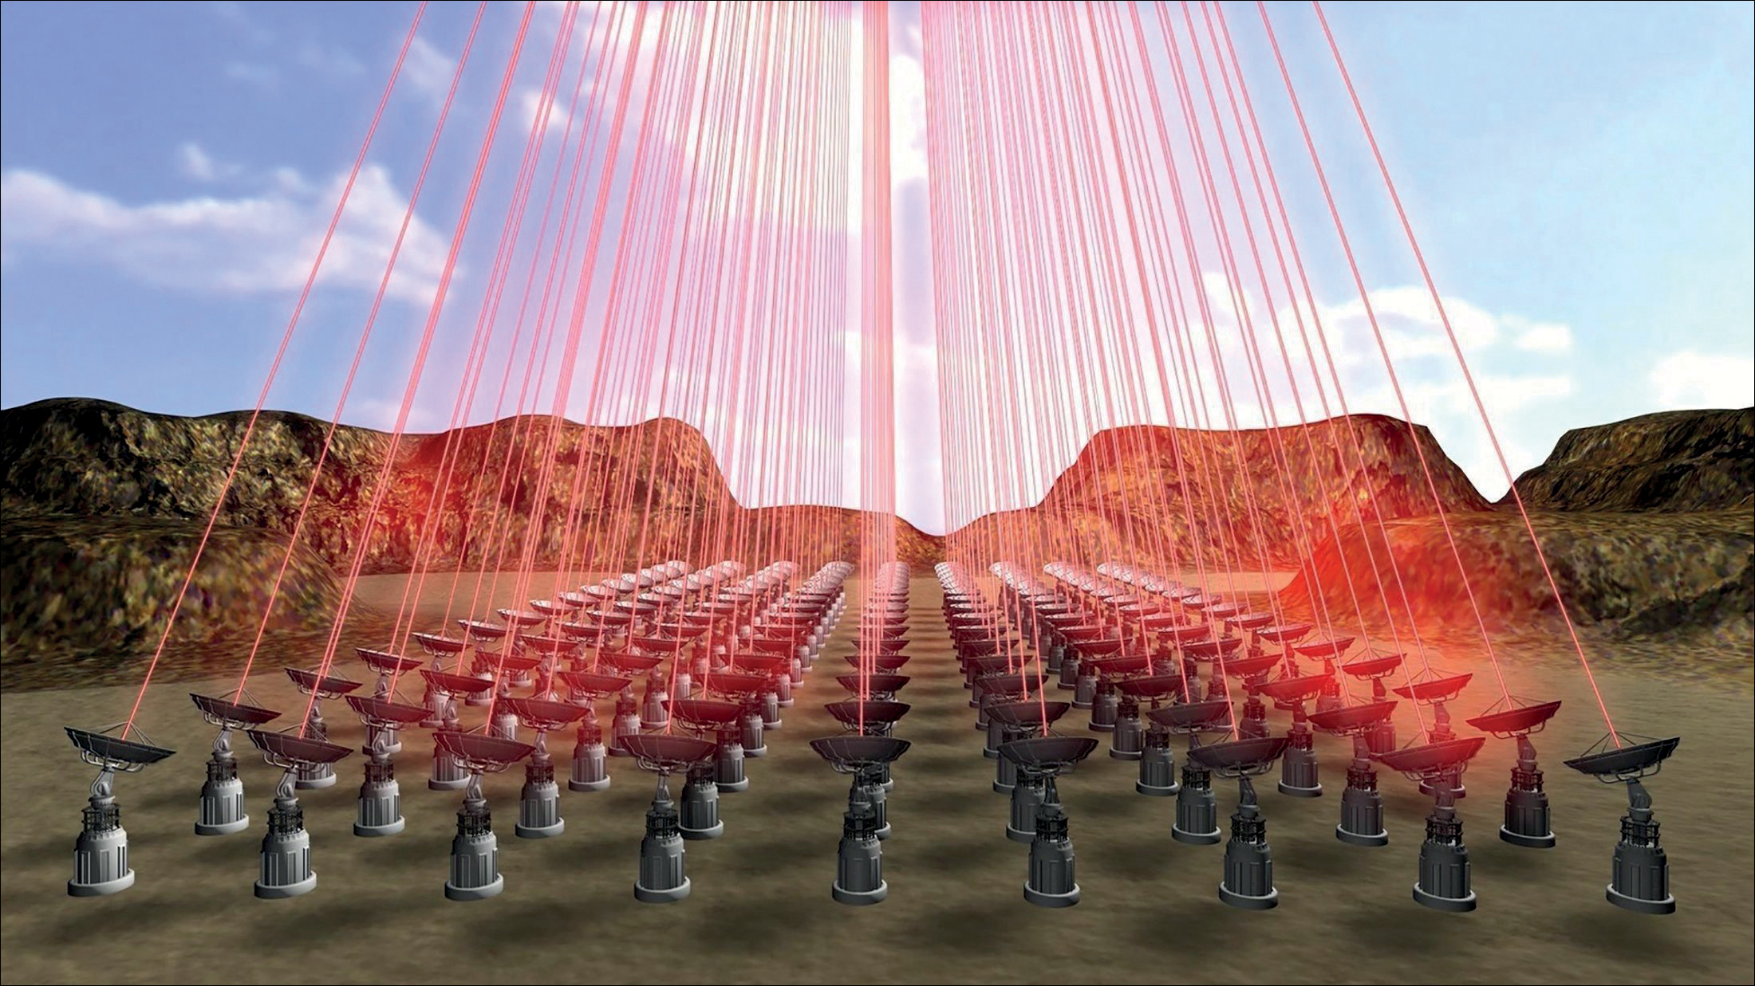
2 Artist's impression of the proposed laser array that may one day provide the power to send a spacecraft to ...
Notes:
2 Artist's impression of the proposed laser array that may one day provide the power to send a spacecraft to our nearerst star. (Breakthrough Initiatives)
Unless provided in the caption above, the following copyright applies to the content of this slide: © 2017 Royal Astronomical Society

Slide 3
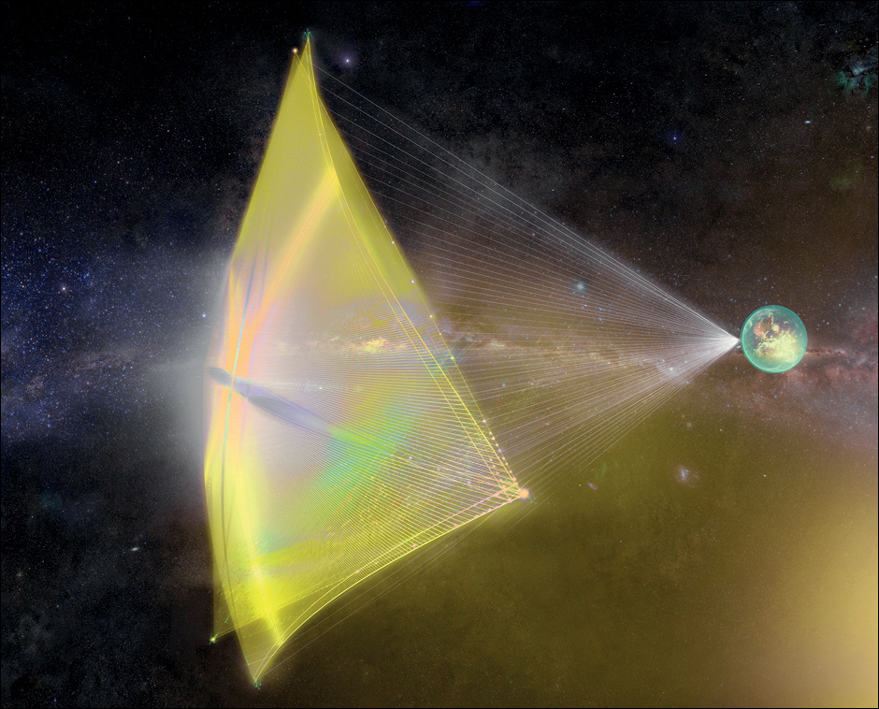
3 The laser array would drive the 4 m sail of the Starshot spacecraft. (Breakthrough Initiatives)
Notes:
3 The laser array would drive the 4 m sail of the Starshot spacecraft. (Breakthrough Initiatives)
Unless provided in the caption above, the following copyright applies to the content of this slide: © 2017 Royal Astronomical Society

