Slide 1
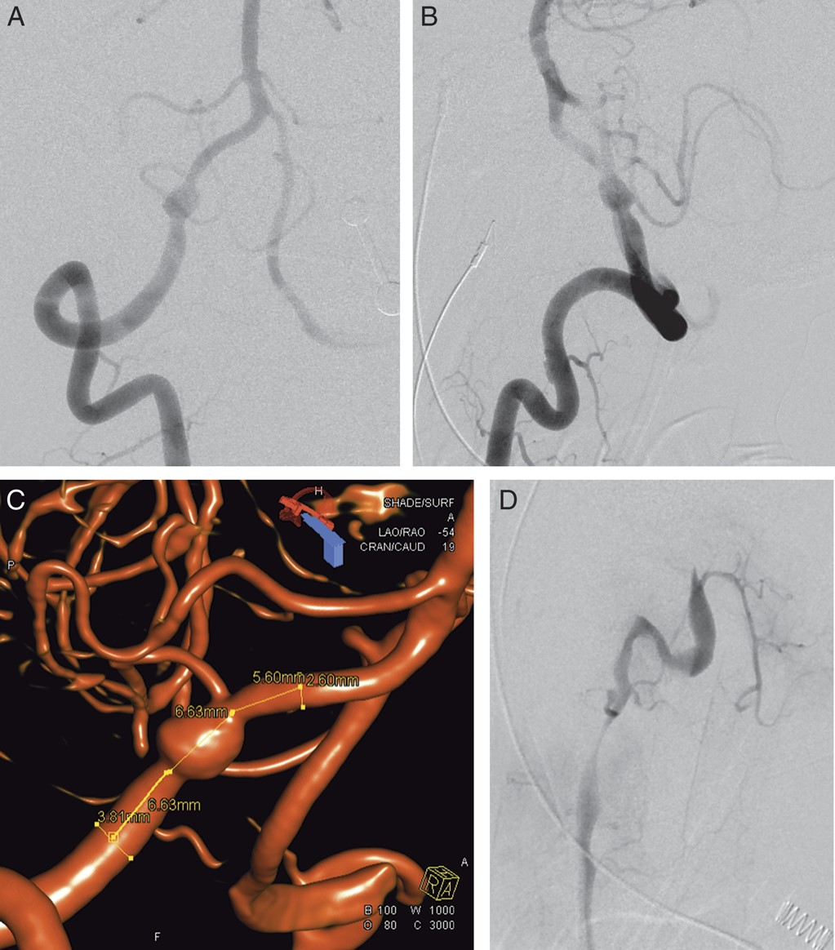
FIGURE 1. Dissecting aneurysm of the intradural segment of the right vertebral artery. Anteroposterior (A) and lateral ...
Notes:
FIGURE 1. Dissecting aneurysm of the intradural segment of the right vertebral artery. Anteroposterior (A) and lateral (B) views from a digital subtraction angiogram demonstrating the aneurysm incorporating the right posterior inferior cerebellar artery. Volume-rendered reconstruction (C) of the aneurysm. The dominant left vertebral artery is seen dissected and occluded on the lateral view digital subtraction angiogram (D).
Unless provided in the caption above, the following copyright applies to the content of this slide: Copyright © 2012 by the Congress of Neurological Surgeons

Slide 2
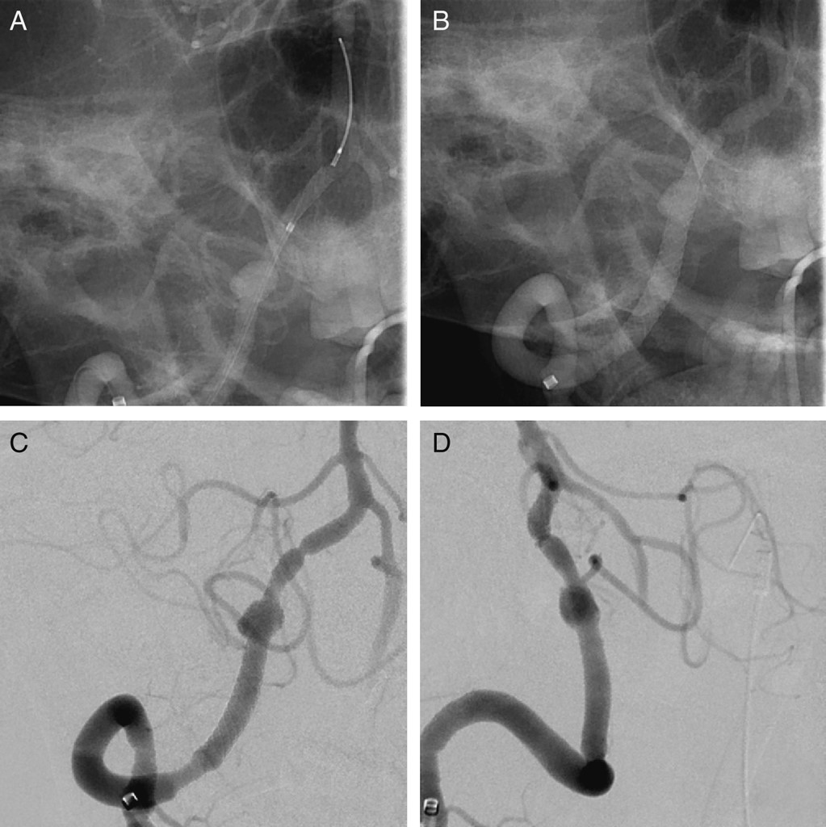
FIGURE 2. Initial Pipeline Embolization Device (PED) reconstruction of the dissecting vertebral artery aneurysm. On ...
Notes:
FIGURE 2. Initial Pipeline Embolization Device (PED) reconstruction of the dissecting vertebral artery aneurysm. On these unsubtracted anteroposterior images, the 3.75 × 14-mm PED is seen released from the capture coil or distal bumper (A) and then deployed and covering the dissecting aneurysm (B). Anteroposterior (C) and lateral (D) images from a post-PED digital subtraction angiogram demonstrate flow in the posterior inferior cerebellar artery.
Unless provided in the caption above, the following copyright applies to the content of this slide: Copyright © 2012 by the Congress of Neurological Surgeons

Slide 3
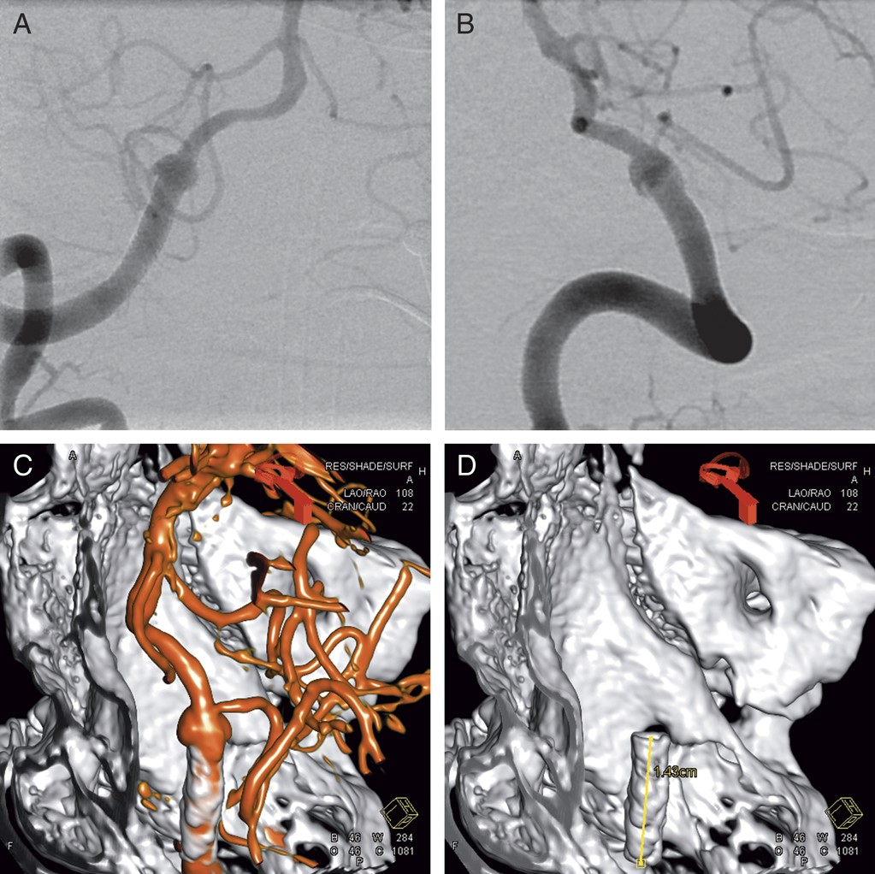
FIGURE 3. Delayed retraction of the Pipeline Embolization Device (PED). Anteroposterior (A) and lateral (B) digital ...
Notes:
FIGURE 3. Delayed retraction of the Pipeline Embolization Device (PED). Anteroposterior (A) and lateral (B) digital subtraction angiographic images after administration of intraarterial nicardipine show that the 3.75 × 14-mm PED is only partially covering the dissecting aneurysm. Dual-volume (C) and single-volume (D) rendered images demonstrate the retracted PED at its nominal length (14 mm).
Unless provided in the caption above, the following copyright applies to the content of this slide: Copyright © 2012 by the Congress of Neurological Surgeons

Slide 4
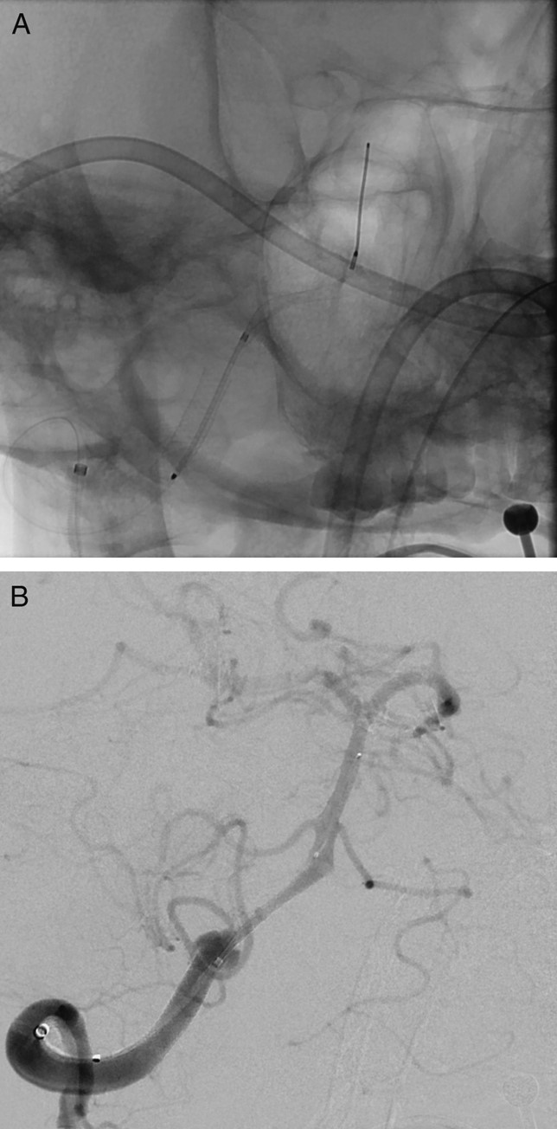
FIGURE 4. Severe vasospasm preventing Pipeline Embolization Device (PED) repositioning and “corking” failure. A, the ...
Notes:
FIGURE 4. Severe vasospasm preventing Pipeline Embolization Device (PED) repositioning and “corking” failure. A, the anteroposterior spot radiograph showing the 4.00 × 14-mm PED released from the capture coil and partially deployed at the vertebrobasilar junction. B, the PED is constrained by vasospasm on the anteroposterior digital subtraction angiographic image.
Unless provided in the caption above, the following copyright applies to the content of this slide: Copyright © 2012 by the Congress of Neurological Surgeons

