Slide 1
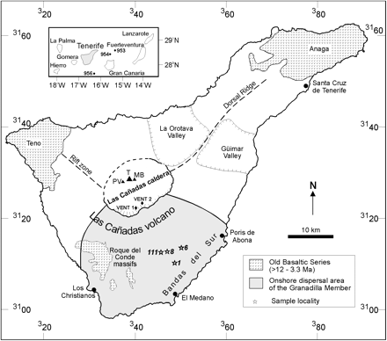
Fig. 1 Map of Tenerife showing the location of Las Cañadas volcano and its nested summit caldera containing the ...
Notes:
Fig. 1 Map of Tenerife showing the location of Las Cañadas volcano and its nested summit caldera containing the post-170 ka stratovolcanic complex of Teide (T), Pico Viejo (PV) and Montaña Blanca (MB); the major sector collapse scars (the Güimar and La Orotava valleys); and the Bandas del Sur, where an extensive Quaternary phonolitic pyroclastic succession is preserved. The onshore dispersal area of the Granadilla Member is shown along with locations of the two inferred vents within the caldera for the eruption (Bryan et al., 2001). Stars and italicized numbers are sample locations of the Granadilla Member. The numbered grid represents 20 km intervals of the UTM grid, zone 28 for the northern hemisphere. Inset map shows the location of Tenerife within the Canary Islands and the offshore drill sites (Ocean Drilling Program Leg 157, sites 953, 954 and 956) where deposits from the Las Cañadas volcano have been reported, and a 610 ± 20 ka ash in hole 953 may be distal deposits from the Granadilla eruption (Brown et al., 2003).
Unless provided in the caption above, the following copyright applies to the content of this slide: © The Author 2006. Published by Oxford University Press. All rights reserved. For Permissions, please e-mail: journals.permissions@oxfordjournals.org

Slide 2
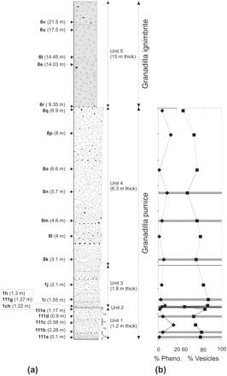
Fig. 2 (a) Sample stratigraphy for the Granadilla Member, showing sample heights (in parentheses) of sample numbers ...
Notes:
Fig. 2 (a) Sample stratigraphy for the Granadilla Member, showing sample heights (in parentheses) of sample numbers (in bold) referred to in text and figures. Numeric prefixes to sample numbers correspond to sample locations shown in Fig. 1. (b) Modal data for the Granadilla pumice samples (see Table 1); Pheno., phenocrysts. Continuous lines denote fall unit boundaries, and horizontal grey bars denote sample horizons where tephriphonolitic magma components (microcrystalline kaersutite and plagioclase glass blebs with microcrystalline kaersutite and plagioclase, and/or glass containing plagioclase, kaersutite, Mg- and Al-rich Fe-Ti oxide phenocrysts) are present. Bulk-pumice vesicularity is reduced where tephriphonolitic glass is present; however, the overall trend is for increasing pumice vesicularity from Unit 1 to Unit 3 (maximum vesicularity of 86%), then a decrease to the top of Unit 4. Granadilla pumices are mostly phenocryst-poor (<10 modal %).
Unless provided in the caption above, the following copyright applies to the content of this slide: © The Author 2006. Published by Oxford University Press. All rights reserved. For Permissions, please e-mail: journals.permissions@oxfordjournals.org

Slide 3
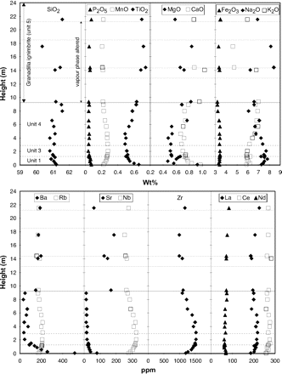
Fig. 3 Geochemical variation with stratigraphic height. The reverse-to-normal ‘cryptic’ compositional zonation of ...
Notes:
Fig. 3 Geochemical variation with stratigraphic height. The reverse-to-normal ‘cryptic’ compositional zonation of minor and trace elements at relatively constant SiO2 should be noted (∼61 wt %). Major and minor elements are normalized to 100% volatile-free, and trace elements are normalized on an anhydrous basis. However, increased scatter for the alkalis, MgO, CaO and Sr reflects element mobility, and is particularly prevalent in Unit 5 because of vapour-phase alteration. All data were obtained by XRF. Dashed lines are fall unit boundaries of the Granadilla pumice; dotted lines denote bedding in the Granadilla ignimbrite.
Unless provided in the caption above, the following copyright applies to the content of this slide: © The Author 2006. Published by Oxford University Press. All rights reserved. For Permissions, please e-mail: journals.permissions@oxfordjournals.org

Slide 4
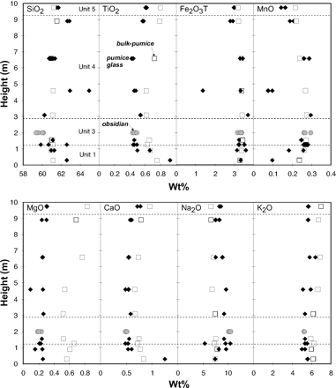
Fig. 4 Major element chemistry of pumice glass (filled symbols), juvenile obsidian clasts (grey symbols) and ...
Notes:
Fig. 4 Major element chemistry of pumice glass (filled symbols), juvenile obsidian clasts (grey symbols) and bulk-pumice (open symbols) vs stratigraphic height. Glass compositions were determined by electron microprobe and normalized to 100 wt % (see Bryan et al., 2002). Bulk-pumice data have been normalized to 100 wt % volatile-free. Dashed lines are fall unit boundaries of the Granadilla pumice. The anomalous glass chemistry (TiO2, CaO, MnO) at the base should be noted.
Unless provided in the caption above, the following copyright applies to the content of this slide: © The Author 2006. Published by Oxford University Press. All rights reserved. For Permissions, please e-mail: journals.permissions@oxfordjournals.org

Slide 5
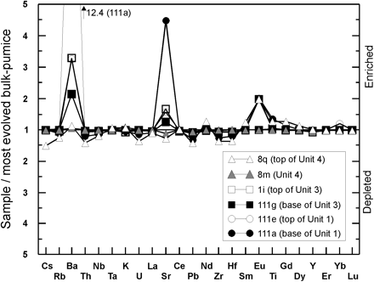
Fig. 5 Enrichment diagram (Hildreth, 1979) for the Granadilla pumice. Element concentrations for each sample have ...
Notes:
Fig. 5 Enrichment diagram (Hildreth, 1979) for the Granadilla pumice. Element concentrations for each sample have been divided by the concentration of the same element in sample 8k, the most evolved bulk-pumice composition (Table 2). The anomalous to extreme enrichment in Ba (12·4 times), Sr and Eu of bulk-pumice compositions from the base should be noted. Bulk-pumice compositions from the top of the Granadilla pumice, represented by sample 8q, show more systematic relative depletions in the incompatible elements (e.g. Cs, Rb, Th, Zr, Hf).
Unless provided in the caption above, the following copyright applies to the content of this slide: © The Author 2006. Published by Oxford University Press. All rights reserved. For Permissions, please e-mail: journals.permissions@oxfordjournals.org

Slide 6
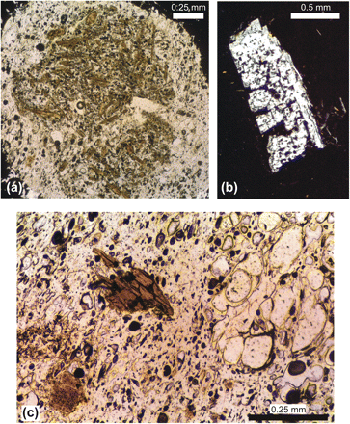
Fig. 6 Photomicrographs of pumice textures. (a) Tephriphonolitic glass bleb comprising fine-grained intergrowths of ...
Notes:
Fig. 6 Photomicrographs of pumice textures. (a) Tephriphonolitic glass bleb comprising fine-grained intergrowths of kaersutite, plagioclase, Fe–Ti oxides ± apatite (sample 111g). Width of view is 1·7 mm; plane-polarized light. (b) Resorbed calcic anorthoclase (An12Ab69Or19) phenocryst in pumice clast from subunit 1B (sample 111b). Length of phenocryst is 1·5 mm; crossed polars. (c) Banded pumice from Unit 3 (sample 111g) preserving the mingling of poorly vesiculated (containing kaersutite) and highly vesiculated glass domains. Width of view is 1 mm; plane-polarized light.
Unless provided in the caption above, the following copyright applies to the content of this slide: © The Author 2006. Published by Oxford University Press. All rights reserved. For Permissions, please e-mail: journals.permissions@oxfordjournals.org

Slide 7
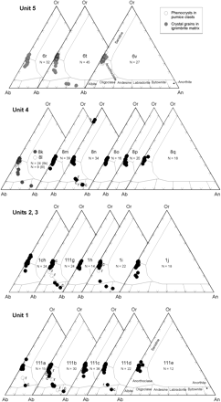
Fig. 7 Albite (Ab)–anorthite (An)–orthoclase (Or) triangular diagrams showing feldspar compositions from the ...
Notes:
Fig. 7 Albite (Ab)–anorthite (An)–orthoclase (Or) triangular diagrams showing feldspar compositions from the Granadilla pumice and ignimbrite. N, number of analyses. Selected core (c) and rim (r) pairs with tie-lines are shown for samples 111a, 111b, 111d, 111g, 1i and 8n.
Unless provided in the caption above, the following copyright applies to the content of this slide: © The Author 2006. Published by Oxford University Press. All rights reserved. For Permissions, please e-mail: journals.permissions@oxfordjournals.org

Slide 8
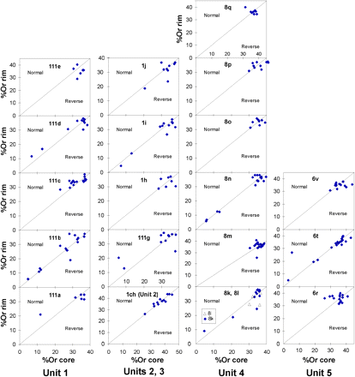
Fig. 8 Zoning patterns of feldspar phenocrysts for individual samples, based on orthoclase (Or) content (molecular ...
Notes:
Fig. 8 Zoning patterns of feldspar phenocrysts for individual samples, based on orthoclase (Or) content (molecular per cent), and arranged in stratigraphic order for each unit. Core and rim analyses are plotted to illustrate the growth history of individual phenocrysts. Feldspar phenocrysts will tend towards higher orthoclase contents during fractional crystallization of phonolite magma under closed-system conditions, resulting in normal compositional zoning. Reverse compositional zoning indicates disturbance of the system (e.g. the introduction of mafic magma). Normal and reversely zoned feldspar phenocrysts are present in most samples. In contrast, a small population of unzoned plagioclase phenocrysts is present in samples 111b, 1i, 8n and 6t, suggesting that these plagioclase phenocrysts were mingled into the magma either immediately prior to or during the eruption.
Unless provided in the caption above, the following copyright applies to the content of this slide: © The Author 2006. Published by Oxford University Press. All rights reserved. For Permissions, please e-mail: journals.permissions@oxfordjournals.org

Slide 9
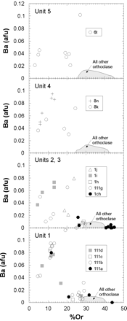
Fig. 9 Ba (atoms per formula unit) vs Or (molecular per cent) content of feldspar phenocrysts. The dominant ...
Notes:
Fig. 9 Ba (atoms per formula unit) vs Or (molecular per cent) content of feldspar phenocrysts. The dominant orthoclase feldspar phenocrysts have very low Ba abundances (<0·01 a.f.u.), whereas the highest abundances occur in the calcic anorthoclase phenocrysts.
Unless provided in the caption above, the following copyright applies to the content of this slide: © The Author 2006. Published by Oxford University Press. All rights reserved. For Permissions, please e-mail: journals.permissions@oxfordjournals.org

Slide 10
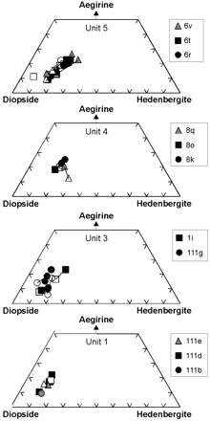
Fig. 10 Pyroxene microphenocryst compositions expressed in terms of the diopside, hedenbergite and aegirine ...
Notes:
Fig. 10 Pyroxene microphenocryst compositions expressed in terms of the diopside, hedenbergite and aegirine end-members. Filled symbols represent core compositions; open symbols, rim compositions. Tie-lines are shown for selected phenocrysts, and generally strong reverse zoning patterns (up to 10% aegirine) occur in pyroxenes with sodic-rich cores (Unit 5).
Unless provided in the caption above, the following copyright applies to the content of this slide: © The Author 2006. Published by Oxford University Press. All rights reserved. For Permissions, please e-mail: journals.permissions@oxfordjournals.org

Slide 11
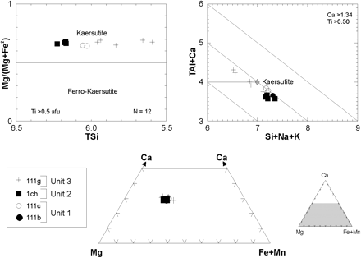
Fig. 11 Phenocryst amphibole compositions. Cation proportions are based on the 13 – (Ca + Na+ K) normalization ...
Notes:
Fig. 11 Phenocryst amphibole compositions. Cation proportions are based on the 13 – (Ca + Na+ K) normalization procedure. The prefix T denotes cation in the tetrahedral site. N, number of analyses.
Unless provided in the caption above, the following copyright applies to the content of this slide: © The Author 2006. Published by Oxford University Press. All rights reserved. For Permissions, please e-mail: journals.permissions@oxfordjournals.org

Slide 12
Fig. 12 Minor element chemistry of titanomagnetite and ilmenite (circled). Tie-lines (continuous lines) join ...
Notes:
Fig. 12 Minor element chemistry of titanomagnetite and ilmenite (circled). Tie-lines (continuous lines) join coexisting phases in equilibrium, whereas the discordant tie-line (dashed line) for sample 1i of Unit 3 illustrates disequilibrium between the coexisting Fe–Ti oxide compositions. N, number of analyses.
Unless provided in the caption above, the following copyright applies to the content of this slide: © The Author 2006. Published by Oxford University Press. All rights reserved. For Permissions, please e-mail: journals.permissions@oxfordjournals.org

Slide 13
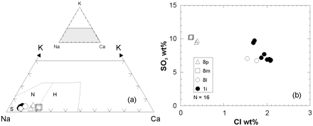
Fig. 13 Nosean phenocryst compositions expressed in terms of (a) Na, K, and Ca (atomic per cent), and (b) ...
Notes:
Fig. 13 Nosean phenocryst compositions expressed in terms of (a) Na, K, and Ca (atomic per cent), and (b) SO3 vs Cl content (N, number of analyses). Field boundaries in (a) are after Lessing & Grout (1971). S, sodalite; N, nosean; H, haüyne.
Unless provided in the caption above, the following copyright applies to the content of this slide: © The Author 2006. Published by Oxford University Press. All rights reserved. For Permissions, please e-mail: journals.permissions@oxfordjournals.org

Slide 14
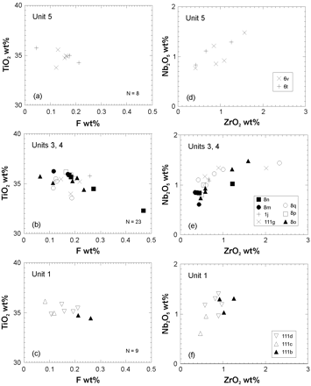
Fig. 14 Titanite chemistry expressed in terms of TiO₂ vs F content (a–c) and Nb₂O₅ ...
Notes:
Fig. 14 Titanite chemistry expressed in terms of TiO2 vs F content (a–c) and Nb2O5 vs ZrO2 (d–f). N, number of analyses. The highest Zr contents are observed in titanites from pumices from the main plinian fall units (Units 3 and 4).
Unless provided in the caption above, the following copyright applies to the content of this slide: © The Author 2006. Published by Oxford University Press. All rights reserved. For Permissions, please e-mail: journals.permissions@oxfordjournals.org

Slide 15
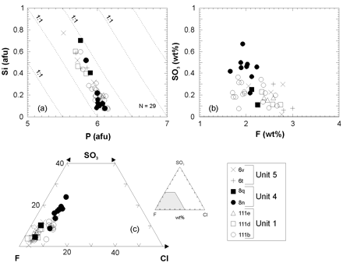
Fig. 15 (a) Si vs P (O = 26); (b) SO₃ vs F; (c) SO₃–F–Cl relationships for apatite ...
Notes:
Fig. 15 (a) Si vs P (O = 26); (b) SO3 vs F; (c) SO3–F–Cl relationships for apatite microphenocrysts and inclusions. N, number of analyses. As with the coexisting nosean phenocrysts, the highest SO3 contents occur in apatites from Unit 4.
Unless provided in the caption above, the following copyright applies to the content of this slide: © The Author 2006. Published by Oxford University Press. All rights reserved. For Permissions, please e-mail: journals.permissions@oxfordjournals.org

Slide 16
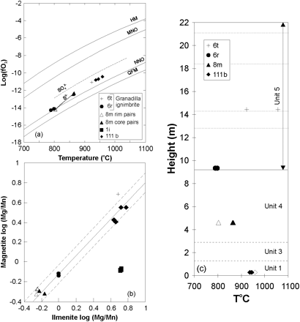
Fig. 16 (a) Temperature and oxygen fugacity (fO₂) estimates obtained from coexisting Fe–Ti oxides. Buffer ...
Notes:
Fig. 16 (a) Temperature and oxygen fugacity (fO2) estimates obtained from coexisting Fe–Ti oxides. Buffer curves are from Rutherford (1993): HM, hematite–magnetite; MNO, MnO–Mn3O4; NNO, Ni–NiO; QFM, quartz–fayalite–magnetite. Dotted line joins core and rim pairs of sample 8 m. (b) Mg/Mn (atomic) ratio of oxide pairs used in geothermometry calculations compared with the equilibrium field of Bacon & Hirschmann (1988), with dashed lines being a 2σ error envelope. It should be noted that the Fe–Ti oxide pairs from sample 1i (Unit 3) are not in equilibrium, as evidenced by the discordant tie-line slope in Fig. 12. Symbols are as for (a). (c) Fe–Ti oxide temperature estimates vs stratigraphic height. Filled symbols represent core pairs; open symbols, rim pairs.
Unless provided in the caption above, the following copyright applies to the content of this slide: © The Author 2006. Published by Oxford University Press. All rights reserved. For Permissions, please e-mail: journals.permissions@oxfordjournals.org

Slide 17
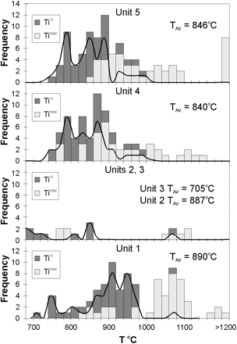
Fig. 17 Histogram of temperatures estimated from the biotite geothermometer of Luhr et al. (1984). Calculations based ...
Notes:
Fig. 17 Histogram of temperatures estimated from the biotite geothermometer of Luhr et al. (1984). Calculations based on the total content of Ti yield anomalously high temperatures, but recalculation using TiVI yields temperature estimates in better agreement with Fe–Ti oxide thermometry. Temperature distribution curves and average temperatures (TAV), based on TiVI, are also shown, and reinforce the stratigraphic variation of Fe–Ti geothermometry in which hotter phonolitic magma was erupted at the onset of the eruption, whereas the lowest temperature magma was erupted during the main plinian phase (Units 3–5).
Unless provided in the caption above, the following copyright applies to the content of this slide: © The Author 2006. Published by Oxford University Press. All rights reserved. For Permissions, please e-mail: journals.permissions@oxfordjournals.org

Slide 18
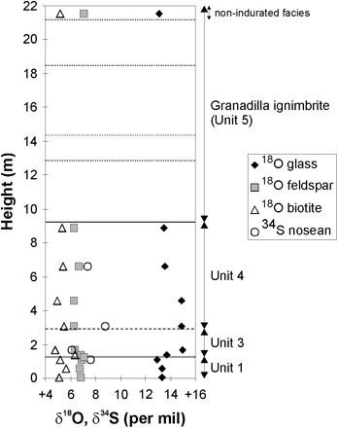
Fig. 18 Oxygen and sulphur isotopic compositions of mineral and glass separates vs stratigraphic height. The slight ...
Notes:
Fig. 18 Oxygen and sulphur isotopic compositions of mineral and glass separates vs stratigraphic height. The slight shift in isotopic composition above and below Unit 2 should be noted (grey bar).
Unless provided in the caption above, the following copyright applies to the content of this slide: © The Author 2006. Published by Oxford University Press. All rights reserved. For Permissions, please e-mail: journals.permissions@oxfordjournals.org

Slide 19
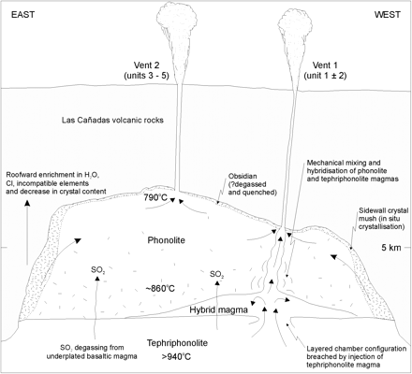
Fig. 19 Possible configuration of the Granadilla magma reservoir. The magma system consists of a large body of highly ...
Notes:
Fig. 19 Possible configuration of the Granadilla magma reservoir. The magma system consists of a large body of highly evolved phonolite magma developed by in situ (sidewall) fractional crystallization, which is underlain by tephriphonolite magma at depth. Intrusion of tephriphonolite magma promoted mingling and mixing, with a hybrid magma rising and venting at the onset of eruption (vent 1). The change in vent location as recorded by isopach and isopleth maps for Units 3 and 4 resulted in the more systematic withdrawal of highly evolved phonolite from vent 2, which had been isolated from magma mixing and mingling. Hybrid or tephriphonolitic magma partly gained access to the conduit during the main plinian phase from vent 2 when there were periods increased discharge and therefore a larger zone and depth of withdrawal.
Unless provided in the caption above, the following copyright applies to the content of this slide: © The Author 2006. Published by Oxford University Press. All rights reserved. For Permissions, please e-mail: journals.permissions@oxfordjournals.org

